Slide 1
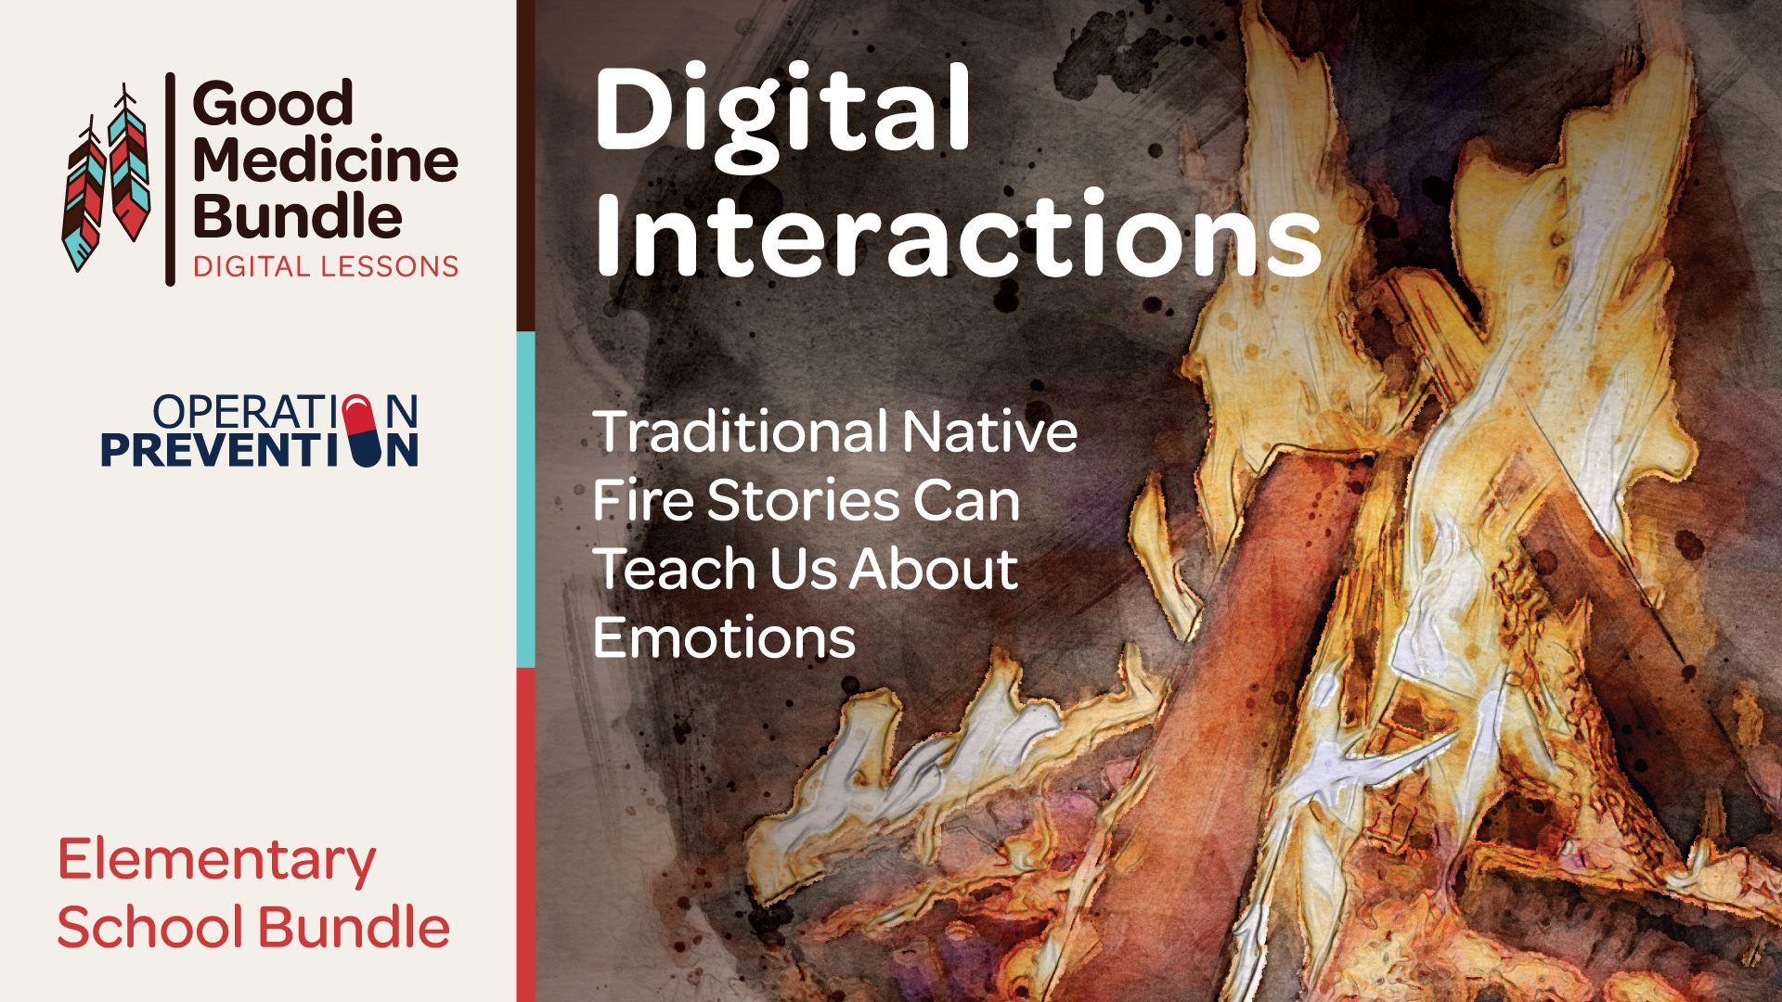

Slide 2
Objectives
Students will:
Read and discuss traditional American Indian stories about fire and its
cultural significance.
Identify how American Indians utilize fire for cultural traditions or needs.
Connect the properties of fire to the effects that emotions have on the body.
Define the difference between an emotion and a feeling.
Analyze how learning about fire can help an individual better understand and manage emotions.
Reflect on how their emotions can help and harm them, and practice steps to manage emotions and feelings.
Notes:
Instructor Notes
Introduce the lesson and discuss the topic and objectives with students. This lesson series will share traditional stories from American Indian tribes that teach us the cultural value of fire. Students will also connect how we each have our own fire (emotions) within us that can do good or harm, depending on how we manage our emotions and feelings.
If tribes or American Indian/Alaska Native students are not represented in your community, this may be an opportunity to ask students what they know about AI/AN peoples. Ensure that students understand there are many tribal communities thriving today.

Slide 3
What can a cultural understanding of fire teach us about managing our emotions?

Slide 4
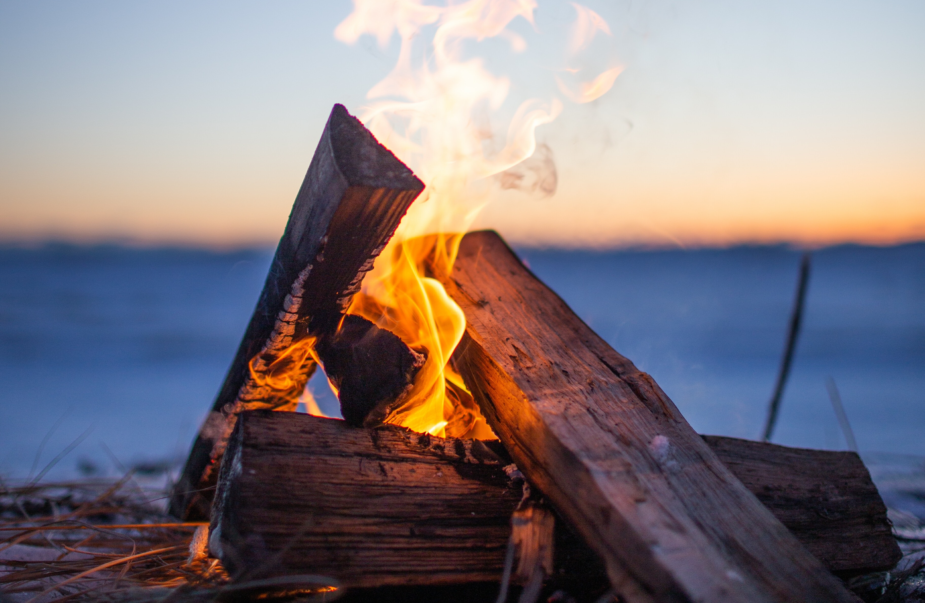
Day 1:
What Do We Know About Fire?
How is fire useful?
How can fire be harmful?
Notes:
Instructor Notes
Students can pair/share, or hold a quick whole-group share about what they know of the useful and harmful qualities of fire. If time allows, the teacher may also ask students if they know how a fire starts.

Slide 5
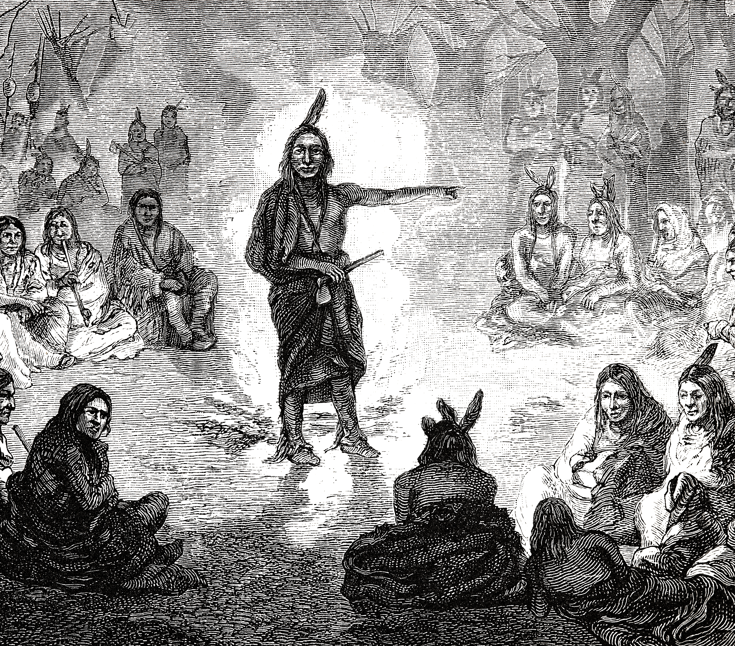
The Cultural Value of Storytelling
American Indian/Alaska Native tribes use storytelling to:
Keep the good and bad parts of history alive
Entertain young children while teaching lessons
Pass down Native languages
Explain things that happen in nature
Share wisdom of the elders
Notes:
Instructor Notes
Ask students to raise their hand if they like reading or hearing stories.
Share that the “oral tradition” of telling stories is an ancient practice and that most Native peoples past and present use storytelling as a way of life.
Selected students can take turns reading the bullet points. Emphasize that stories were used to teach life values, as well as promote an understanding of nature and relationships to others. These stories were used to teach all, but especially children.
Direct students to look at the image. Briefly mention to students that many times stories are told in circles, so that everyone can hear and respect each other’s stories or reflections. The class will be using talking circles each day of this lesson series.

Slide 6
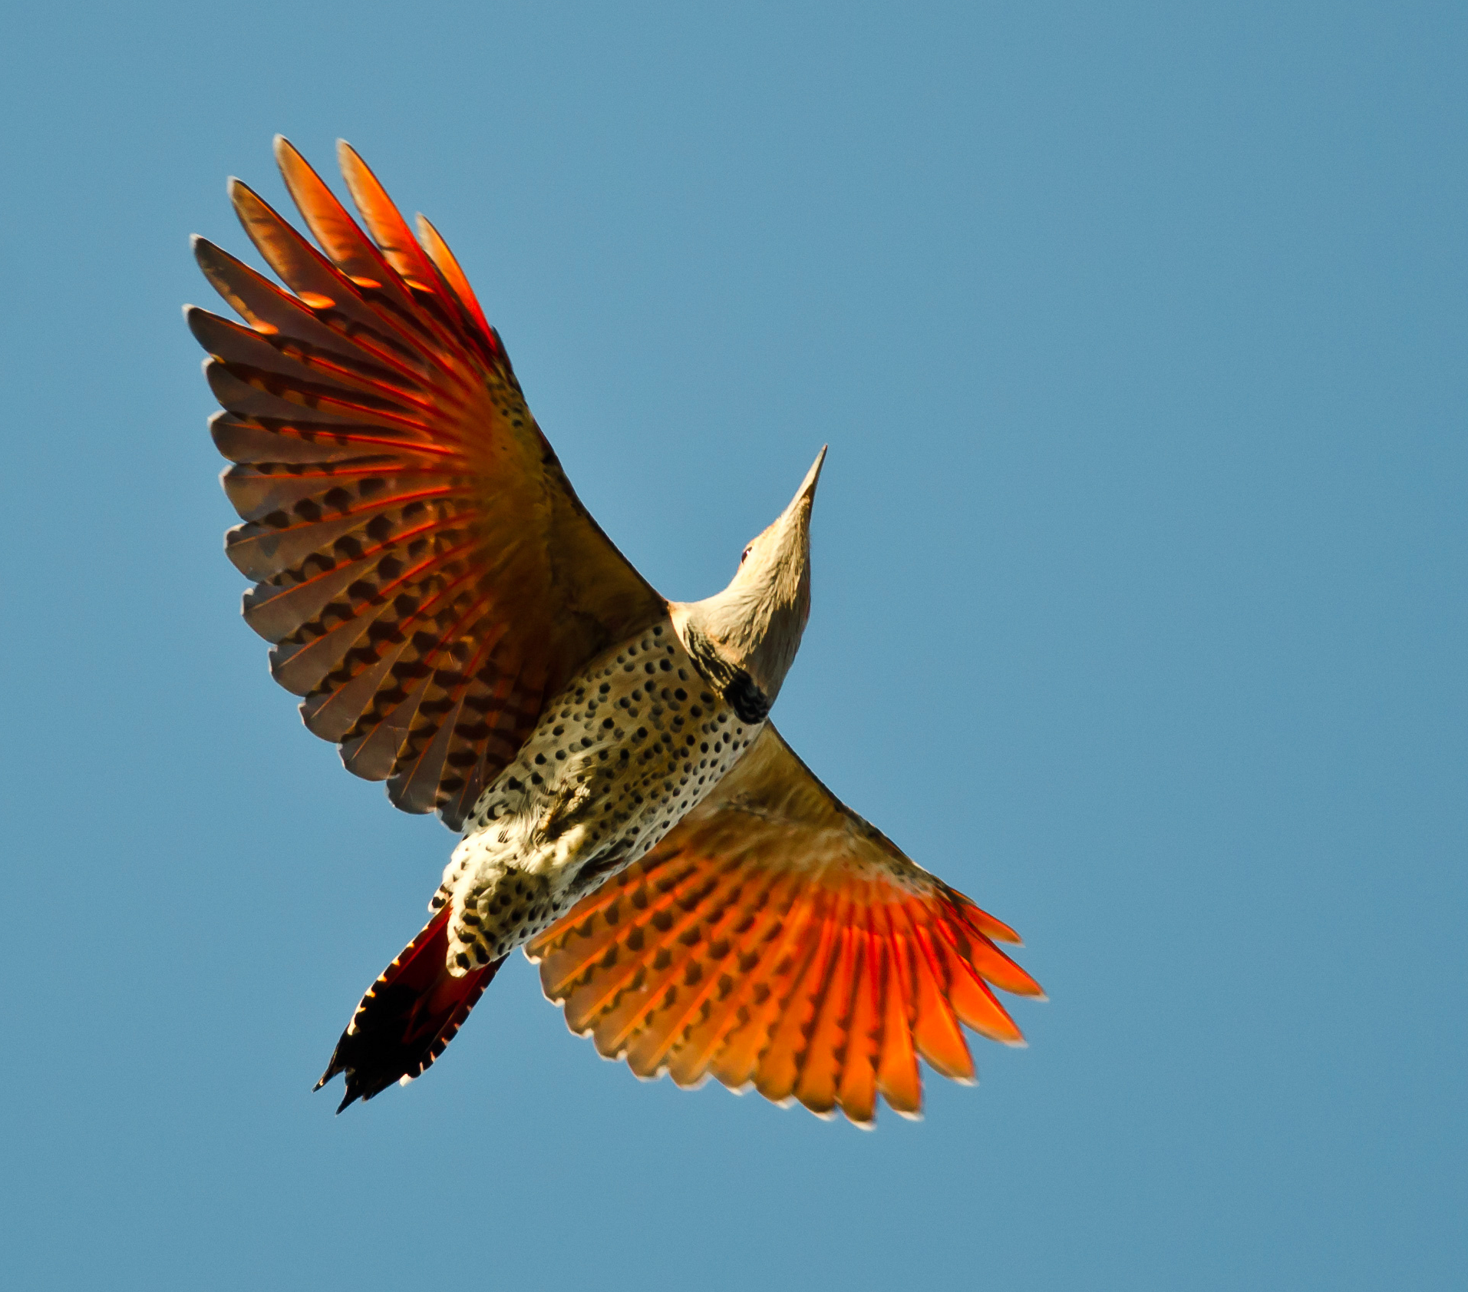
Traditional Story: How the Flicker Bird Brought Fire
Why did the humans in this story need fire? Why would this be important to tribes who lived a long time ago?
What lessons does the story teach us about how American Indians view the relationship between humans and animals?
How does this story explain some of the physical features or behaviors of animals like the Flicker bird?
Notes:
Instructor Notes
Ensure students have Handout 1: How the Flicker Bird Brought Fire. This is a story from the Eastern Shoshone tribal nation. They currently live in Wyoming. Shoshone comes from the word sosoni, which means “tall grass”, and refers to the material used to build their houses.
Read the text as a whole or small group. It is best if the teacher has anticipated stopping points where students will need vocabulary or comprehension support.
Allow students time to answer the reading response questions at the bottom of the story. This can be individual or partner share.
Select students to share their responses to each question and allow for additional discussion time. It is important to note that like other traditional cultures, these stories demonstrate the relationship with and value placed on animals and other natural elements. Stories like this were used to explain why animals look or behave in certain ways. They are also used to share why humans are to be thankful for nature, which is another cultural value of AI/AN people.

Slide 7
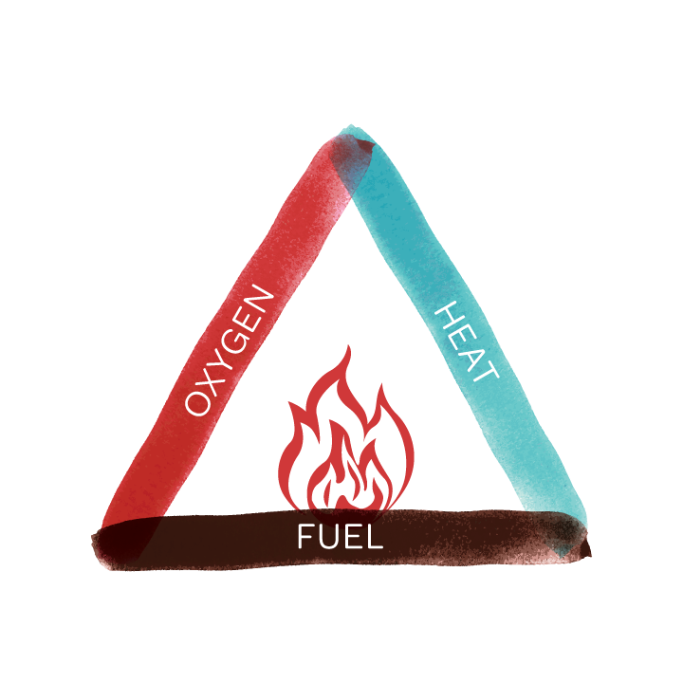
The Fire Triangle
Heat
Oxygen
Fuel
Key Word: ignite
(to cause to catch fire;
to trigger or spark)
Notes:
Instructor Notes
This slide is to briefly explain what it takes for a fire to happen. This is an opportunity to introduce and teach the academic vocabulary term ignite. If students are already aware of this term, and how it can be used across multiple contexts, then simply ask students to share what they already know about the definition.
Discuss that this triangle shows that fire is a process that keeps fueling itself as it gets hotter. Because a fire needs oxygen, people use things like water, wet blankets, or foam to put out a fire, because those items can cut off the oxygen to a fire. If time allows, ask students if they have seen fires or firefighting in the news.

Slide 8
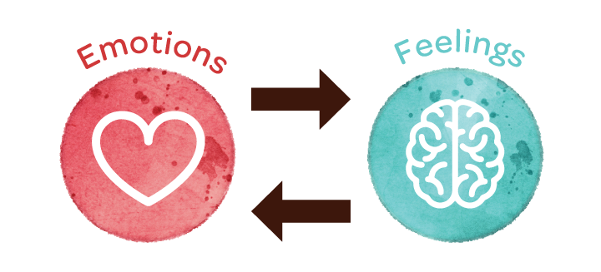
Our Emotions Are The Things That Ignite Us
Notes:
Instructor Notes
Have students brainstorm and share aloud all the emotions they can list. Ask a student to share how he/she thinks emotions work.
Direct their attention to Handout 2: Understanding Our Emotions and Feelings. Prompt students to read the handout independently, and then prepare to discuss what they think the main idea of the article is.
Ask students aloud, “What information does the table at the top of the page provide for the reader?”
Ask one or two students to summarize what the article teaches about the difference between an emotion and a feeling. Help students understand the cyclical process of emotions leading to feelings, which also cause emotions to change or be affirmed.

Slide 9
Traditional Talking Circle
A respectful way to communicate in a group
Shared value of everyone’s voice
Uses an object like a talking stick or feather for the person who is speaking
Only the person with the talking object may speak at that time.
Sharing Time:
How can our emotions be useful?
How can they be harmful?
Notes:
Instructor Notes
For lesson closure, have students stand in a circle around the room. This can also be done in smaller circles. Ensure that one student in the circle has the talking stick/object.
Pose the first question, “How can our emotions be helpful?”, and give several students time to speak. They should pass the talking stick as they answer or respond to others.
Pose the second question, “How can our emotions be harmful?”, and follow the same protocol. Remind students that only the person with the stick is to be speaking.
Bring the circle to a close by re-emphasizing that our emotions are important to us and that we should not be afraid of them. However, just like something important as fire, our emotions can also cause us to feel ways that aren’t good for us. Sometimes, people might make bad decisions such as hurting others or trying drugs or alcohol. Tell students that tomorrow they will learn more about how our emotions affect our behavior.
Notes for the teacher:
Talking Circles are an ancient and important part of many Native American communities. They are a simple and valuable way to communicate our feelings to a group, and in doing so, we form a respectful and compassionate community.
Protocol: Sit in a circle and prepare to listen and share. The Talking Circle can be focused on any topic or issue. Each person has the opportunity to speak when they are holding the stick, feather, or other object used to identify whose turn it is to speak. The circle is complete when everyone has an opportunity to speak once, and most discussions have two or more opportunities for individuals to speak.

Slide 10
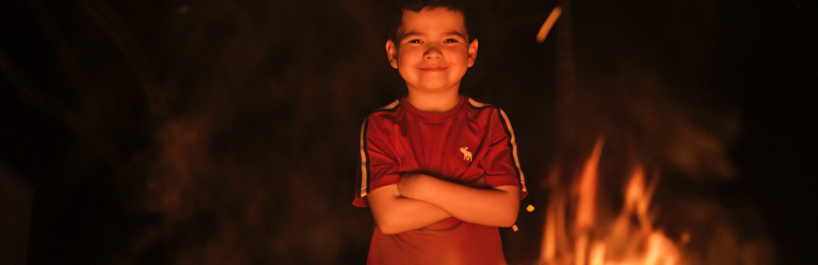
Day 2:
What Can Fire Teach Us About Our Emotions?
Notes:
Instructor Notes
Have students begin class by independently reading Student Handout 1: About Emotions. Then, students can either pair/share or discuss the handout as a whole group. Some students may find this like their learning about primary and secondary colors. This can be a helpful comparison for younger students.
Then, ask one or two students to define the previous day’s key word: ignite. Tell students to listen for that word in our story today.

Slide 11
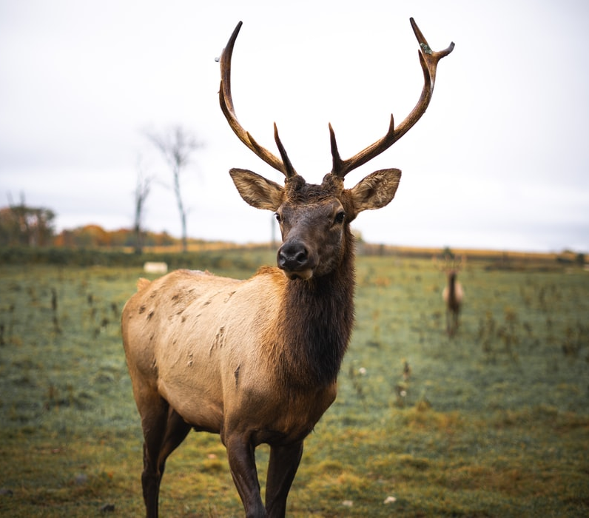
Traditional Story: When Elk Gave Fire to the People
Discussion Questions
What do the stories teach us about the human need for fire?
Why do American Indian tribes value fire?
Notes:
Instructor Notes
As a class or in small groups, read the Eastern Shoshone story on Student Handout 2: When Elk Gave Fire to the People. Anticipate beforehand where students may need a comprehension check while reading.
Give students time to answer the reading response questions on the handout. If time allows, students can discuss their responses before answering the discussion questions.
The whole group discussion centers on how humans need fire to live. In current times, this translates into our use of heat and electricity. Have students reflect on how life may have been many years ago, and how fire was an essential and daily part of life. Stories like this one would demonstrate how grateful Native people were for fire, and and how they gave thanks to nature for providing it.

Slide 12
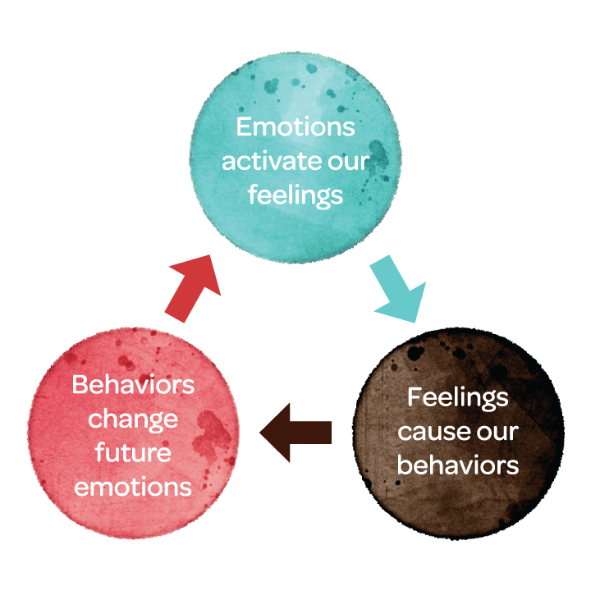
How Our Emotions
Affect Our Behavior
Notes:
Instructor Notes
As you share Student Handout 3: How Emotions Affect Our Behavior, remind students that they are learning about fire to understand how our own emotions work in our bodies. Connect the reading from the prior lesson about how emotions are a physical response, that turns into a brain response, in the form of thoughts and feelings. The article they read in this lesson will explain how emotions impact our behaviors and actions.
Choose how students will read the article. If students need comprehension support, this can be a whole-group read.
After reading, ask students to discuss the answers to these questions:
How do emotions lead to our behaviors?
Why might some people experience the same emotions, but act differently?
Have you ever been surprised at your reaction to something emotional?
Why do you think the author includes this sentence in paragraph 3 of the article “An important thing to remember is that emotions are not bad.”
By the end of the discussion, ensure that students understand the emotion cycle presented on this slide. Also, emphasize that emotions, like fire, are good and are here to be more helpful than harmful. But like fire, our emotions can also harm us if they cause negative thoughts and behaviors. Sometimes our thoughts can become so strong that we make poor decisions like trying drugs or alcohol.

Slide 13
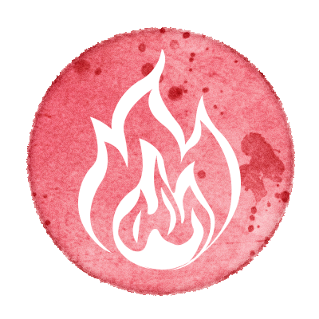

Putting Our Learning Together
How can fire help us?
How can our emotions help us?
How can fire harm us?
How can our emotions harm us?
Notes:
Instructor Notes
Provide students with Student Handout 4: Putting Our Learning Together. This is a way for students to independently summarize what they have learned so far about fire and emotions, as well as include their own knowledge and experience.

Slide 14
Traditional Talking Circle
Sharing Time:
How are our emotions connected to our behaviors?
Are we able to change our behavior?
Should we be afraid of our emotions?
Notes:
Instructor Notes
Conclude the lesson with a Talking Circle. This aligns to the learning theme of American Indian cultural values, and will also help students understand how to engage with each other with respect.
This is a very important place to continue to emphasize that our emotions are natural and helpful to us as they can keep us out of danger and help us show others how we feel. However, when our emotions are not balanced they can cause us to try things or do things that we normally wouldn’t. Though we may not be able to change our emotions easily. We can make decisions to change our thoughts and behaviors before they get out of control.

Slide 15
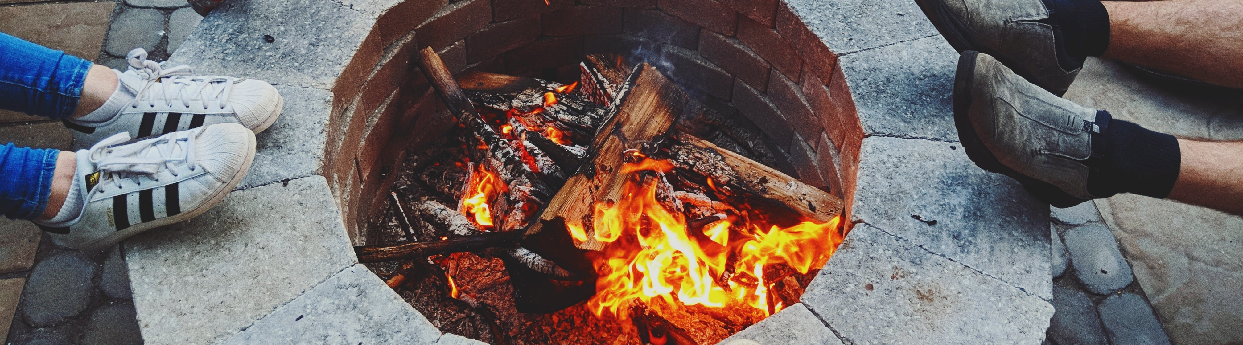
Day 3:
Traditional Uses of Fire Teach Us About
Managing Our Emotions
Notes:
Instructor Notes
Ask students to share with a partner something they have learned in this lesson series that has been new or interesting to them.
Then ask students how/if these lessons have made them think differently about their emotions. Allow time for sharing.
Emphasize that today’s lesson will focus on managing our emotions. Check for student understanding of the word managing or management.

Slide 16
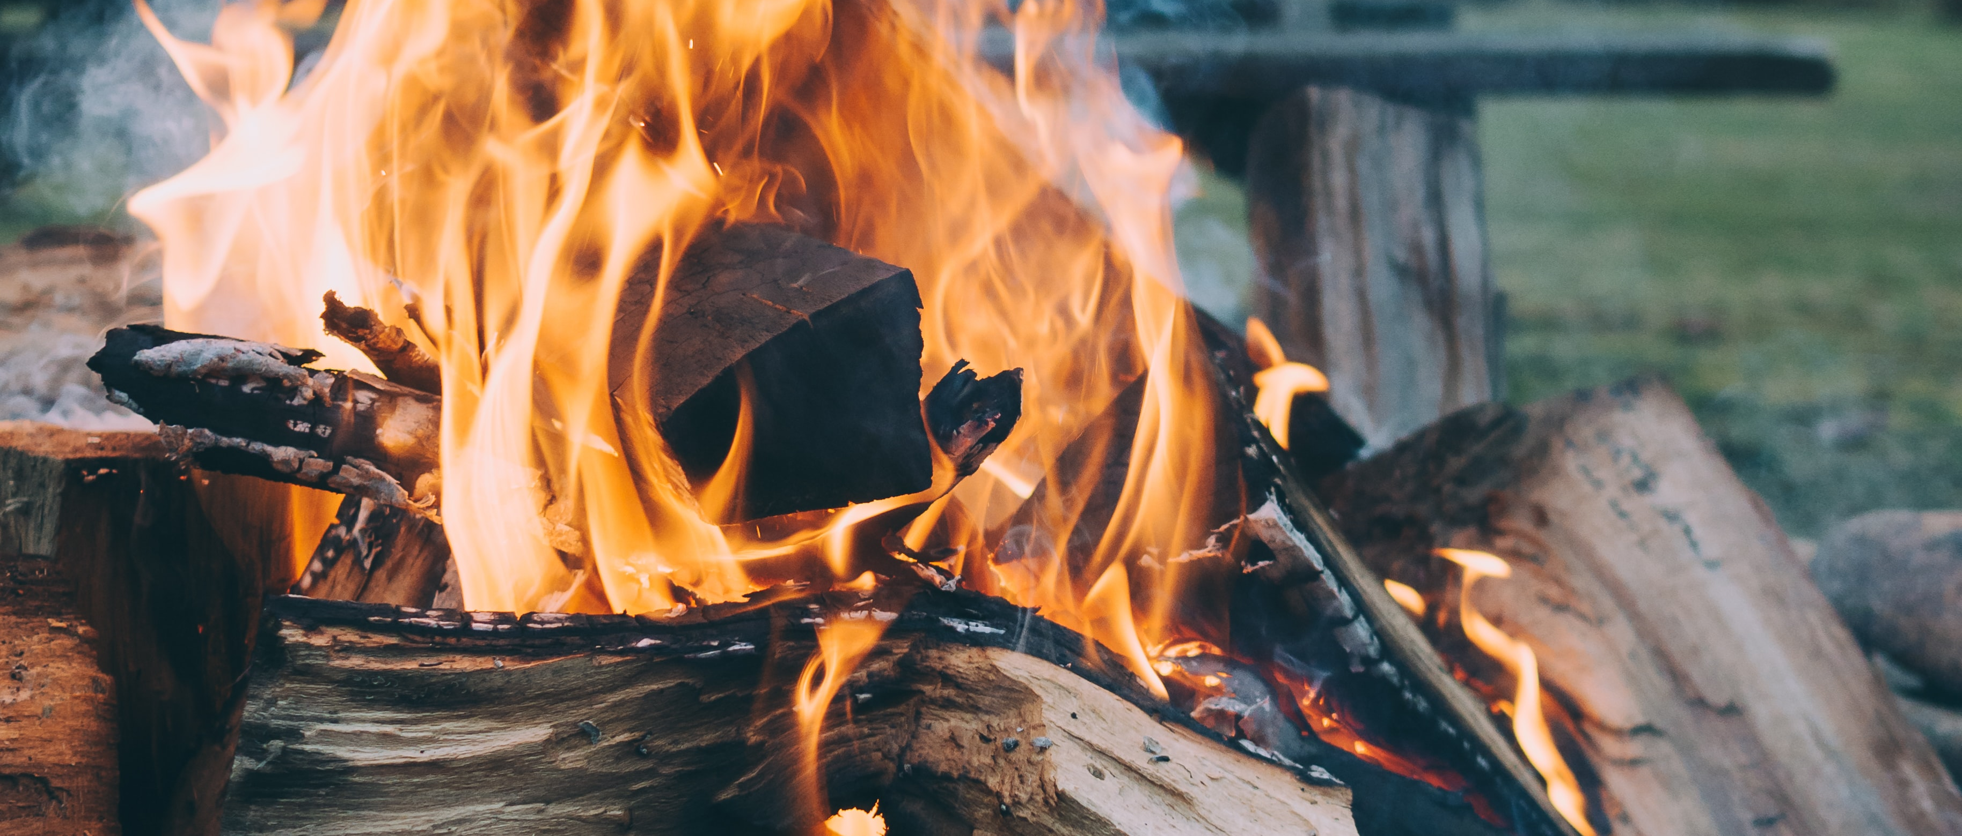
See, Think, Wonder Facing History
Notes:
Instructor Notes
As time permits, use the Teaching Strategy: See, Think, Wonder | Facing History strategy. This can be done as a whole group with the digital images or printed and shared in small groups.
Have students share responses to each of the images. These reflect fire at various stages from controlled to raging. Students may wonder about the second image, which depicts cultural or prescribed burning. It is actually just as controlled as the first image, but students may not understand this practice. This is what they will learn about in the first reading today.

Slide 17
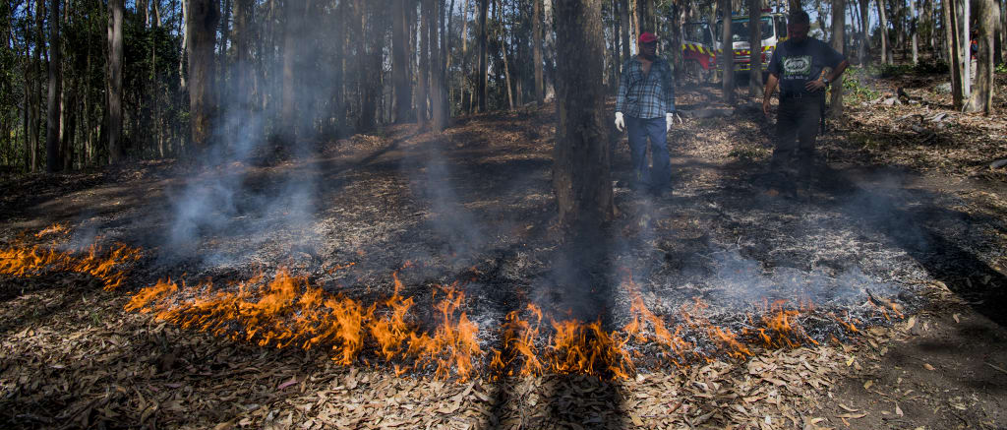
See, Think, Wonder Facing History

Slide 18
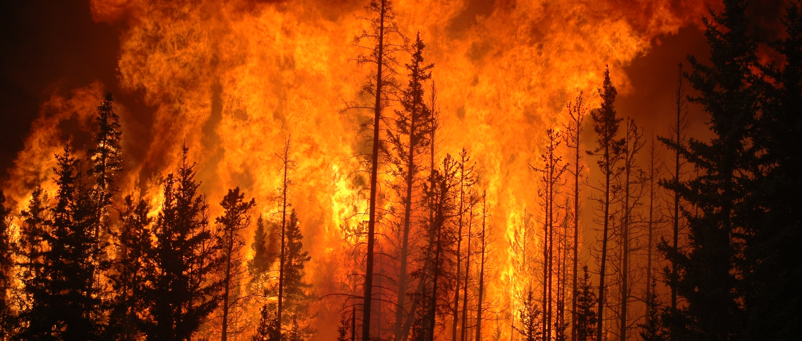
See, Think, Wonder Facing History

Slide 19
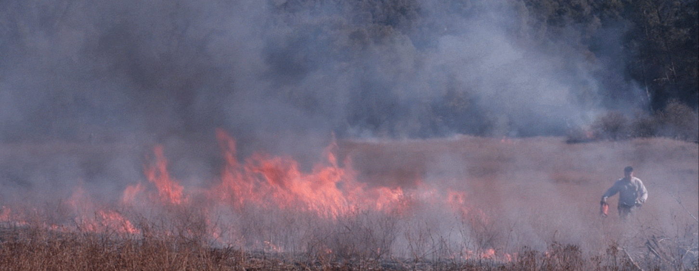
Cultural Article: How Native Americans Utilize
Fire to Balance the Land
Notes:
Instructor Notes
This reading will further explain how cultural or prescribed burning is used to help with growth. Before reading, display the image on the slide. Ask students what they think is happening in the image. Allow for various student ideas, but do not let students know what is actually happening.
Provide students with Handout 1: How Native Americans Utilize Fire to Balance the Land. Give students time and support for reading.
Ask students to discuss the differences they notice between the pictures on the second page of the handout.
Return to the image on the screen and ask students to use what they learned in the article to rethink the picture. The man is intentionally causing and controlling the fire to burn off the brush that can catch fire later, and cause an uncontrollable forest fire. Then read the caption of the image: “Elijah Knight of the North Fork Mono tribe lights grass on fire as part of a broadcast burn, which is a controlled application of fire to fuels.”

Slide 20
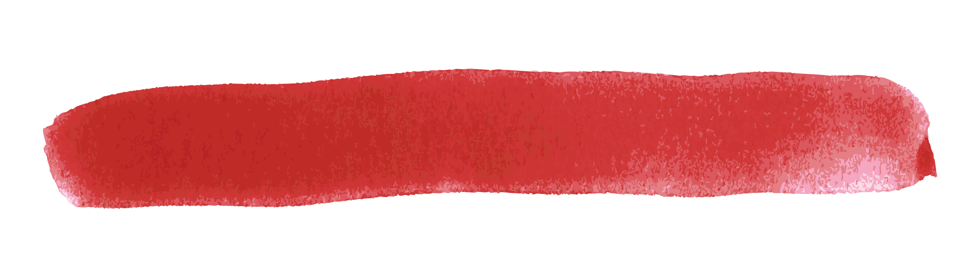
Managing Our Emotional Fires
1. Identify what is causing the emotion.
2. Identify what you are thinking about that
emotion, or the situation.
3. Think about the effects of your thoughts
and actions.
Notes:
Instructor Notes
Remind students that they have been learning about fire to better understand their emotions. Provide Handout 2: Managing Our Emotional Fires. Allow for time and support for student reading. Focus on the checklist and ask students how that can help them to change their emotional responses.
Then hand out the half-sheets from Handout 3: Reflect & Respond. This activity will help students make text connections and prepare for the final talking circle. If time allows, ask several students to share responses.

Slide 21
Traditional Talking Circle
Sharing Time:
Why is it easier to stop a fire or emotion when it is little, and harder when it is big?
How can a “firestorm” of emotion cause people to make poor decisions?
How can talking about our emotions be helpful?
Notes:
Instructor Notes
To close out the lesson series, complete one last talking circle. As this asks students to reflect on all of their learning, this may take longer, or could take place in an additional class session.
Also, ask students to reflect on the use of the talking circle and how it could benefit their class to use it more often.
For students to have personal time to reflect on the lessons, send home Handout 4: Reflect & Look Forward as homework, or plan to complete it in another class session
Extension Activities
Share images and information from the following articles on the Yurok tribe in California. The Yurok Cultural Fire Management Council works alongside other tribes such as the Karuk to assist local fire departments in prescribed cultural burning to help prevent forest fires and foster regrowth of forests. This is a current example how the cultural value and respect of fire is still used to bring balance and safety in nature. The article references them as “firelighters” rather than “firefighters.” These tribes also teach college students the cultural ways of fire management to maintain the beauty of the forests for the future.
The Guardian article: https://www.theguardian.com/us-news/2019/nov/21/wildfire-prescribed-burns-california-native-americans
NPR.org article (with live motion images) ‘To Manage Wildfire, California Looks To What Tribes Have Known All Along” https://www.npr.org/2020/08/24/899422710/to-manage-wildfire-california-looks-to-what-tribes-have-known-all-along

