Slide 1
Notes:
Please insert an image of a parent administering medication to an upper elementary age child.

Slide 2
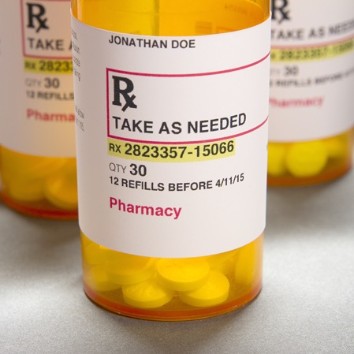
Patient Name
Name of medication and strength
Instructions on how and when to take this medication
Physical description of the medication
Expiration date
Number of pills in bottle
Notes:
Instructor Notes: Invite students to review the information on the prescription medication label. Ask students to consider why each piece of information is important to know.

Slide 3
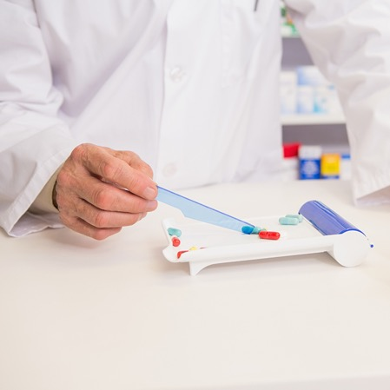
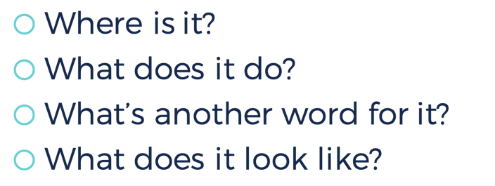
Work with your partner to define the term medication using the clue questions.
Where is it?
What does it do?
What’s another word for it?
What does it look like?
Notes:
Instructor Notes: Organize students into partners and distribute one index card to each partner group. Direct students to work with a partner to generate a definition using the guiding questions. This will help assess what students already know about medication. Allow partner groups to share their definitions.

Slide 4
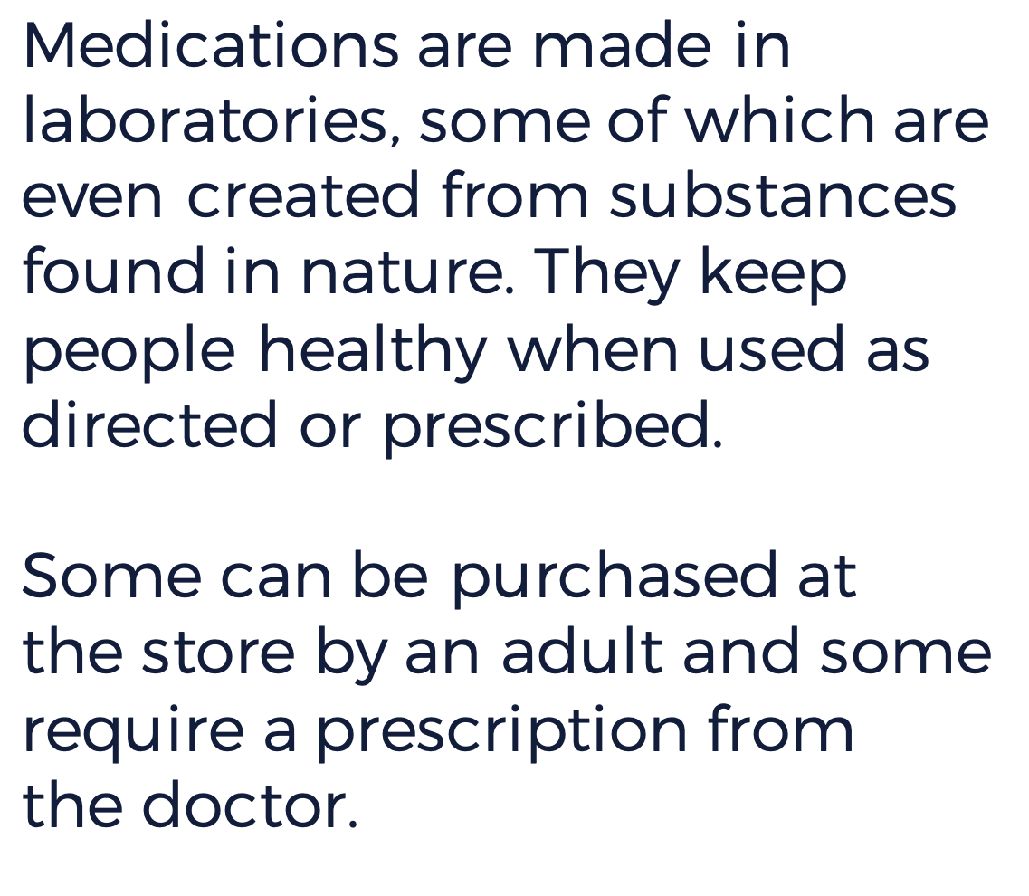
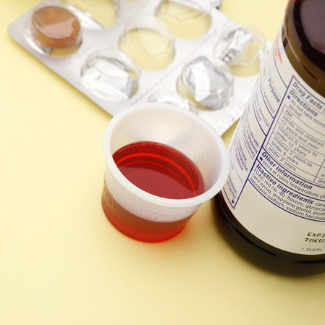
Notes:
Instructor Notes: Click once to present the definition on this slide and allow students to revise their original definitions as needed. Work as a class to finalize and record a working definition.

Slide 5
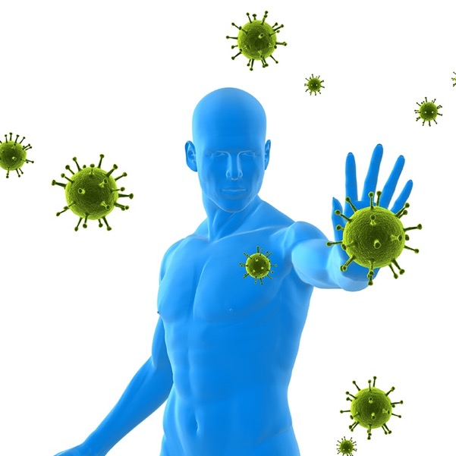
Notes:
Instructor Notes: Describe the role of the immune system in the body. It is a system made up of special cells, proteins, tissues, and organs that work to protect the human body. Explain that medication may be considered when the immune system is unable to protect the body on its own.

Slide 6
Notes:
Instructor Notes: Ask students to write down three things they might already do, or can do, to prevent illness. Use the video The Immune System to reinforce that preventive measures (e.g. immunizations, proper rest, good nutrition, regular exercise, routine check-ups) are the best ways to fight illness and that when preventive measures are not enough, medication can be used to assist the immune system. Guide students to add to their list, and provide an opportunity to clarify any questions, after they viewed the video. Explain that children and pre-teens should always consult a doctor or responsible adult regarding the possible need for medication.
The Immune System
https://kidshealth.org/en/kids/ismovie.html

Slide 7
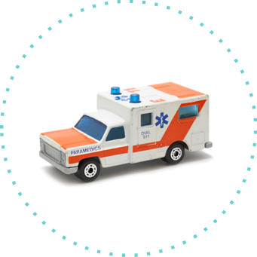
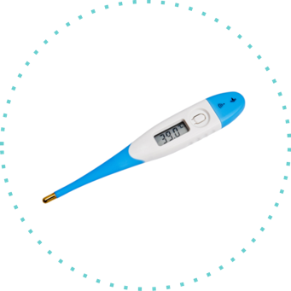
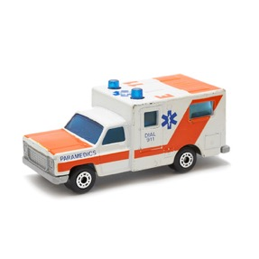
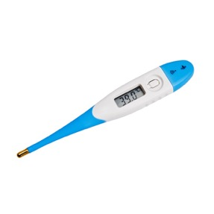
Notes:
Instructor Notes: Use the collection of pictures and objects shown. (e.g. tissues, thermometer, plastic bag filled with grass, breast cancer ribbon, picture of American Heart Association logo, toy ambulance) that are related to how medications are used to assist the immune system (manage and prevent disease, ease symptoms).
Present the images one at a time and ask students what they think the collection represents. Accept and record all ideas allowing students to modify their theme ideas after each item is presented.
After the entire collection is revealed, explain that medications are used to manage and prevent disease (e.g. cancer, heart disease), ease symptoms (e.g. seasonal allergies, cold), and can be used to help in the diagnosis of some illnesses.
Work as a group to classify the collection of objects into two categories (manage and prevent disease, ease symptoms). Some objects (e.g. ambulance) might be a good fit for both groups depending on the class discussion.
Answer Guide:
Manage and Prevent Disease: breast cancer ribbon, American Heart Association logo, ambulance
Ease Symptoms: tissues (cold, seasonal allergies), grass (seasonal allergies), thermometer, ambulance

Slide 8
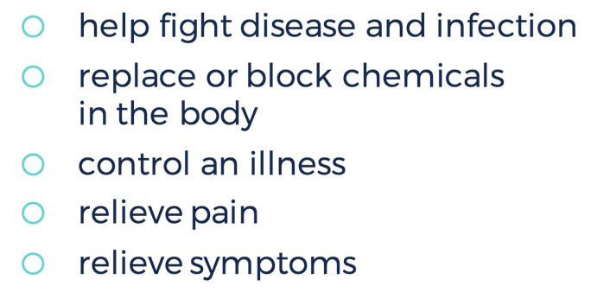
Notes:
Instructor Notes: Summarize the role of medications with students using the information on the slide. Review that medications are used to make a person feel better when they are sick to help fight disease and infection, replace or block chemicals in the body, to control an illness, relieve pain, and relieve symptoms.

Slide 9
Describe two ways that humans use medications.
Why did Chloe, from the video, need an antibiotic?
Notes:
Instructor Notes: Guide students to respond on an exit card.
If needed, share the video again from slide 6:
The Immune System
http://kidshealth.org/en/kids/ismovie.html

Slide 11
Notes:
Instructor Notes: Show the video clip and ask students to describe what they see. Have students record their ideas in their journals or blank piece of paper. After students share, confirm that the video shows what a pill look like as it dissolves to be absorbed into the body.

Slide 12
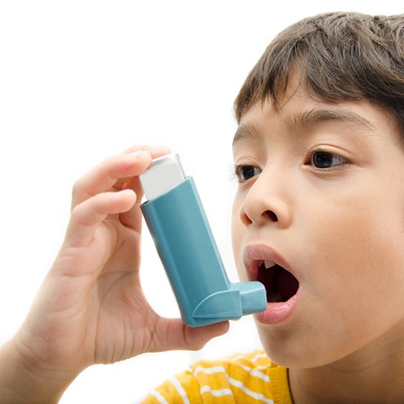
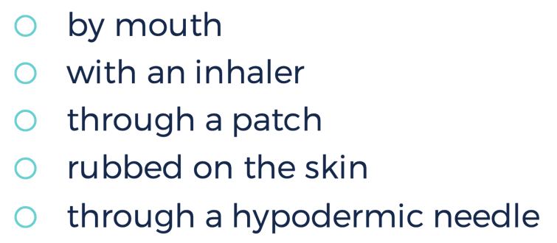
by mouth
with an inhaler
through a patch
rubbed on the skin
through a hypodermic needle
Notes:
Instructor Notes:
Pose the question, “How does medication enter the body?” Have students work individually to brainstorm and record ideas about how medications enter the human body. Allow some students to share their ideas with the class. Click once to reveal the list of ways that medications can enter the body. Allow students to revise their original lists.

Slide 13
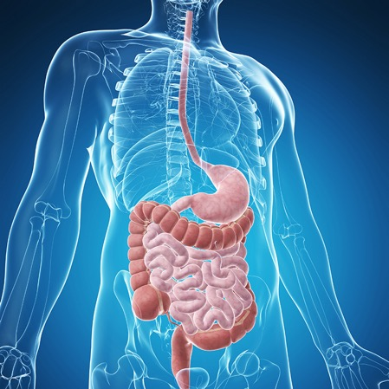
Notes:
Instructor Notes: Use the provided diagram to explain how medications that enter the body through the mouth travel through the digestive system. Explain that from the digestive system medications are absorbed into the bloodstream. Use video on next slide to help build student understanding of an oral medication’s journey.

Slide 14
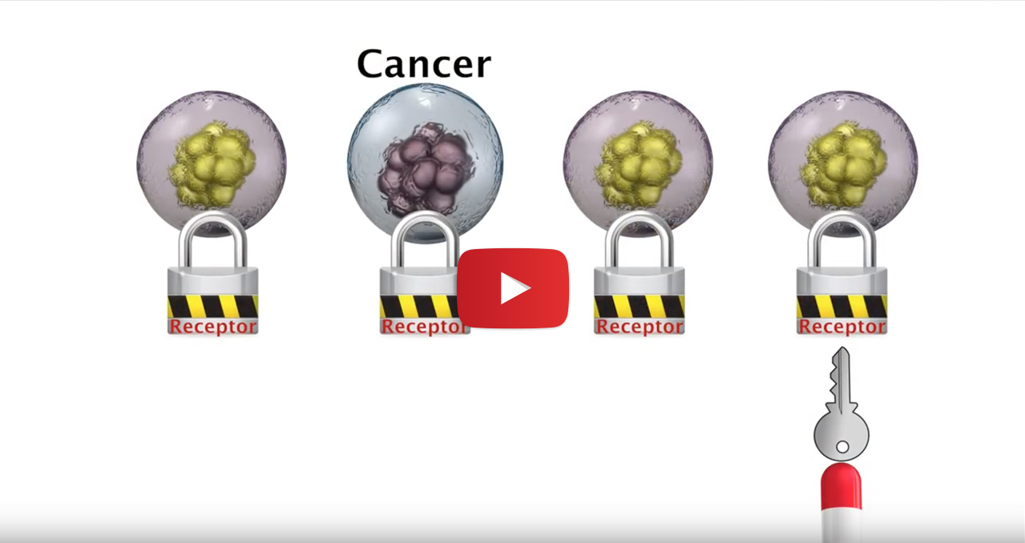
Notes:
Instructor Notes: Use the first part of the How Does Medicine Work? video (0:00-1:13) to help your students understand what happens to a pill when it is swallowed.
Points to reinforce:
Medications that enter the body through the mouth travel through the digestive system and are absorbed into the bloodstream.
Specific medications are used for specific conditions. So, it is really important to seek adult (e.g. parent/guardian/doctor) when you think you might need medication.
If you are not taking medication correctly it is not going to do its job, and it might even make you sick.
Link to Rutger’s video How Does Medicine Work?
https://www.youtube.com/watch?v=3EbJ24ubPOY&t=1s&spfreload=10

Slide 15
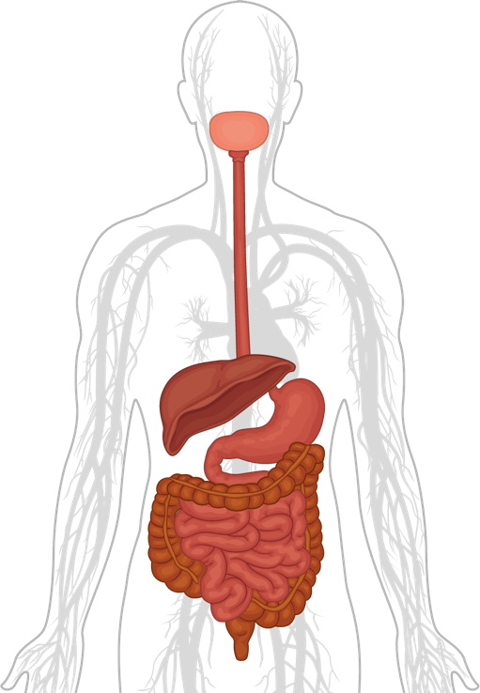
DEMONSTRATE YOUR UNDERSTANDING: Create a Skit
Create a skit that demonstrates how medication that enters through the mouth travels through the digestive system.
Notes:
Instructor Notes: Provide paper and markers and allow students to work in groups to create skits that show how medication travels through the digestive system. Allow students to present their skits to their peers.
Photographs of organ(s)
Alternatively, conduct a demonstration. Refer to the diagram and video on slide 13, as needed, to direct students. Have students stand with signs to represent the organs. Have another student stand with a cup of beans, blocks, or pennies to represent the pill. Have the pill travel through the digestive system. Prompt the organs to breakdown/absorb the medication (take beans, blocks or pennies) as it passes. Explain that from the digestive system medication is released into the bloodstream and that often the liver chemically alters the medication before it enters the bloodstream. Conduct the demonstration at least two more times using different students.

Slide 16
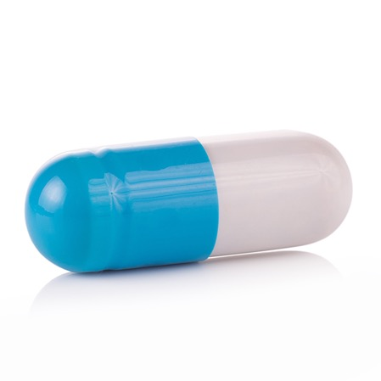
On Your Own Add on to the provided diagram to show how the medication or pill traveled through the digestive system.
Extension Explain where the medication goes when it exits the digestive system.
Notes:
Instructor Notes: Distribute a digestive system diagram to each student. Have students work individually to use numbers, symbols, and words to label the diagram to show how medication travels through the bloodstream.
Optional: Use the provided link to help deepen your students understanding of the functions of the digestive system. Type “digestion system movie” in the search box.
https://kids.usa.gov/teens/health-and-safety/general-health/index.shtml

Slide 17
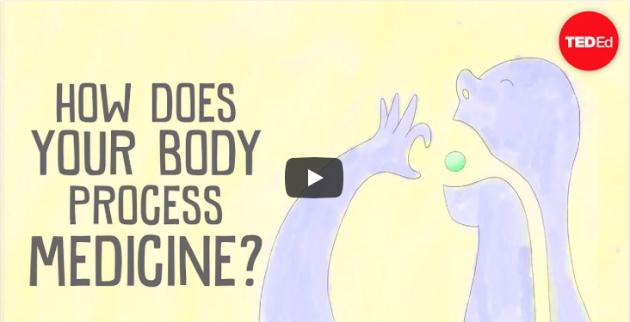
Notes:
Instructor Notes: Use this video for students to check their work and summarize what happens to a pill when it is swallowed. Ask students to share how the digestive system plays a role with food and medications.
Anticipated responses:
The digestive system breaks down food into energy.
The digestive system dissolves a pill into the bloodstream to help the healing process.
How does your body process medicine - Celine Veraly - TED talk
https://ed.ted.com/lessons/how-does-your-body-process-medicine-celine-valery

Slide 19
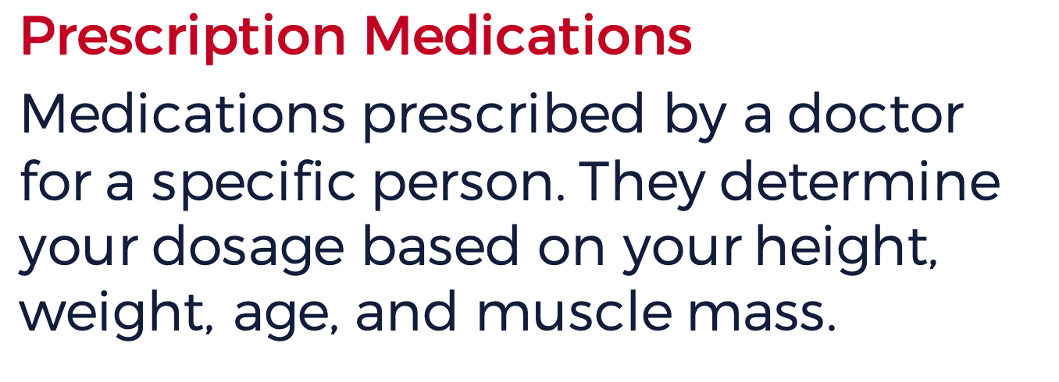
Prescription Medications
Medications prescribed by a doctor for a specific person. They determine your dosage based on your height, weight, age, and muscle mass.
Over-the-Counter Medications (OTC)
Medications that do not need a doctor’s prescription and can be sold directly to an adult customer.
Notes:
Instructor Notes: Introduce the two categories of medications by displaying the terms Over-The-Counter (OTC) and Prescription. Ask students what they think prescription medications means. Click to reveal and review the description for prescription medications. Emphasize that prescriptions are specific to the individual based on their condition, height, weight, age, and muscle mass. So, they cannot be safely shared or stored in a shared space. Ask students how they think OTC medications differ from prescription medications. Click to reveal and review the description of OTC medications. Allow time for students to ask clarifying questions.

Slide 20
Notes:
Instructor Notes: Distribute a capture sheet to each student and read the questions aloud. Ask students to answer the questions using the information presented in the next three slides including the video.
Answer guide:
What should I know about my medications?
You should know the name, purpose, and dosage of your medications.
What should I do if I am not sure of my dosage?
You should ask your doctor for prescription medications and pharmacist/responsible adult for OTC medications. Be sure to use the correct measuring tool when taking your medication.
Why do I need to tell my doctor the names of all of my medications?
My doctor needs to know the names of all of my medications to avoid negative medication interactions and side effects.
How do I safely store my medications?
To safely store my medications, I should put them in a cool and dry place out of the reach of children and pets.

Slide 21
Notes:
Instructor Notes: Review some of the symptoms/conditions that may be treated by each category of medications. Ask students if they notice a difference. Make sure they understand that prescription medications are typically used to treat more severe health issues (e.g. prescriptions treat conditions that may not have OTC treatment available, symptoms/conditions that require doctor supervision). You may have students on prescription medications for asthma, explain that sometimes it is necessary to see the doctor when OTC medications are not working.

Slide 22
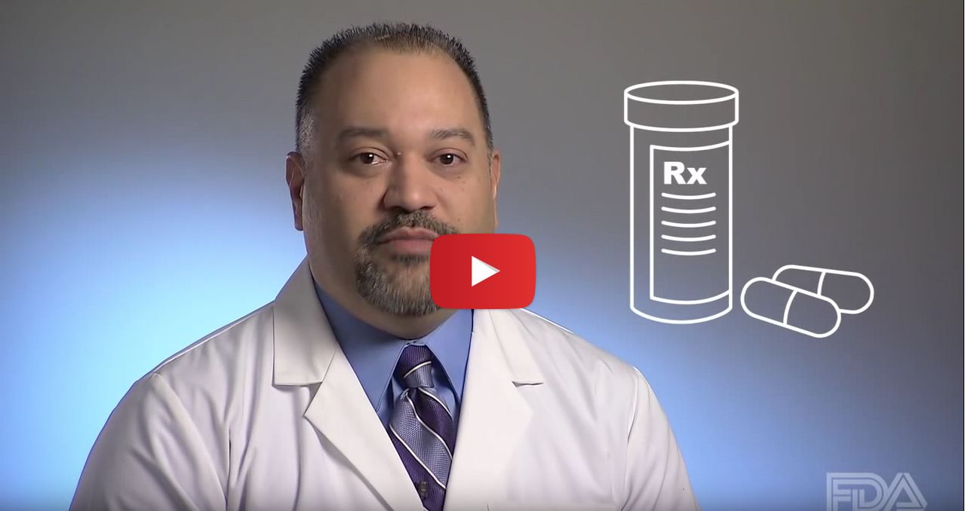
Notes:
Instructor Notes: Show video, pausing to allow students to answer the questions/complete their capture sheets.
Image linked to Teaching Kids About Using Medicine Safely
https://www.youtube.com/watch?v=gHv7KWB9RuI&spfreload=10

Slide 23
Patient Name
Name of medication and strength
Instructions on how and when to take this medication
Physical description of the medication
Expiration date
Number of pills in bottle
Notes:
Instructor Notes: Invite students to review the information on the prescription medication label again. Ask students to apply what they have learned to explain why each piece of information is important to understand to ensure safety.
Anticipated responses:
Patient Name: Know exactly who the medication is for.
Name of Medication and Strength: Know what the medication is called and that the amount of customized for a specific person.
Instructions: Explains how to take the medication. Take only as directed on the label. If it is daily, it should be taken once each day. If it says “three times a day” it should be taken throughout the day, instead of all at once. Note if it asks to take with food or water and follow those directions.
Physical description of the medication: Helps identify the medication by describing physical appearances.
Expiration date: Throw away medications that are past the expiration date. Old medications may not work or can make you sick.
Number of pills in bottle: The number of pills prescribed is unique to each person and situation.

