Slide 1










Slide 2


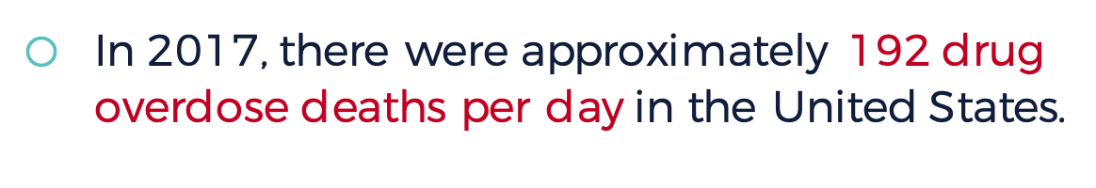
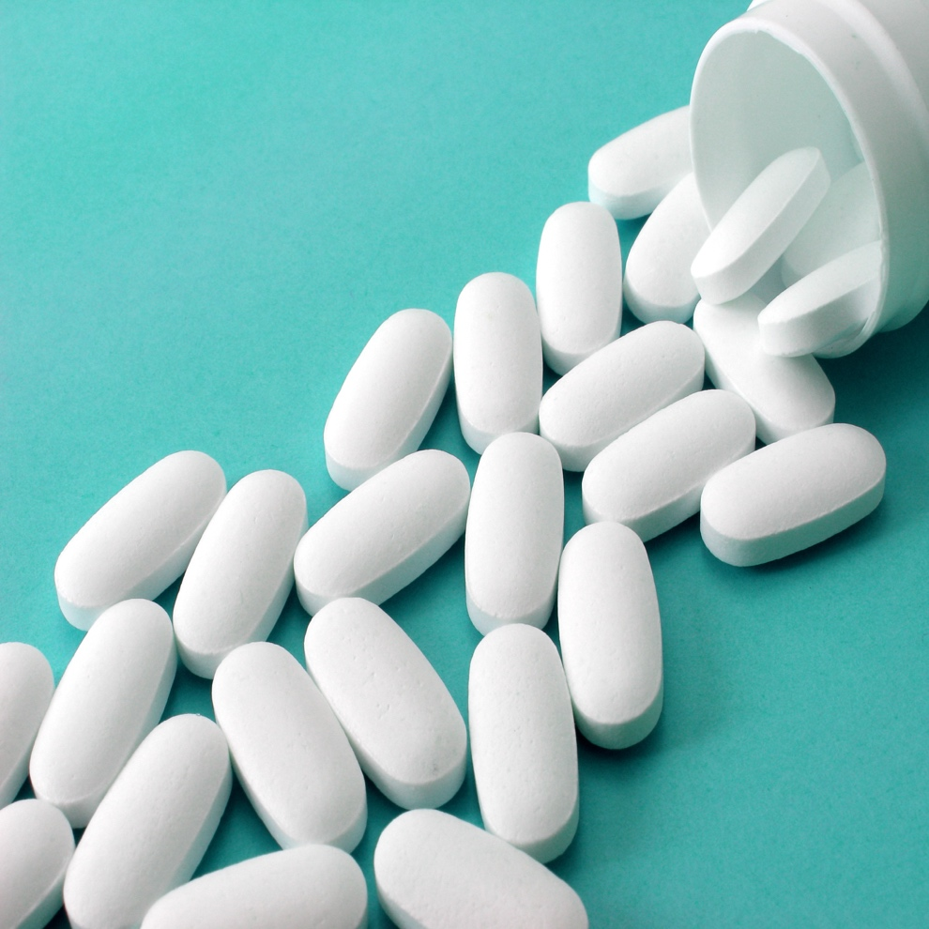
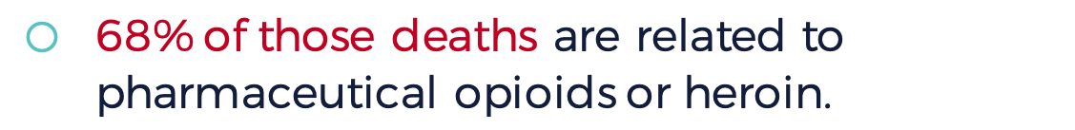
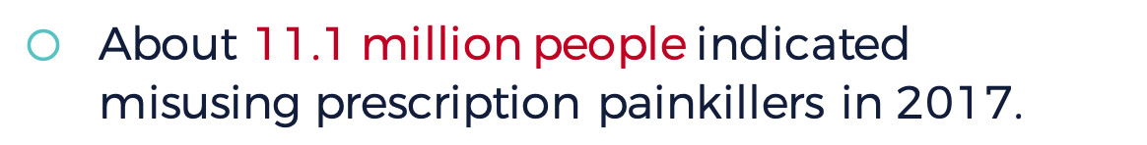
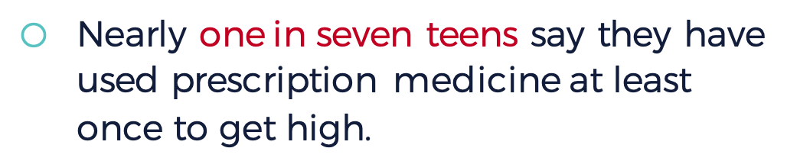

In 2017, there were approximately 192 drug overdose deaths per day in the United States.
68% of those deaths are related to pharmaceutical opioids or heroin.
About 11.1 million people indicated misusing prescription painkillers in 2017.
Nearly one in seven teens say they have used prescription medicine at least once to get high.
Notes:
Clicking on slide will reveal following statistics:
• In 2017, there were approximately 192 drug overdose deaths per day in the United States.
• 68% of those deaths are related to pharmaceutical opioids or heroin.
• About 11.1 million people indicated misusing or abusing prescription painkillers in 2017.
• Nearly one in seven teens say they have used prescription medicine at least once in their lifetime to get high.

Slide 3







Addiction is rare.
When used to treat pain, prescription opioid drugs are not addictive.
Only certain people are at risk of misusing opioid drugs.
Prescription opioids are the most rapidly growing class of misused drugs.
Notes:
Instructor Notes:
Create 2 groups to review statements about prescription opioids and heroin.
Anyone can be affected by drug misuse and abuse. There are no barriers that make anyone safe from this issue.
Prescription drugs are the most rapidly growing class of abused drugs.
Many factors determine the likelihood that someone may become addicted to a drug. This includes both inherited and environmental factors.
There were 192 drug overdose deaths per day in 2017 in the United States. Nearly 68% of those deaths were related to pharmaceutical opioids or heroin.

Slide 4





Opioids work in your body the same way that over-the-counter pain relief medications do.
It is easy to quit opioid dependency if you are disciplined.
Prescription opioids and heroin affect your body the same way.
Heroin affects the body but not the brain.
Notes:
Instructor Notes:
Create 2 groups to review statements about prescription opioids and heroin.
5. Prescription pain relief medication interacts with your body differently than over the counter medications.
6. Addiction to opioid prescription drugs and/or heroin is very strong. It alters the body and the mind, and professional help is often necessary to get away from the addiction.
7. Prescription opioids and heroin both interact with our body by attaching to a specific receptor in the brain.
8. Heroin affect both brain and body and can cause people to become physically and psychologically dependent on them to perform normal daily functions.

Slide 5

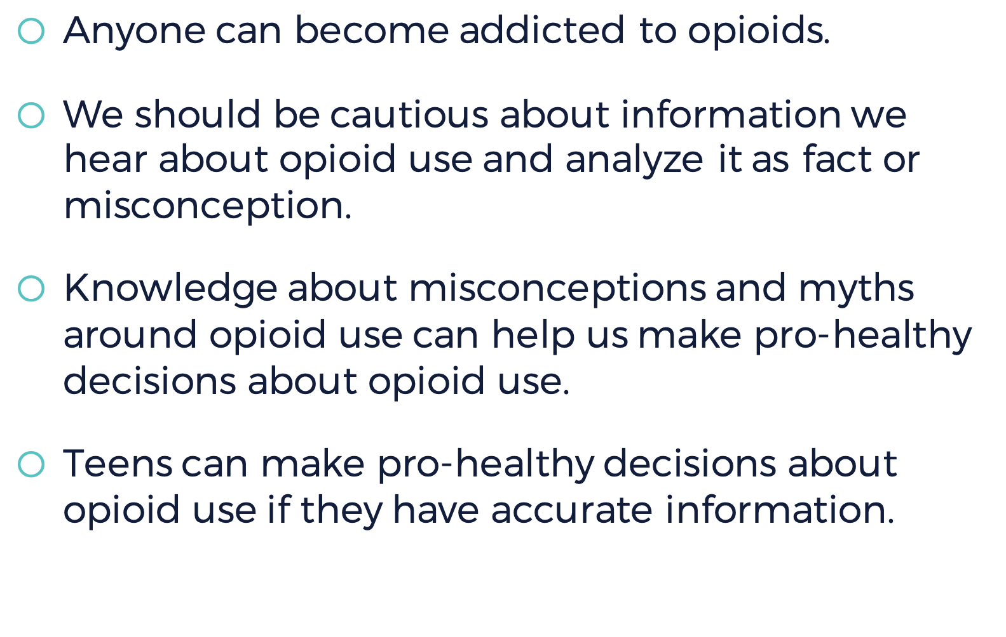


Slide 6
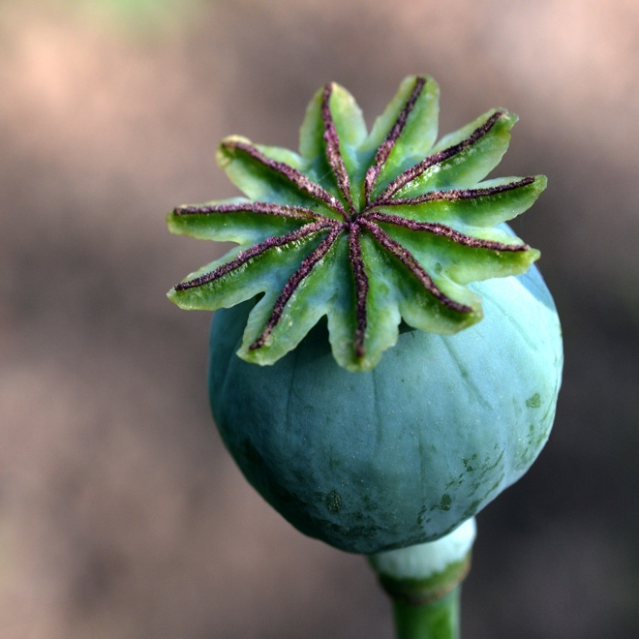

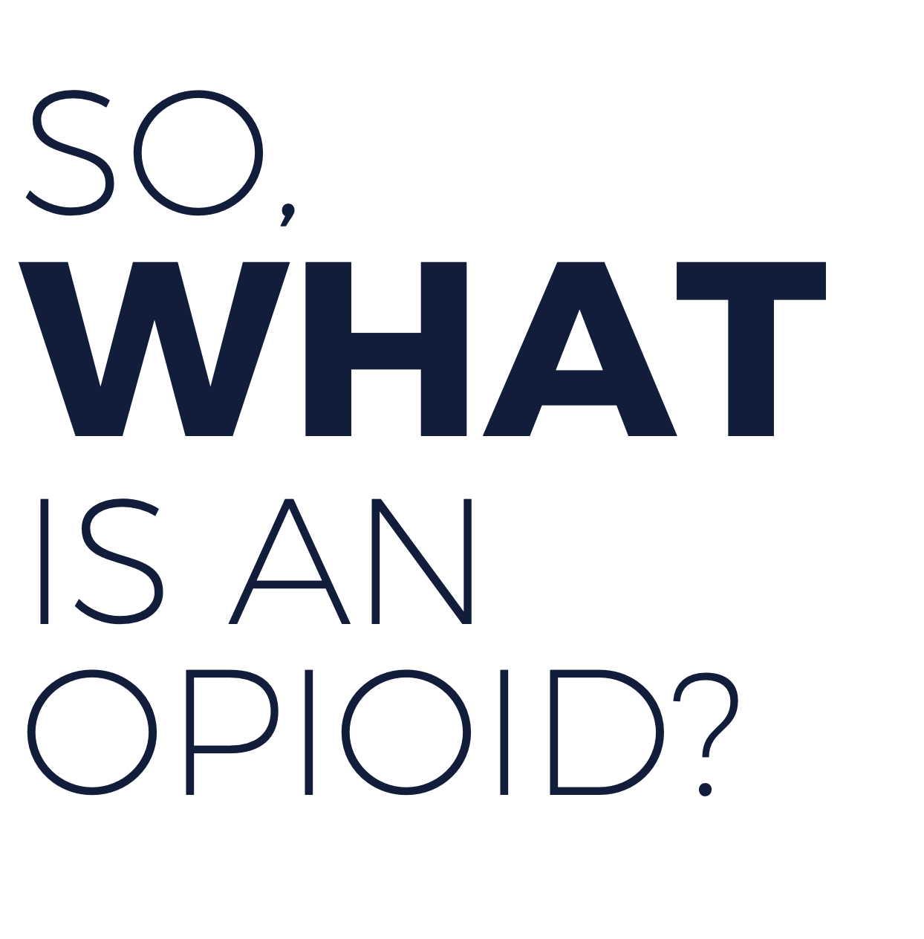
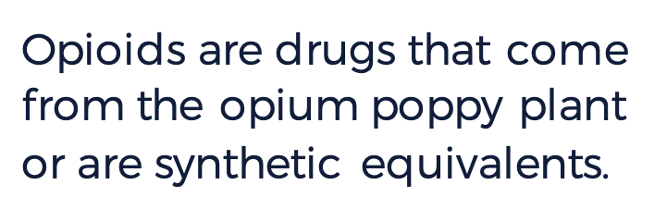
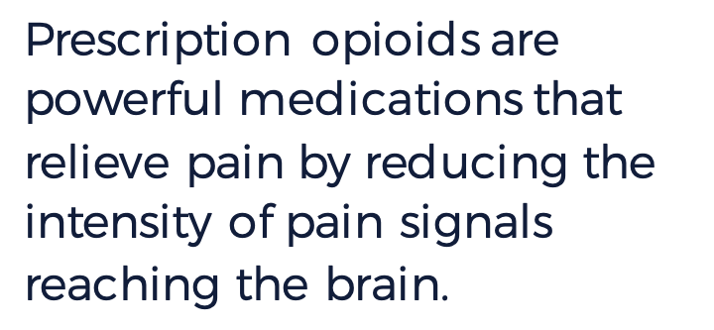

?
Opioids are drugs that come from the opium poppy plant or are synthetic equivalents.
Prescription opioids are powerful medications that relieve pain by reducing the intensity of pain signals reaching the brain.
Notes:
Instructor Notes:
Brainstorm with students about what they think opioids are and where they come from.

Slide 7






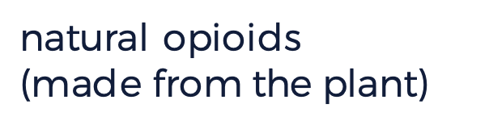
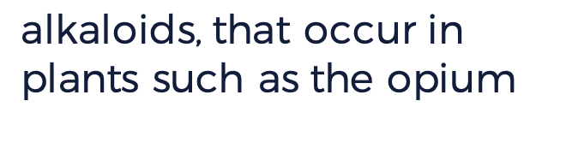



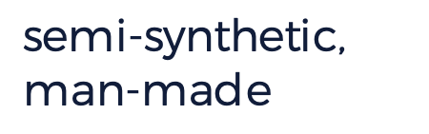










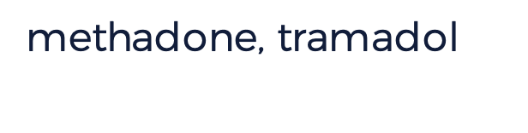

morphine
poppy
opioids
heroin
fully synthetic
fentanyl
man-made
opioids
Notes:
Instructor Notes:
Missing words for students to choose from:
poppy
Morphine
opioids
heroin
fully synthetic
opioids
manmade
fentanyl

Slide 8






What might someone who is addicted to
opioids look like?
Are there
certain features?
How could
you tell?
Notes:
Instructor Notes:
Arrange students in small groups. Provide each group with a handout they will list their group answers on. Review one of the potential misconceptions, “addiction is a choice,” with students by watching this video from NIDA: “Anyone Can Become Addicted to Drugs”: https://vimeo.com/188196247 (English) or https://vimeo.com/188178805 (Spanish)

Slide 9
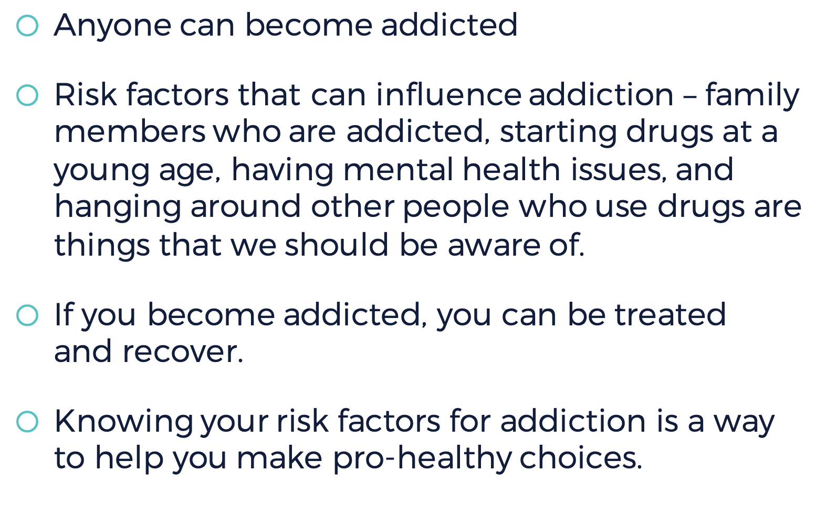


Slide 10

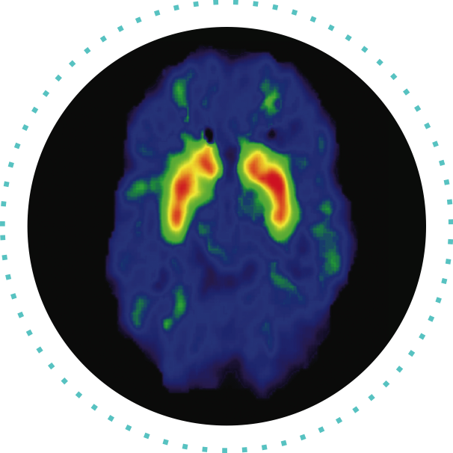

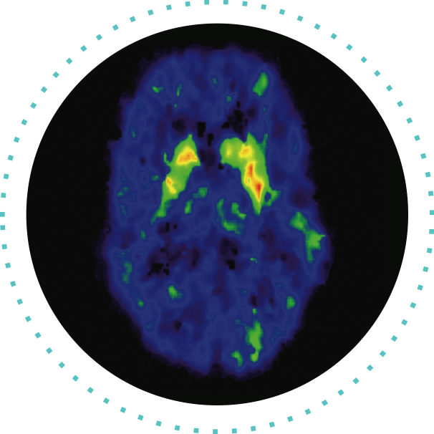



What do you notice about the two brains in each image?
How are they different?
How do you think these differences might be impacting the human body?
Notes:
Video link: https://www.youtube.com/watch?v=DMcmrP-BWGk
Instructor Notes:
As they view the images, students should note how the brains are different:
In Image A, the left side shows normal activation of the brain during a cognitive task. The right side shows brain activation with the influence of drugs. Activation is shown by color: red shows strongest activity, then orange, then yellow, then green. The image on the left shows strong activation in red and orange in the target area while the image on the right shows much less and weaker activation, with only a little yellow or green.
Image B shows memory activation in the amygdala for someone who has taken drugs when watching a non-drug related video and when watching a drug related video. The left side shows less activation in the amygdala. It becomes more active when the person is watching the video related to drugs.
Image C shows how a healthy and a drug-addicted brain process glucose, a main source of energy. The healthy brain, on the left, shows much more activity throughout different regions of the brain, suggesting that it is better able to absorb the energy it needs to function.

Slide 11

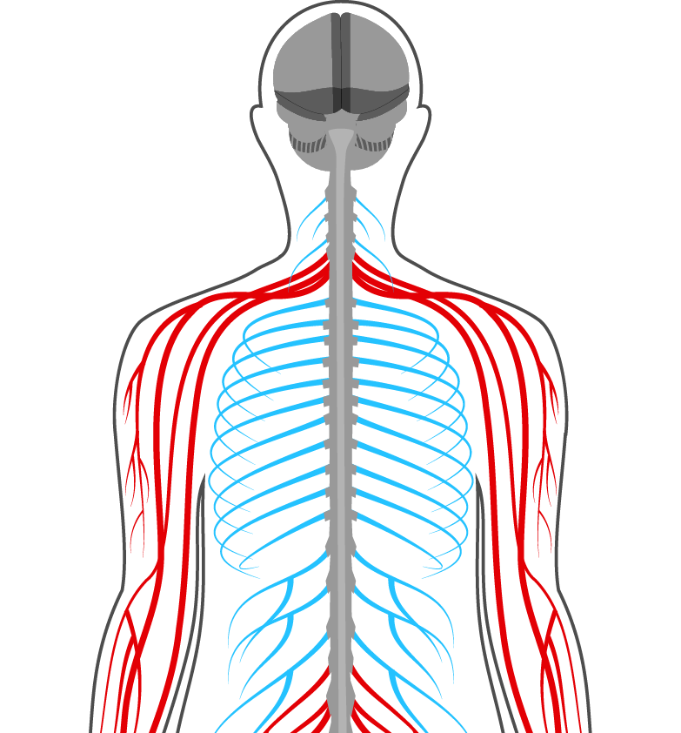

Notes:
Instructor Notes:
Clarify with students that opioids act upon the opioid receptors in our nervous system. This is a big deal because of all the different parts they just learned our nervous system controls. Ask students to identify parts of the nervous system that could be affected by opioid misuse and to explain their reasoning.

Slide 12


Notes:
Instructor Notes:
2018 Virtual Field Trip Video Clip: https://www.operationprevention.com/virtual-field-trip
Fast forward to 6:47 in the video and begin there. (Watch the clip from 6:47-10:19.)

Slide 13

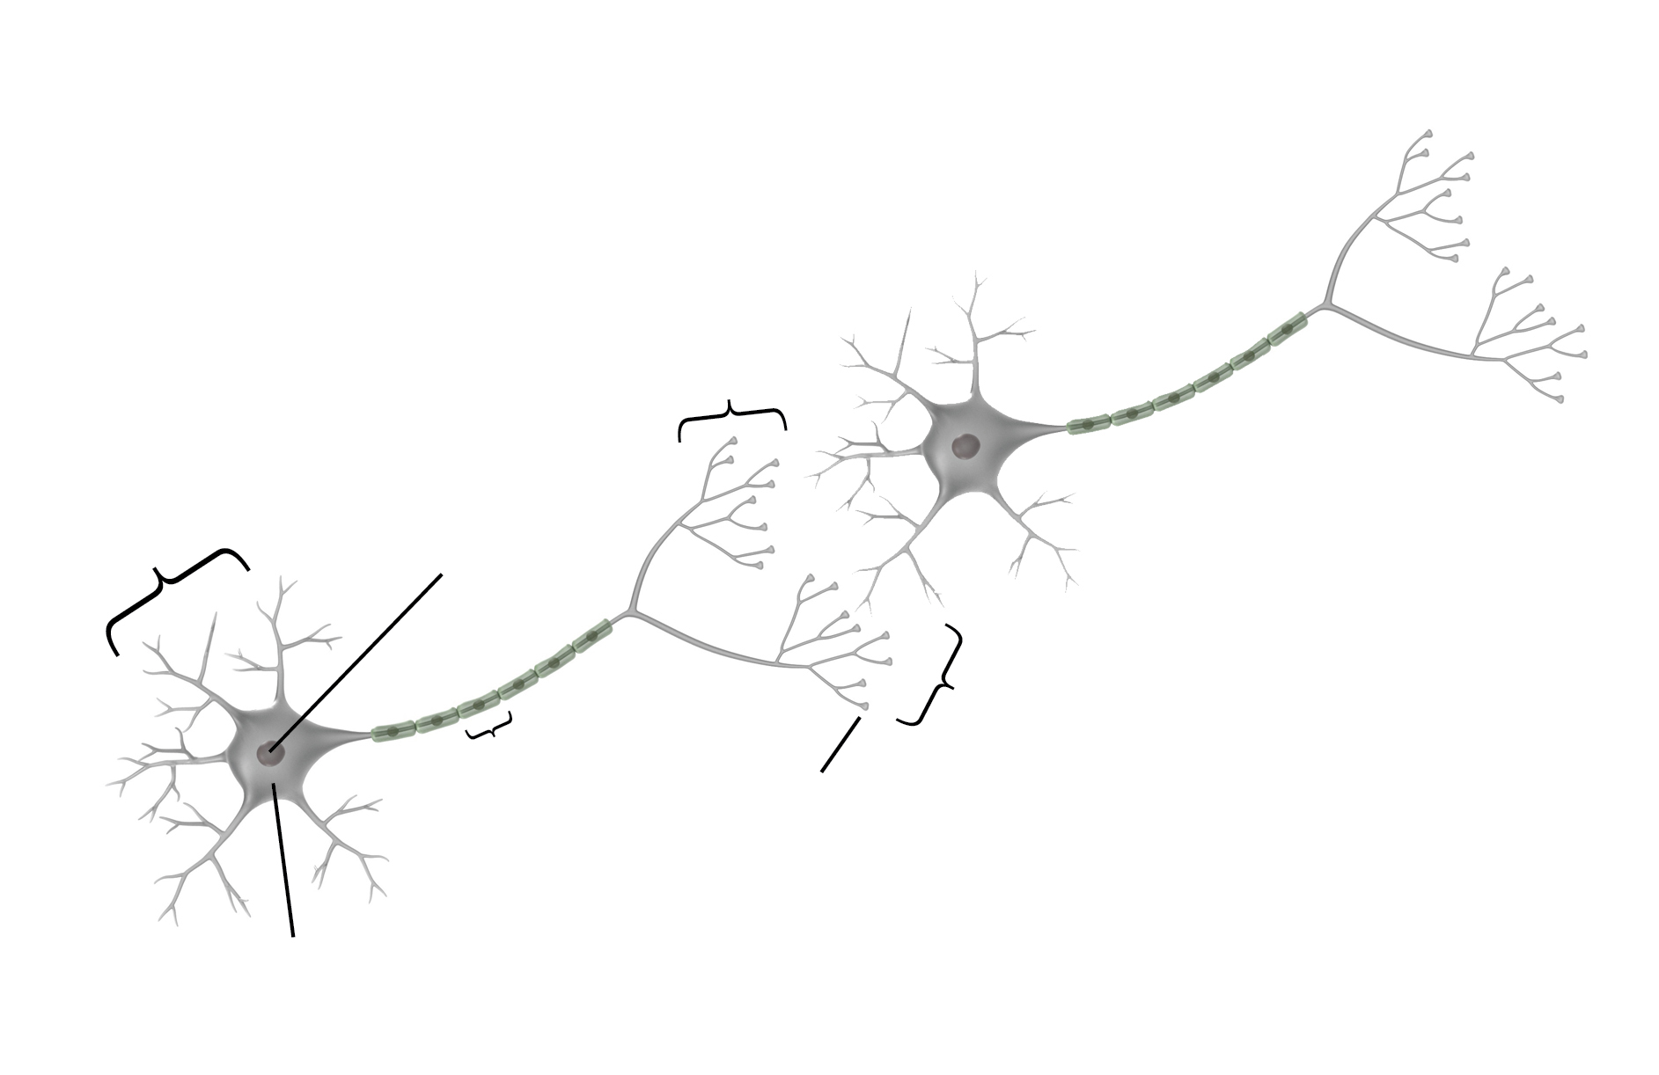

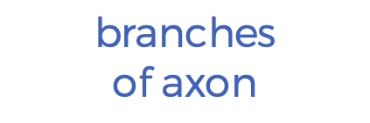








branches
of axon
dendrites
nucleus
synaptic gap
axon
terminal bulbs
cell body
Notes:
Image source:
science.education.nih.gov

Slide 14
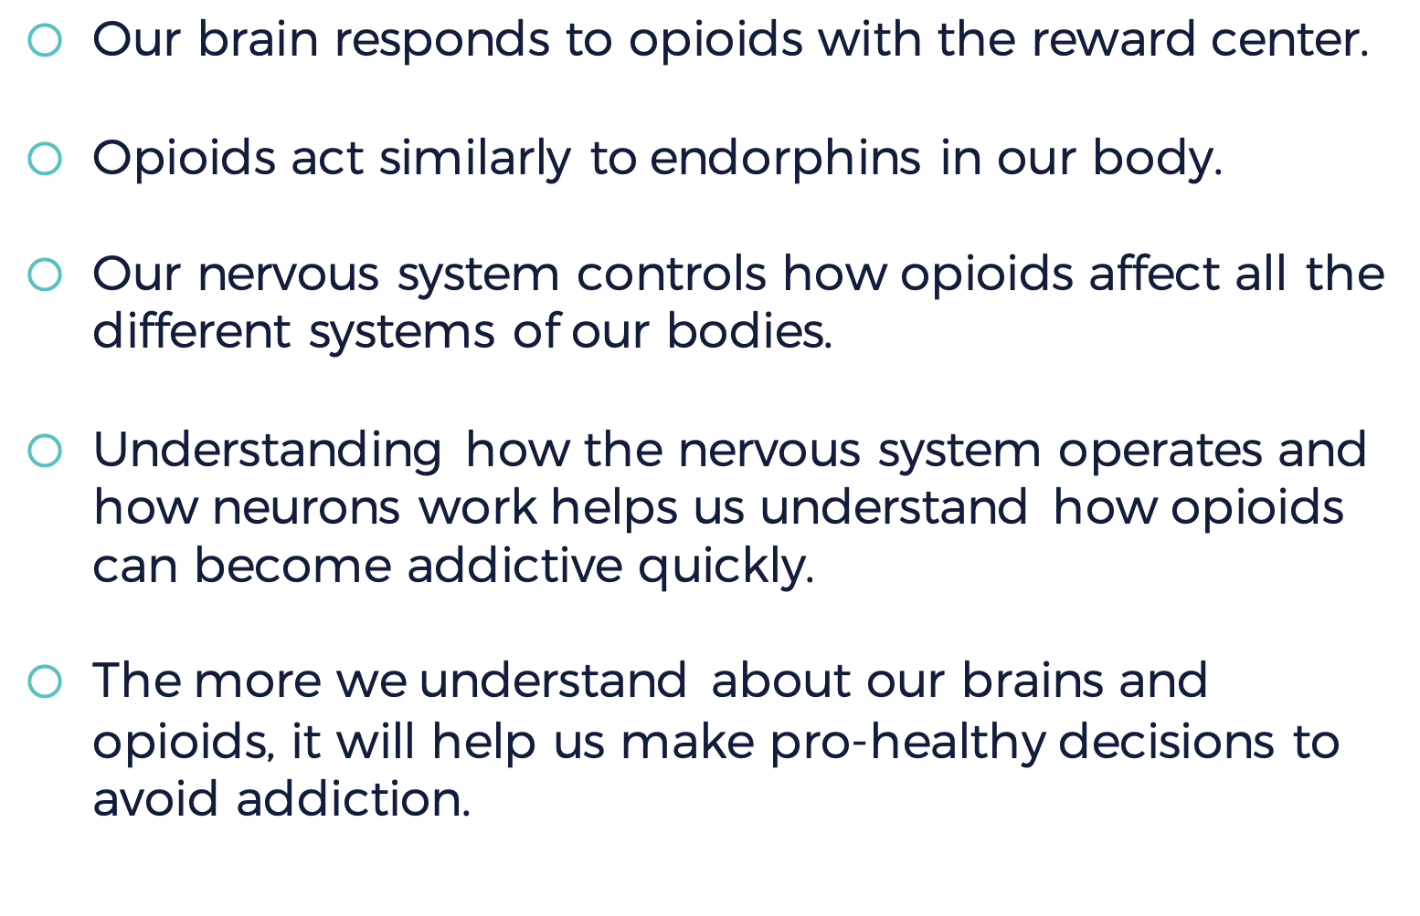


Slide 15

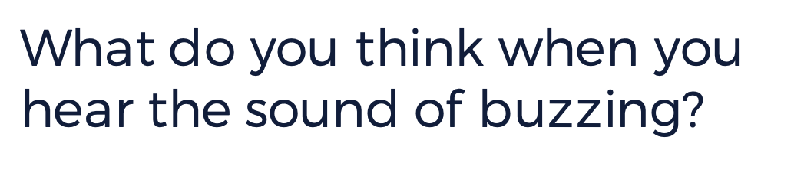
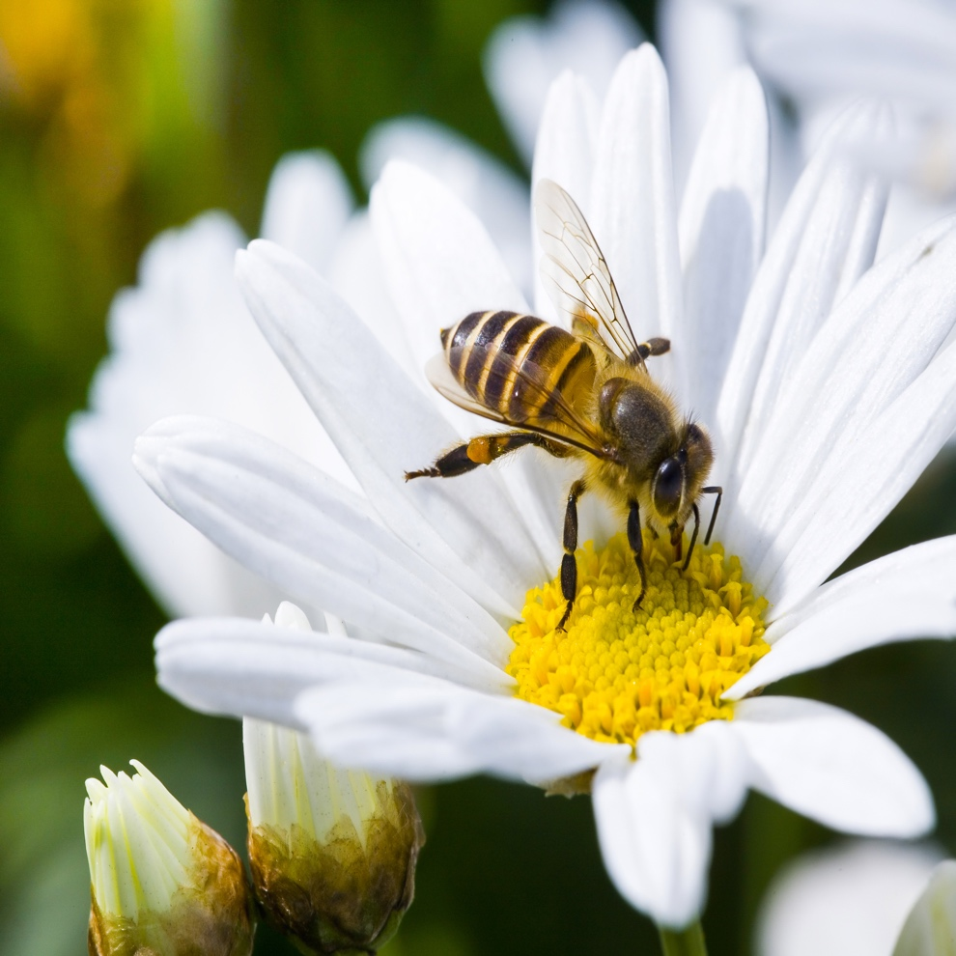
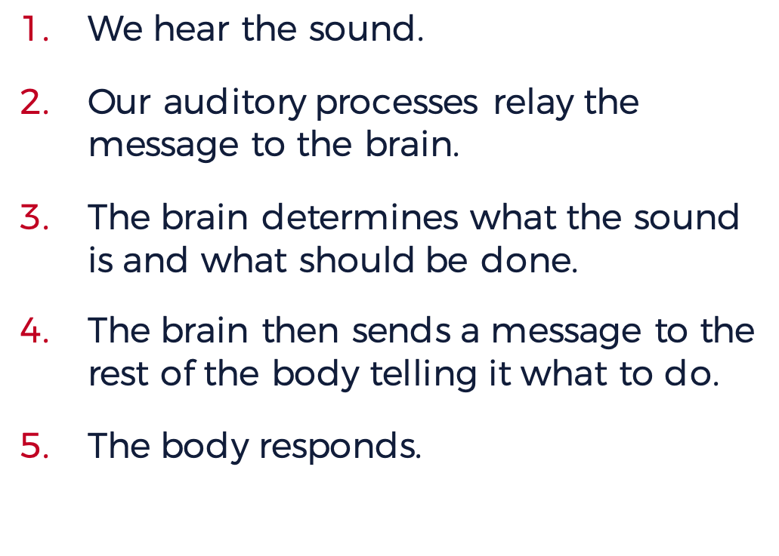


What do you think when you hear the sound of buzzing?
We hear the sound.
Our auditory processes relay the message to the brain.
The brain determines what the sound is and what should be done.
The brain then sends a message to the rest of the body telling it what to do.
The body responds.
Notes:
Instructor Notes:
“Bottom-up” and “top-down” processing refer to the direction in which the message, or impulse, travels. The brain is considered to be at “the top” of the nervous system, so if the brain sends the message the direction is top-down; if the message is sent to the brain the direction is bottom-up.

Slide 16





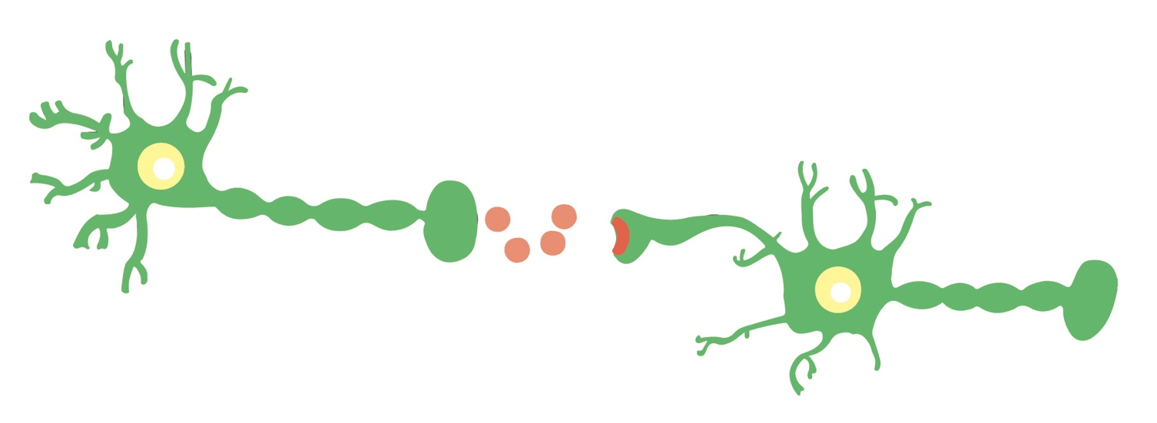

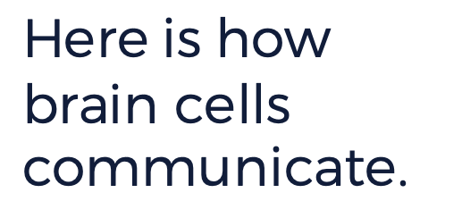
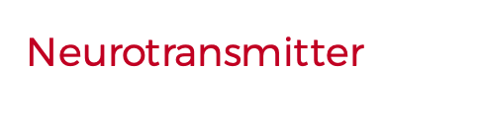

Notes:
Instructor Notes:
Emphasize that even when we take prescription opioid drugs correctly, we are still altering the messaging process in the brain; the opiate acts on certain neurotransmitters to increase pain relief and block pain signals. In other words, the opioid prevents the pain message from reaching the brain; because we are not conscious of the pain, we do not experience it.

Slide 17

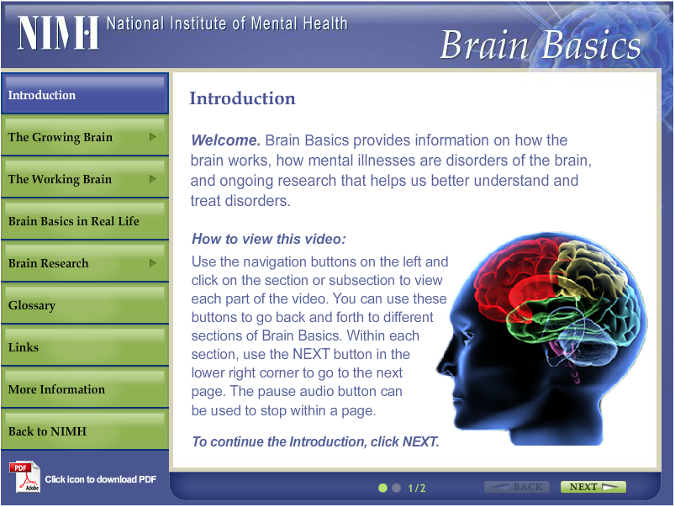



Notes:
<PRODUCTION NOTES: You can access the “Brain Basics” web page here:
http://www.nimh.nih.gov/brainbasics/index.html to embed video.
>
Display the following keywords using the slide: neuron, neurotransmitters, axon, dendrites, and synaptic gap.
Instructor Notes:
The “Brain Basics” web page consists of numerous short videos on a variety of topics. For this lesson, students will watch one video categorized under “The Working Brain” titled “Neurotransmitters”. Roll the cursor over the appropriate category to reveal the video; clicking on a video title will cause the video to play in the main section of the web page.

Slide 18



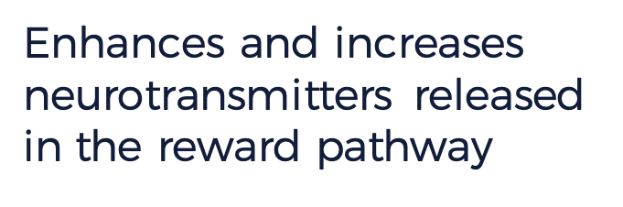
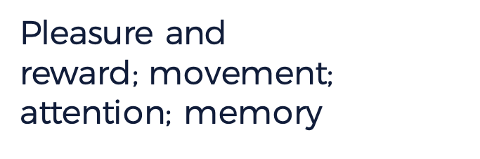


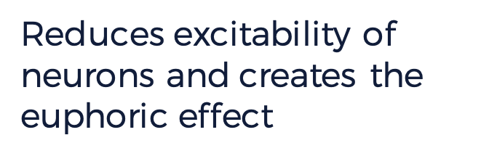
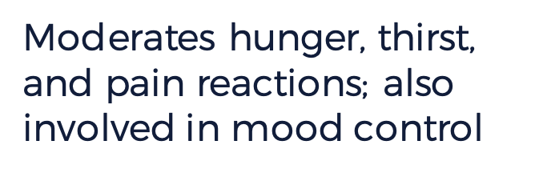
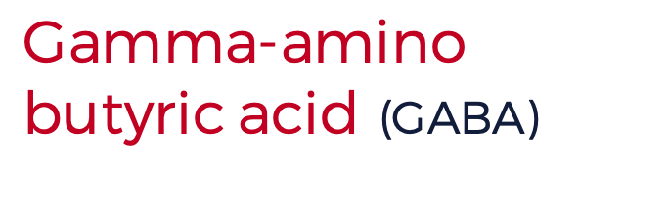
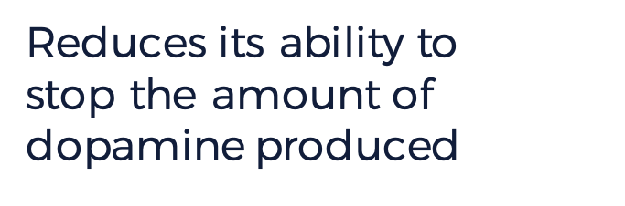
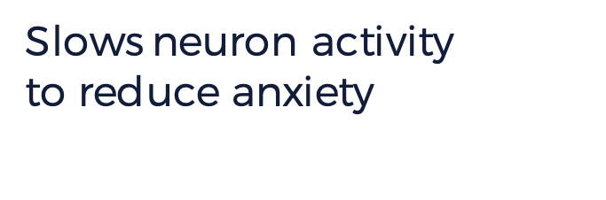

Enhances and increases neurotransmitters released in the reward pathway
Pleasure and
reward; movement; attention; memory
Dopamine
Reduces excitability of neurons and creates the euphoric effect
Moderates hunger, thirst, and pain reactions; also involved in mood control
Reduces its ability to
stop the amount of dopamine produced
Slows neuron activity
to reduce anxiety
Notes:
Instructor Notes:
Invite students to consider how each of these neurotransmitters, affected by opioids, could impact the human body by completing the last column of the chart.

Slide 19




FALSE

Slide 20

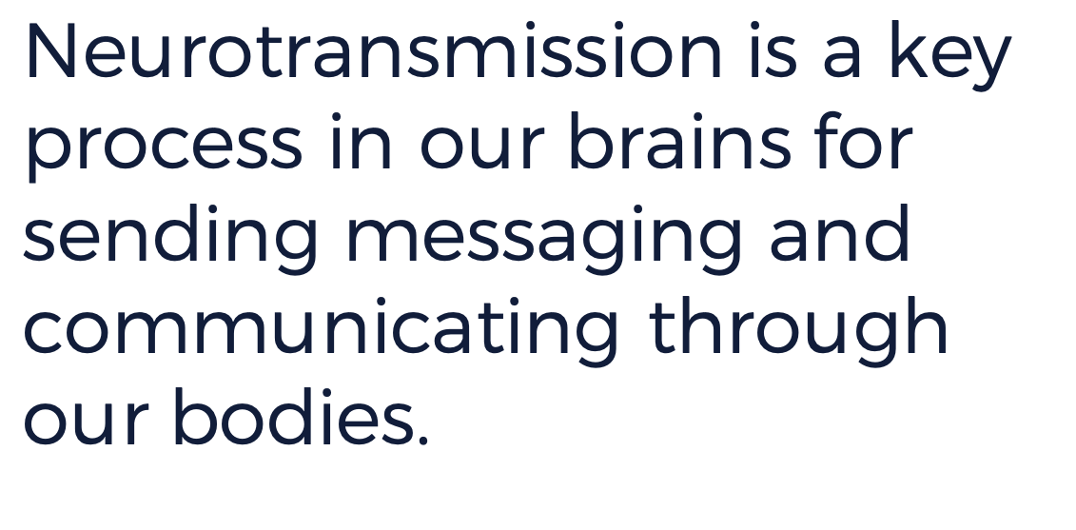


Slide 21
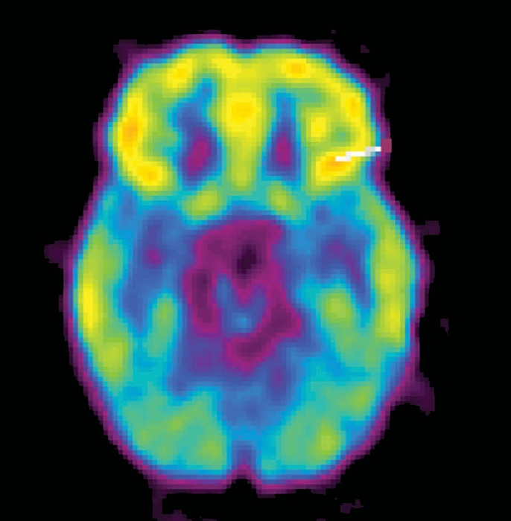
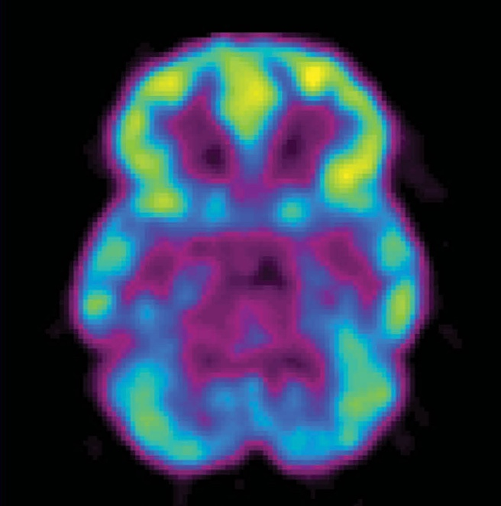



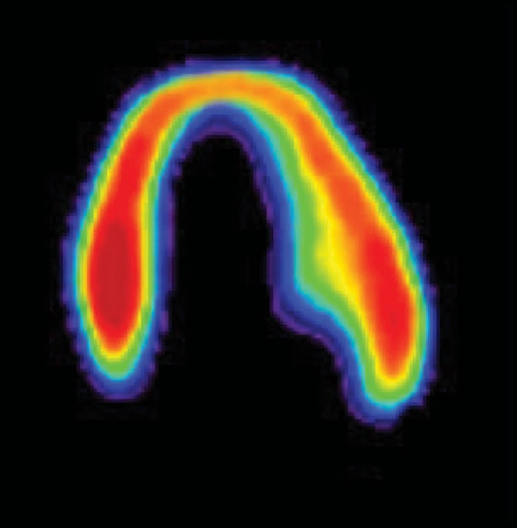
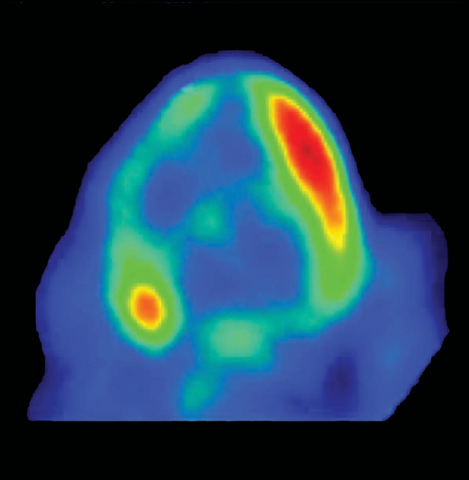



Scans of a healthy heart and a diseased heart show similarities,
respectively, to a healthy brain and a brain on drugs.
What do you notice about these images?
BRAIN / HEART COMPARISON
Notes:
<Image source:
https://www.drugabuse.gov/about-nida/legislative-activities/testimony-to-congress/2015/harnessing-power-science-to-inform-substance-abuse-addiction-policy-practice
>
Instructor Notes:
To help students interpret this image, you may need to explain that metabolism refers to how the body uses energy. Red areas of the image are using more energy than blue or black areas are using.

Slide 22
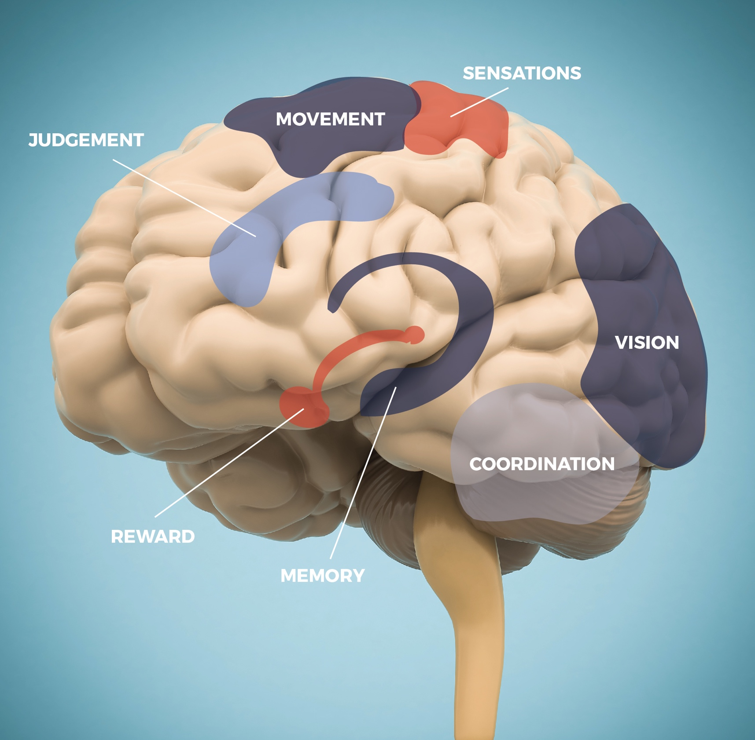
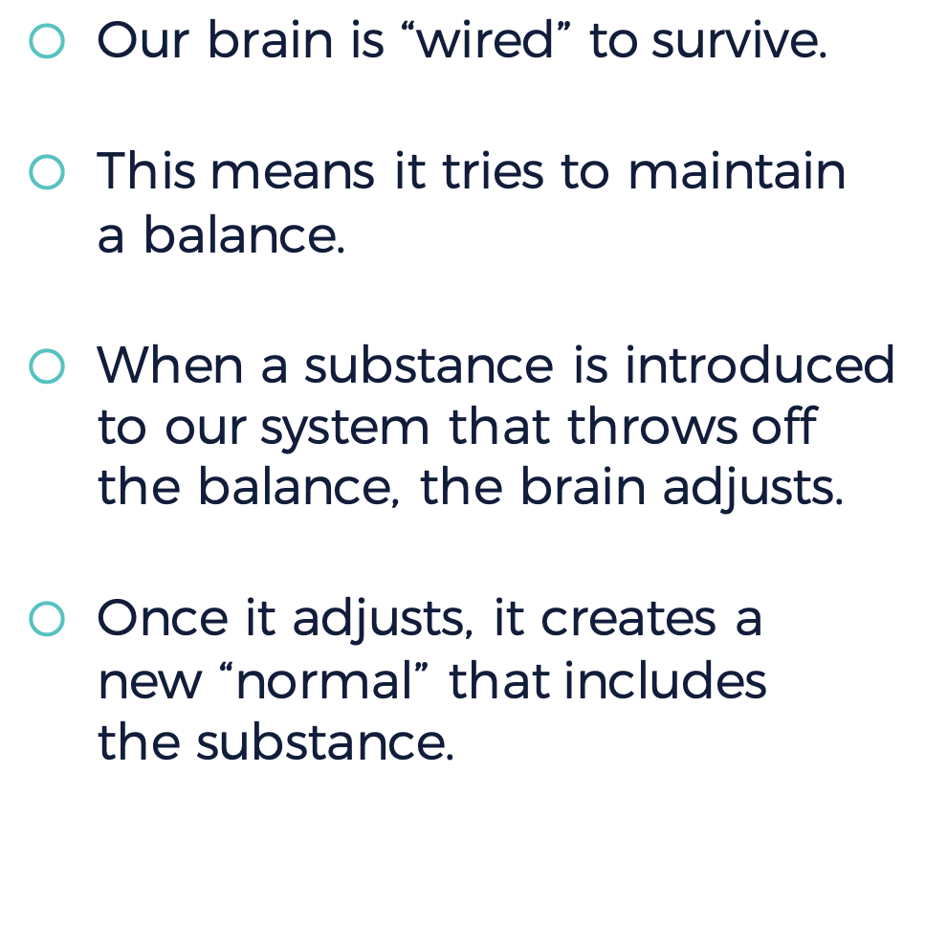

Notes:
Instructor Notes:
Based on the information students learn about the different parts of the brain, ask students to predict factors that make the still-developing adolescent brain vulnerable to taking risks through impulsive actions. For example, in the highlighted parts, 'judgment' is controlled by the frontal lobe, and 'sensations' are controlled by the parietal lobe.

Slide 23




THE
ADOLESCENT
BRAIN
STUDENT
RESPONSES
Notes:
Instructor Notes:
After reviewing the slide, divide the class into pairs or small groups and ask them to come up with a list of factors that might influence risk based on adolescent brain development. Combine these lists into a full class list, and then together, rank them from “most influential” to “least influential.” Be sure that students explain their rankings.

Slide 24



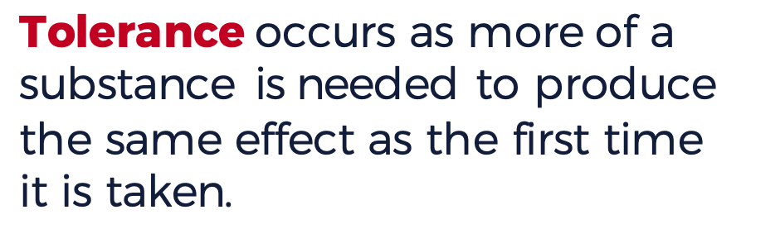
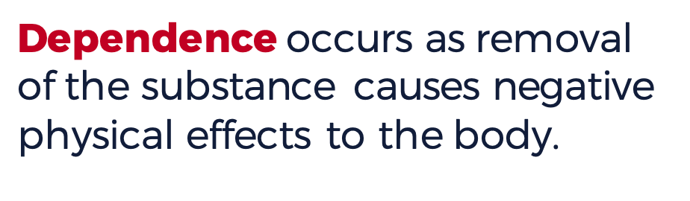
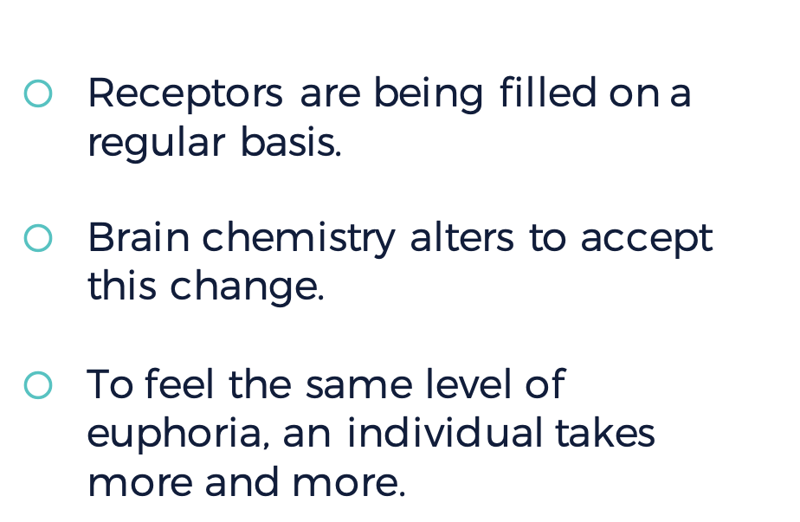
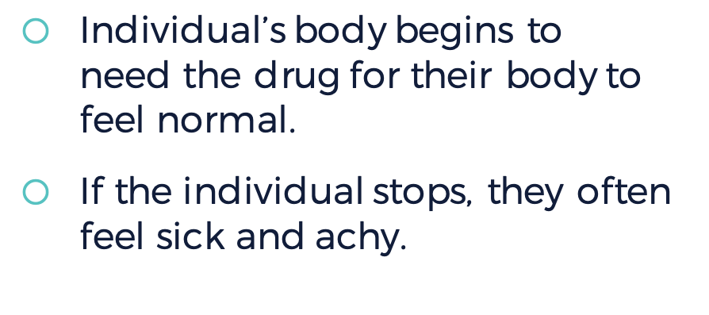


Slide 25
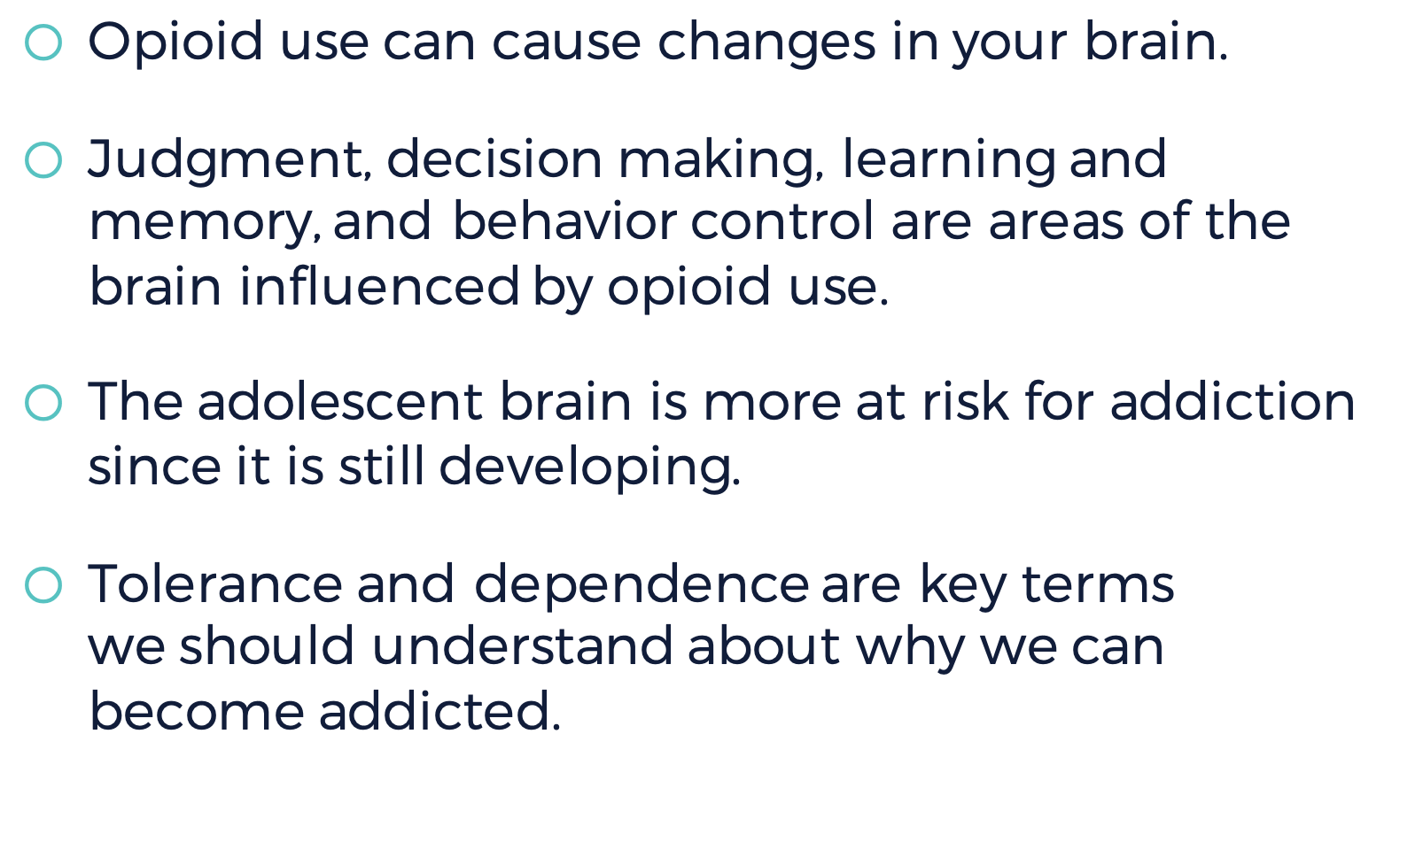


Slide 26





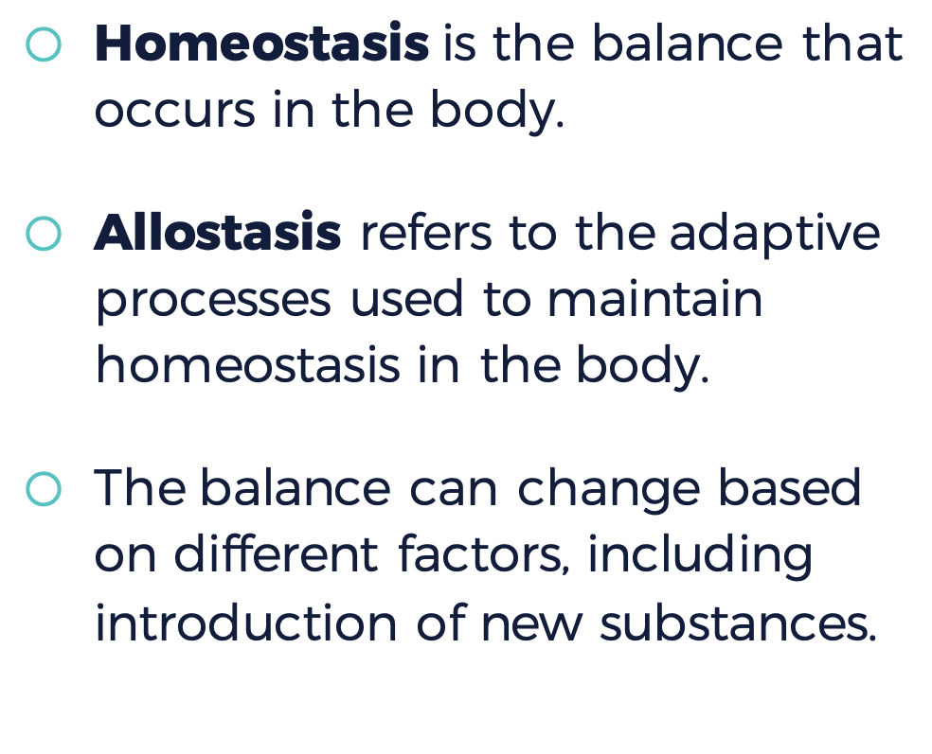

Notes:
Instructor Notes:
Using this slide, students should be able to define the terms homeostasis and allostasis. They should also be explain to explain how stress to the physiological system leads to adaptation. Create one set of six notecards for each pair of students. On each notecard, there should be one step in the process. Students should work together with a partner to be the notecards in the correct order. See Educator Guide for the steps and correct order.

Slide 27

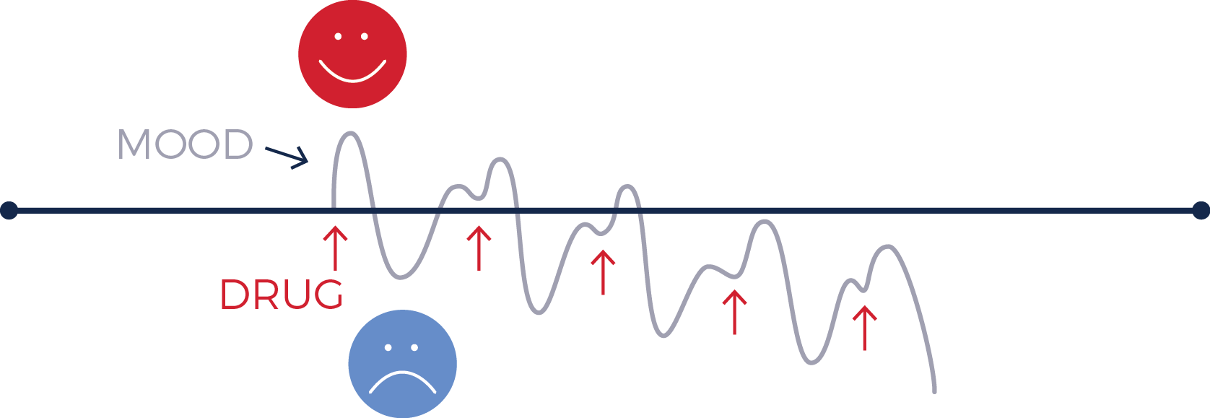

Notes:
Instructor Notes:
Students should work together with their same partner/group as the previous slide to create six new cards describing how heroin affects the allostasis and homeostasis processes. By the end of this activity, students should understand how adaptation leads to heroin addiction as the body seeks to create a “new normal,” or a homeostatic system.

Slide 28
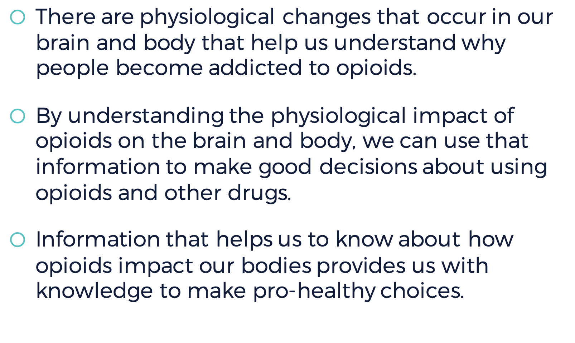


Slide 29



Look back at the chart you created at the
beginning of the lesson.
Is there anything you would now add or remove?

Slide 30




