Slide 1







Slide 2

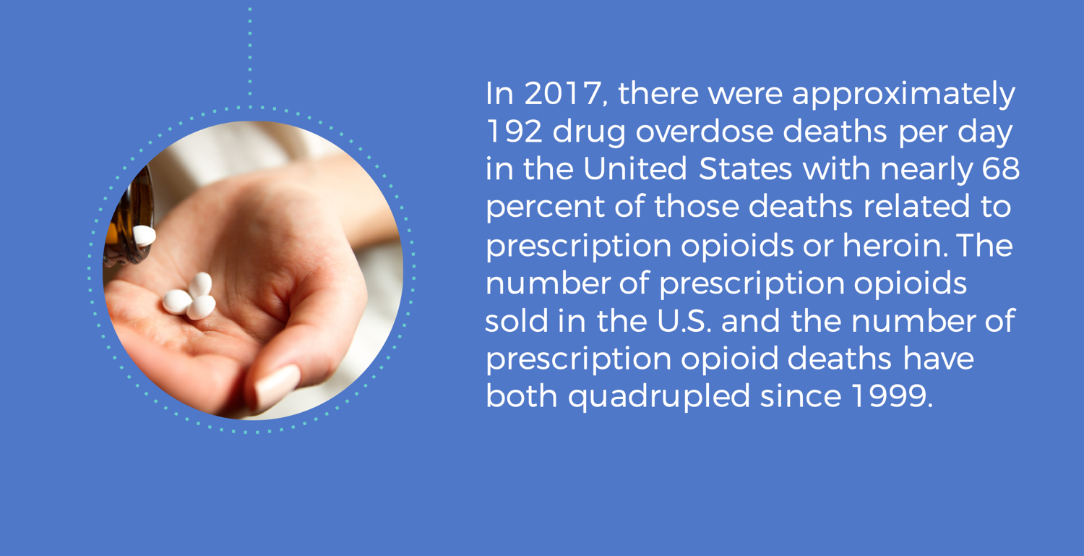
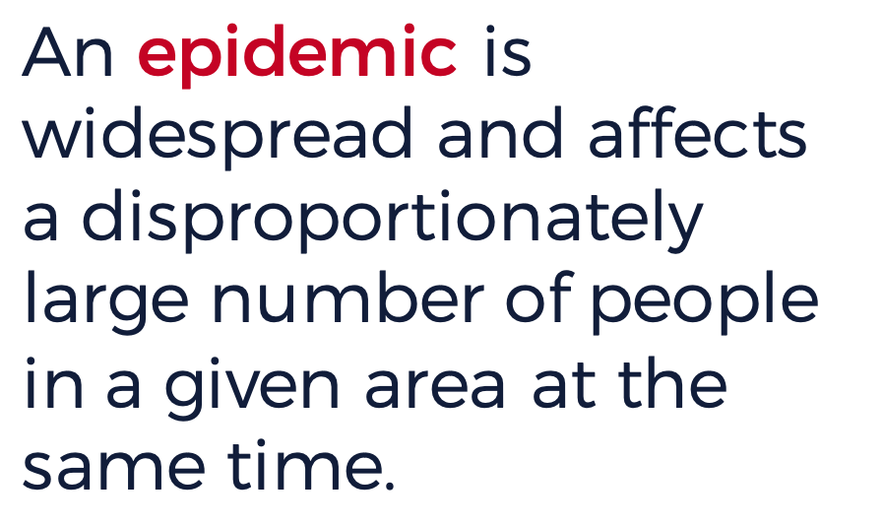




In 2017, there were approximately 192 drug overdose deaths per day in the United States with nearly 68 percent of those deaths related to prescription opioids or heroin. The number of prescription opioids sold in the U.S. and the number of prescription opioid deaths have both quadrupled since 1999.
Ebola
SARS
Opioids
Obesity
HIV/AIDS
HINI Flu Virus
Cholera
Ebola
SARS
Opioids
Obesity
Notes:
Instructors Notes:
Display the definitions of a pandemic and epidemic. An epidemic is widespread and affects a disproportionately large number of people in a given area at the same time. A pandemic is a disease that spreads throughout the world.
Click the slide to display the following examples from the past and present:
Ebola
SARS
Prescription Opioids
Obesity
HIV/AIDS
H1N1 Flu Virus
Cholera
Invite students to sort the list into the correct category of either an epidemic or pandemic. Click the slide to reveal which of the listed pandemics are epidemics. Ask students to share out if any of the answers surprised them. Clarify that an epidemic disease is not required to be contagious, the term has been applied to both the obesity and opioid epidemics.
Click to display the information (design note: this text box will need to float in on click)
In 2017, there were approximately 192 drug overdose deaths per day in the United States with nearly 68 percent of those deaths related to prescription opioids or heroin. The number of prescription opioids sold in the U.S. and the number of prescription opioid deaths have both quadrupled since 1999.
Ask students, How does this information support opioids being classified as an epidemic?

Slide 3


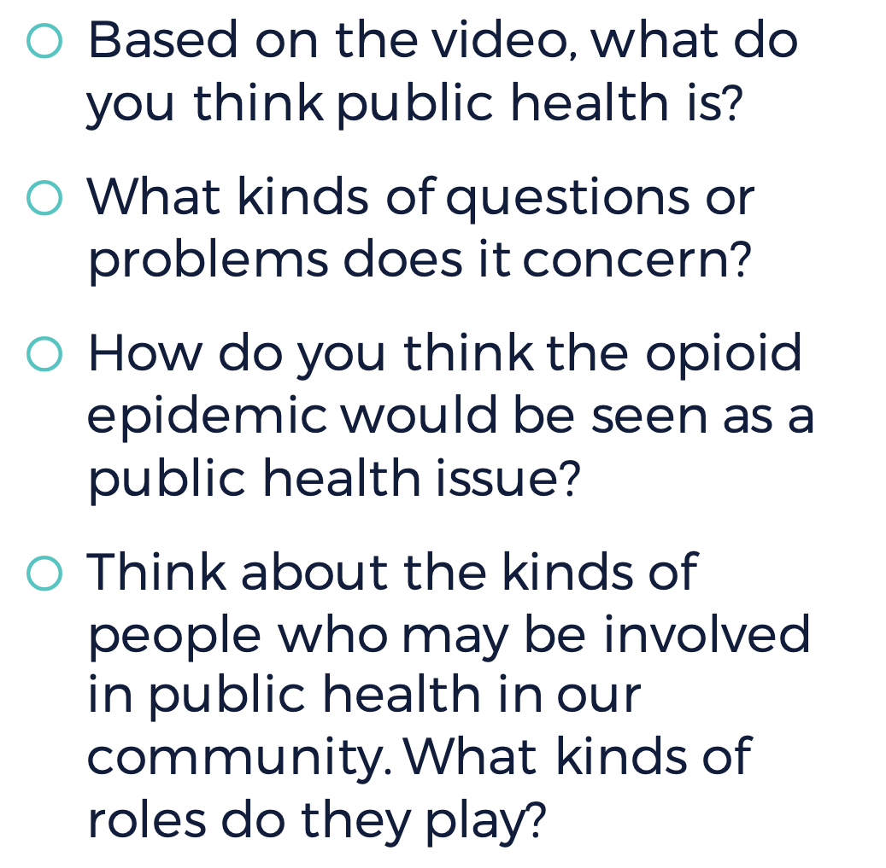
Notes:
Instructor Notes:
Guide students to brainstorm recent health crises in the news and share out examples.
Examples might include: the water crises in Flint Michigan, cigarette addiction or alcohol abuse, HIV/AIDS, the Zika virus, seasonal flu epidemics, etc.
Invite students to consider the question: What is public health and why does it matter?
Show the video, What is Public Health? http://ph.ucla.edu/news/multimedia/video/what-health-public-health-treatment-vs-prevention (2:05)
Start a conversation by asking these questions:
Based on the video, what do you think public health is?
What kinds of questions or problems does it concern?
How do you think the opioid epidemic would be seen as a public health issue?
Think about the kinds of people who may be involved in public health in our community. What kinds of roles do they play?

Slide 4

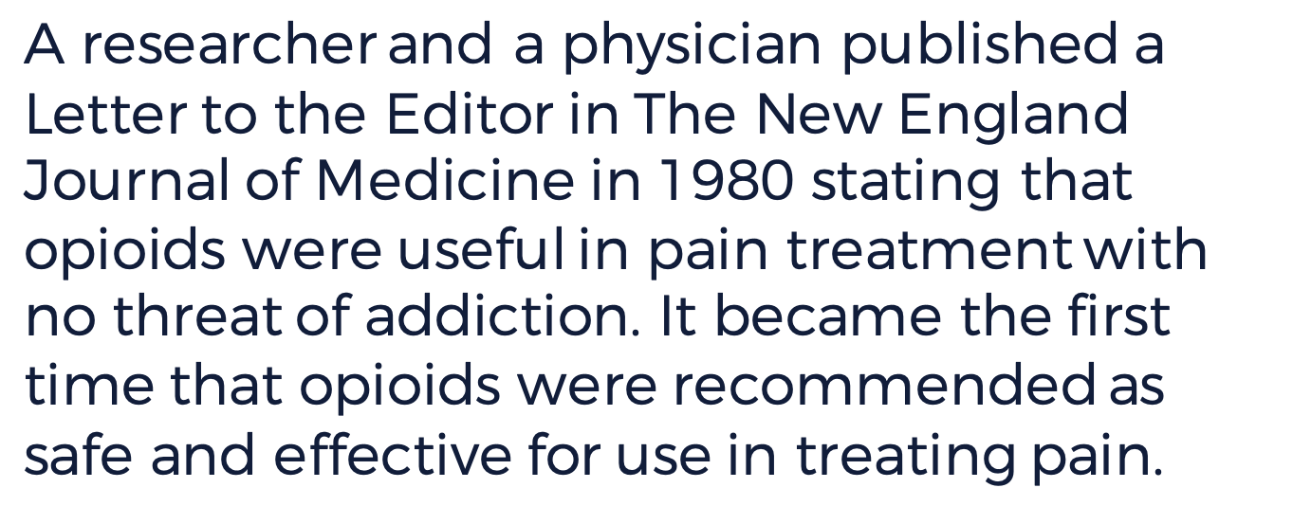


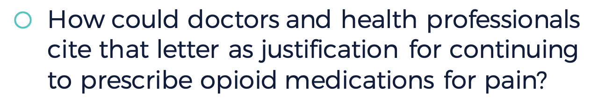
Why would the fact that a medical journal originally published this letter be so influential?
How could doctors and health professionals cite that letter as justification for continuing to prescribe opioid medications for pain?
Notes:
Instructors Notes:
Invite students to explore how opioid prescriptions evolved into a health crisis and is currently an epidemic.
Display the passage on the slide: A researcher and a physician published a Letter to the Editor in The New England Journal of Medicine in 1980 stating that opioids were useful in pain treatment with no threat of addiction. It became the first time that opioids were recommended as safe and effective for use in treating pain.
Ask students:
Why would the fact that a medical journal originally published this letter be so influential?
How could doctors and health professionals cite that letter as justification for continuing to prescribe opioid medications for pain?
Clarify that prescribing opioids in hospitals or medical clinics was well known to help moderate pain, as was the effect of the drugs on the brain and body. But before 1980, there was no scientific research establishing whether or not these drugs were addictive to patients. One letter to a medical journal changed all that and triggered what has, since, spread this epidemic to every state, and every demographic—old and young, poor and wealthy, and every race, color or ethnicity.

Slide 5

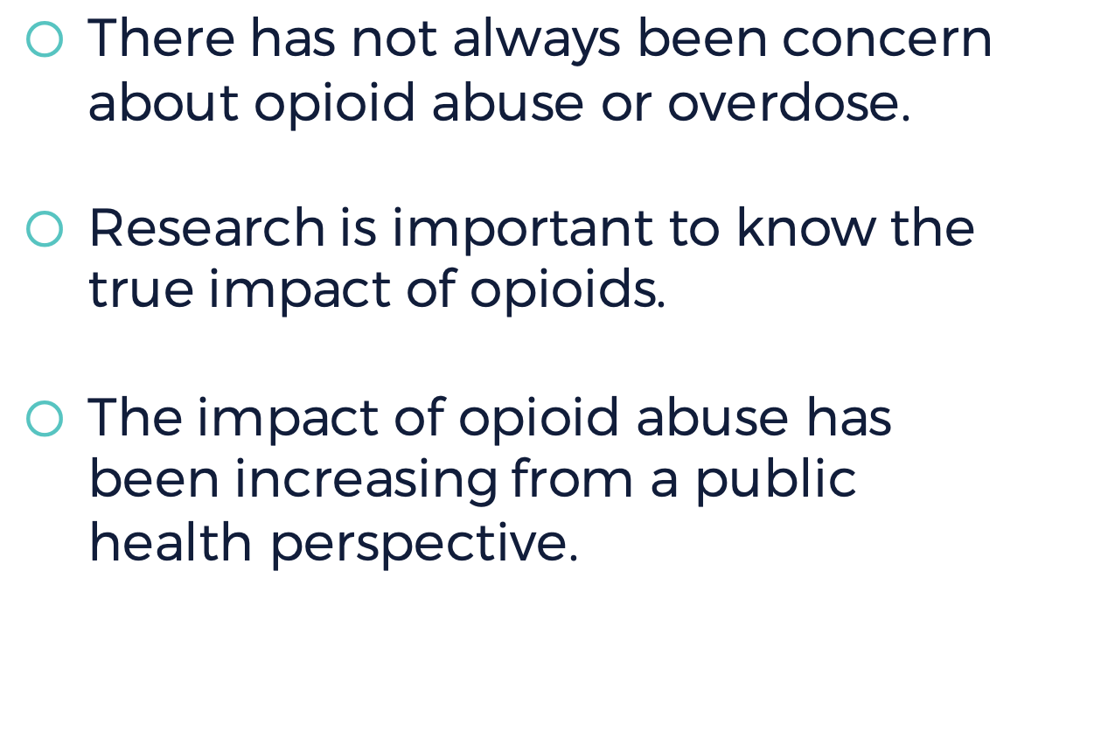

Slide 6


Notes:
Instructors Notes:
Ask students to break into groups of four or five, seated in a circle. Instruct them to start the game of telephone. Ask for a volunteer in each group to discuss the plans for a get-together over the weekend. They may want to covertly write down the message for accuracy, and hide it so no one else sees it. Make sure the leader includes at least one phone number or address, a date and time, and details about what to wear and food to bring.
Then start the game of telephone by whispering the details to the player to their left, and onward until it comes to the last person, who then reports aloud what s/he heard.
How close was the last person’s report to the original message?
Can they track each time the message became distorted?
What do you think might happen if every person in your group passed the message they heard to a friend outside of your class—and that person, in turn, passed it on again?
Summarize with students how reporting, even in a prestigious medical journal, can be taken out of context to become distorted over time, and the impact this distortion has had on turning a narrowly defined use of pain medications for hospitalized patients into a crisis of epidemic proportions.

Slide 7

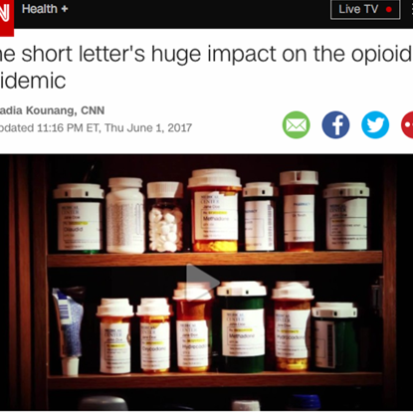

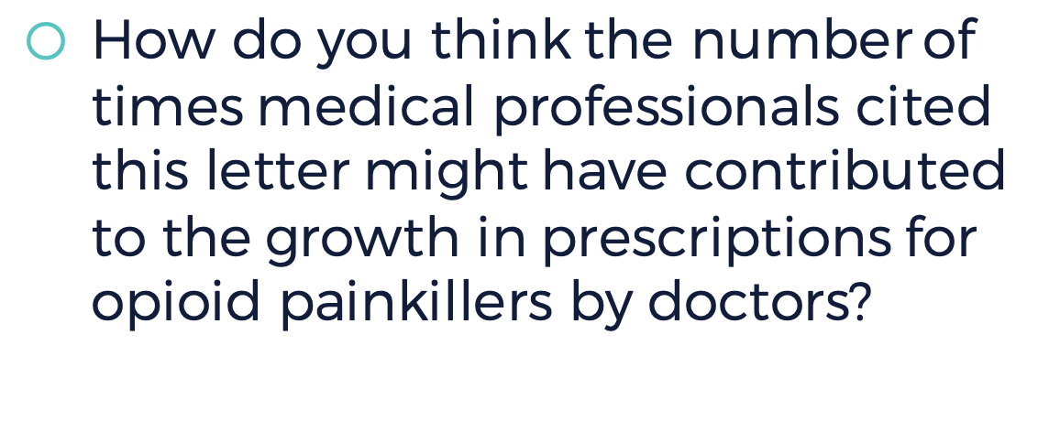
  What trends do you observe from year-to-year about citations for this letter, from 1991 to 2017?
  How do you think the number of times medical professionals cited this letter might have contributed to the growth in prescriptions for opioid painkillers by doctors?
Notes:
Instructor Notes:
Invite student groups to read this CNN article, “One short letter’s huge impact on the opioid epidemic.” Article is also available as a handout.
http://www.cnn.com/2017/06/01/health/opioid-epidemic-1980-letter-origins-study/index.html
Instruct students to take down key facts from the story on paper, on a blackboard, or on a tablet.
As students study the bar graph in the article showing the number and types of citations for the 1980 letter, what trends do they observe from year-to-year about citations for this letter, from 1991 to 2017?
Ask students to think about how the number of times medical professionals cite this letter might contribute to the growth in the prescription of opioid painkillers by doctors?

Slide 8



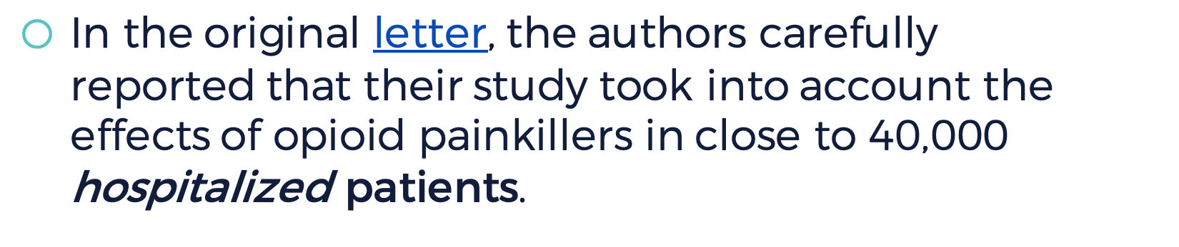
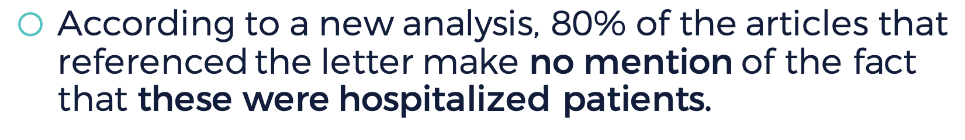
One of the original authors has since claimed that his letter has been misrepresented.
Dr. Jick told CNN in 2016 that it was never meant to apply to the general population.
In the original letter, the authors carefully
reported that their study took into account the effects of opioid painkillers in close to 40,000 hospitalized patients.
According to a new analysis, 80% of the articles that referenced the letter make no mention of the fact that these were hospitalized patients.
Notes:
Instructors Notes:
Guide students to think critically about the article. Clarify that one of the original authors has subsequently claimed that his letter has been misrepresented in later references and citations. Dr. Jick told CNN in 2016 that it was never meant to apply to the general population. In the original letter, the authors carefully reported that their study took into account the effects of opioid painkillers in close to 40,000 hospitalized patients. Yet, according to a new analysis, 80% of the articles that referenced the letter make no mention of the fact that these were hospitalized patients.
What is the context for the original authors’ opinion, and why is it important?
What are the consequences for omitting relevant information about hospitalization (in other words, patients under a doctor’s supervision and, presumably, for the time the patient is in the hospital) if that is omitted in subsequent references of the study?
How do you think that may have skewed treatment recommendations?
How did the Ohio Attorney General allege that these pharmaceutical companies misled medical professionals?
In what ways do you think the misleading information may have contributed to overprescribing opioids?
Link to letter: https://www.nejm.org/doi/10.1056/NEJM198001103020221

Slide 9
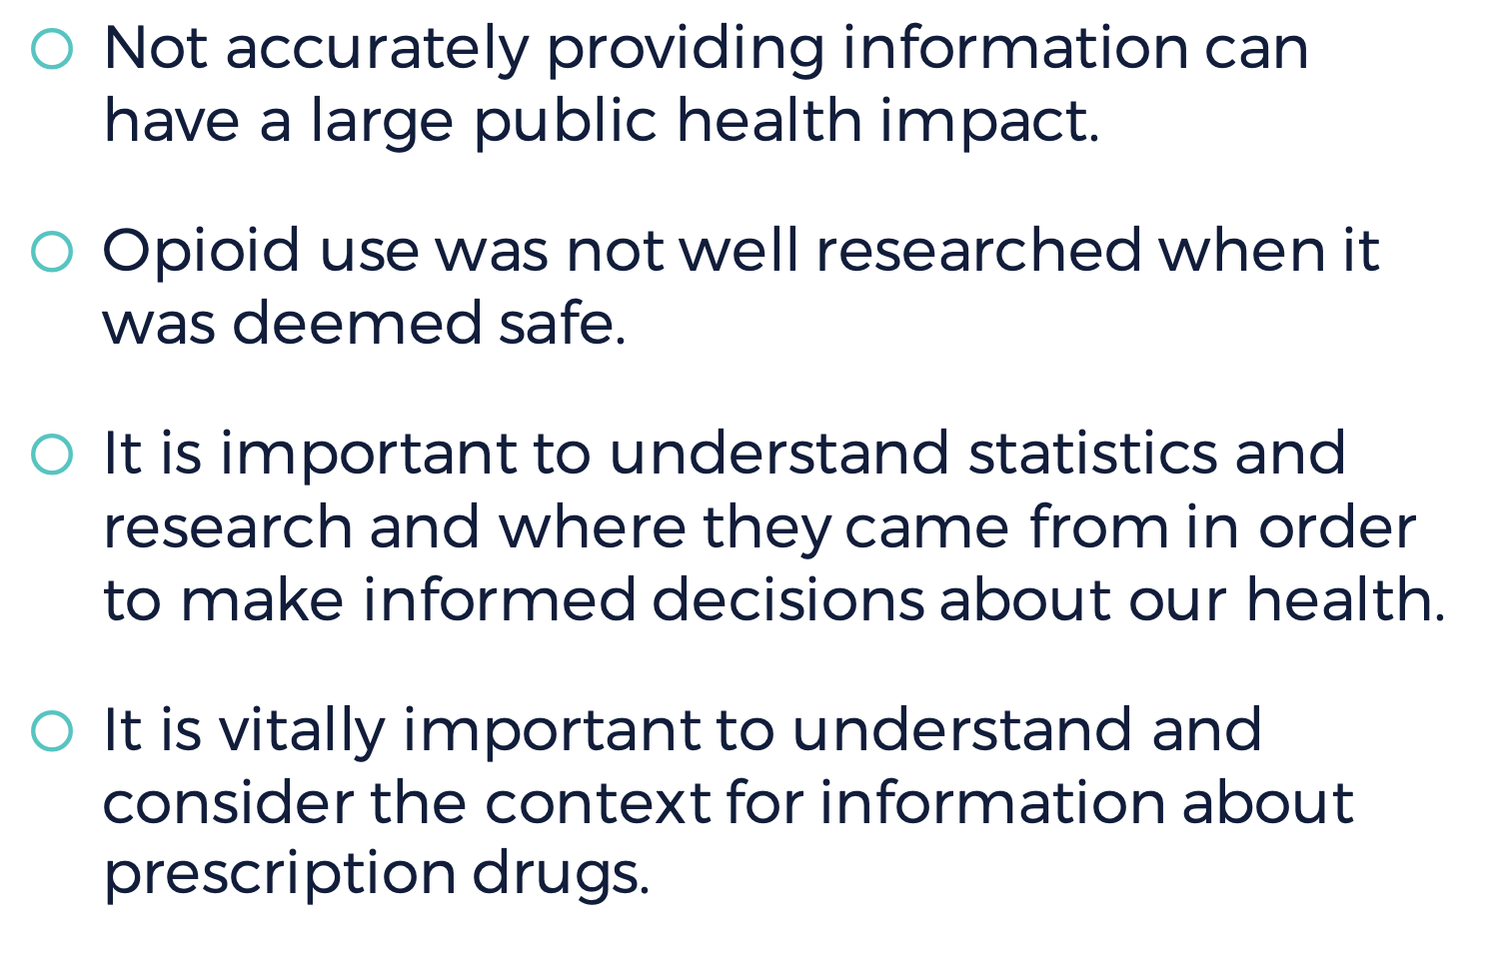

Slide 10


Notes:
Instructors Notes:
Ask students:
Do you think our community is impacted by the opioid epidemic? What evidence supports your response? It is anticipated students will share they have seen news reports, discussed the topic in other classes, heard information on the radio, or noticed reports on social media. Students may say their community is not impacted because they have not noticed any reports.
How can exploring an issue through multiple perspectives construct a more accurate interpretation of an issue or event? It is anticipated that students will recognize that one viewpoint will be partial, limited, or even distorted. Analyzing and considering different viewpoints adds multiple layers of meaning and can help generate more solutions and better overall understanding.
Guide students to brainstorm five resources that could help them find out.
Anticipated responses include news articles, infographics, interviews, outreach and awareness flyers, news videos, and guest speakers.

Slide 11







Notes:
Instructors Notes:
Divide students into reporting teams to begin defining the scope of the problem. Each team will investigate the problem through a different public health lens. Assign a different community role to each group.
Law enforcement (police, sheriff, courts, fire department, etc.)
Health and medical community (hospitals, clinics, mobile health units, emergency medical technicians, local morgue, social workers and counselors)
Corrections (jails and prisons)
Public health institutions (local health department, coroner’s office, researchers, epidemiologists, community health workers)
Mayor, town council members, or another elected official(s)
Education (counselors, school nurse)

Slide 12

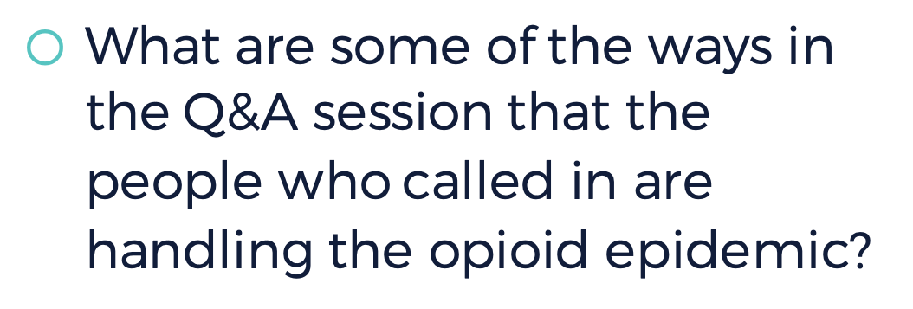

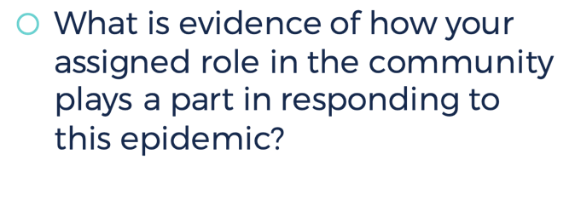
What are some of the ways in the Q&A session that the people who called in are handling the opioid epidemic?
What is evidence of how your assigned role in the community plays a part in responding to this epidemic?
Notes:
Instructors Notes:
Explain to students that they will use a podcast as a resource to help them kick-start their research with some background information. Students should listen for evidence of how their role in the community plays a part in responding to this epidemic.
Listen with the class to the NPR News interview program, “The Call-In,” in an interview with Acting DEA Administrator Chuck Rosenberg, about how a public health epidemic impacts the community, and the public health response http://www.npr.org/2017/02/26/517305305/the-call-in-the-opioid-epidemic-and-how-opioids-have-affected-your-lives (8 min. 51 secs).
Key takeaways:
Interviewing experts to understand how they approach the public health problem of opioid abuse is an effective way to gain an overview of the problem at the local level. By talking to the experts, students will learn the techniques of interviewing, how to find facts to support the evidence, and putting those facts into a format that is easy to comprehend, either visually (graphics, infographics), in an article or report, or in digital formats like video or podcasts.
Key points for the discussion:
What are some of the ways in the Q&A session that the people who called in are grappling with this crisis?
Public health questions are addressed by different, often coordinating, agencies and experts, to work on health and safety problems that affect their communities.
Each agency is concerned with a different piece of the puzzle, based on their training, experience and expertise. For example, the law enforcement community is trained to follow the law and protect citizens from drug trafficking and violence; social workers may help people who have been victims of a crime to address mental health concerns; ER doctors and nurses are trained to save people who may have overdosed, as are EMTs.
Each agency or organization would keep statistics and capture trends for different purposes. These might be collected from each agency by the local health department to better understand the problem and look for solutions.

Slide 13



Notes:
Image: Community Roles and Perspectives Student Handout
Instructors Notes:
Guide students to take a coordinated public health approach in reporting on the local scope of the problem by examining local news stories, infographics, outreach and awareness flyers, news videos, and interviews through the lens of their assigned community perspective. Provide time for students to conduct their research and record their findings using the Community Roles and Perspectives Student Handout.

Slide 14

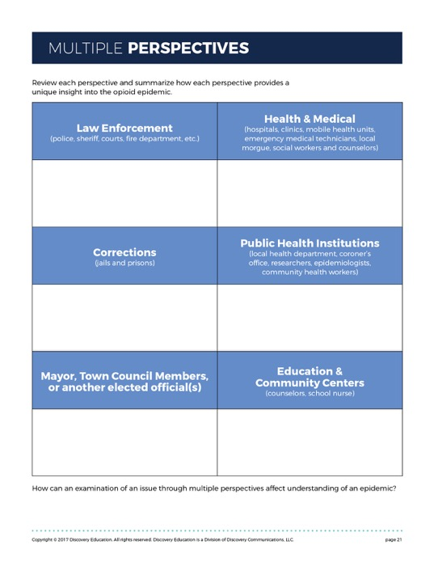

Notes:
Image of Multiple Perspectives Student Handout
Instructors Notes:
Distribute the Multiple Perspectives Student Handout. Ask each team to share its research, headline and any graphics, maps or photos with the class. As students listen, they should summarize how each perspective provides a unique insight into the opioid epidemic.
Invite students to reflect on the following questions:
What is it about opioids that have led to a public health crisis in the community?
Are there groups of people at particular risk for misusing prescription opioids and using heroin?
What stories did they hear about how the opioid epidemic is impacting their community?
How would they describe the problem in their community to other students and families about this situation?
How can an examination of an issue through multiple perspectives affect the understanding of an epidemic?
Using the class evidence, determine if their community is impacted by the opioid epidemic, or if the opioid epidemic has not impacted their community.
Designate one side of the room as "not affected at all" and the other as "significantly affected." Instruct students to create a human barometer to visualize their conclusion by placing themselves on either side of the room, or somewhere in-between, depending on their evidence based decision.

Slide 15
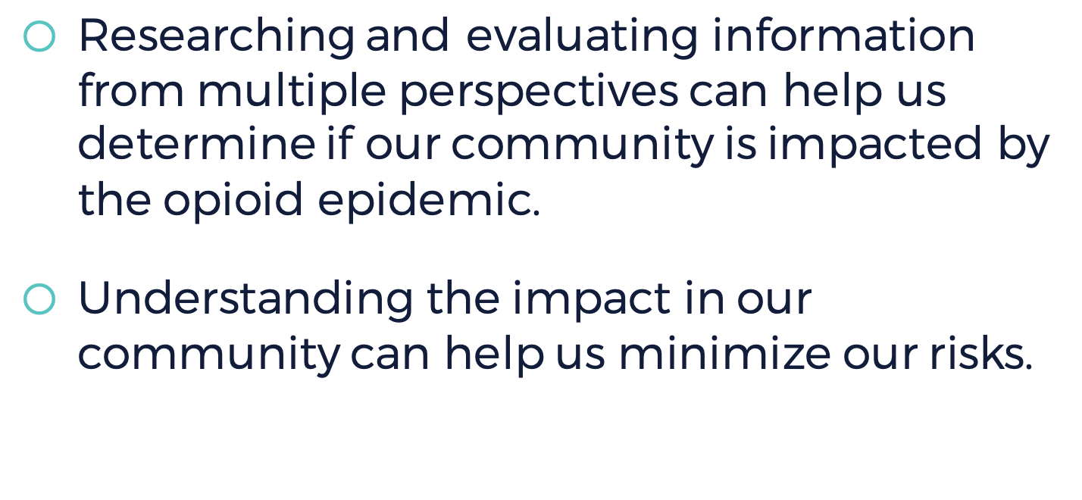

Slide 16



Notes:
Once students have summarized their findings, it’s time to share that with the school community. Students have spent time creating materials outlining the scope of the problem and what they have learned. Guide students to identify one, or two key, overarching messages they would like other students to know about the opioid epidemic.

Slide 17



Who are the student audience(s) you want to reach?
What are the messages students would like for the community to know?
Is word of mouth the best way to engage families and others?
Could students organize a presentation to the PTA? How would they promote it?
Which social media tools will reach outside audiences and how do you build greater awareness?
Notes:
Invite students to think about the audiences they want to reach with their overarching messages, who they are, what they care about, and the best ways to reach them.
o Who are the student audience(s) you want to reach?
o What are the messages students would like for the community to know?
o Is word of mouth the best way to engage families and others?
o Could students organize a presentation to the PTA? How would they promote it?
o Which social media tools will reach outside audiences and how do you build greater awareness?
Students may choose to create a digital campaign, flyers, video PSA, podcast or blog with posts of their research and interviews to share within the school and community, so that other students can benefit from their research.
Optional Extension: Most researchers, health professionals, and other experts on the problem of drug abuse and addiction will agree that prevention is the best treatment. Invite students to brainstorm practices and activities that may contribute to promoting healthy activities that can lead to drug abuse prevention and include this as part of their campaign. As part of this activity, students will want to consider what prevention is, and which prevention programs are most effective.
What activities, experiences and practices contribute to physical and mental health?
List some of the key things they can do to prevent substance abuse. These may include: regular exercise, healthy eating, spending time regularly with friends and family, listening to music, engaging in sports, clubs or other after school activities.
Ask students why they think these activities promote prevention, or help teens develop effective tools to resist peer pressure.
Discuss social and emotional qualities like resilience, focused awareness, mindfulness, creativity, teamwork, gratitude, and taking responsibility for their actions. Invite them to reflect on how these qualities may contribute to growing a strong prevention muscle.
Inventory local prevention options. Suggest students create an inventory to find out what local resources are available. Some examples include: help hotlines, clinics, local colleges and universities, hospitals, law enforcement, and local public health agencies.

Slide 18

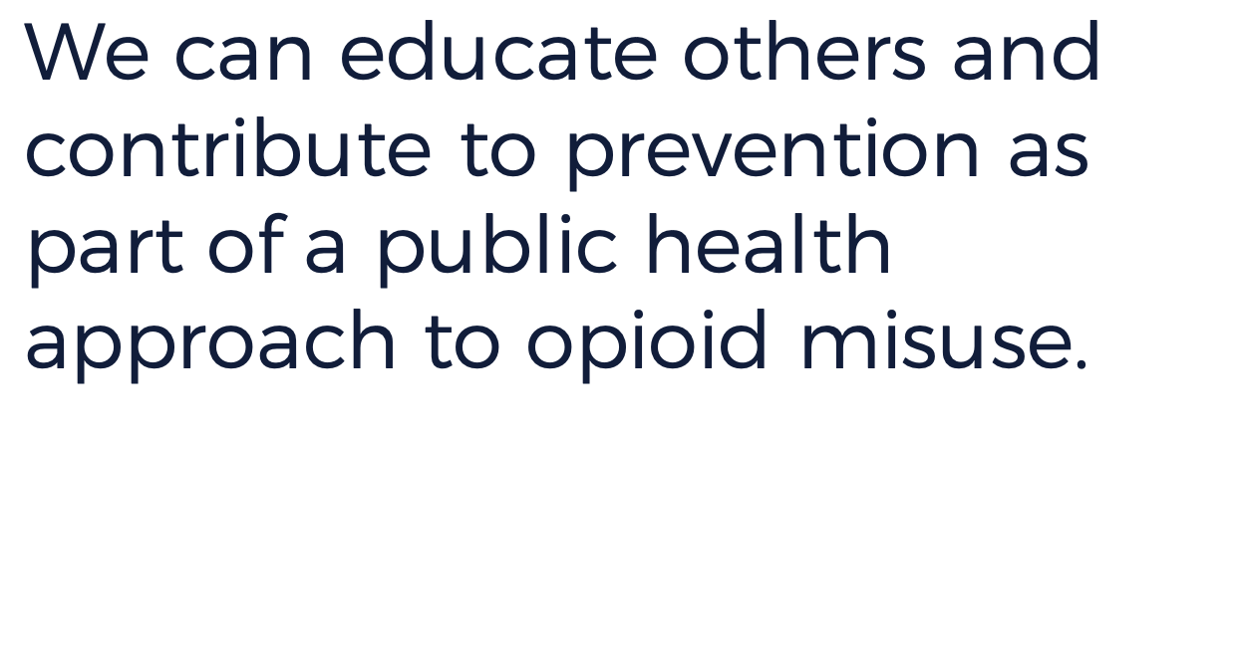

Slide 19




Notes:
Distribute the Levels of Reflection Student Handout for students to summarize and reflect on the impact of the US opioid epidemic. Ask students to select one question from each level to respond to as part of their reflection. The mirror invites students to consider the individual impact of researching the opioid epidemic. The microscope guides students to consider how this research helped students learn more about their community. The binoculars ask students to reflect on larger social issues and their own personal development.

