Slide 1

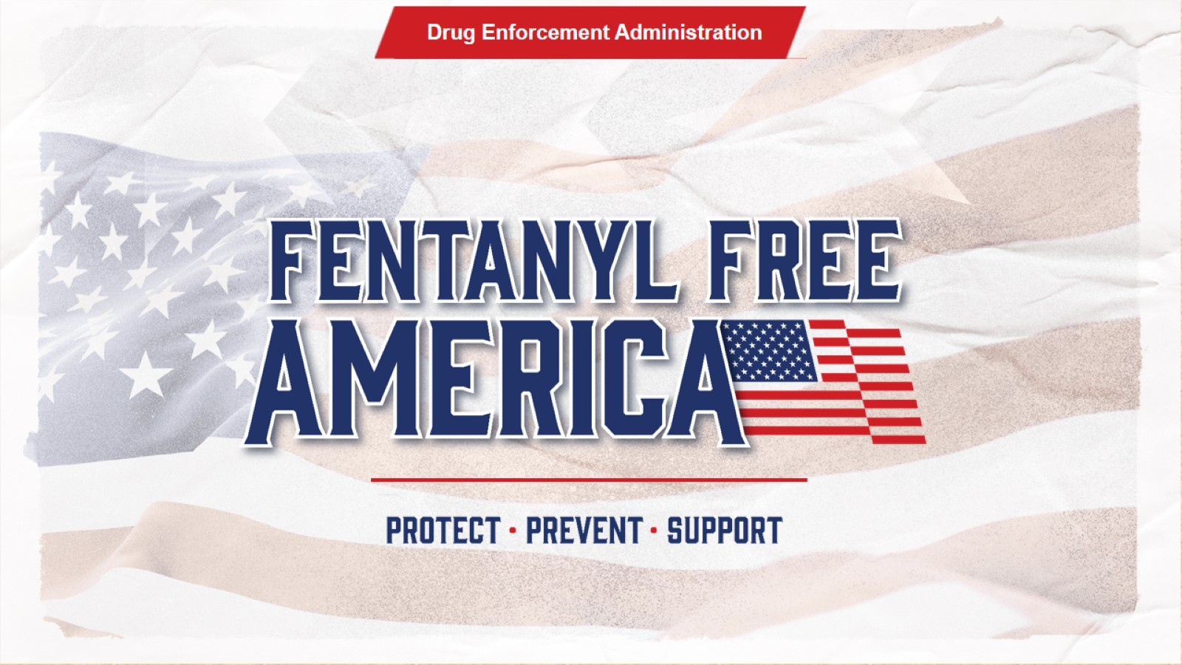


Fentanyl Free America
Drug Enforcement Administration
Speaker Notes:
Thank you for the opportunity to speak with you today about Fentanyl Free America.
Notes:
Thank you for the opportunity to speak with you today about Fentanyl Free America.

Slide 2
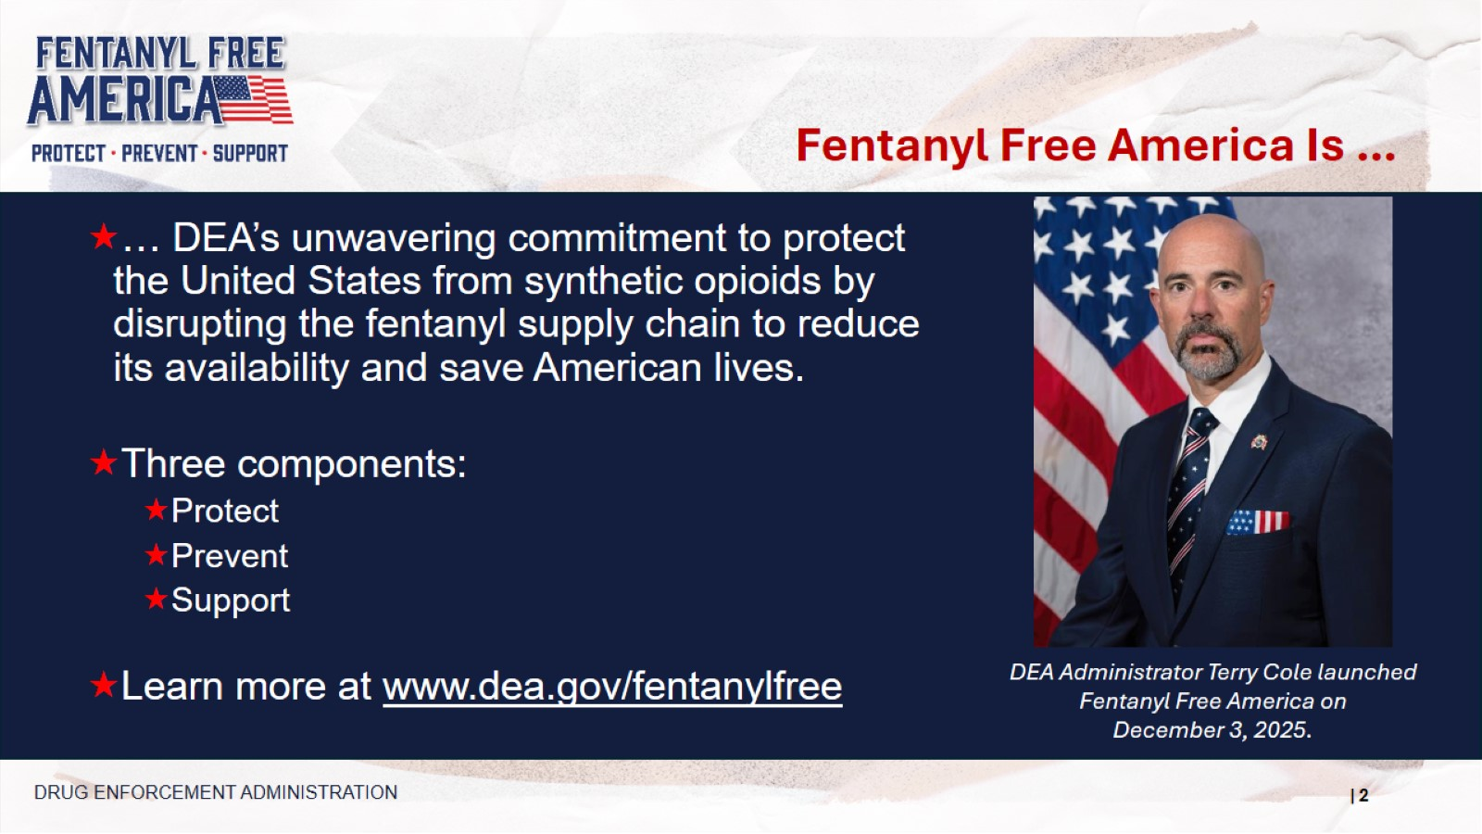
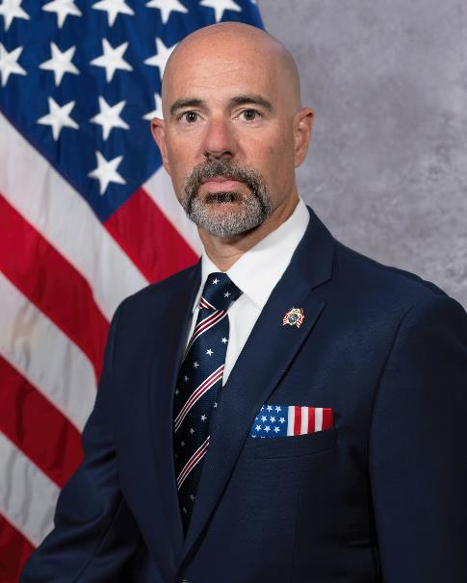
Fentanyl Free America Is …
… DEA’s unwavering commitment to protect the United States from synthetic opioids by disrupting the fentanyl supply chain to reduce its availability and save American lives.
Three components:
Protect
Prevent
Support
Learn more at www.dea.gov/fentanylfree
DEA Administrator Terry Cole launched Fentanyl Free America on
December 3, 2025.
DRUG ENFORCEMENT ADMINISTRATION
Speaker Notes:
On December 3, 2025, DEA Administrator Terry Cole launched Fentanyl Free America, a multi-faceted effort to save American lives from synthetic opioids by disrupting the fentanyl supply chain to reduce its availability.
Fentanyl Free America has three components:
Protect Americans from drug traffickers;
Prevent fentanyl use, especially among young people; and
Support those affected by fentanyl, to include those suffering from addiction and their loved ones.
In today’s presentation we will discuss how DEA and its partners do this work.
However, if there is one thing I would like you to leave here today knowing, it is the Fentanyl Free America web address, dea.gov/fentanylfree, to visit and share with your friends and colleagues.
Notes:
On December 3, 2025, DEA Administrator Terry Cole launched Fentanyl Free America, a multi-faceted effort to save American lives from synthetic opioids by disrupting the fentanyl supply chain to reduce its availability.
Fentanyl Free America has three components:
Protect Americans from drug traffickers;
Prevent fentanyl use, especially among young people; and
Support those affected by fentanyl, to include those suffering from addiction and their loved ones.
In today’s presentation we will discuss how DEA and its partners do this work.
However, if there is one thing I would like you to leave here today knowing, it is the Fentanyl Free America web address, dea.gov/fentanylfree, to visit and share with your friends and colleagues.

Slide 3

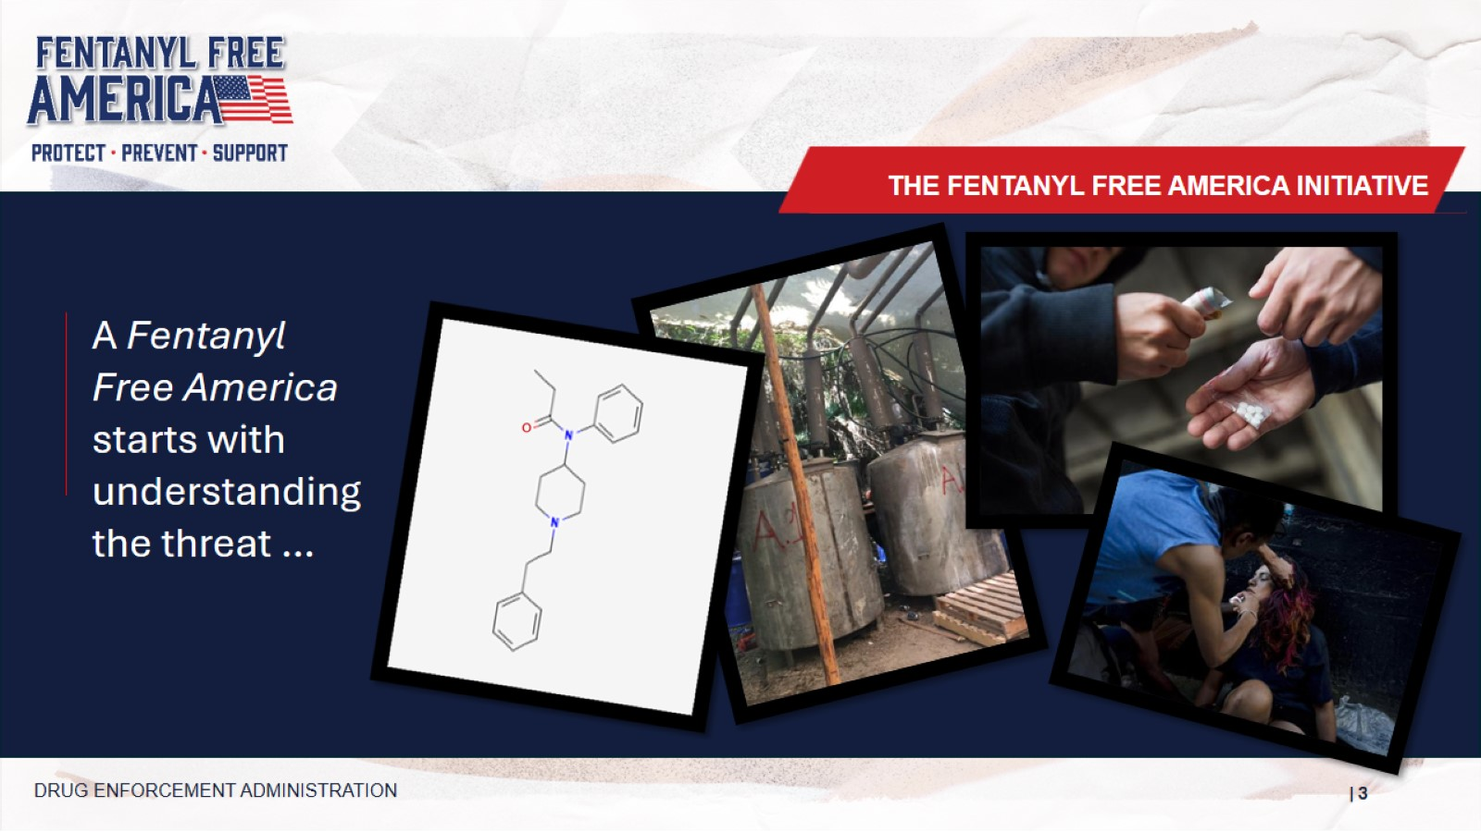

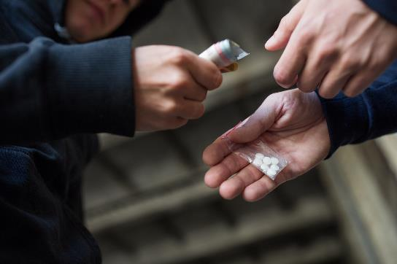
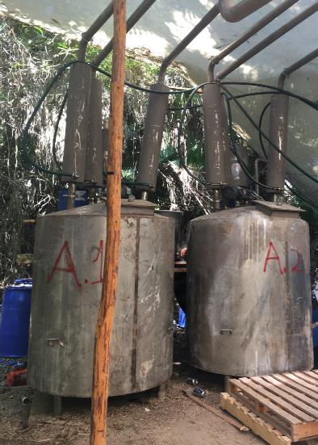
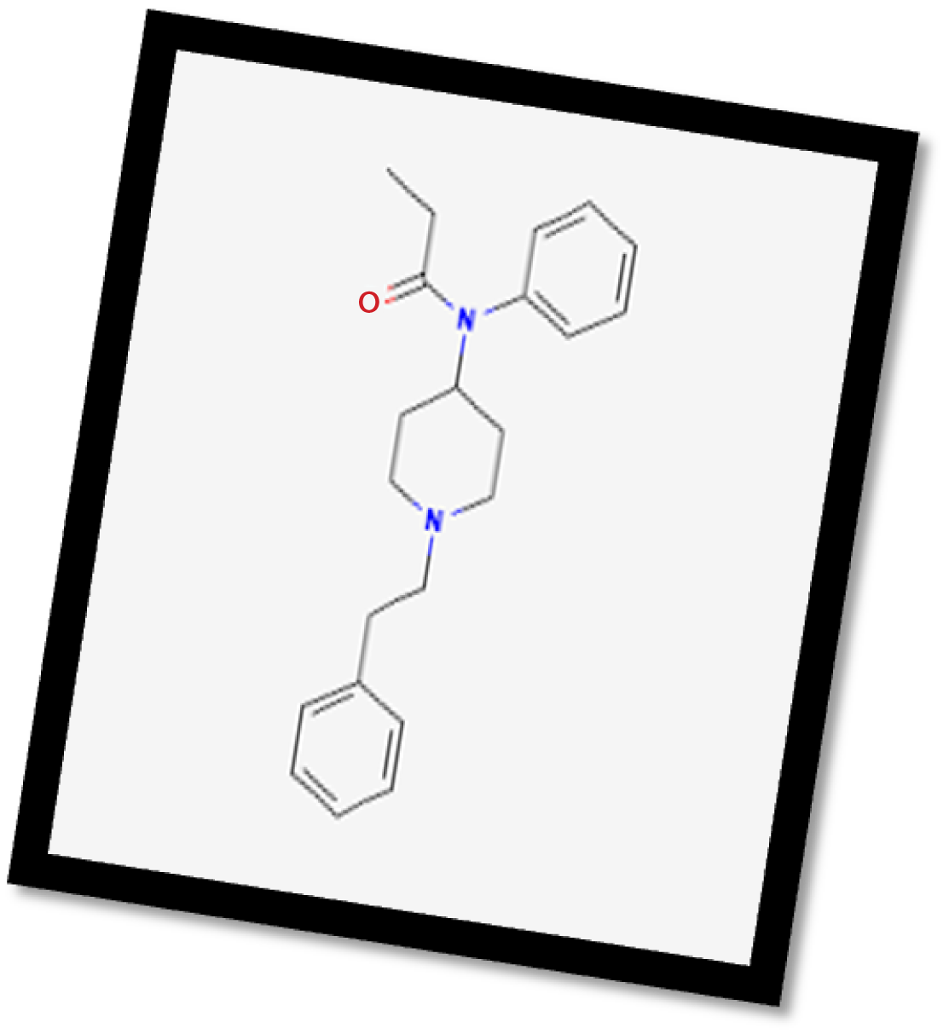
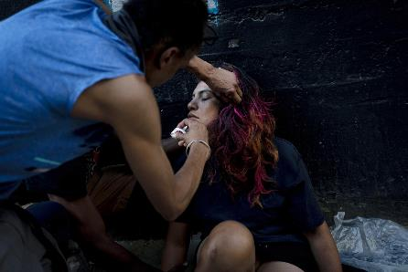
A Fentanyl Free America starts with understanding the threat …
THE FENTANYL FREE AMERICA INITIATIVE
DRUG ENFORCEMENT ADMINISTRATION
Notes:
A Fentanyl Free America starts with understanding the threat …

Slide 4
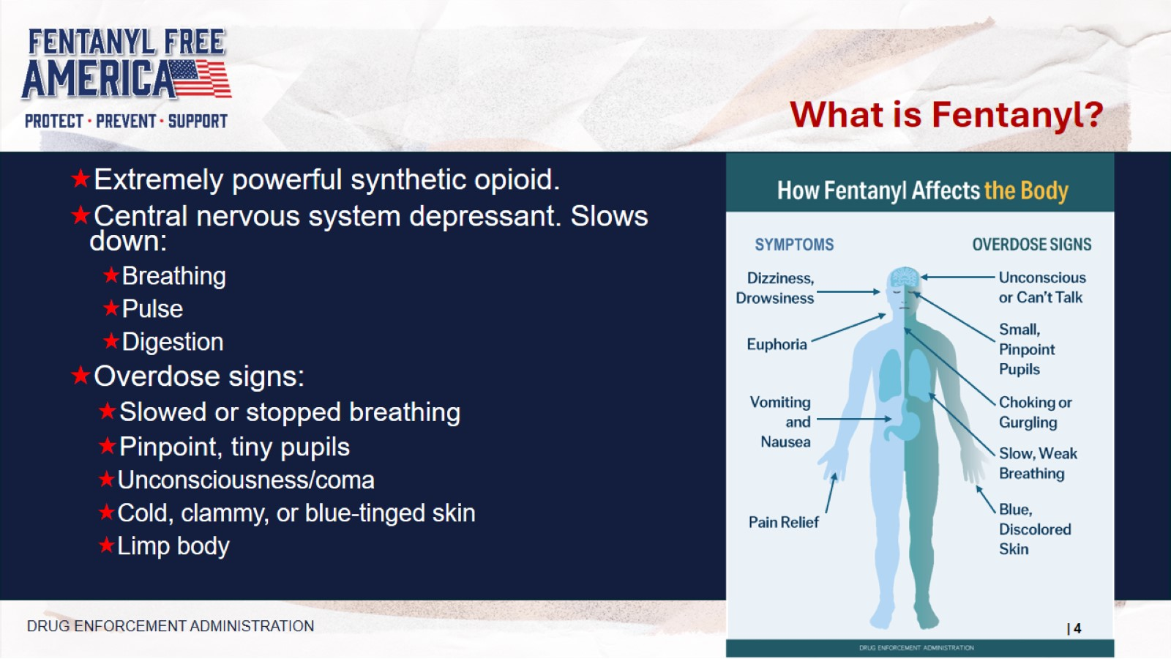
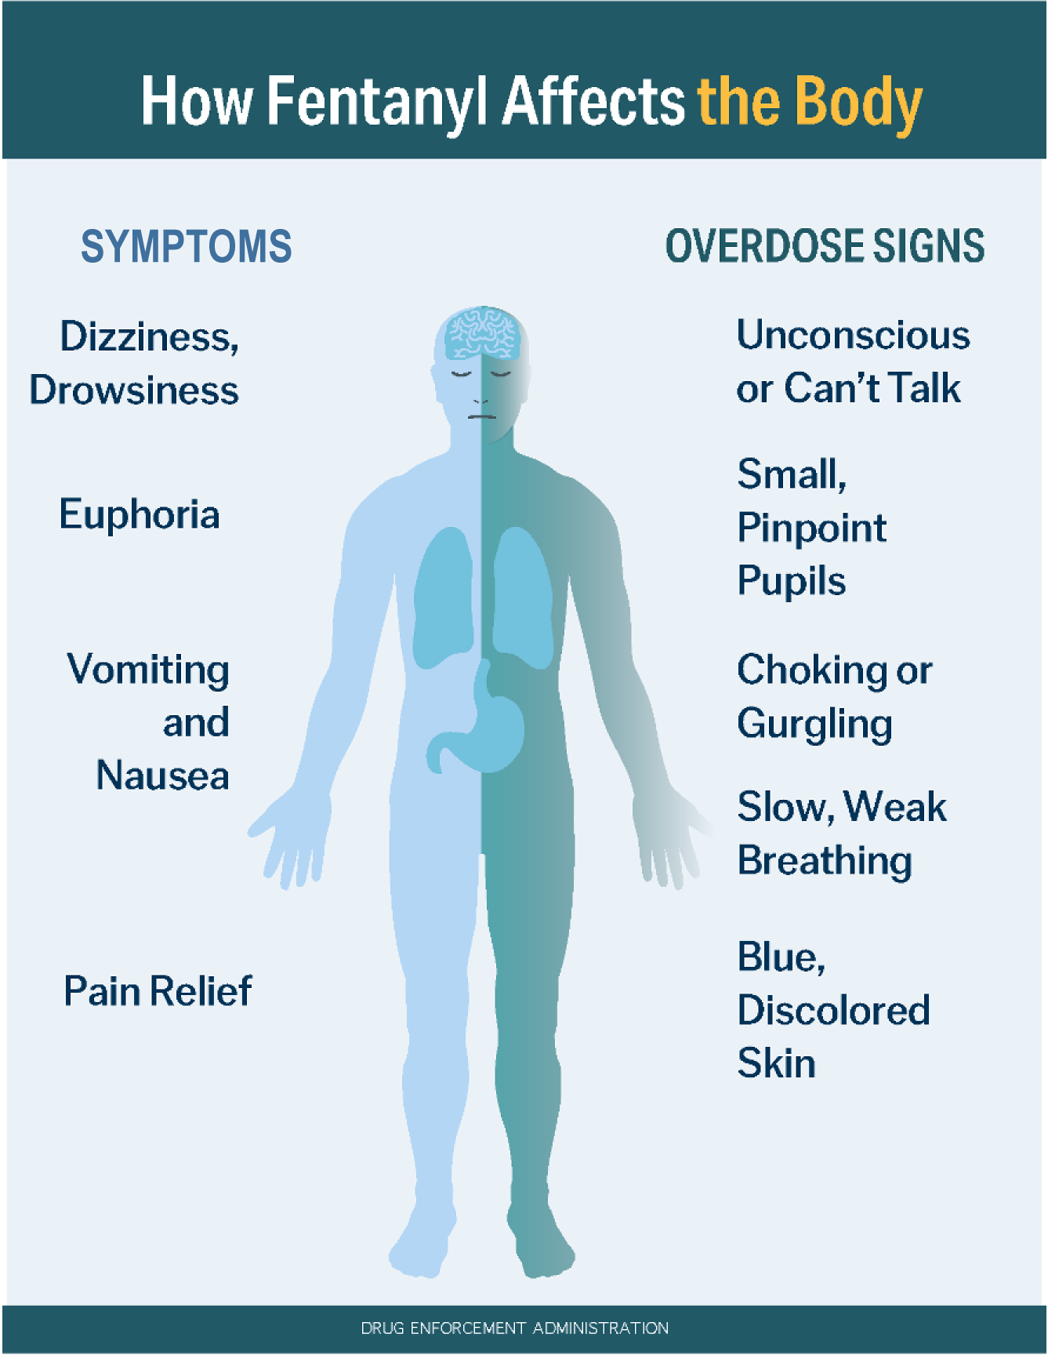
What is Fentanyl?
Speaker Notes:
While we may see fentanyl in the news, it is important to take a moment and understand what it really is.
It is an extremely powerful synthetic opioid. That means that it is man-made, unlike heroin which is made from the poppy plant.
It is a depressant. That means that it slows down everything in your body, including breathing, pulse, and digestion. In short, when the body slows down too much, people die.
Extremely powerful synthetic opioid.
Central nervous system depressant. Slows down:
Breathing
Pulse
Digestion
Overdose signs:
Slowed or stopped breathing
Pinpoint, tiny pupils
Unconsciousness/coma
Cold, clammy, or blue-tinged skin
Limp body
DRUG ENFORCEMENT ADMINISTRATION
Notes:
While we may see fentanyl in the news, it is important to take a moment and understand what it really is.
It is an extremely powerful synthetic opioid. That means that it is man-made, unlike heroin which is made from the poppy plant.
It is a depressant. That means that it slows down everything in your body, including breathing, pulse, and digestion. In short, when the body slows down too much, people die.

Slide 5
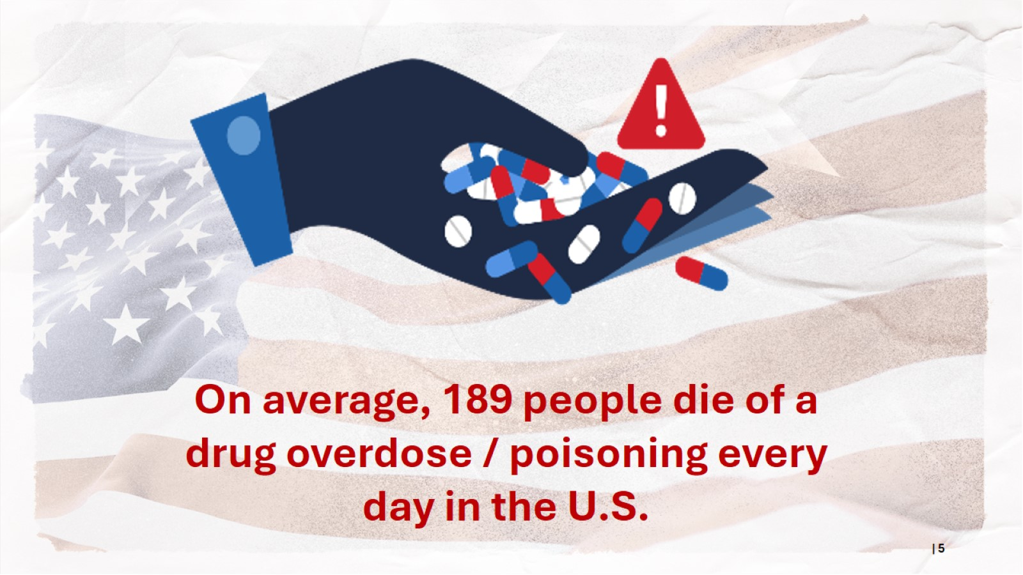

On average, 189 people die of a drug overdose / poisoning every day in the U.S.
Speaker Notes:
This is where we have to start:
On average 189 people die of a drug overdose every day in the United States. There are a lot of ways to look at this number – a plane crash every day; more people than are in a graduating class of high school seniors; or more than eight people during the time I am here with you today.
But when your child, your sibling, your friend, it is one of those 189, it is your world. Every death due to drug overdoses or poisonings is a tragedy.
NOTE: Based on most recent data from CDC (at time of publication), September 2025. Data may be revised upward.
Notes:
This is where we have to start:
On average 189 people die of a drug overdose every day in the United States. There are a lot of ways to look at this number – a plane crash every day; more people than are in a graduating class of high school seniors; or more than eight people during the time I am here with you today.
But when your child, your sibling, your friend, it is one of those 189, it is your world. Every death due to drug overdoses or poisonings is a tragedy.
NOTE: Based on most recent data from CDC (at time of publication), September 2025. Data may be revised upward.

Slide 6
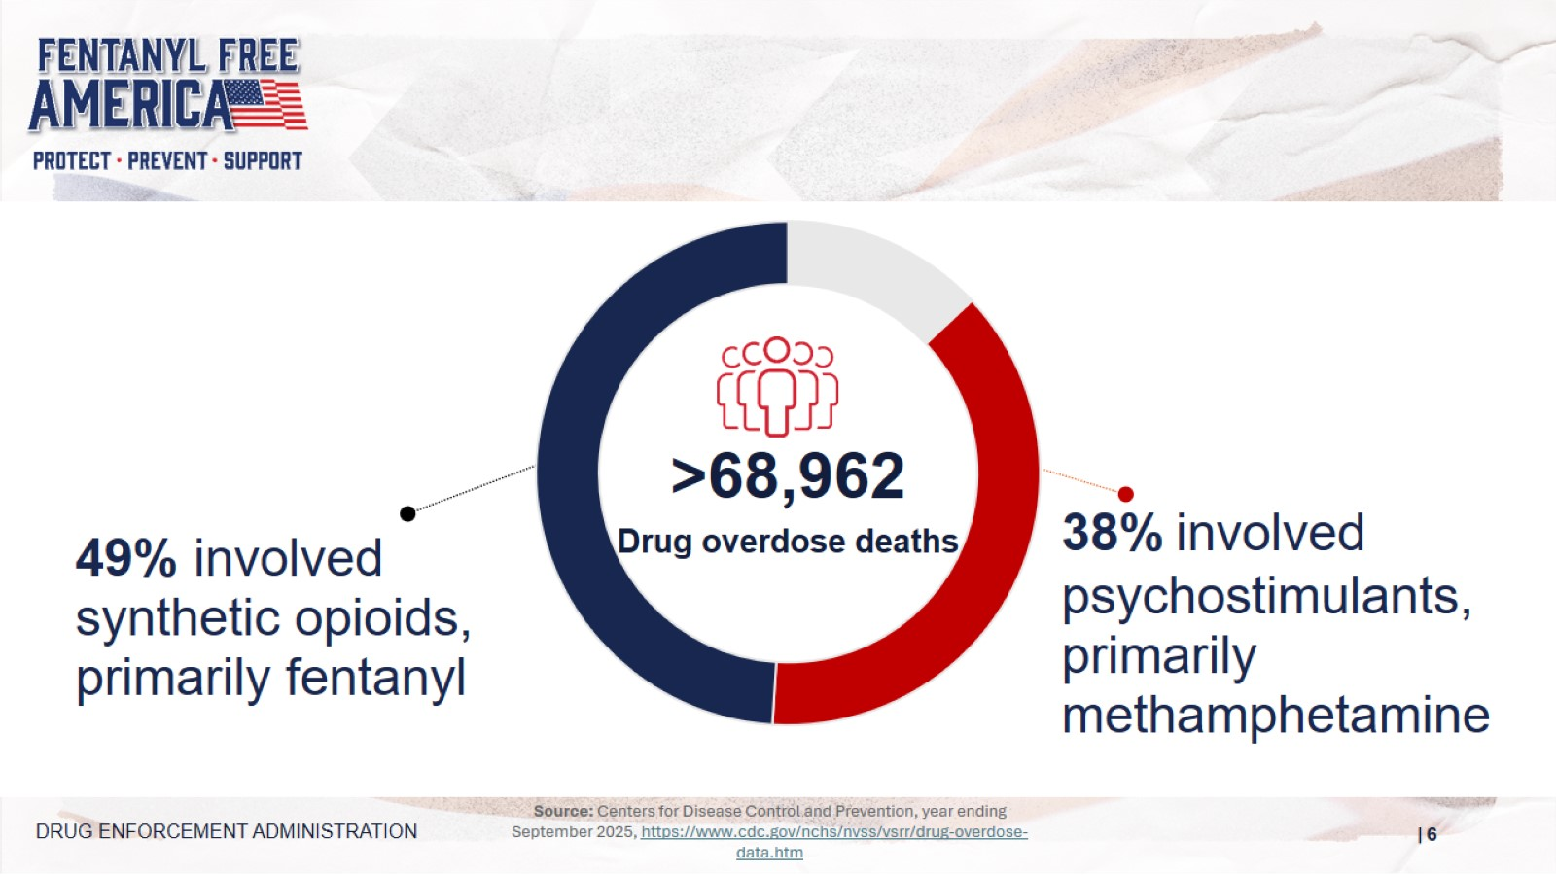

Overdose Deaths
Source: Centers for Disease Control and Prevention, year ending September 2025, https://www.cdc.gov/nchs/nvss/vsrr/drug-overdose-data.htm
Speaker Notes:
Overdose deaths.
Majority of overdose deaths are from opioids.
The majority of opioid deaths are from synthetic opioids, like fentanyl.
DRUG ENFORCEMENT ADMINISTRATION
Notes:
Overdose deaths
Majority of overdose deaths are from opioids
The majority of opioid deaths are from synthetic opioids, like fentanyl

Slide 7
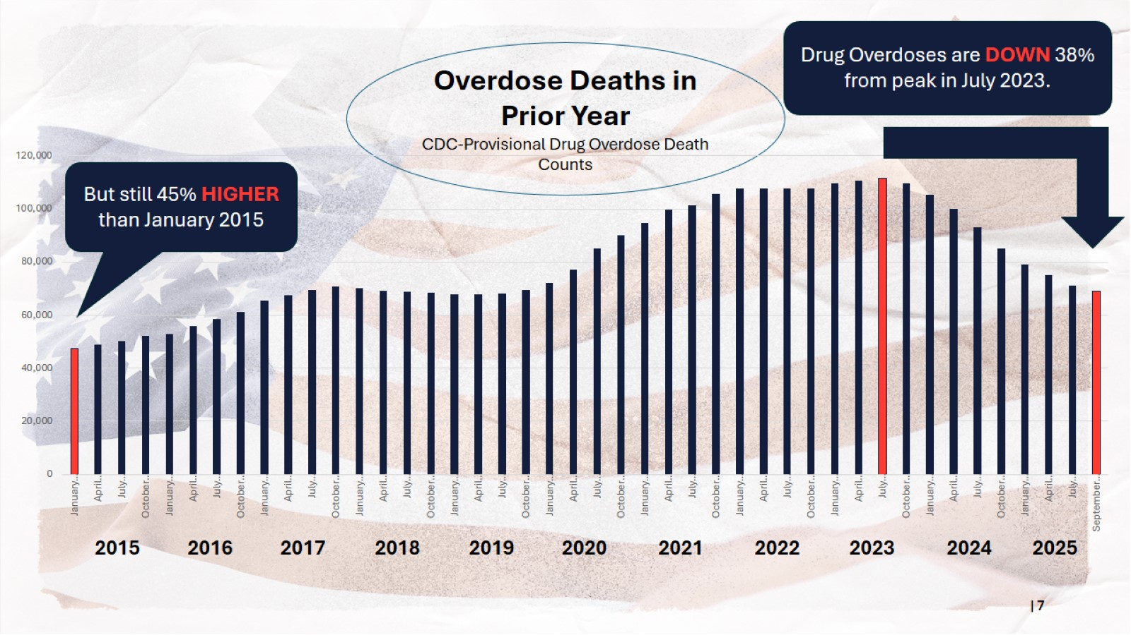
Overdose Deaths in Prior Year
Drug Overdoses are DOWN 38% from peak in July 2023.
Overdose Deaths in Prior Year
CDC-Provisional Drug Overdose Death Counts
But still 45% HIGHER than January 2015
2015 | 2016 | 2017 | 2018 | 2019 | 2020 | 2021 | 2022 | 2023 | 2024 | 2025
Speaker Notes:
This slide shows the rate at which Americans have been dying from drug overdoses over the past decade.
The bars reflect the number of people who died in the year prior to that month. [NOTE: NOT THE NUMBER OF DEATHS PER MONTH.]
So, we be thankful that numbers are moving it the right direction, while at the same time recognizing that the number of people dying is still far too high.
Notes:
This slide shows the rate at which Americans have been dying from drug overdoses over the past decade.
The bars reflect the number of people who died in the year prior to that month. [NOTE: NOT THE NUMBER OF DEATHS PER MONTH.]
So, we be thankful that numbers are moving it the right direction, while at the same time recognizing that the number of people dying is still far too high.

Slide 8
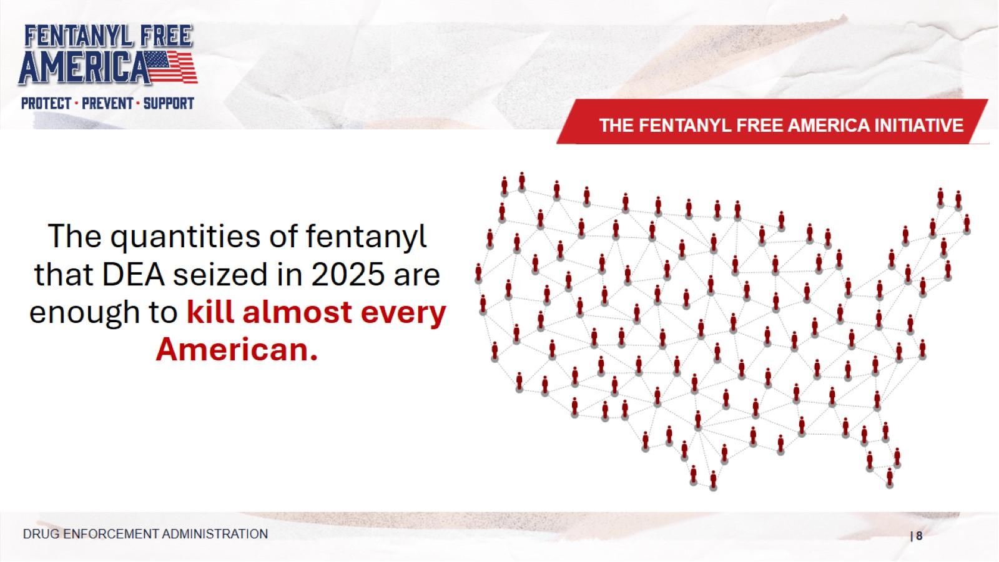
THE FENTANYL FREE AMERICA INITIATIVE
The quantities of fentanyl that DEA seized in 2025 are enough to kill almost every American.
DRUG ENFORCEMENT ADMINISTRATION
Speaker Notes:
In calendar year 2025, DEA seized more than 45 million fentanyl pills and more than 9,600 pounds of fentanyl powder. This is the most fentanyl seized by DEA in a single year. It amounts to approximately 333 million deadly doses of fentanyl—enough to kill almost every American. (As of 12/12/25)
Notes:
In calendar year 2025, DEA seized more than 45 million fentanyl pills and more than 9,600 pounds of fentanyl powder. This is the most fentanyl seized by DEA in a single year. It amounts to approximately 333 million deadly doses of fentanyl—enough to kill almost every American. (As of 12/12/25)

Slide 9
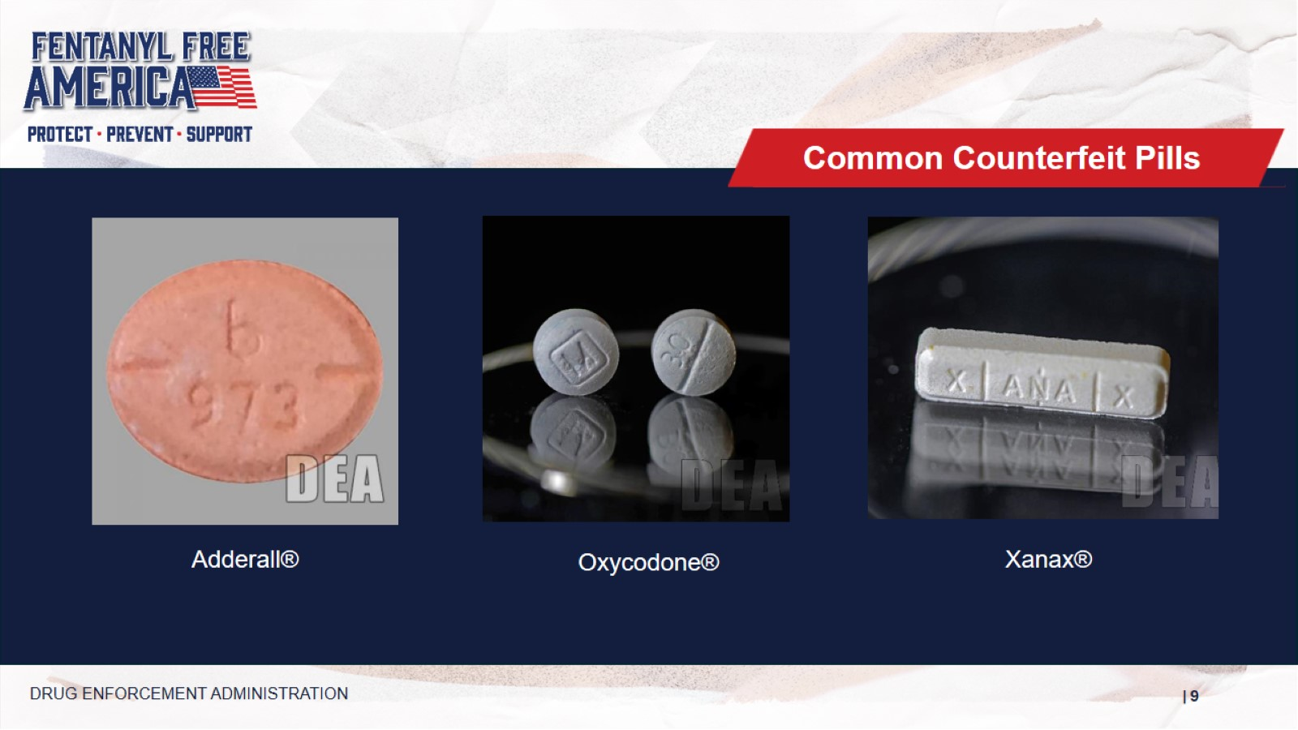
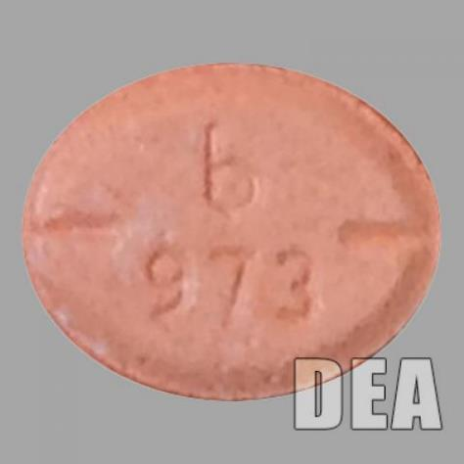
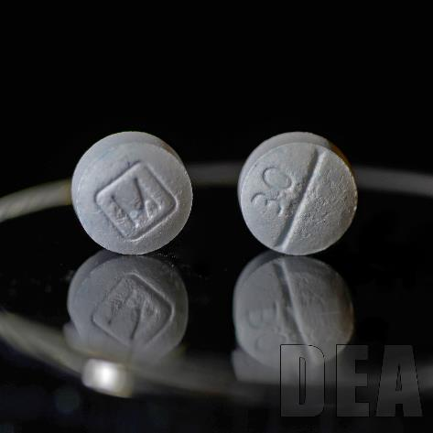
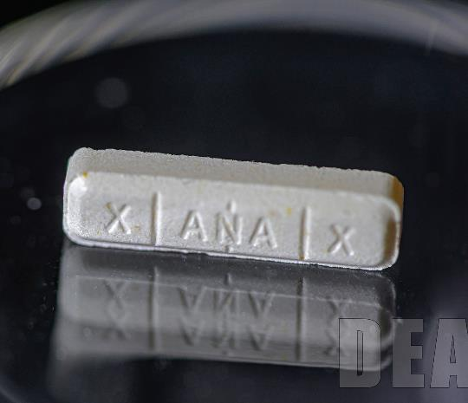
Common Counterfeit Pills
Adderall®
Oxycodone®
Xanax®
DRUG ENFORCEMENT ADMINISTRATION
Speaker Notes:
Some of the most common fake pills are made to look like prescription opioids such as oxycodone, hydrocodone (Vicodin), alprazolam (Xanax) and stimulants like amphetamines such as Adderall.
Fake prescription pills are widely accessible and often sold on social media and e-commerce platforms, making them available to anyone with a smartphone.
Notes:
Some of the most common fake pills are made to look like prescription opioids such as oxycodone, hydrocodone (Vicodin), alprazolam (Xanax) and stimulants like amphetamines such as Adderall.
Fake prescription pills are widely accessible and often sold on social media and e-commerce platforms, making them available to anyone with a smartphone.

Slide 10
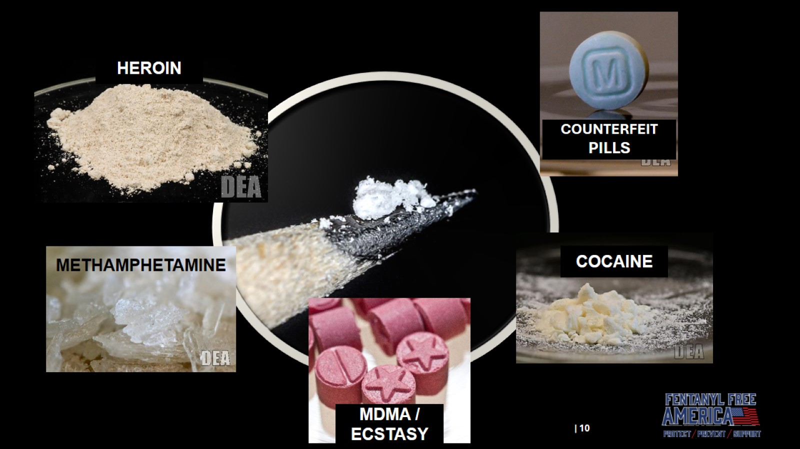
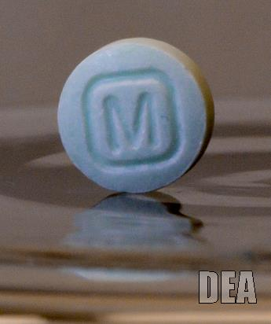
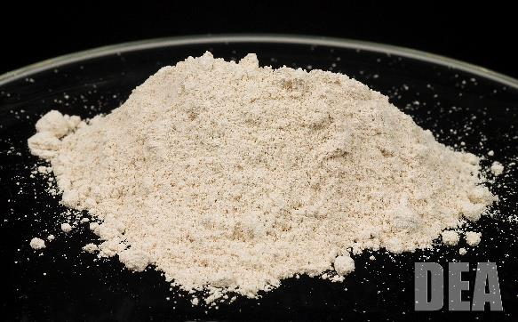
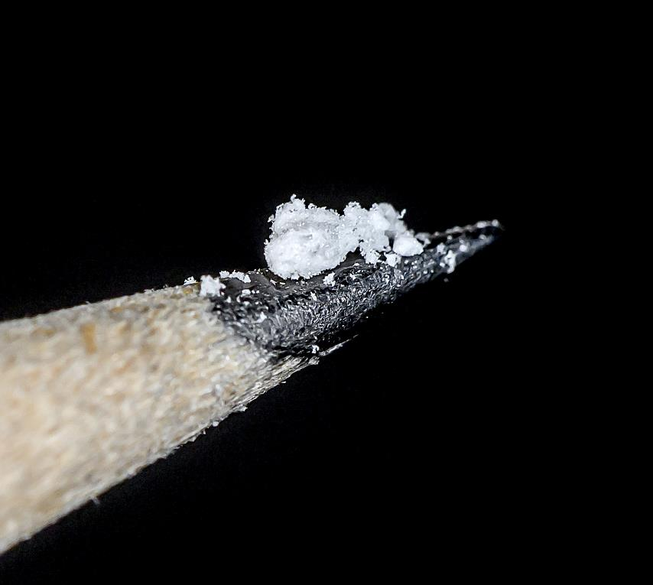
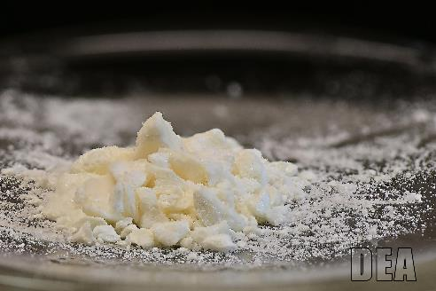
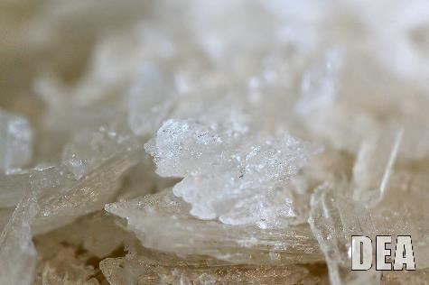
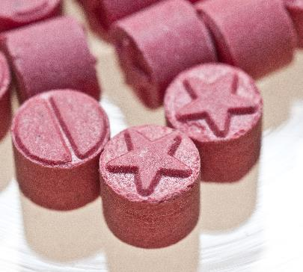
Photos of abused drugs
HEROIN
COUNTERFEIT PILLS
COCAINE
METHAMPHETAMINE
MDMA / ECSTASY
Speaker Notes:
While fentanyl appears most often in heroin and counterfeit pills, fentanyl and its analogs are also being found in meth, MDMA/Ecstasy and cocaine.
Notes:
While fentanyl appears most often in heroin and counterfeit pills, fentanyl and its analogs are also being found in meth, MDMA/Ecstasy and cocaine.

Slide 11
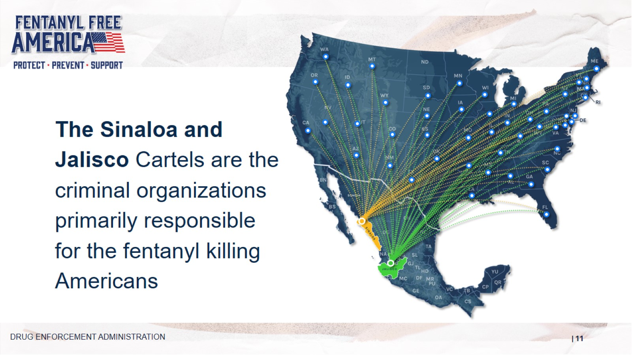
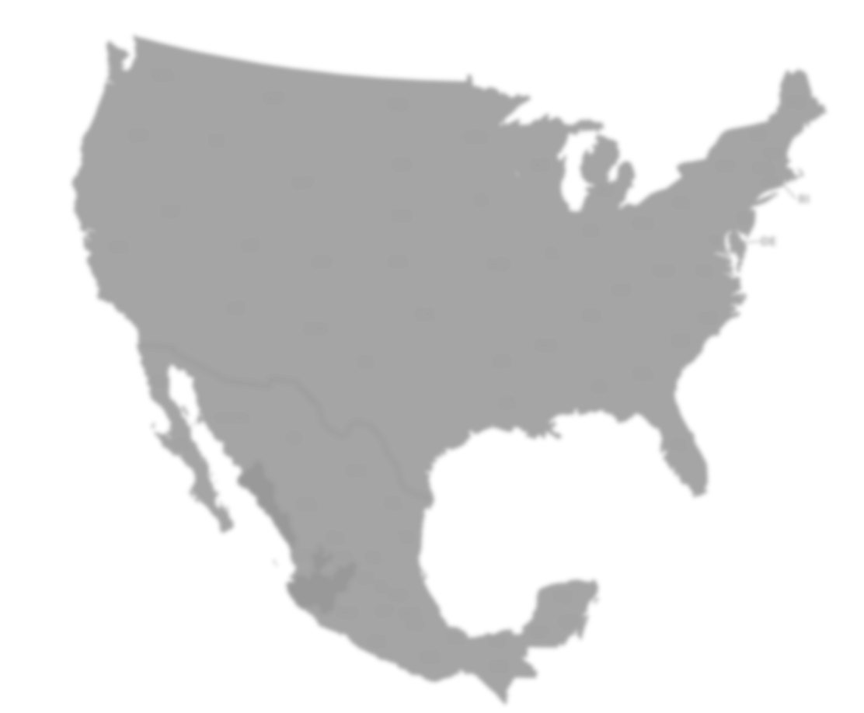
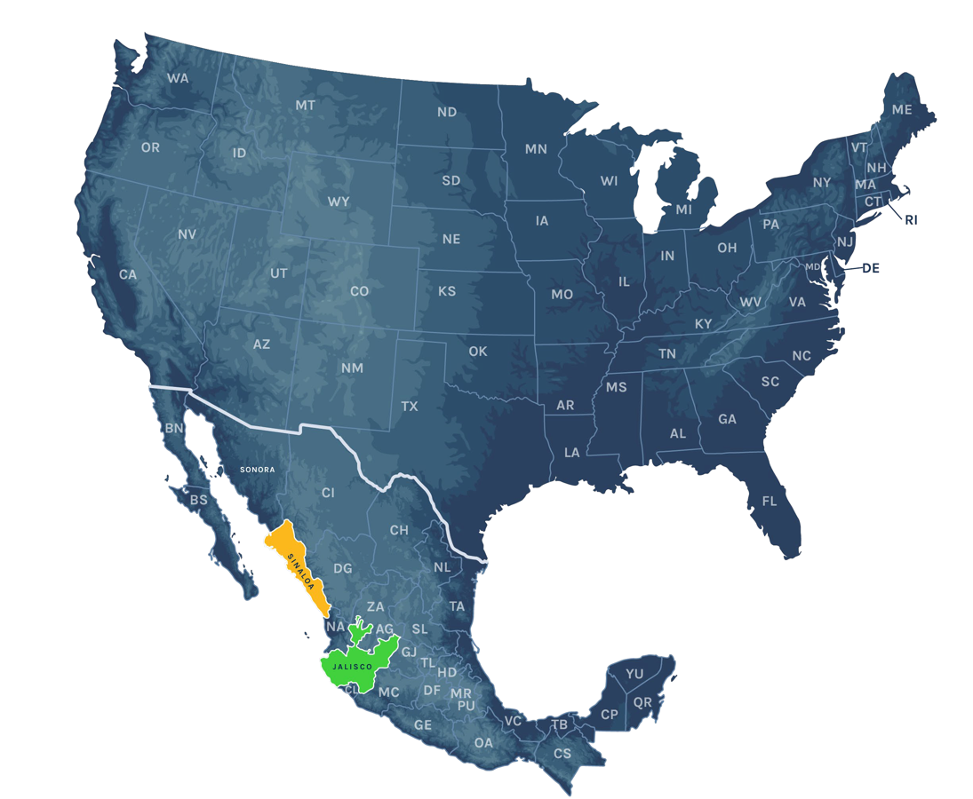









The Sinaloa and Jalisco Cartels are the criminal organizations primarily responsible for the fentanyl killing Americans
Speaker Notes:
While fentanyl appears most often in heroin and counterfeit pills, fentanyl and its analogs are also being found in meth, MDMA/Ecstasy and cocaine.
DRUG ENFORCEMENT ADMINISTRATION
Notes:
While fentanyl appears most often in heroin and counterfeit pills, fentanyl and its analogs are also being found in meth, MDMA/Ecstasy and cocaine.

Slide 12
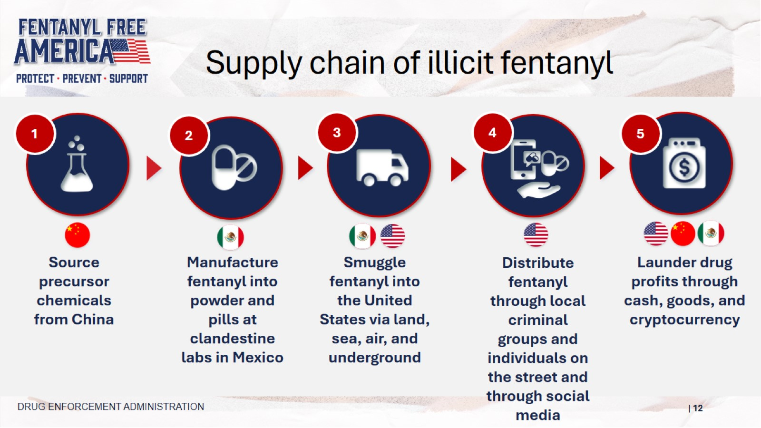









Supply chain of illicit fentanyl
1
2
3
4
5
Source precursor chemicals from China
Manufacture fentanyl into powder and pills at clandestine labs in Mexico
Smuggle fentanyl into the United States via land, sea, air, and underground
Distribute fentanyl through local criminal groups and individuals on the street and through social media
Launder drug profits through cash, goods, and cryptocurrency
Speaker Notes:
Here is an infographic that shows you the supply chain that illicit fentanyl takes on its way to American cities and towns.
It starts with precursor chemicals from China that are smuggled to Mexico.
In Mexico, those chemicals are manufactured into fake pills made to look like legitimate pharmaceuticals.
From there, the pills are smuggled into American communities and distributed to individuals.
The final step is that the profits made from the sale of these poisons are laundered back to the drug cartels and their suppliers.
DRUG ENFORCEMENT ADMINISTRATION
Notes:
Here is an infographic that shows you the supply chain that illicit fentanyl takes on its way to American cities and towns.
It starts with precursor chemicals from China that are smuggled to Mexico.
In Mexico, those chemicals are manufactured into fake pills made to look like legitimate pharmaceuticals.
From there, the pills are smuggled into American communities and distributed to individuals.
The final step is that the profits made from the sale of these poisons are laundered back to the drug cartels and their suppliers.

Slide 13
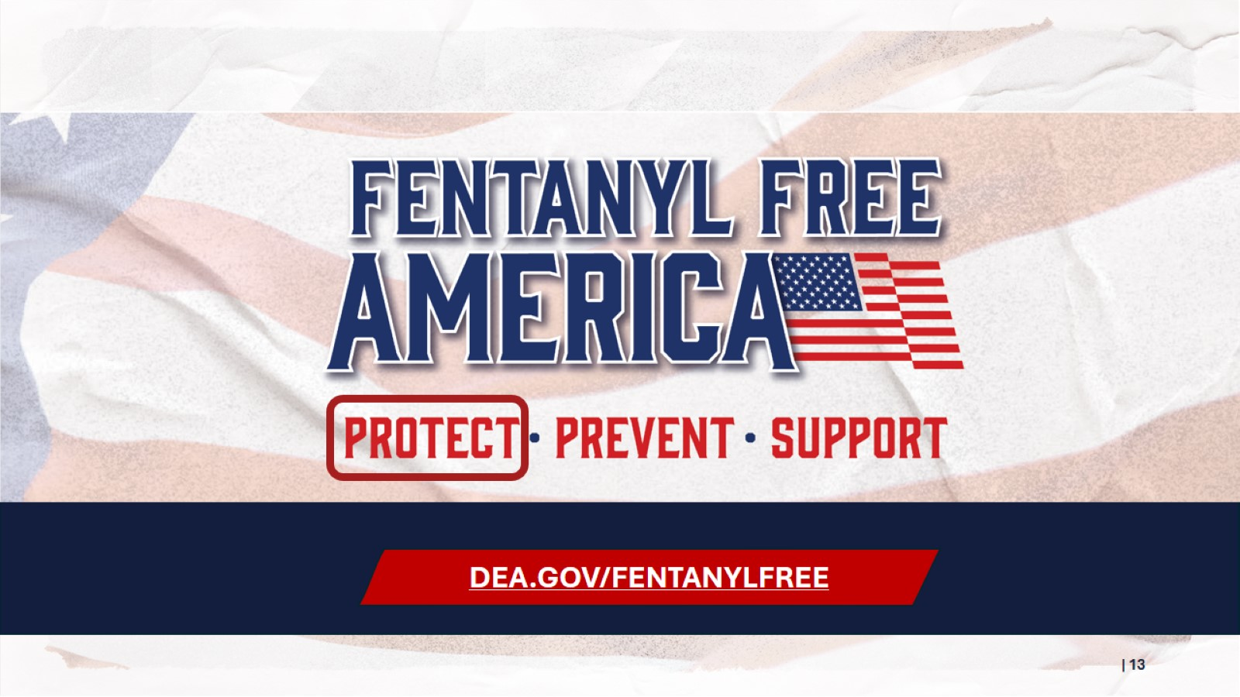

PROTECT
DEA.GOV/FENTANYLFREE
Speaker Notes:
DEA is, first and foremost, a law enforcement agency. We protect communities through increased enforcement and stronger measures to prevent fentanyl production and distribution.
Notes:
DEA is, first and foremost, a law enforcement agency. We protect communities through increased enforcement and stronger measures to prevent fentanyl production and distribution.

Slide 14
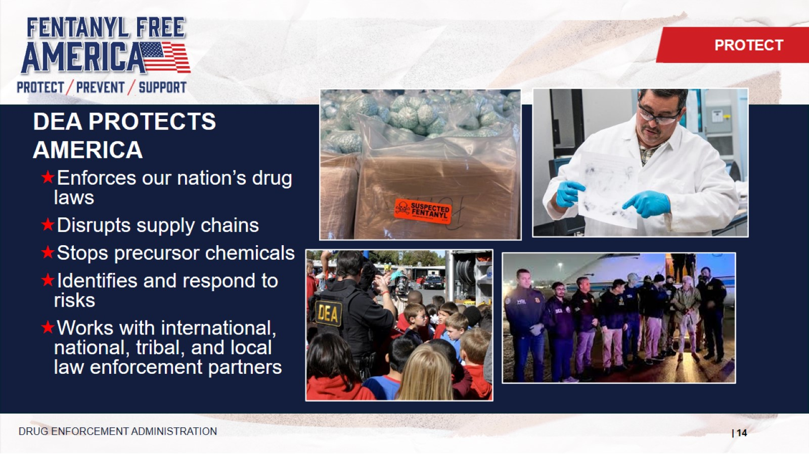

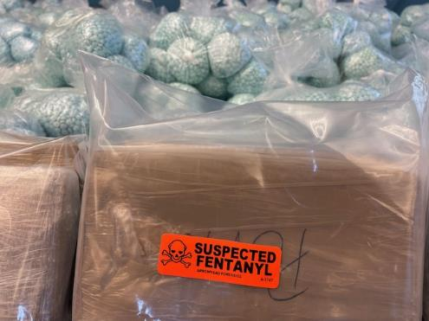
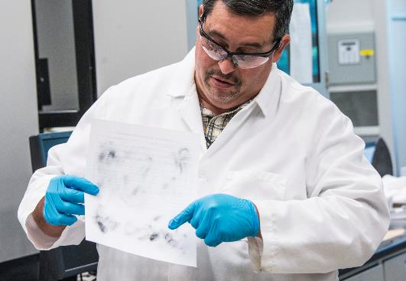
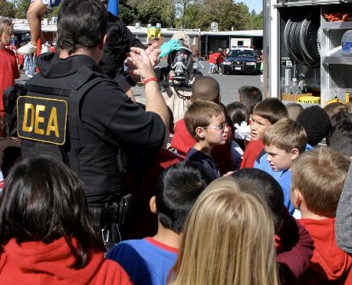
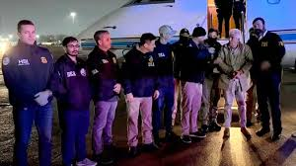
DEA PROTECTS AMERICA
PROTECT
Enforces our nation’s drug laws
Disrupts supply chains
Stops precursor chemicals
Identifies and respond to risks
Works with international, national, tribal, and local law enforcement partners
Speaker Notes: DEA leads the fight to protect American lives and communities from the devastating impact of fentanyl.
Our mission is clear and rooted in decisive action: dismantling the cartels responsible for manufacturing and trafficking this deadly poison, breaking their command-and-control networks, disrupting the illicit financial systems that sustain them, and cutting off the supply before it reaches our neighborhoods.
Partnerships are at the heart of DEA’s work. DEA collaborates with law enforcement agencies and civilian organizations at every level to achieve results.
DRUG ENFORCEMENT ADMINISTRATION
Notes:
DEA leads the fight to protect American lives and communities from the devastating impact of fentanyl.
Our mission is clear and rooted in decisive action: dismantling the cartels responsible for manufacturing and trafficking this deadly poison, breaking their command-and-control networks, disrupting the illicit financial systems that sustain them, and cutting off the supply before it reaches our neighborhoods.
Partnerships are at the heart of DEA’s work. DEA collaborates with law enforcement agencies and civilian organizations at every level to achieve results.

Slide 15
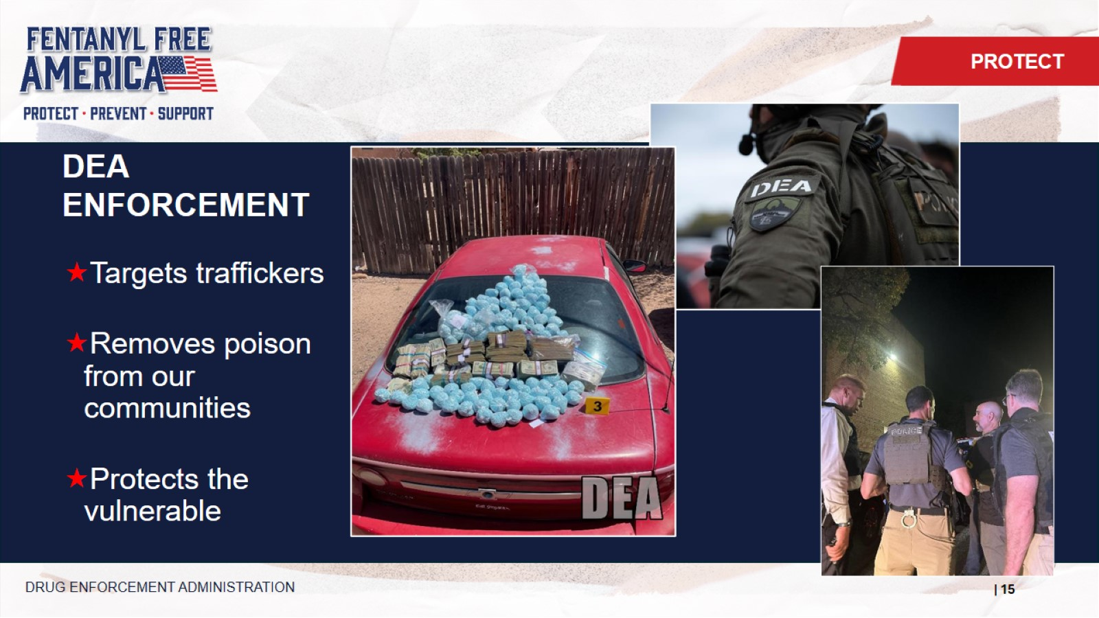
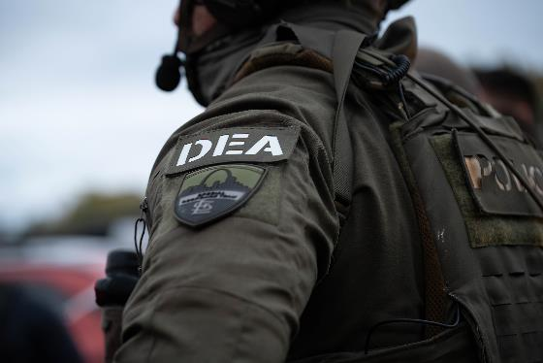
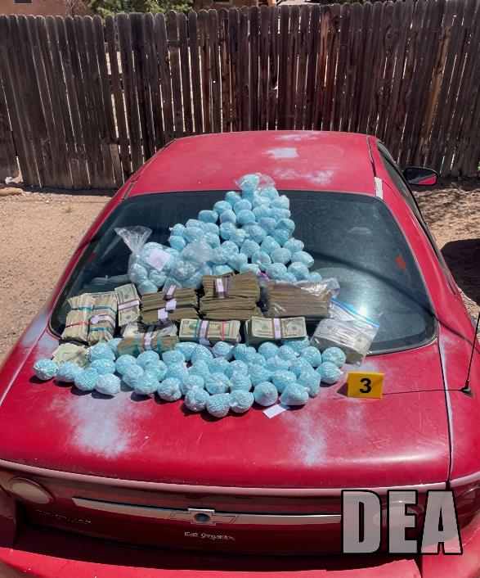
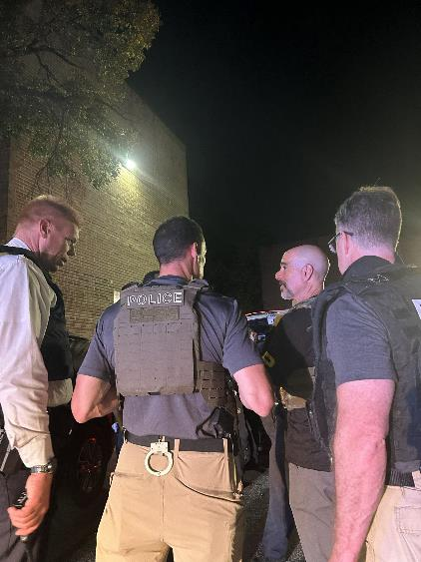
DEA ENFORCEMENT
PROTECT
Targets traffickers
Removes poison from our communities
Protects the vulnerable
DRUG ENFORCEMENT ADMINISTRATION
Speaker Notes:
DEA serves many functions, but again, enforcement is at the heart of what we do. DEA agents and task force officers investigate and arrest those who traffic drugs in our community, with a focus on those who do the most harm.
Every pill and packet of powder that DEA-led enforcement efforts take off the streets can save a life.
And the lives that are most at risk are those who are most vulnerable – young people and those struggling with substance use or seeking to recover.
Notes:
DEA serves many functions, but again, enforcement is at the heart of what we do. DEA agents and task force officers investigate and arrest those who traffic drugs in our community, with a focus on those who do the most harm.
Every pill and packet of powder that DEA-led enforcement efforts take off the streets can save a life.
And the lives that are most at risk are those who are most vulnerable – young people and those struggling with substance use or seeking to recover.

Slide 16
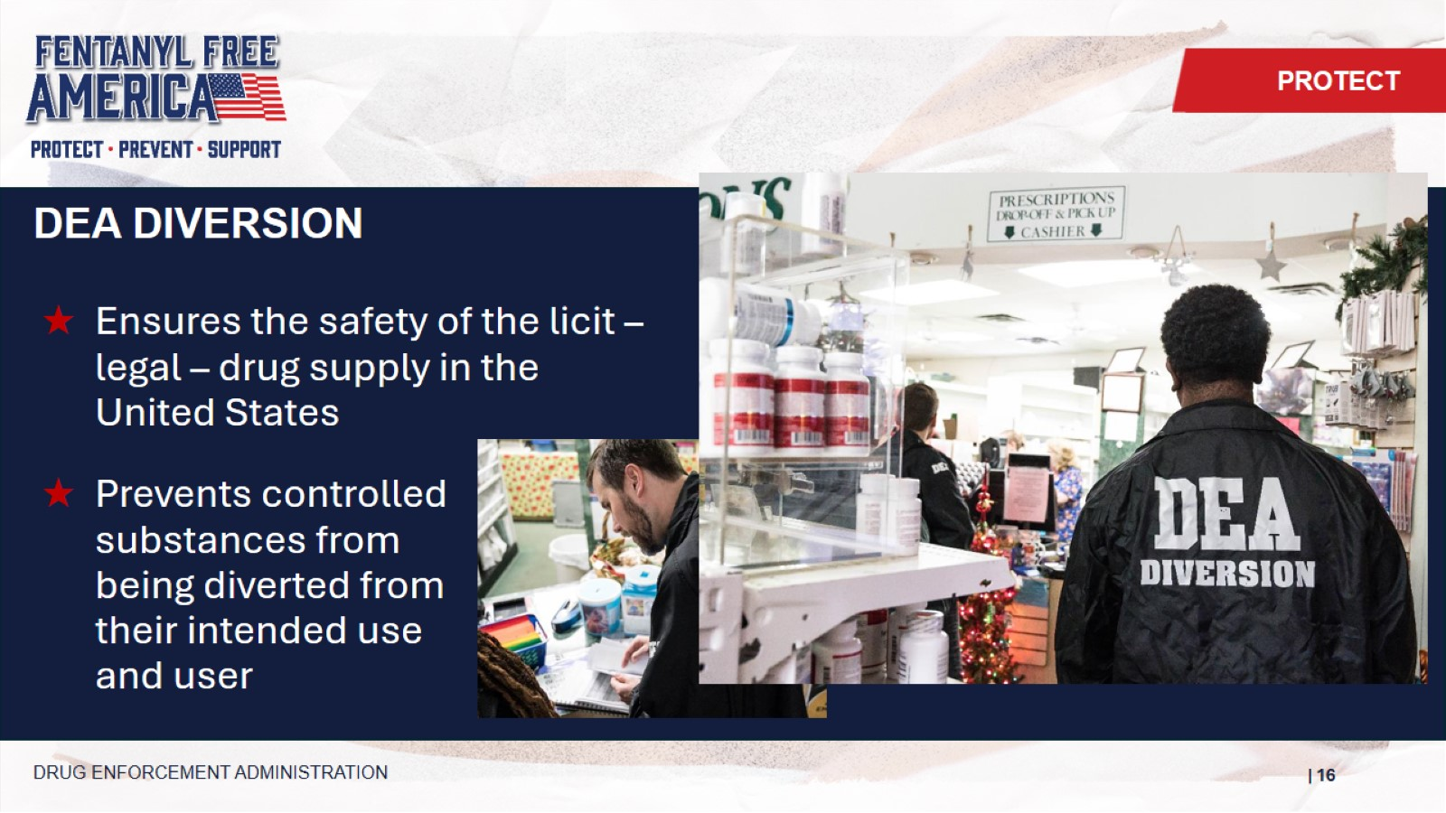
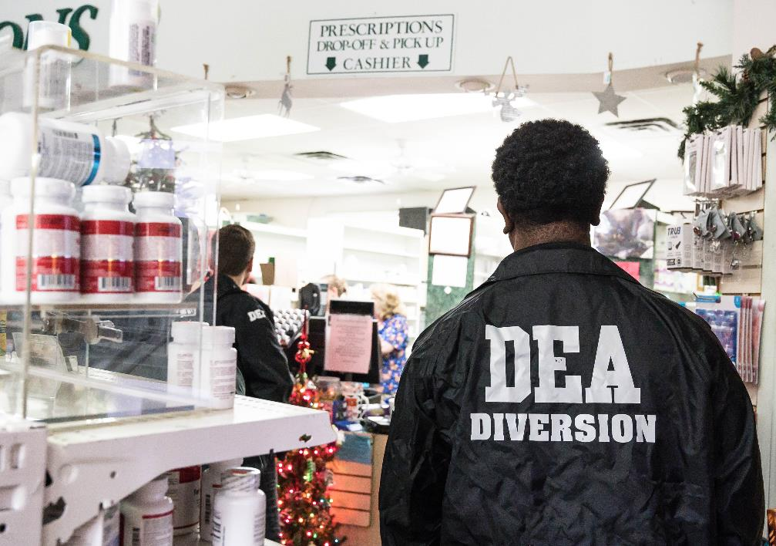
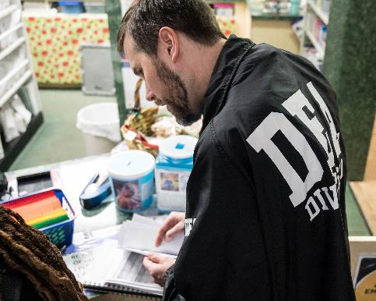
DEA DIVERSION
PROTECT
Ensures the safety of the licit – legal – drug supply in the United States
Prevents controlled substances from
being diverted from
their intended use
and user
DRUG ENFORCEMENT ADMINISTRATION
Speaker Notes:
Many people are unaware that DEA is also a regulatory agency.
The mission of DEA's Diversion Control Division is to prevent, detect, and investigate the diversion of controlled pharmaceuticals and listed chemicals from legitimate sources while ensuring an adequate and uninterrupted supply for legitimate medical, commercial, and scientific needs.
Notes:
Many people are unaware that DEA is also a regulatory agency.
The mission of DEA's Diversion Control Division is to prevent, detect, and investigate the diversion of controlled pharmaceuticals and listed chemicals from legitimate sources while ensuring an adequate and uninterrupted supply for legitimate medical, commercial, and scientific needs.

Slide 17
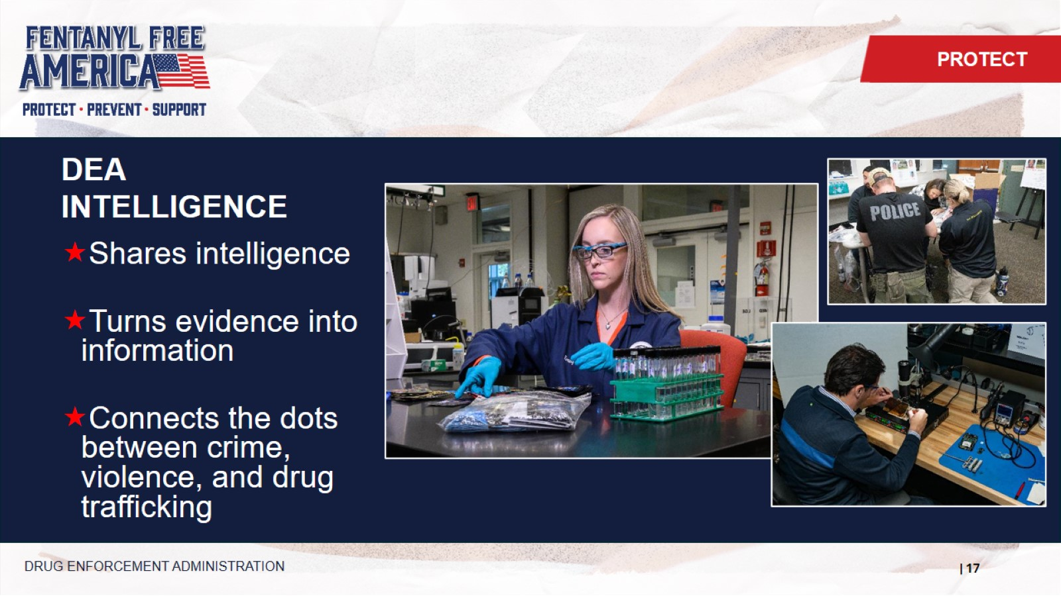
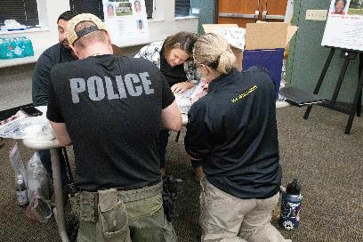
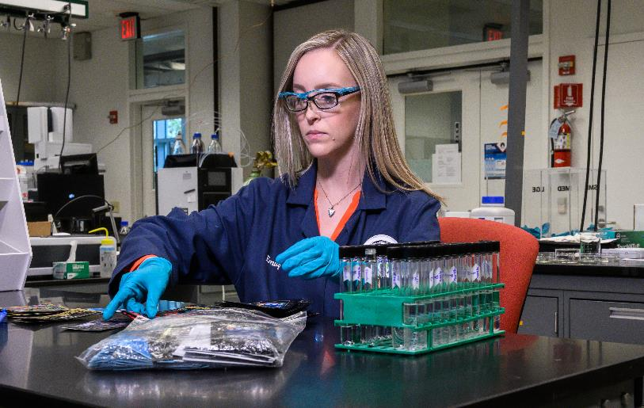
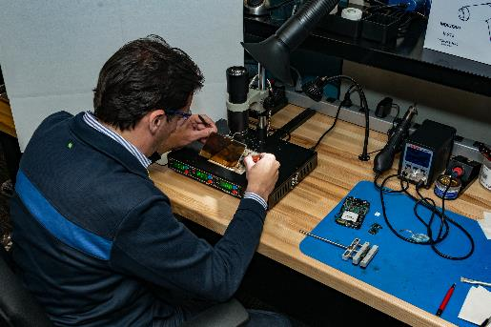
DEA INTELLIGENCE
PROTECT
Shares intelligence
Turns evidence into information
Connects the dots between crime, violence, and drug trafficking
DRUG ENFORCEMENT ADMINISTRATION
Speaker Notes:
Arrests made by agents and cases made by diversion specialists start with DEA Intelligence analysts who gather information from all sources to track patterns and identity risks.
DEA shares timely and actionable intelligence with state and local partners, and analyzes exhibits to identity trends, patterns, and new risks to our nation.
Notes:
Arrests made by agents and cases made by diversion specialists start with DEA Intelligence analysts who gather information from all sources to track patterns and identity risks.
DEA shares timely and actionable intelligence with state and local partners, and analyzes exhibits to identity trends, patterns, and new risks to our nation.

Slide 18
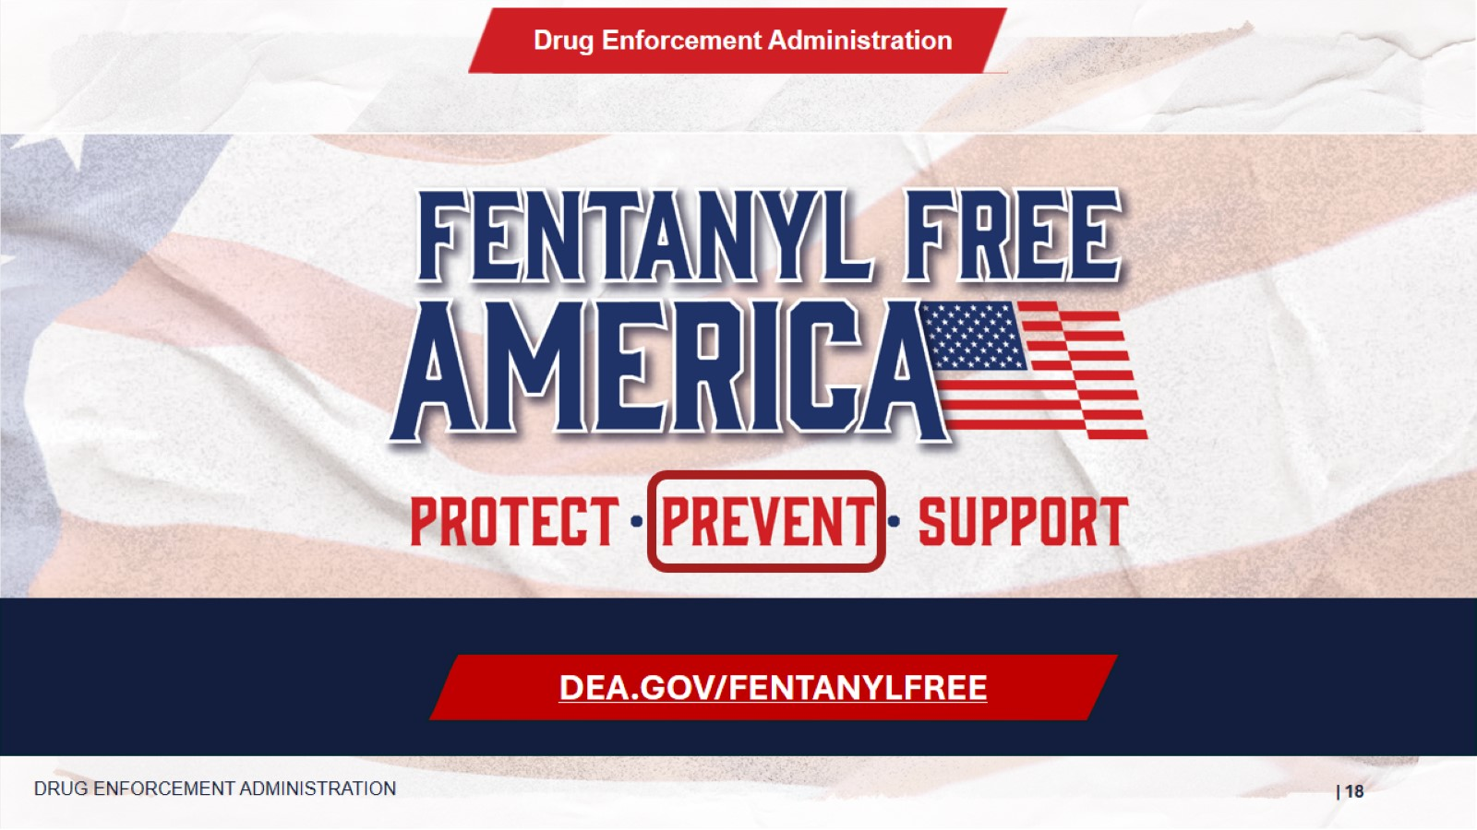
PREVENT
DEA.GOV/FENTANYLFREE
DRUG ENFORCEMENT ADMINISTRATION
Speaker Notes:
While protection of Americans is DEA’s core mission, DEA also dedicates resources towards prevention and works with partners to achieve the goal of reducing demand for illicit drugs.
Notes:
While protection of Americans is DEA’s core mission, DEA also dedicates resources towards prevention and works with partners to achieve the goal of reducing demand for illicit drugs.

Slide 19
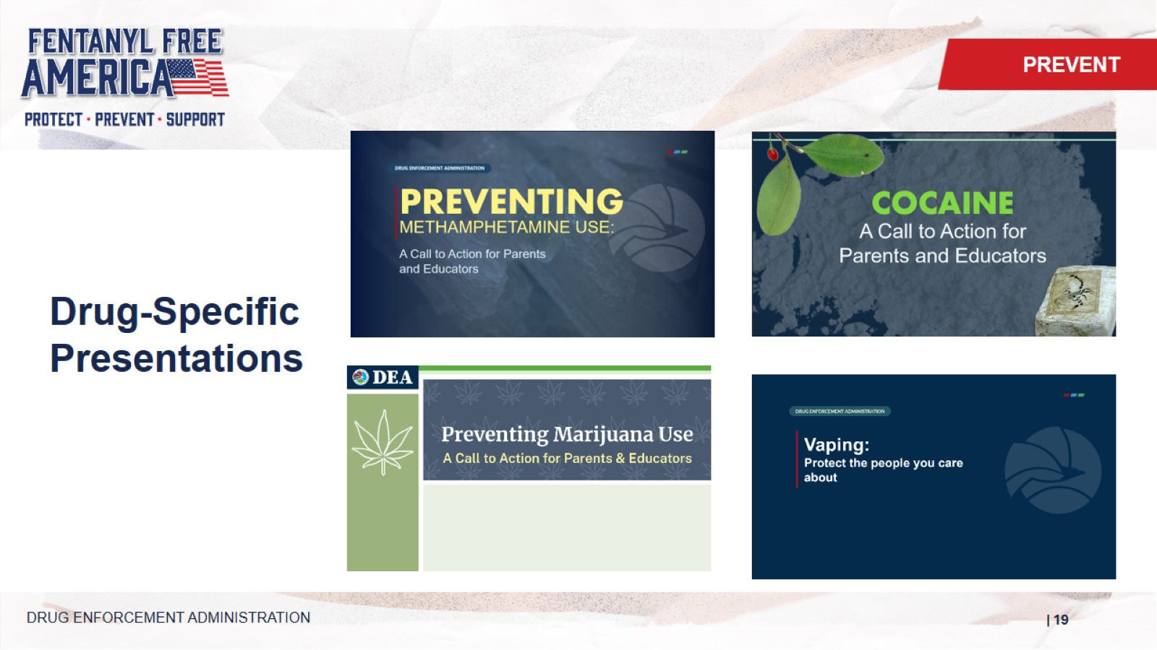
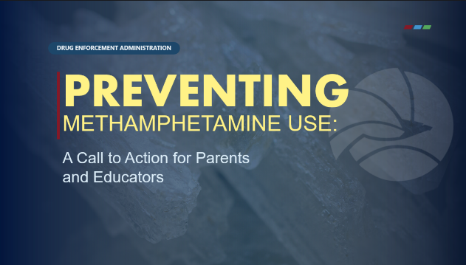



Drug-Specific Presentations
PREVENT
Speaker Notes:
There are several other presentations, including a brand new one on vaping.
These presentations can be delivered by DEA’s community outreach specialists, or partners.
DRUG ENFORCEMENT ADMINISTRATION
Notes:
There are several other presentations, including a brand new one on vaping.
These presentations can be delivered by DEA’s community outreach specialists, or partners.

Slide 20
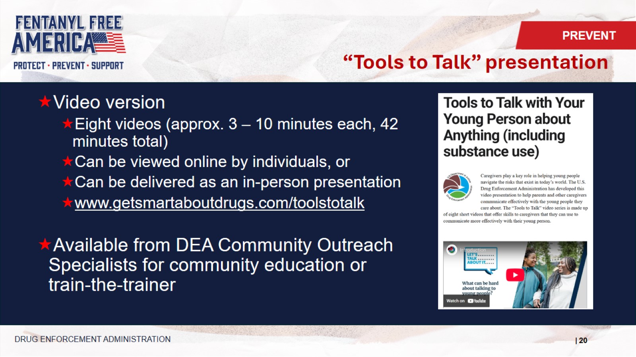

“Tools to Talk” presentation
PREVENT
Video version
Eight videos (approx. 3 – 10 minutes each, 42 minutes total)
Can be viewed online by individuals, or
Can be delivered as an in-person presentation
www.getsmartaboutdrugs.com/toolstotalk
Available from DEA Community Outreach Specialists for community education or train-the-trainer
DRUG ENFORCEMENT ADMINISTRATION
Speaker Notes:
This presentation is available from Community Outreach Specialists, but we also wanted to make it available more broadly.
For that reason, we created a video version. It is available at getsmartaboutdrugs.com/toolstotalk
There are a total of eight videos that are 3-10 minutes in length.
They can be viewed by individuals, or as a group, when they can lead to discussion.
Notes:
This presentation is available from Community Outreach Specialists, but we also wanted to make it available more broadly.
For that reason, we created a video version. It is available at getsmartaboutdrugs.com/toolstotalk
There are a total of eight videos that are 3-10 minutes in length.
They can be viewed by individuals, or as a group, when they can lead to discussion.

Slide 21



Together for Families is …
PREVENT
A “big tent” to bring together all of the organizations that serve families – from prevention to loss of a loved one
An online resource for families seeking support
A way for DEA to spotlight resources from our partners
www.dea.gov/togetherforfamilies
DRUG ENFORCEMENT ADMINISTRATION
Notes:
Together for Families is …
A “big tent” to bring together all of the organizations that serve families – from prevention to loss of a loved one
An online resource for families seeking support
A way for DEA to spotlight resources from our partners
You can snap a picture of the QR code to go there now.

Slide 22


National Take Back Prescription Day
PREVENT
www.deatakeback.com
DRUG ENFORCEMENT ADMINISTRATION
Speaker Notes:
Take Back Day is an initiative handled by Diversion.
Happens 2x’s a year, in April and October; usually the last Saturday of each month and provide an opportunity to clear unwanted medications from your home.
If you work in law enforcement or for a community organization, each Division has their own Take Back Coordinator that you can work with.
Notes:
Take Back Day is an initiative handled by Diversion.
Happens 2x’s a year, in April and October; usually the last Saturday of each month and provide an opportunity to clear unwanted medications from your home.
If you work in law enforcement or for a community organization, each Division has their own Take Back Coordinator that you can work with.

Slide 23


Website for Parents & Caregivers
PREVENT
www.getsmartaboutdrugs.com
DRUG ENFORCEMENT ADMINISTRATION
Speaker Notes:
Get Smart about Drugs is focused on parents, caregivers and educators.
Notes:
Get Smart about Drugs is focused on parents, caregivers and educators.

Slide 24


Website for Higher Ed
PREVENT
www.campusdrugprevention.gov
DRUG ENFORCEMENT ADMINISTRATION
Speaker Notes:
DEA has a number of websites that serve different audiences.
Campus Drug Prevention serves prevention professionals who work in colleges and universities.
Notes:
DEA has a number of websites that serve different audiences.
Campus Drug Prevention serves prevention professionals who work in colleges and universities.

Slide 25


Website for Teens
PREVENT
www.justthinktwice.com
DRUG ENFORCEMENT ADMINISTRATION
Notes:
Just Think Twice is DEA’s website for young people.

Slide 26


Website for Educators
PREVENT
www.operationprevention.com
DRUG ENFORCEMENT ADMINISTRATION
Speaker Notes:
Operation Prevention is DEA’s free curriculum for schools, developed in cooperation with Discovery Education, the people who brought you Shark Week.
Notes:
Operation Prevention is DEA’s free curriculum for schools, developed in cooperation with Discovery Education, the people who brought you Shark Week.

Slide 27





Publications
PREVENT
getsmartaboutdrugs.gov/community-outreach-resources
Speaker Notes:
DEA’s Community Outreach and Prevention Section provides a variety of drug prevention education publications available for free to the public as digital files for download, and hard copies. Most of our publications are also available in Spanish.
DRUG ENFORCEMENT ADMINISTRATION
Notes:
DEA’s Community Outreach and Prevention Section provides a variety of drug prevention education publications available for free to the public as digital files for download, and hard copies. Most of our publications are also available in Spanish.

Slide 28




Strategic Areas for Tribal Outreach
PREVENT
National Prescription Drug Take Back: Work with Tribal law enforcement to increase access to collection sites.
Awareness Events: Raise awareness of and reduce the demand for drugs and the misuse of prescription drugs.
Partnerships: Work within and across communities.
Prevention Messages and Materials: Create materials that resonate with Native audience.
DRUG ENFORCEMENT ADMINISTRATION
Speaker Notes:
DEA also engages in Tribal Outreach by engaging communities and customizing content for this audience.
Notes:
DEA also engages in Tribal Outreach by engaging communities and customizing content for this audience.

Slide 29


Operation Engage
PREVENT
Goals:
Identify and affect local drug threat enforcement priorities and drug use trends.
Support and contribute to local drug use prevention efforts.
Bridge public safety and public health efforts.
Objectives:
Leverage DEA intelligence to build awareness of local drug threats.
Raise awareness of local drug threats and change attitudes to reduce drug misuse.
Support local drug-free community coalitions to aid their impact and ensure lasting success.
DRUG ENFORCEMENT ADMINISTRATION
Speaker Notes:
The U.S. Drug Enforcement Administration’s Operation Engage initiative is a comprehensive community-level approach that bridges public health and public safety to address the drug epidemic through prevention strategies, facilitating conversations and collaboration with local partners. Each field division office identifies its most challenging area within their region based on current drug threat data, designates a city or region, and focuses evidence-informed substance use prevention and community outreach efforts to make a true and measurable difference by engaging communities and customizing content for this audience.
Notes:
The U.S. Drug Enforcement Administration’s Operation Engage initiative is a comprehensive community-level approach that bridges public health and public safety to address the drug epidemic through prevention strategies, facilitating conversations and collaboration with local partners. Each field division office identifies its most challenging area within their region based on current drug threat data, designates a city or region, and focuses evidence-informed substance use prevention and community outreach efforts to make a true and measurable difference by engaging communities and customizing content for this audience.

Slide 30


Operation Engage 2026 Sites
PREVENT
DRUG ENFORCEMENT ADMINISTRATION
Speaker Notes:
Operation Engage is currently active in 11 communities across the United States.
Notes:
Operation Engage is currently active in 11 communities across the United States.

Slide 31



DEA Community Outreach Specialists
PREVENT
DRUG ENFORCEMENT ADMINISTRATION
Speaker Notes:
And in DEA’s 23 field divisions we have Community Outreach Specialists who are civilian employees who engage communities and advance primary prevention efforts. Contact information for your COS plus access to the content we have shared is available via the QR code on the screen. (https://www.getsmartaboutdrugs.gov/community-outreach-resources)
Notes:
And in DEA’s 23 field divisions we have Community Outreach Specialists who are civilian employees who engage communities and advance primary prevention efforts. Contact information for your COS plus access to the content we have shared is available via the QR code on the screen. (https://www.getsmartaboutdrugs.gov/community-outreach-resources)

Slide 32

SUPPORT
DEA.GOV/FENTANYLFREE
DRUG ENFORCEMENT ADMINISTRATION
Speaker Notes:
Finally, DEA is committed to supporting those who are affected by fentanyl and other illicit substances.
Notes:
Finally, DEA is committed to supporting those who are affected by fentanyl and other illicit substances.

Slide 33



Early intervention and treatment SAVES LIVES
SUPPORT
www.dea.gov/recovery-resources
Speaker Notes:
Our partner agencies, including SAMHSA, provide support for early intervention and treatment, which saves lives. DEA has gathered additional information at dea.gov/recovery-resources that families and individuals can use.
DRUG ENFORCEMENT ADMINISTRATION
Notes:
Our partner agencies, including SAMHSA, provide support for early intervention and treatment, which saves lives. DEA has gathered additional information at dea.gov/recovery-resources that families and individuals can use.

Slide 34



Together for Families
SUPPORT
www.dea.gov/togetherforfamilies
DRUG ENFORCEMENT ADMINISTRATION
Speaker Notes:
DEA’s Together for Families program provides links to resources offered by our partners.
Go to dea.gov/togetherforfamilies.
Click on Resources for Families .
And then select the dropdown option for “Getting loved ones help for a substance use problem, or supporting their recovery”
You will then have access to organizations that provide support to families at no cost.
Notes:
DEA’s Together for Families program provides links to resources offered by our partners.
Go to dea.gov/togetherforfamilies
Click on Resources for Families
And then select the dropdown option for “Getting loved ones help for a substance use problem, or supporting their recovery”
You will then have access to organizations that provide support to families at no cost.

Slide 35



JOIN THE FIGHT TO MAKE AMERICA FENTANYL FREE
Opportunities:
Educate public – especially young people -- about dangers associated with fentanyl
Connect people with information, resources, and support
Participate in efforts, such as Drug Take Back events, to remove drugs from our communities
www.dea.gov/fentanylfree/promote
Toolbox: Billboards, Fact Sheet, Logo, Posters, Public Service Announcements, Social Media
DRUG ENFORCEMENT ADMINISTRATION
Speaker Notes:
Finally, I ask you today to Join the Fight!
We need every American’s assistance to save lives from fentanyl and other deadly drugs.
Please share what you have seen here today, through conversations and connections.
Participate in Take Back events that remove unwanted medications from our homes and communities.
And go to the Promote page to access resources you can use to get the word out.
Notes:
Finally, I ask you today to Join the Fight!
We need every American’s assistance to save lives from fentanyl and other deadly drugs.
Please share what you have seen here today, through conversations and connections.
Participate in Take Back events that remove unwanted medications from our homes and communities.
And go to the Promote page to access resources you can use to get the word out.

Slide 36

Thank you!
Contact Information

