Slide 1

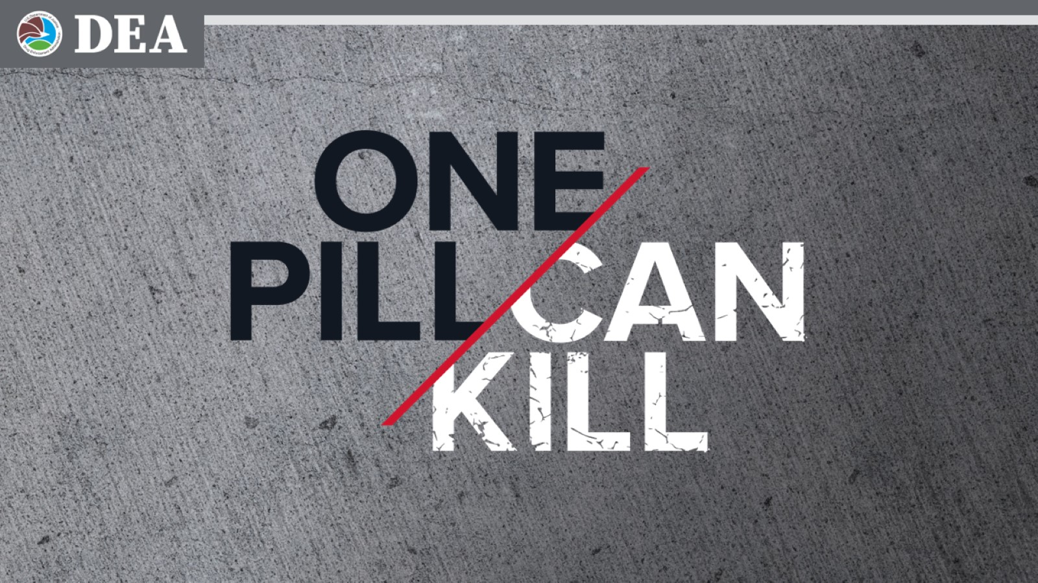

One Pill Can Kill
Speaker Notes: Localize your welcome page….
Explain who DEA is and what we do
Here to talk about the threat to our community from fake pills and fentanyl
Notes:
Localize your welcome page….
Explain who DEA is and what we do
Here to talk about the threat to our community from fake pills and fentanyl

Slide 2
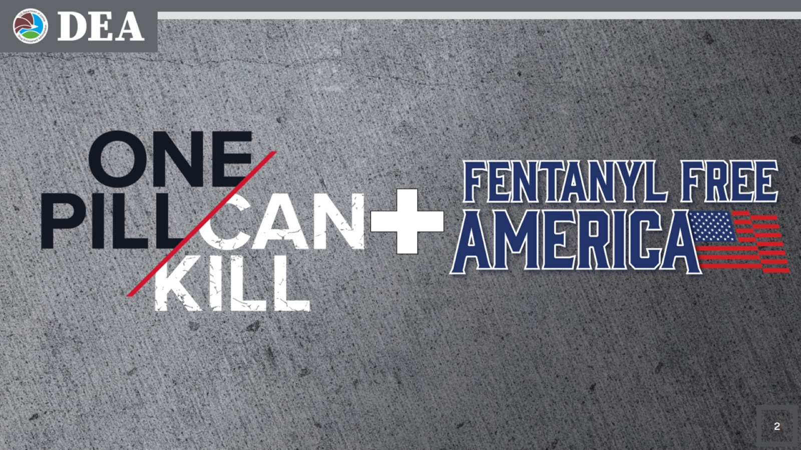

One Pill Can Kill + Fentanyl Free America
Speaker Notes: One Pill Can Kill is part of DEA’s new Fentanyl Free America mission.
Notes:
One Pill Can Kill is part of DEA’s new Fentanyl Free America mission.

Slide 3

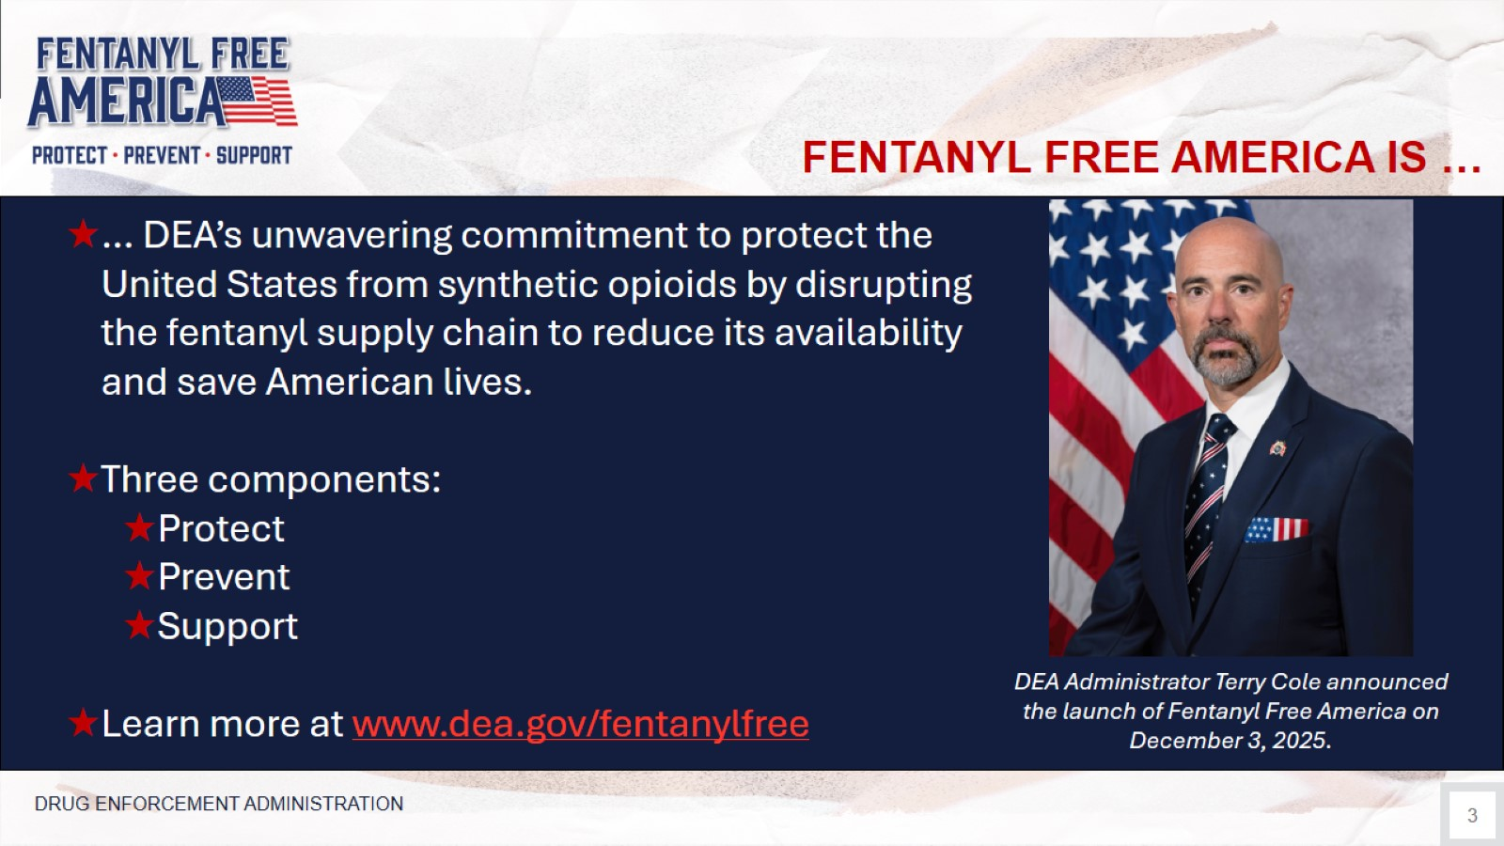

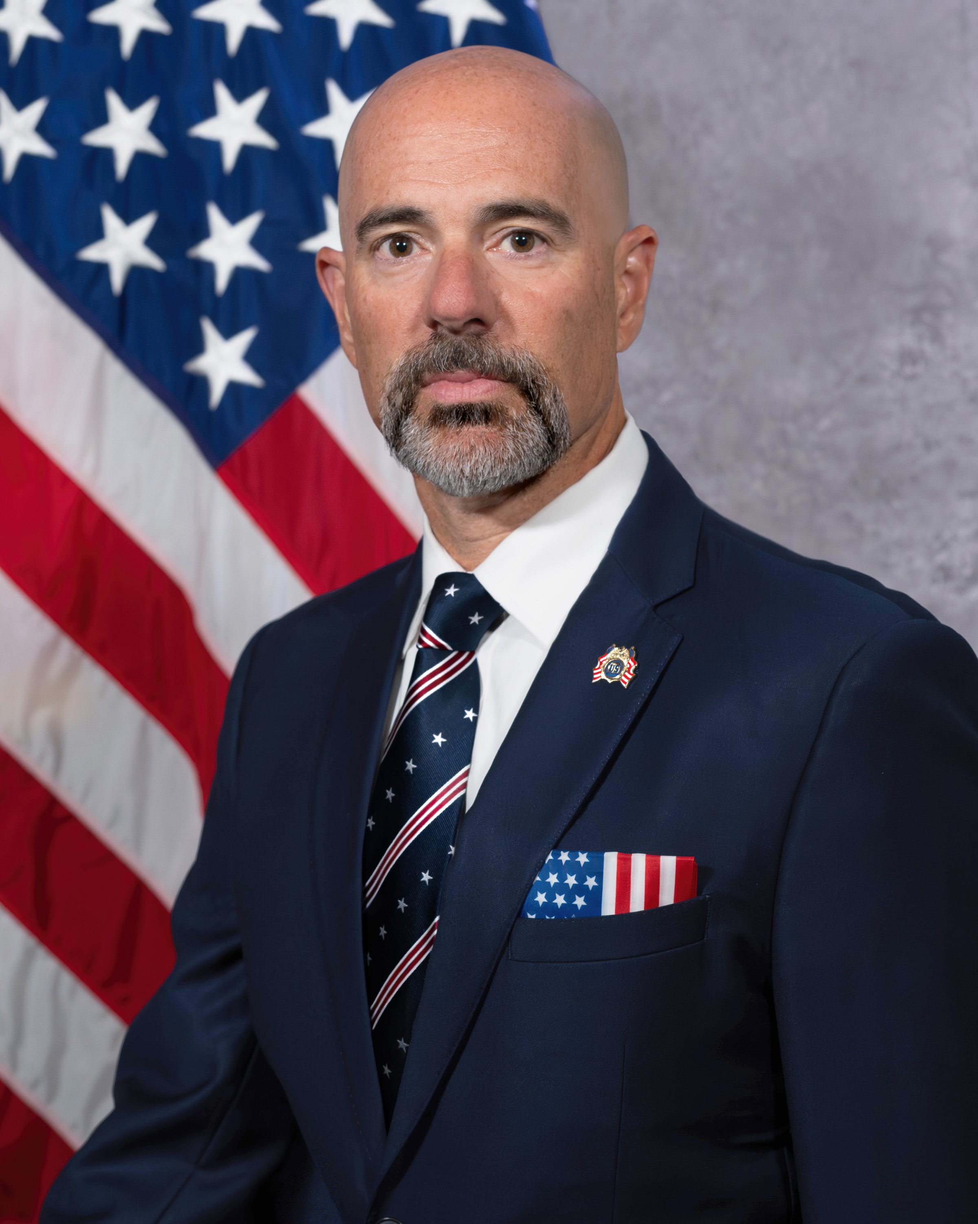
FENTANYL FREE AMERICA IS …
Speaker Notes:
On December 3, 2025, DEA Administrator Terry Cole launched Fentanyl Free America, a multi-faceted effort to save American lives from synthetic opioids by disrupting the fentanyl supply chain to reduce its availability.
Fentanyl Free America has three components:
Protect Americans from drug traffickers;
Prevent fentanyl use, especially among young people; and
Support those affected by fentanyl, to include those suffering from addiction and their loved ones.
In today’s presentation we will discuss how DEA and its partners do this work.
However, if there is one thing I would like you to leave here today knowing, it is the Fentanyl Free America web address, dea.gov/fentanylfree, to visit and share with your friends and colleagues.
… DEA’s unwavering commitment to protect the United States from synthetic opioids by disrupting the fentanyl supply chain to reduce its availability and save American lives.
Three components:
Protect
Prevent
Support
Learn more at www.dea.gov/fentanylfree
DEA Administrator Terry Cole announced the launch of Fentanyl Free America on
December 3, 2025.
DRUG ENFORCEMENT ADMINISTRATION
Notes:
On December 3, 2025, DEA Administrator Terry Cole launched Fentanyl Free America, a multi-faceted effort to save American lives from synthetic opioids by disrupting the fentanyl supply chain to reduce its availability.
Fentanyl Free America has three components:
Protect Americans from drug traffickers;
Prevent fentanyl use, especially among young people; and
Support those affected by fentanyl, to include those suffering from addiction and their loved ones.
In today’s presentation we will discuss how DEA and its partners do this work.
However, if there is one thing I would like you to leave here today knowing, it is the Fentanyl Free America web address, dea.gov/fentanylfree, to visit and share with your friends and colleagues.

Slide 4
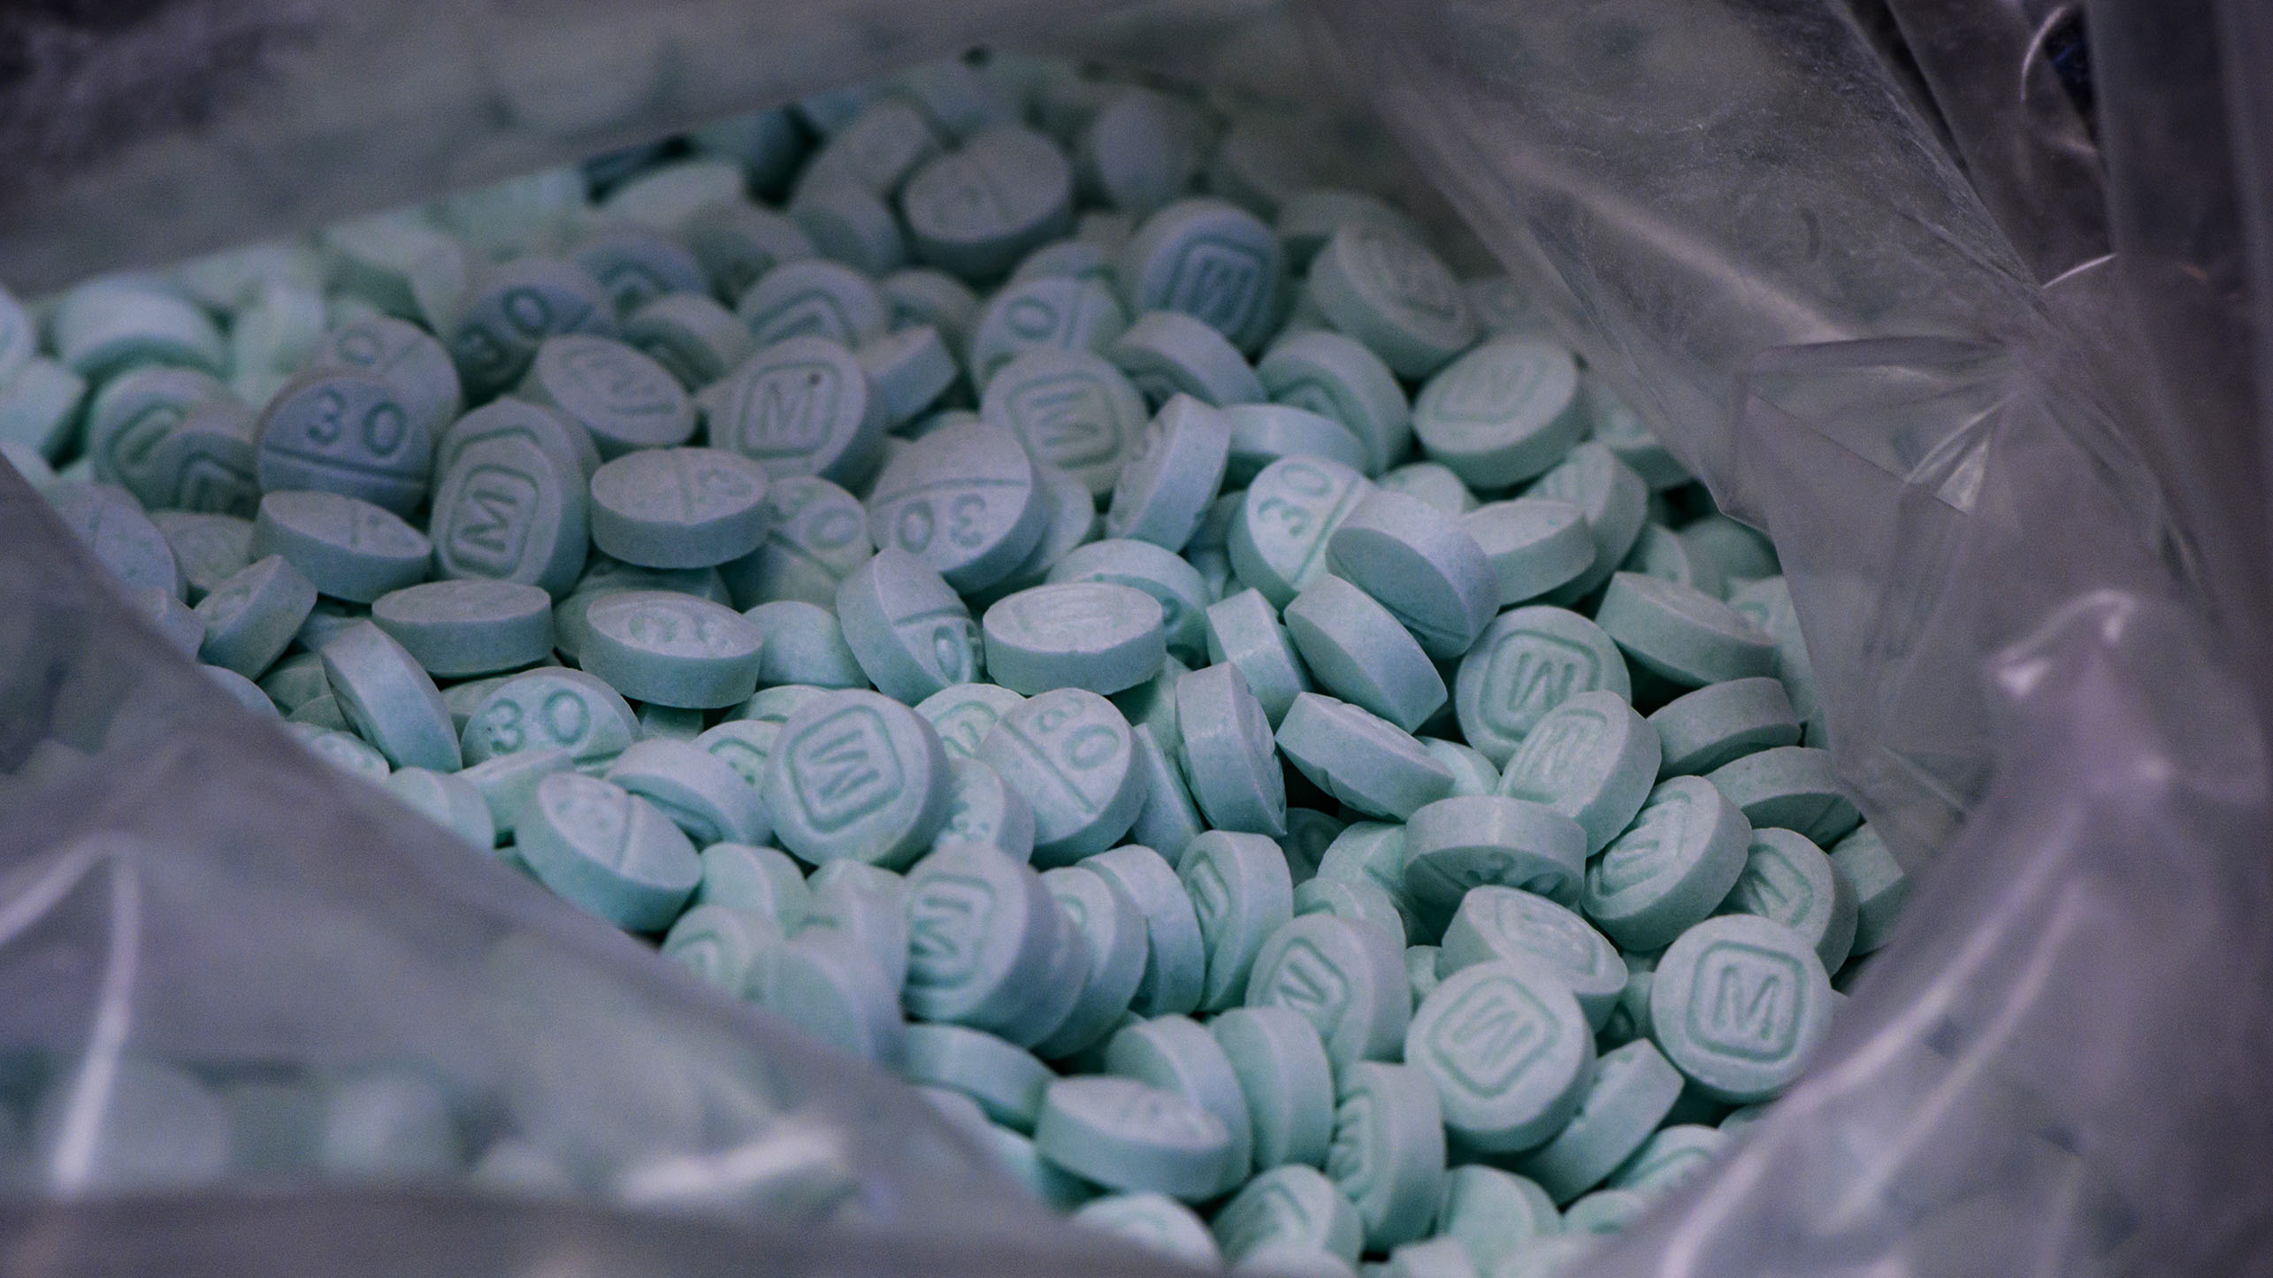
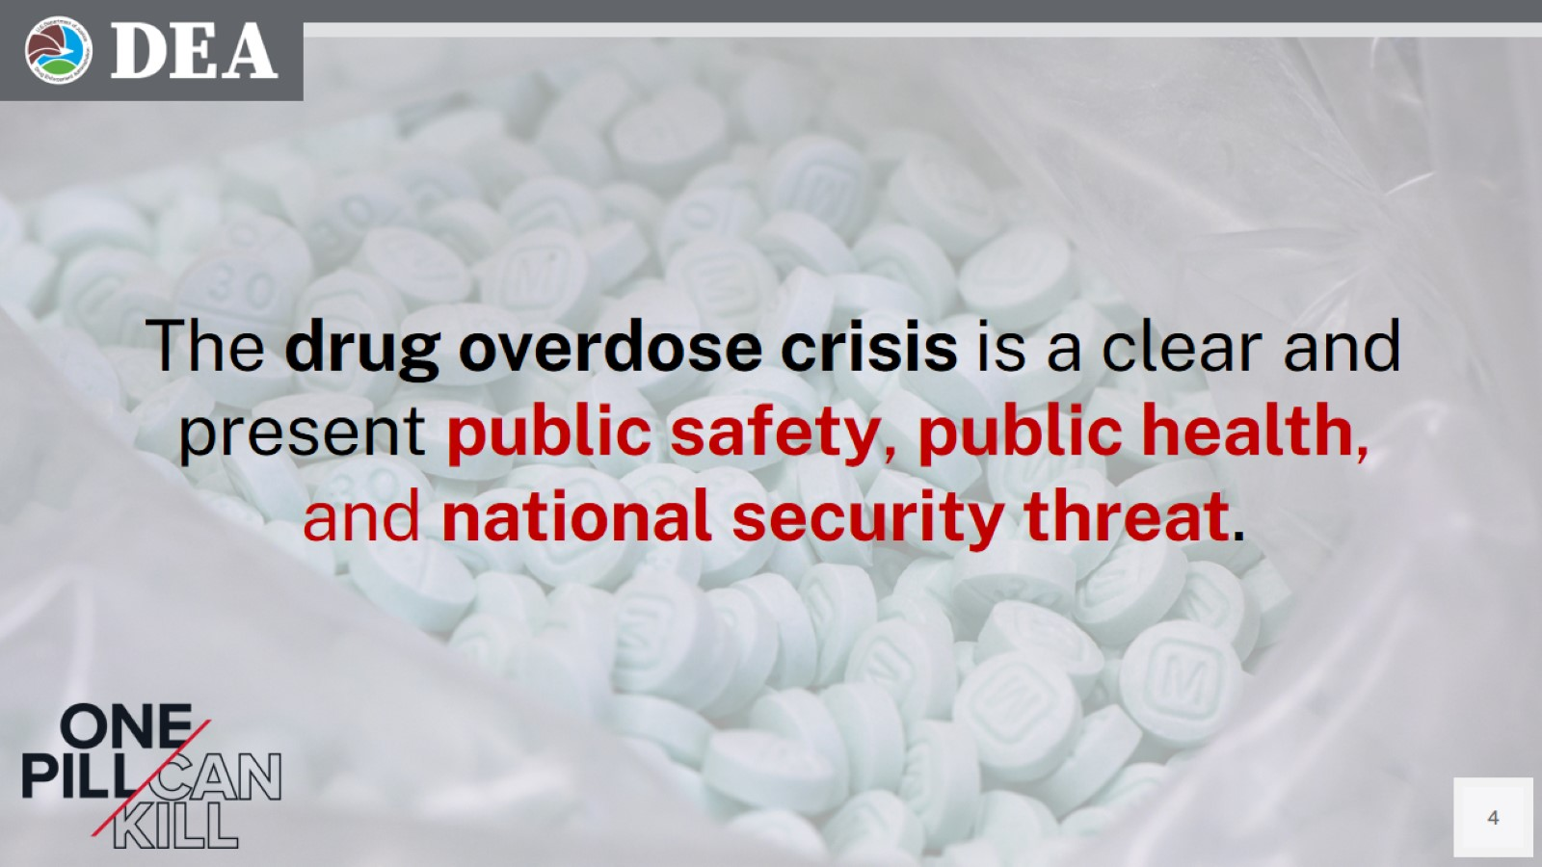
Drug Overdose Crisis
The drug overdose crisis is a clear and present public safety, public health, and national security threat.
Speaker Notes:
We are here today to talk about the drug overdose crisis. It is one of the greatest threats to the safety, health and well-being in every community across America.
DEA is doing everything it can to keep dangerous and deadly drugs out of your community, but we need your help. We need you to be educated about the dangers of today’s drugs. As we will discuss, some of these drugs are so lethal that experimenting with them just one time – could be deadly.
Notes:
We are here today to talk about the drug overdose crisis. It is one of the greatest threats to the safety, health and well-being in every community across America.
DEA is doing everything it can to keep dangerous and deadly drugs out of your community, but we need your help. We need you to be educated about the dangers of today’s drugs. As we will discuss, some of these drugs are so lethal that experimenting with them just one time – could be deadly.

Slide 5
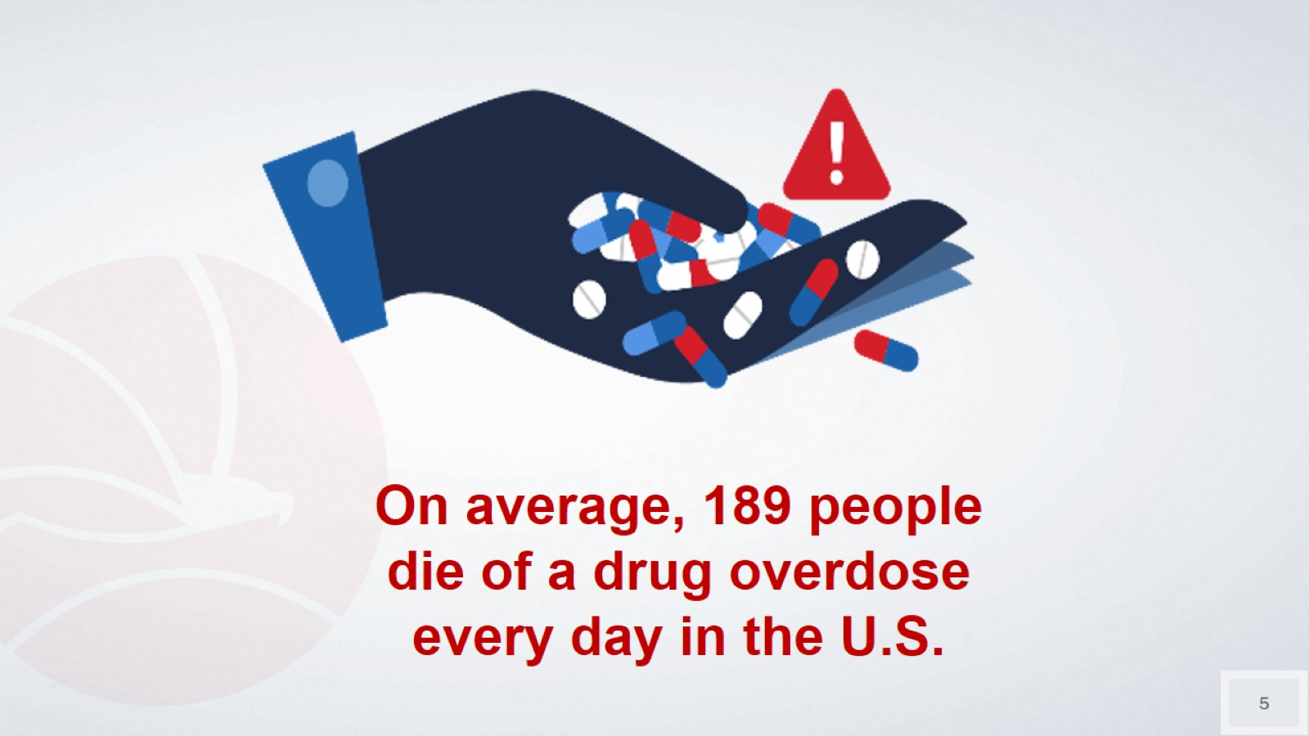
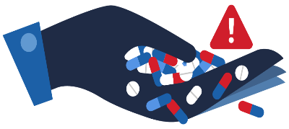
On average, 189 people die of a drug overdose every day in the U.S.

Slide 6
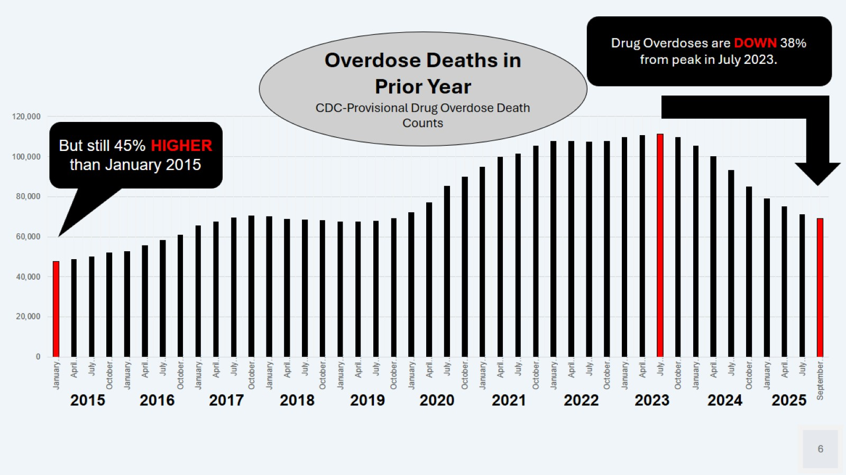
Overdose Deaths in Prior Year
Speaker Notes:
This slide shows the rate at which Americans have been dying from drug overdoses over the past decade.
The bars reflect the number of people who died in the year prior to that month. [NOTE: NOT THE NUMBER OF DEATHS PER MONTH.]
So, we be thankful that numbers are moving it the right direction, while at the same time recognizing that the number of people dying is still far too high.
Drug Overdoses are DOWN 38% from peak in July 2023.
Overdose Deaths in Prior Year
CDC-Provisional Drug Overdose Death Counts
But still 45% HIGHER than January 2015
2015 | 2016 | 2017 | 2018 | 2019 | 2020 | 2021 | 2022 | 2023 | 2024 | 2025
Notes:
This slide shows the rate at which Americans have been dying from drug overdoses over the past decade.
The bars reflect the number of people who died in the year prior to that month. [NOTE: NOT THE NUMBER OF DEATHS PER MONTH.]
So, we be thankful that numbers are moving it the right direction, while at the same time recognizing that the number of people dying is still far too high.

Slide 7
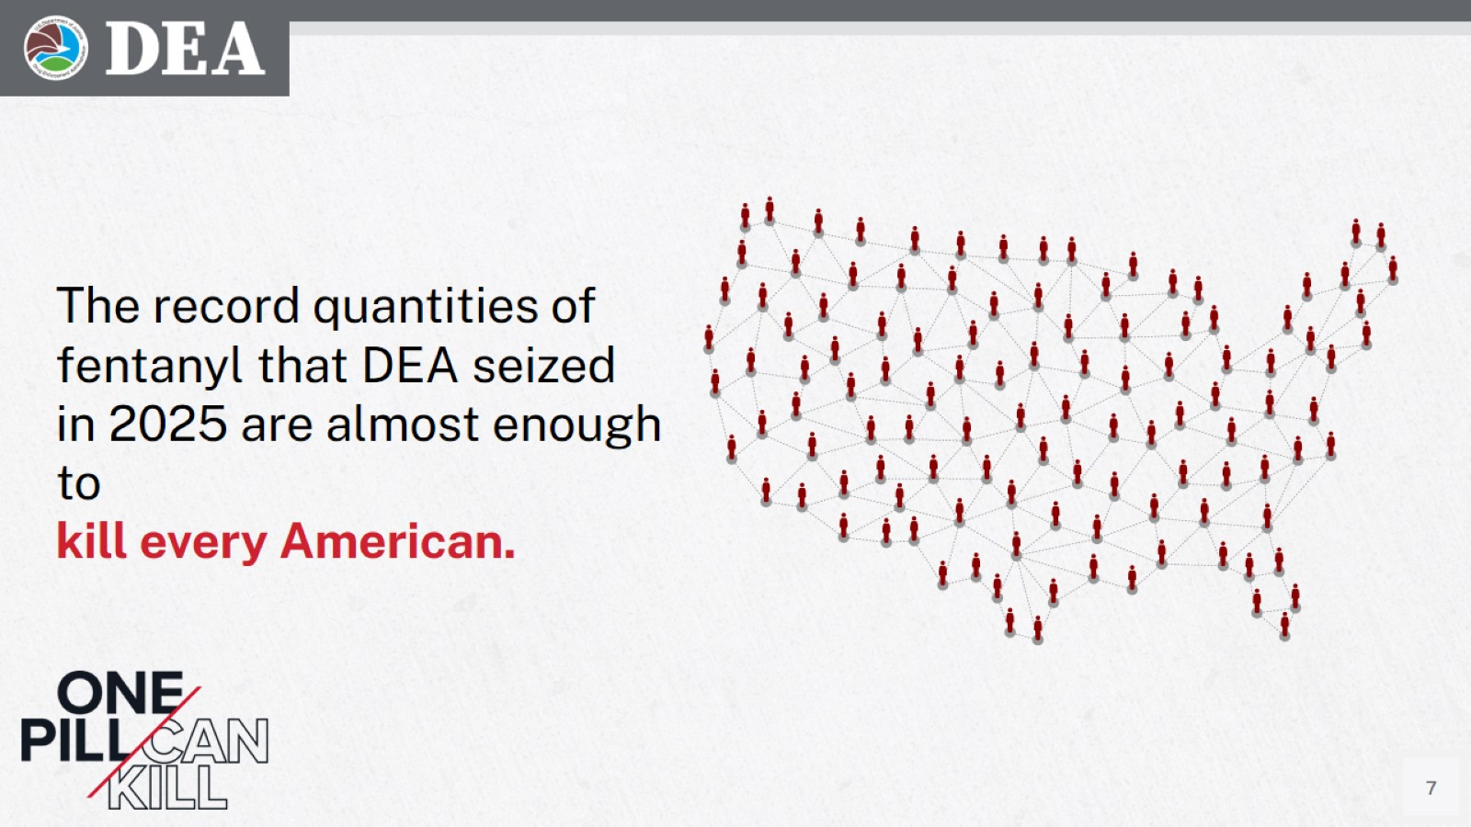
The record quantities of fentanyl that DEA seized in 2025 are almost enough to kill every American.
Speaker Notes:
In calendar year 2024, DEA seized more than 77 million fentanyl pills and nearly 12,000 pounds of fentanyl powder. It amounts to more than 300 million deadly doses of fentanyl—enough to kill every American.
Notes:
In calendar year 2024, DEA seized more than 77 million fentanyl pills and nearly 12,000 pounds of fentanyl powder. It amounts to more than 300 million deadly doses of fentanyl—enough to kill every American.

Slide 8
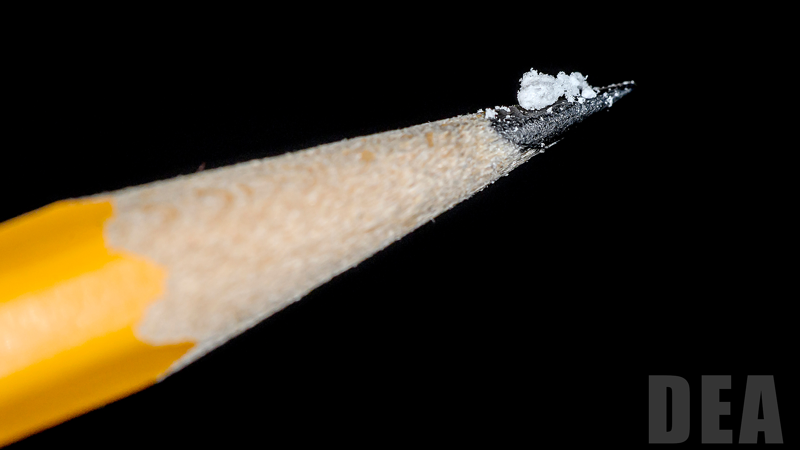
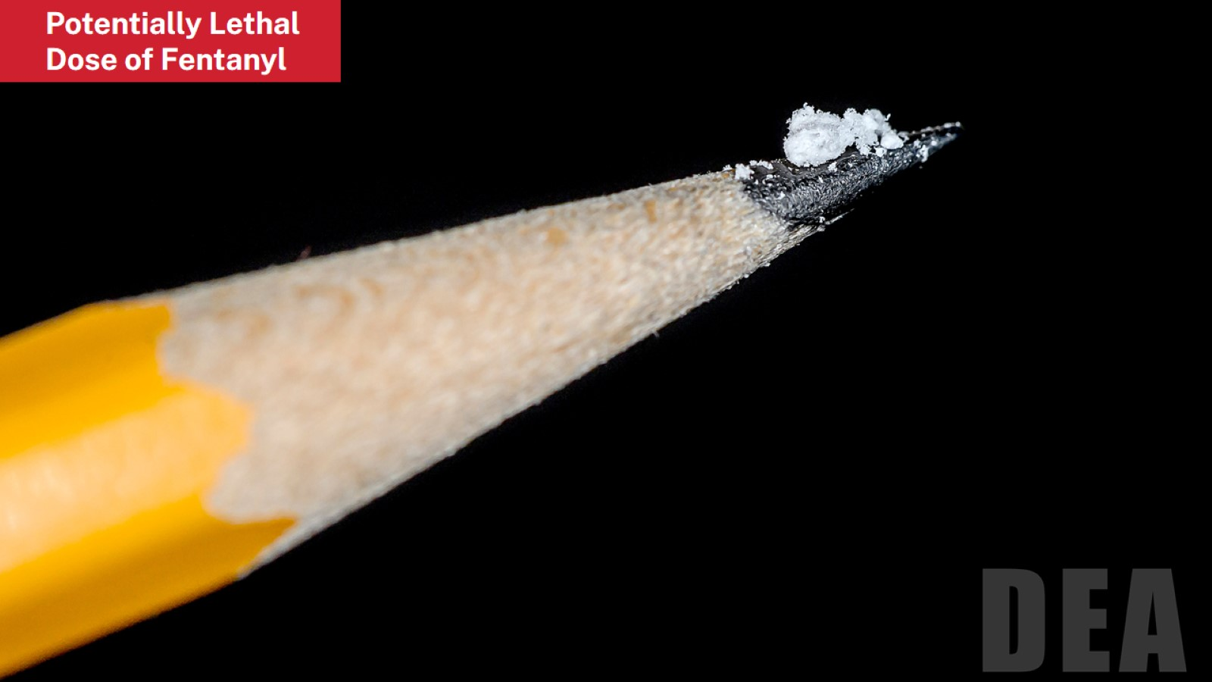
Potentially Lethal Dose of Fentanyl
Speaker Nores:
This is approximately 2 milligrams of Fentanyl and considered to be a lethal dose of fentanyl.
Fentanyl is 50 times more potent than heroin and 100 times more potent than morphine.
The fentanyl driving this crisis isn’t just sold in fake pills. Dealers are mixing fentanyl with other illicit drugs to make their product go further and increase their profits.
Notes:
This is approximately 2 milligrams of Fentanyl and considered to be a lethal dose of fentanyl.
Fentanyl is 50 times more potent than heroin and 100 times more potent than morphine.
The fentanyl driving this crisis isn’t just sold in fake pills. Dealers are mixing fentanyl with other illicit drugs to make their product go further and increase their profits.

Slide 9
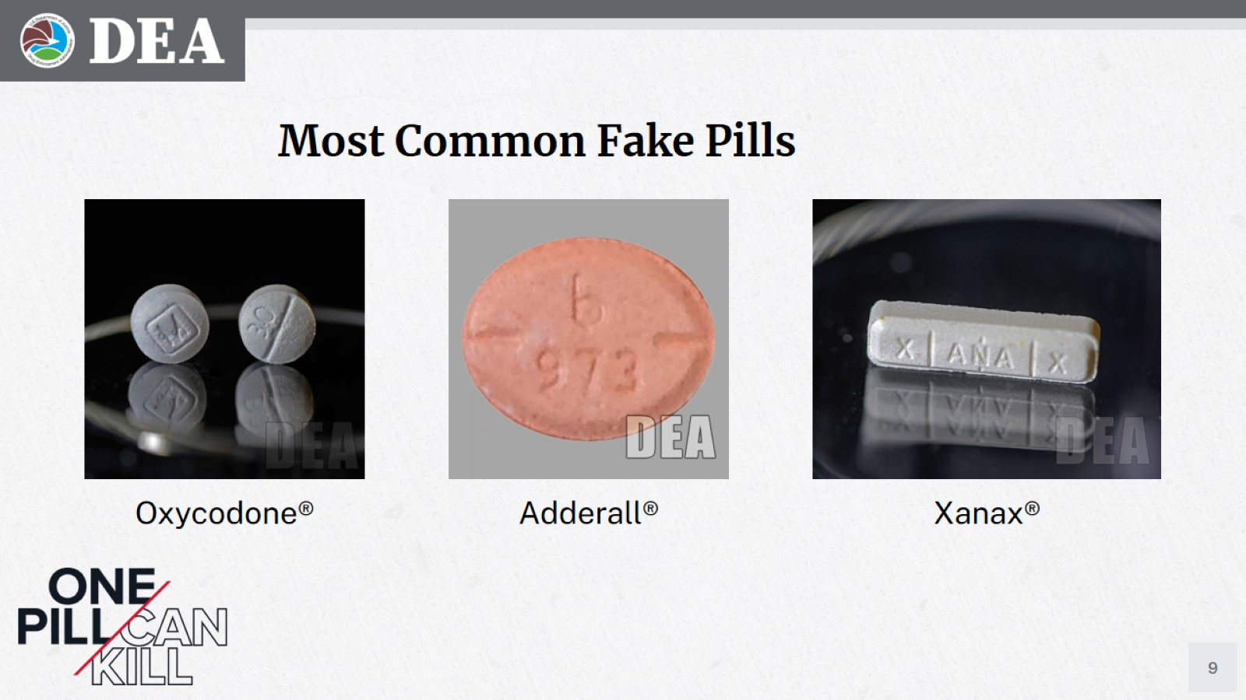
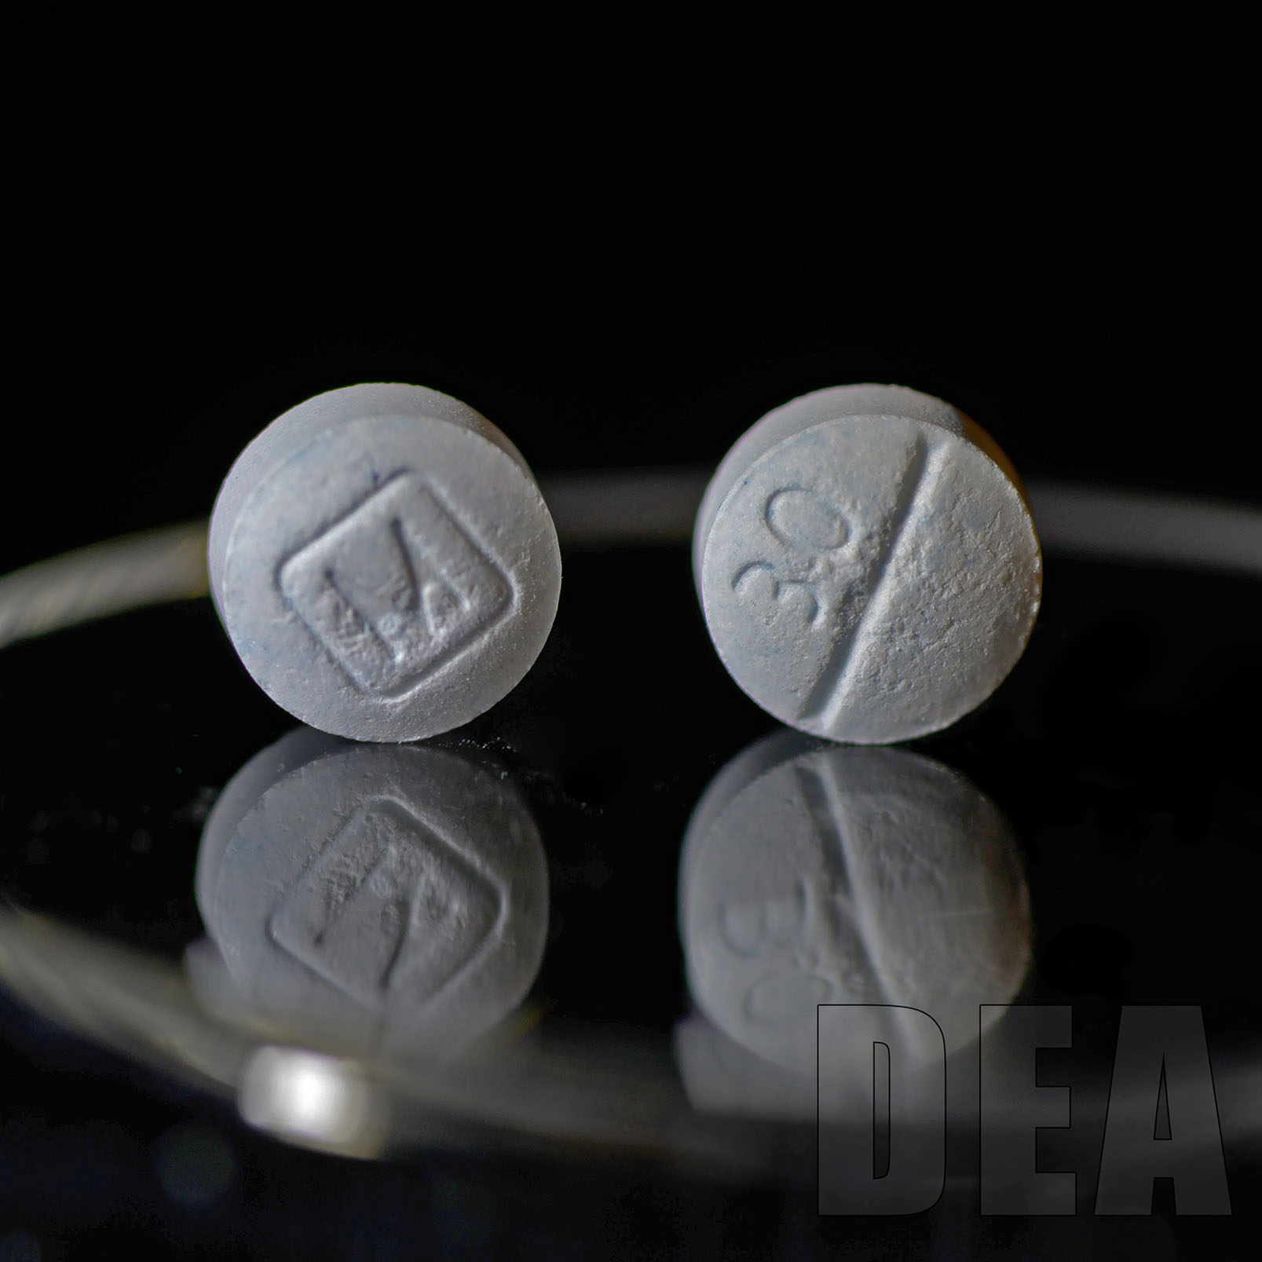
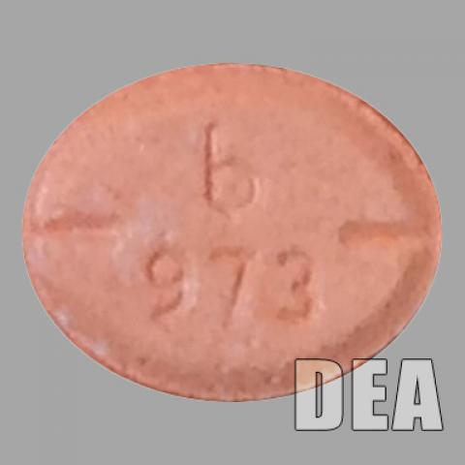
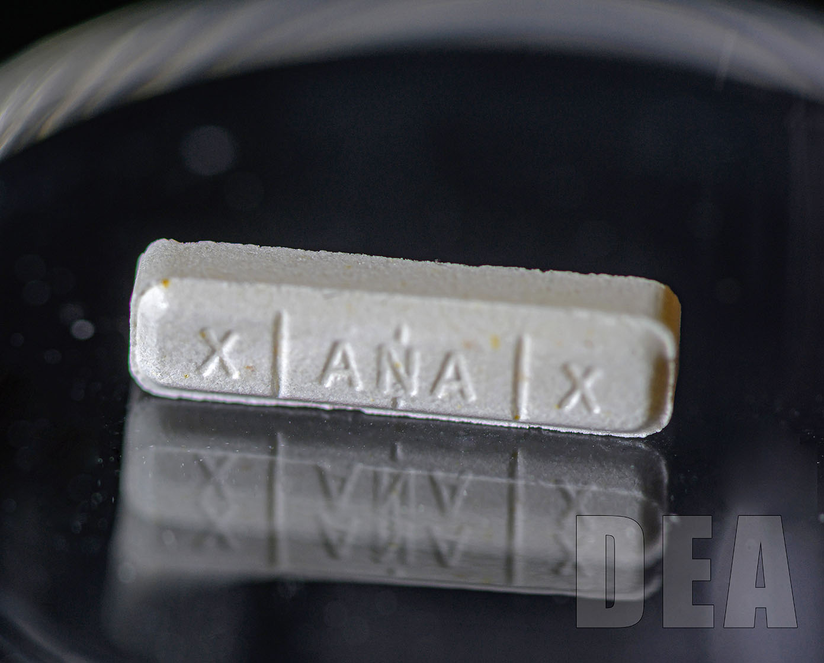
Most Common Fake Pills
Oxycodone®
Adderall®
Xanax®
Speaker Notes:
Some of the most common fake pills are made to look like prescription opioids such as oxycodone, hydrocodone (Vicodin), alprazolam (Xanax) and stimulants like amphetamines such as Adderall.
Fake prescription pills are widely accessible and often sold on social media and e-commerce platforms, making them available to anyone with a smartphone.
Notes:
Some of the most common fake pills are made to look like prescription opioids such as oxycodone, hydrocodone (Vicodin), alprazolam (Xanax) and stimulants like amphetamines such as Adderall.
Fake prescription pills are widely accessible and often sold on social media and e-commerce platforms, making them available to anyone with a smartphone.

Slide 10
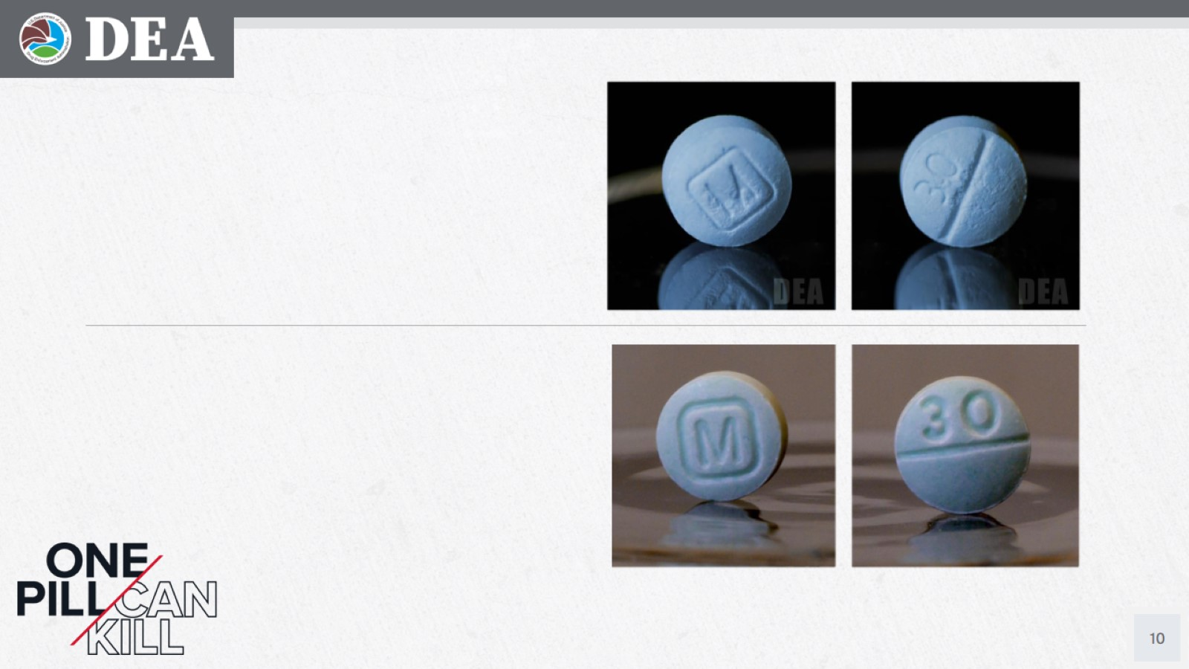
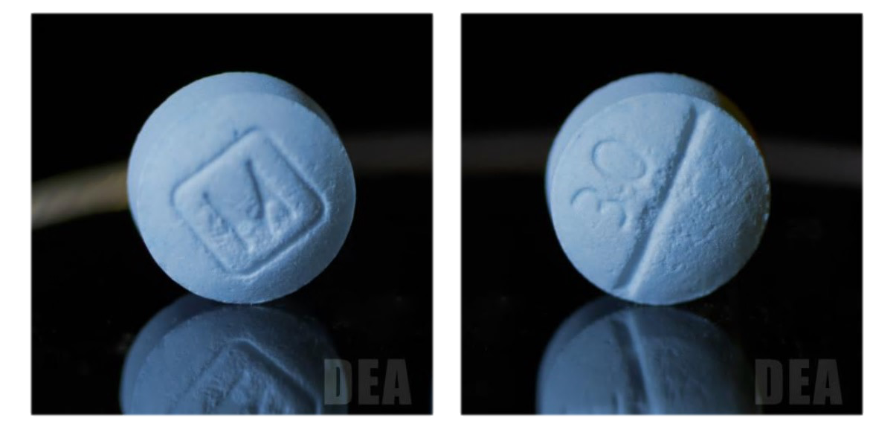
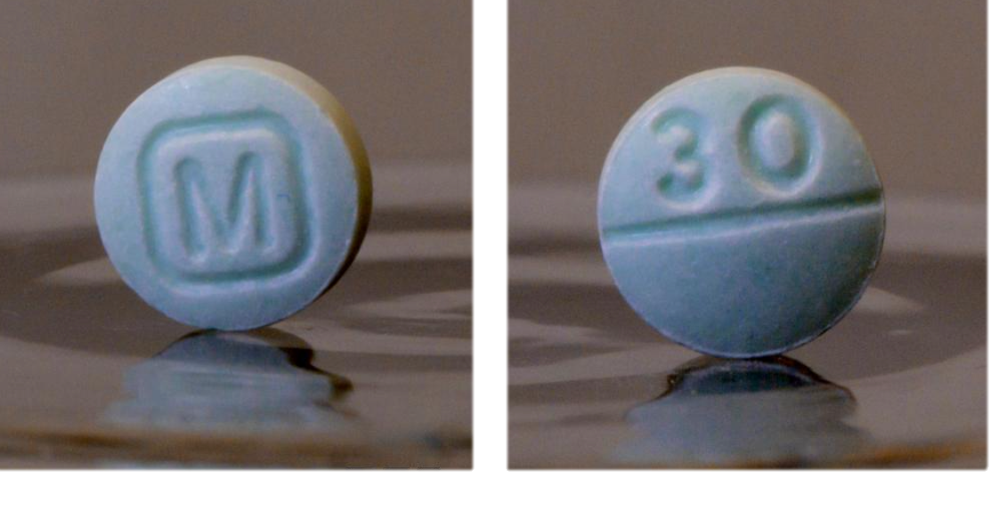
Authentic Versus Fake Oxycodone (1 of 2)
Speaker Notes: Let me ask you, which of these pills do you think is real? And which is the fake?
Notes:
Let me ask you, which of these pills do you think is real? And which is the fake?

Slide 11
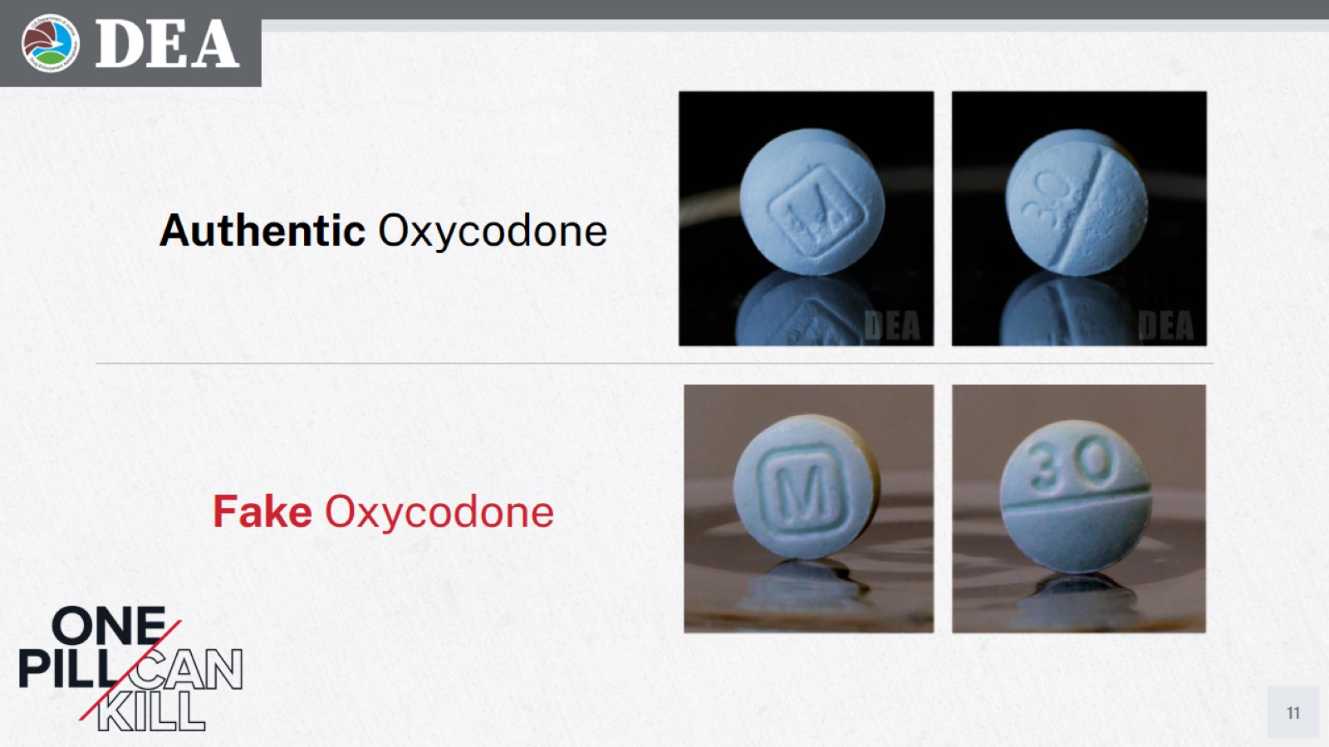
Authentic Versus Fake Oxycodone (2 of 2)
Authentic Oxycodone
Fake Oxycodone

Slide 12
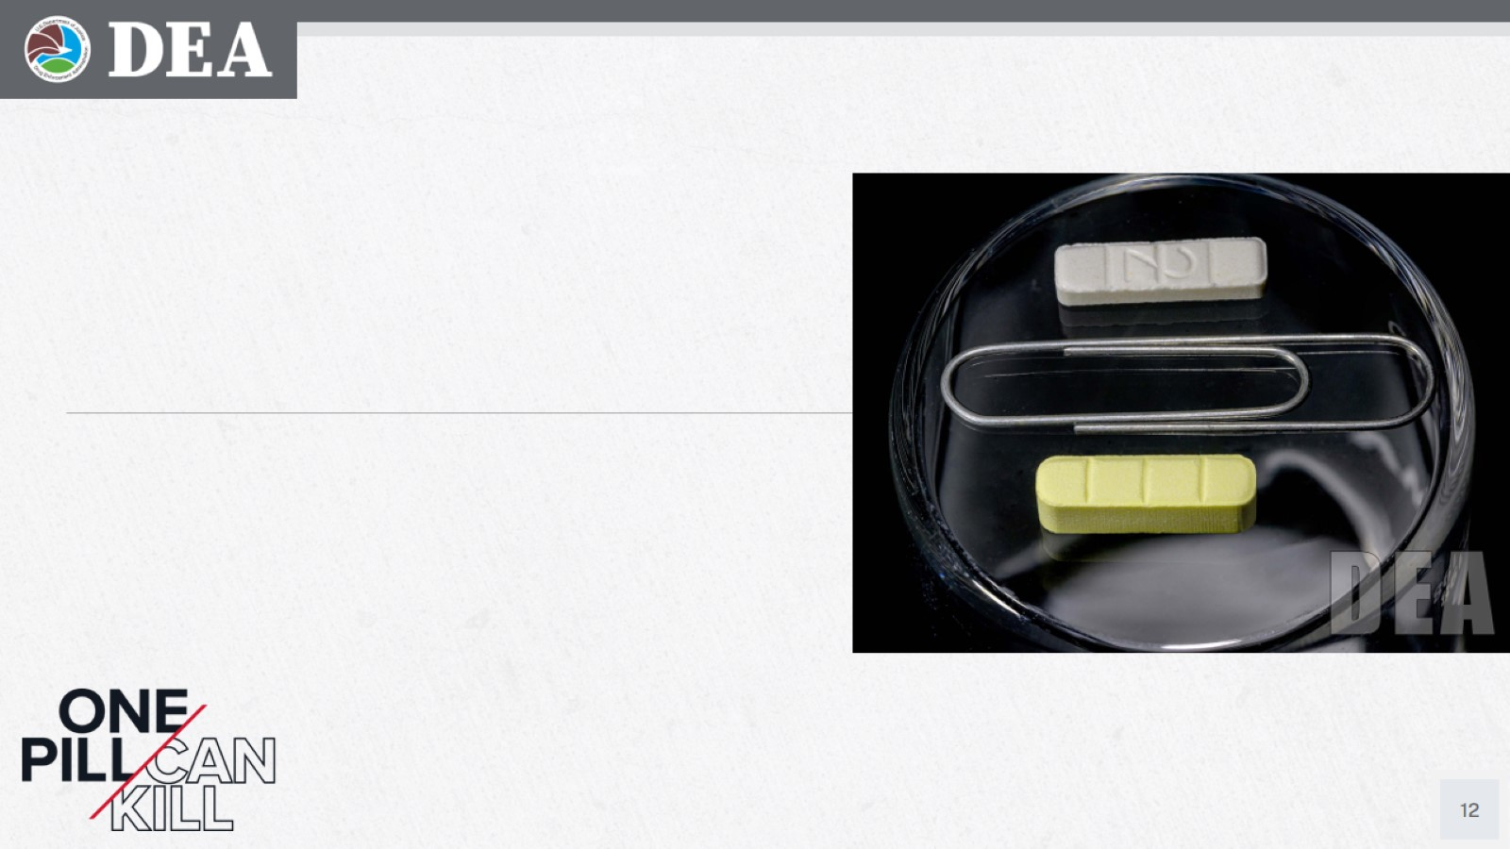
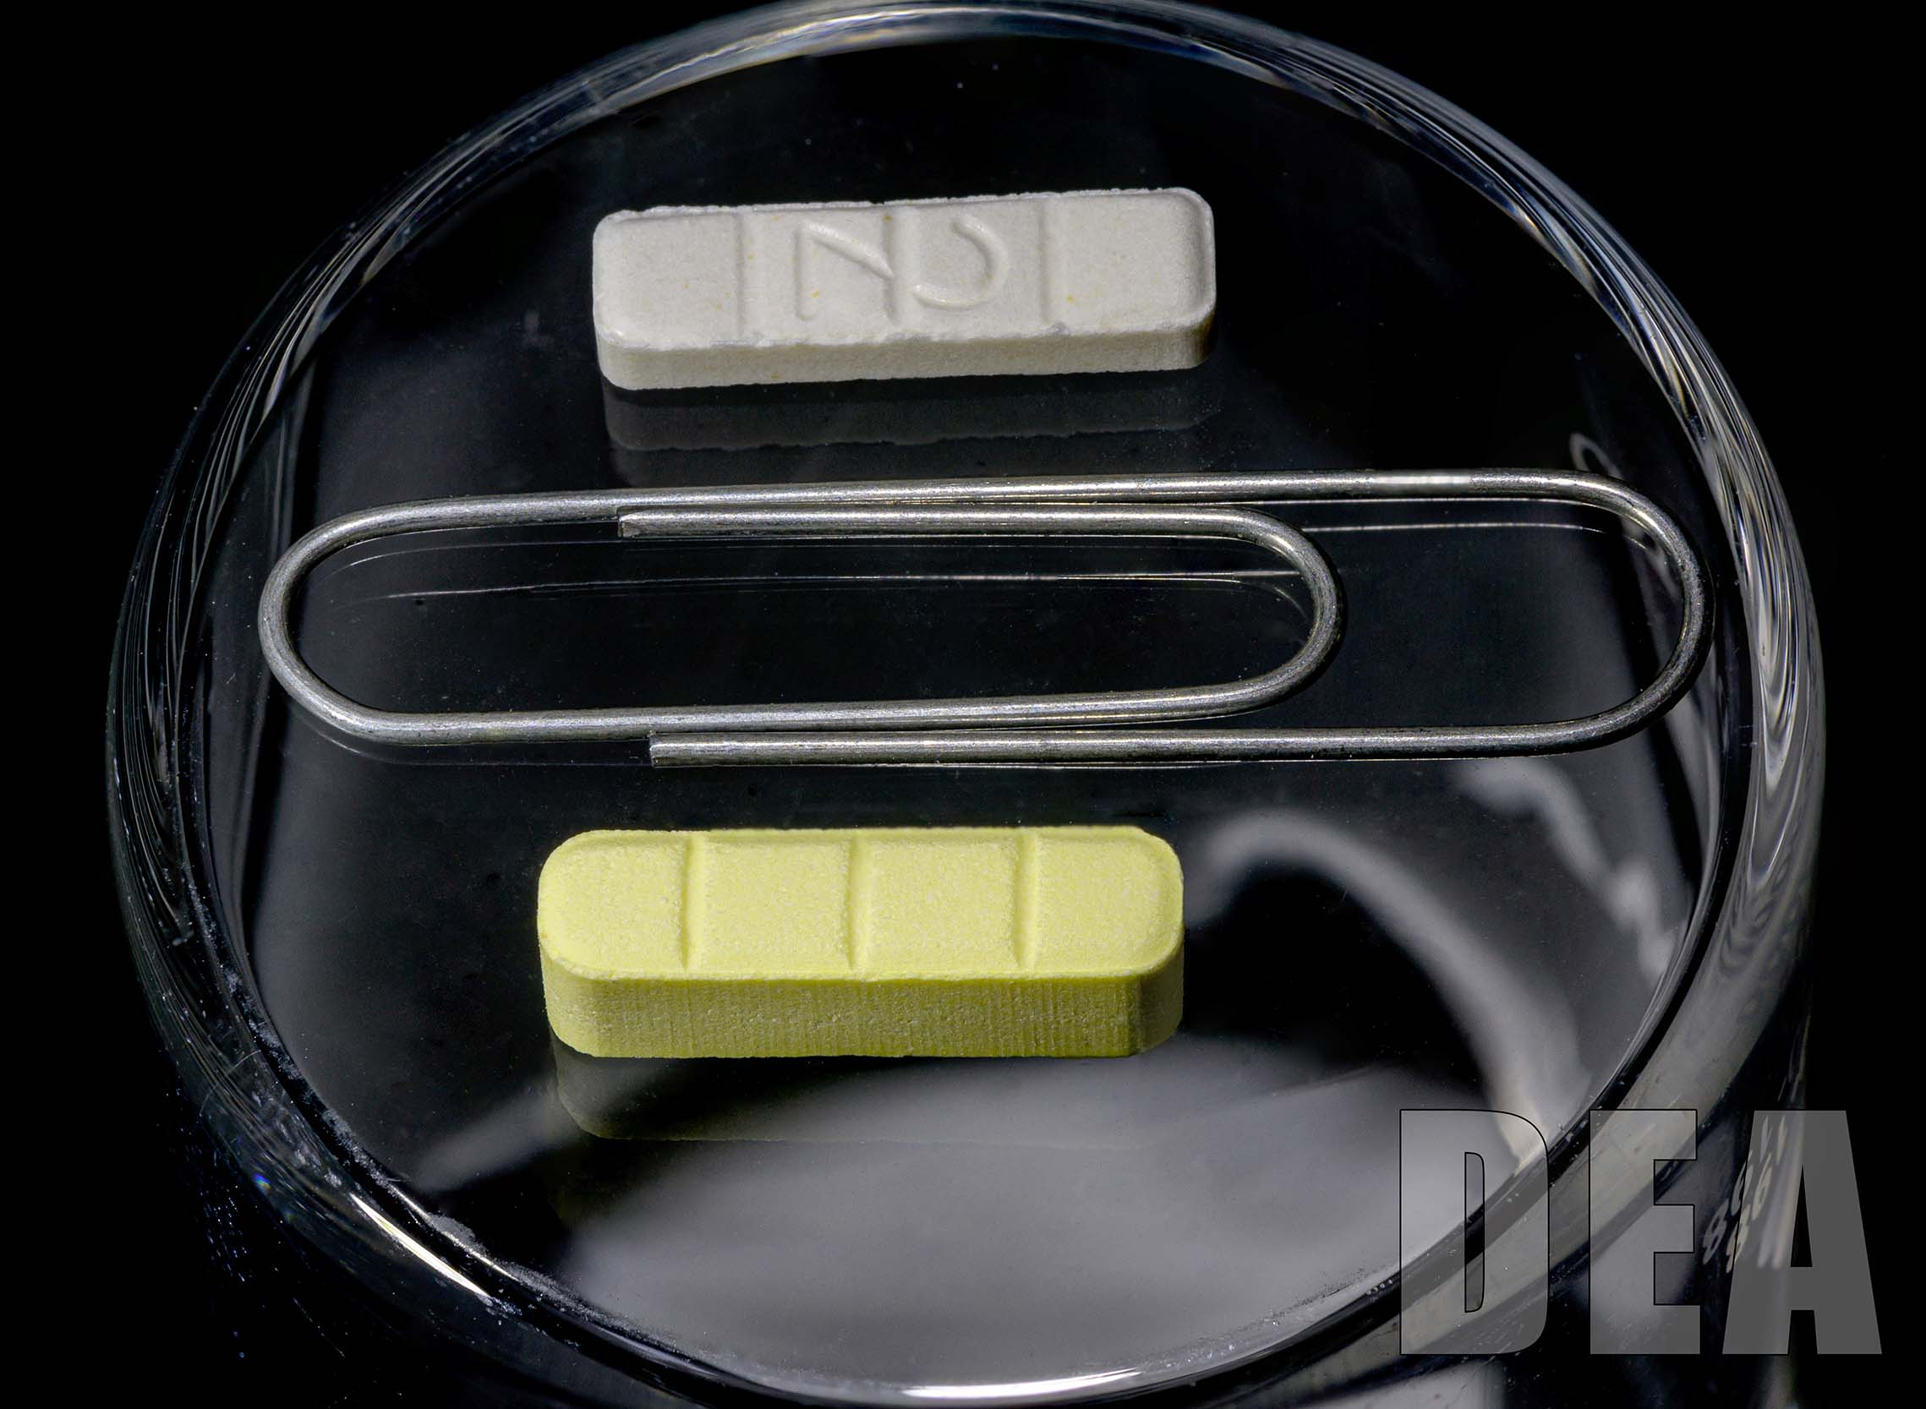
Authentic Versus Fake Xanax (1 of 2)
Speaker Notes:
How about this picture?
Notes:
How about this picture?

Slide 13
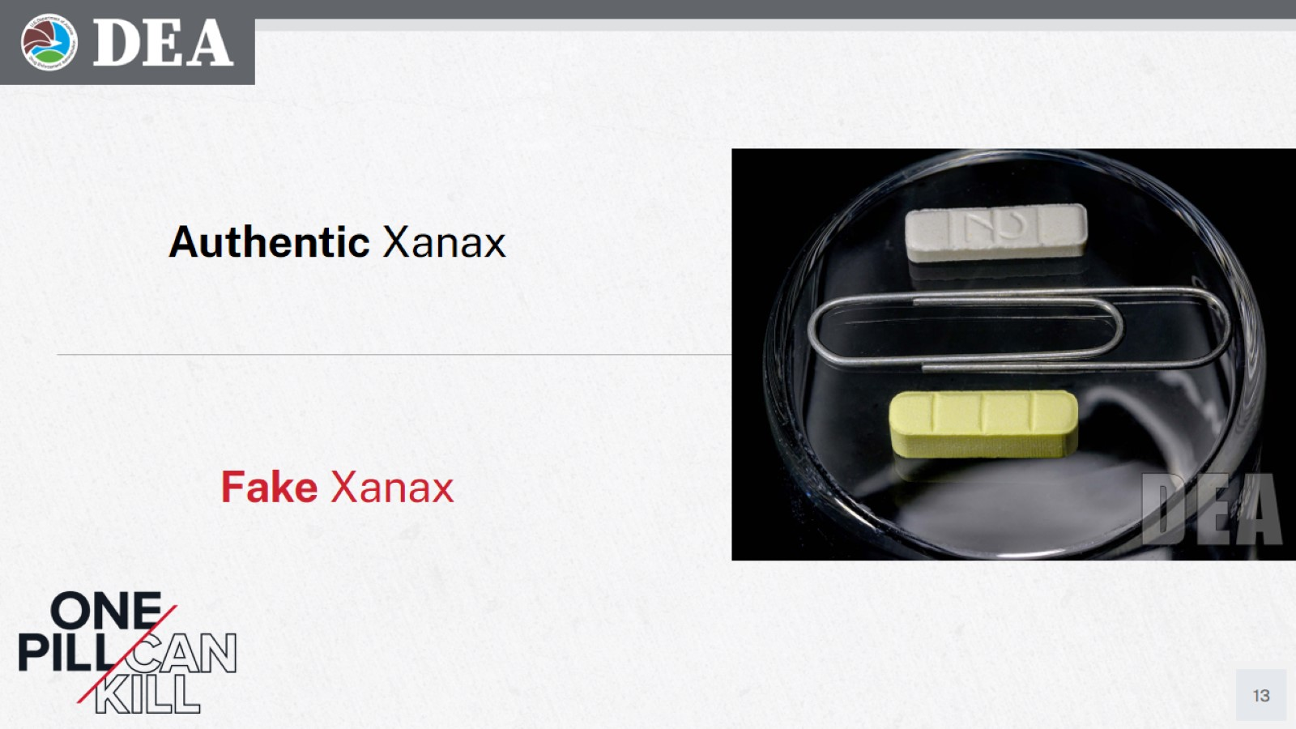
Authentic Versus Fake Xanax (2 of 2)
Authentic Xanax
Fake Xanax
Speaker Notes:
Xanax
Real – top
Fake - Bottom
The fact of the matter is, fake pills appear nearly identical to legitimate prescription medications.
If you did not get a pill from a licensed physician or pharmacist there is no way of telling whether a pill is legitimate or fake. Even that pill your friend gives you for your headache or back pain – there is no way to tell whether they contain fentanyl or methamphetamine. Even if someone tells you it is Oxycodone, Vicodin or Adderall you can’t trust them, unless it came from a pharmacist.
Expect it to be fake – drug traffickers are preying on our dependence on pills and will market certain products as legitimate medications when they contain none of the active ingredients of those medications.
Notes:
Xanax
Real – top
Fake - Bottom
The fact of the matter is, fake pills appear nearly identical to legitimate prescription medications.
If you did not get a pill from a licensed physician or pharmacist there is no way of telling whether a pill is legitimate or fake. Even that pill your friend gives you for your headache or back pain – there is no way to tell whether they contain fentanyl or methamphetamine. Even if someone tells you it is Oxycodone, Vicodin or Adderall you can’t trust them, unless it came from a pharmacist.
Expect it to be fake – drug traffickers are preying on our dependence on pills and will market certain products as legitimate medications when they contain none of the active ingredients of those medications.

Slide 14
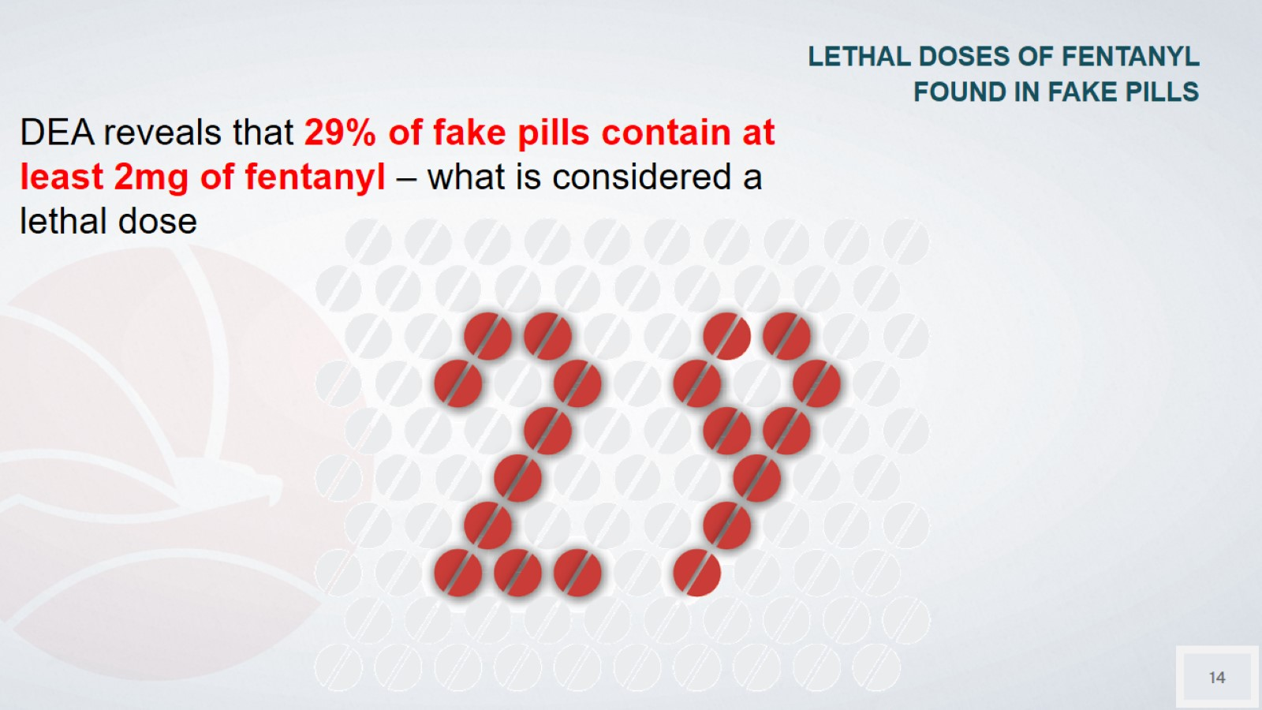
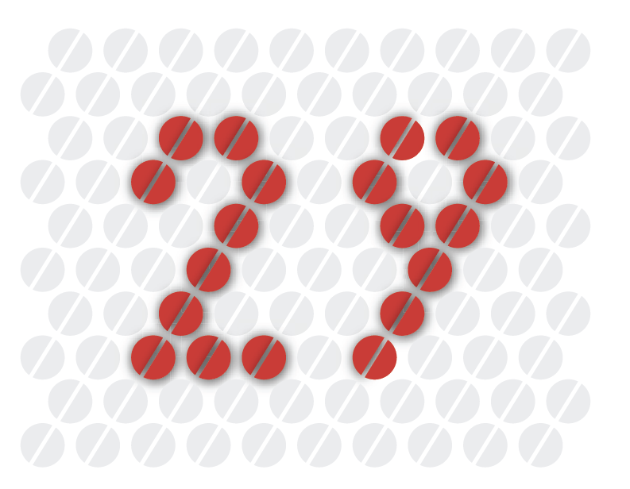
LETHAL DOSES OF FENTANYL FOUND IN FAKE PILLS
DEA reveals that 29% of fake pills contain at least 2mg of fentanyl – what is considered a lethal dose
Speaker Notes: In recent years, DEA has tracked the percentage of counterfeit fentanyl pills that contain a lethal dose. Most recently, DEA determined that 29 percent of these pills are deadly. That is down from recent years, but still incredibly dangerous.
Notes:
In recent years, DEA has tracked the percentage of counterfeit fentanyl pills that contain a lethal dose. Most recently, DEA determined that 29 percent of these pills are deadly. That is down from recent years, but still incredibly dangerous.

Slide 15
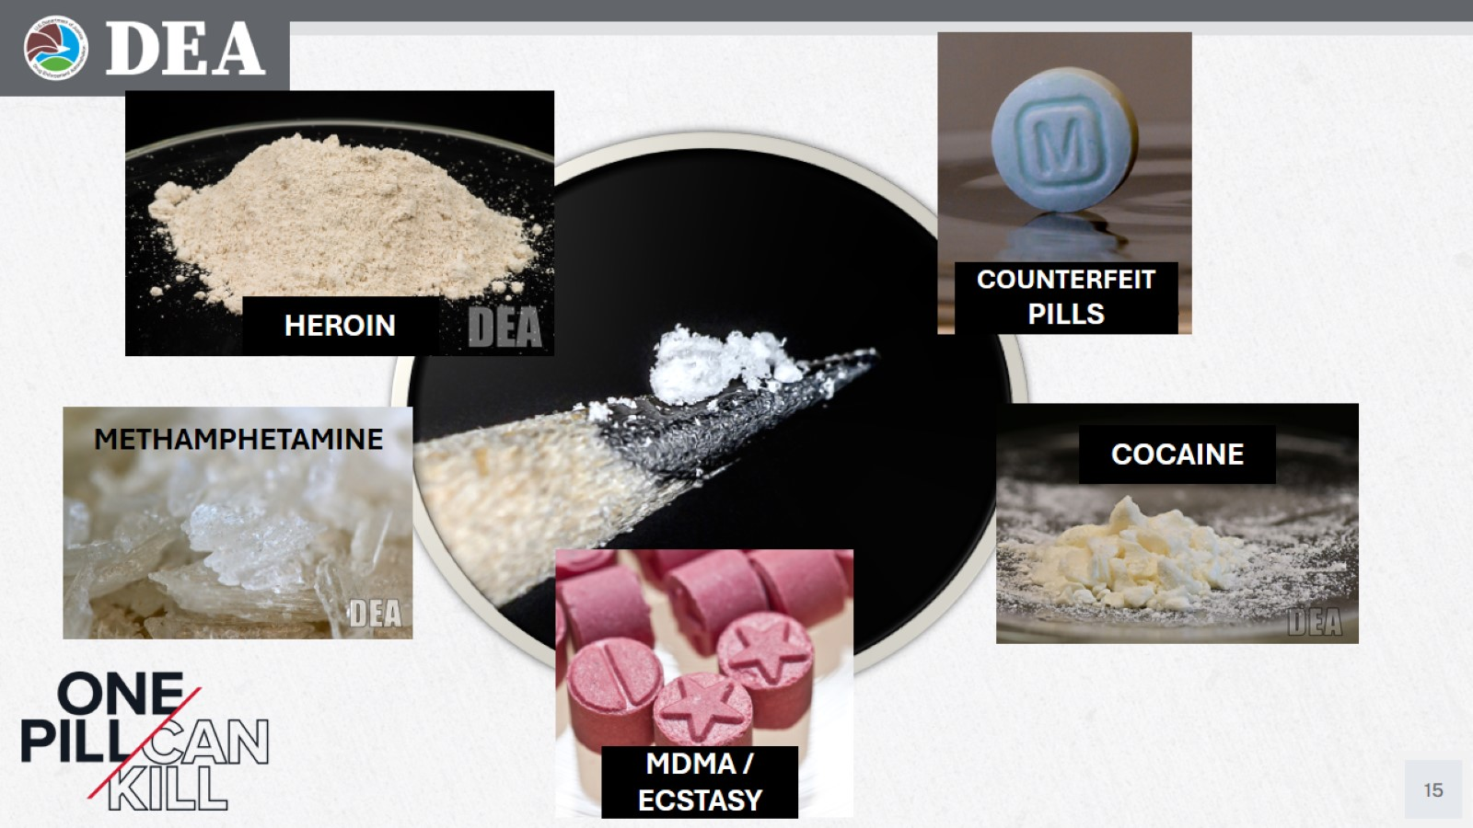
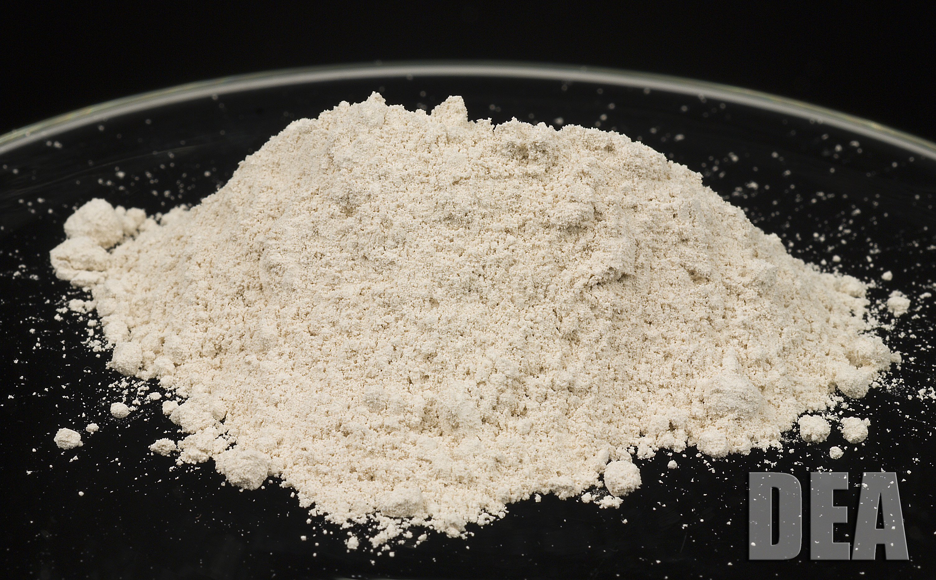
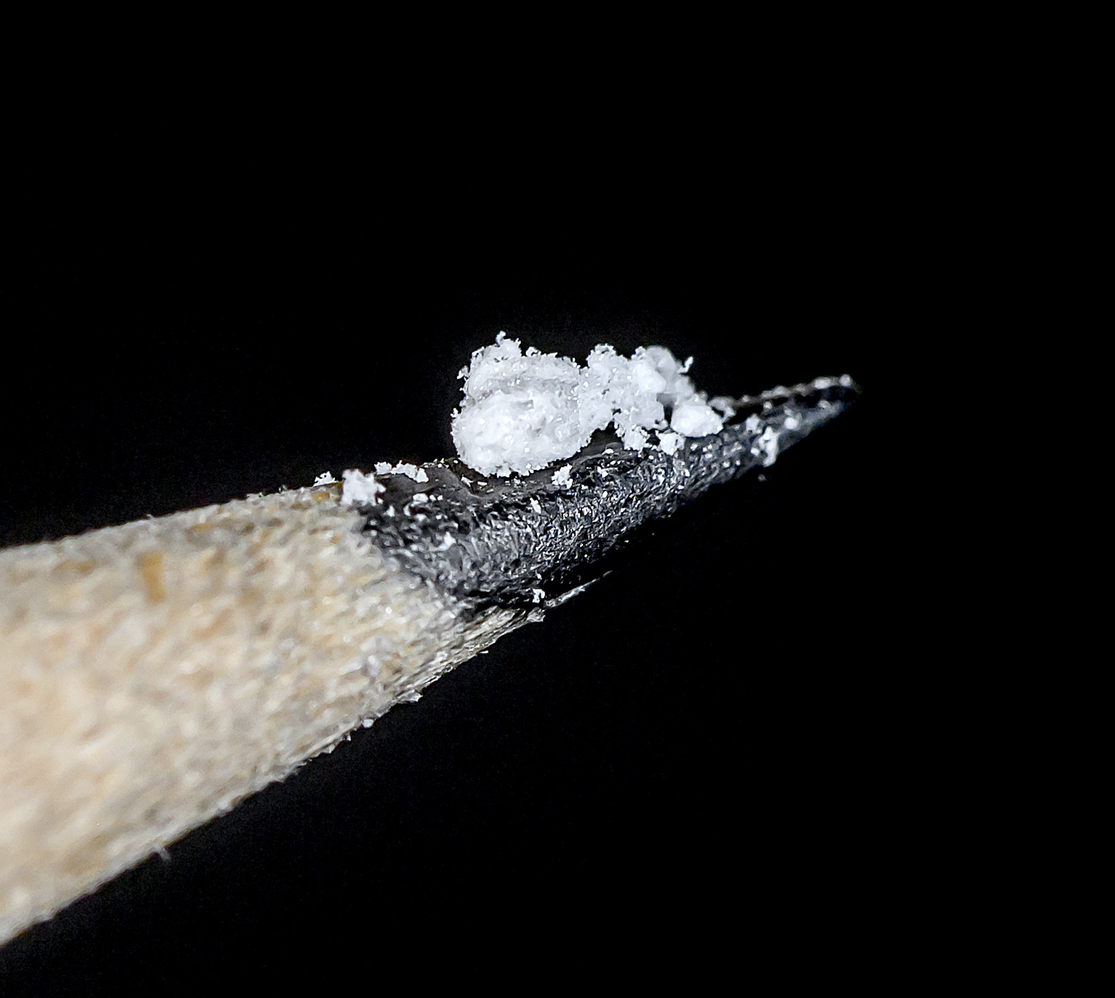
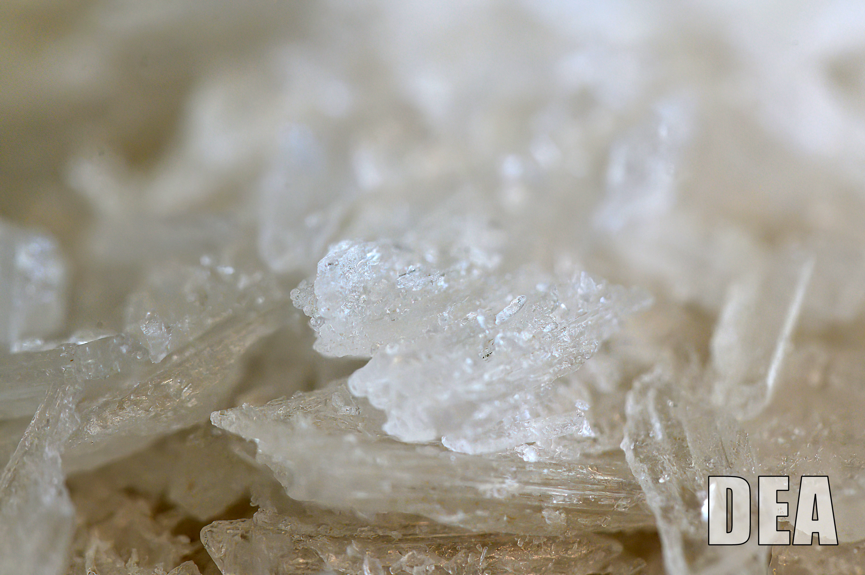
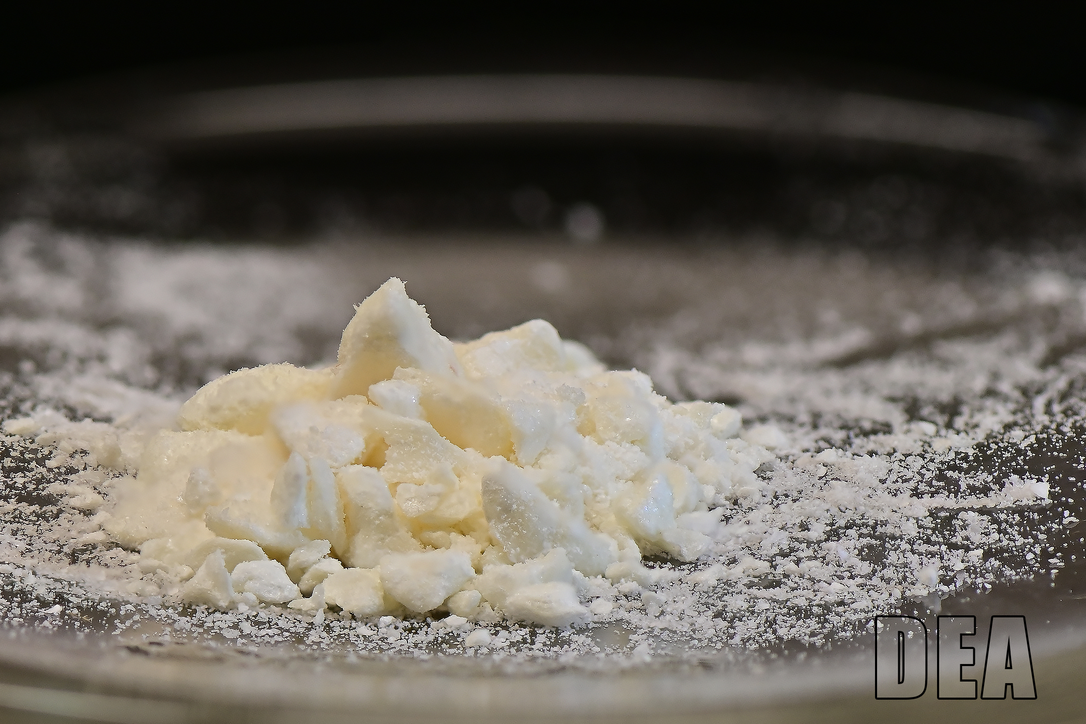
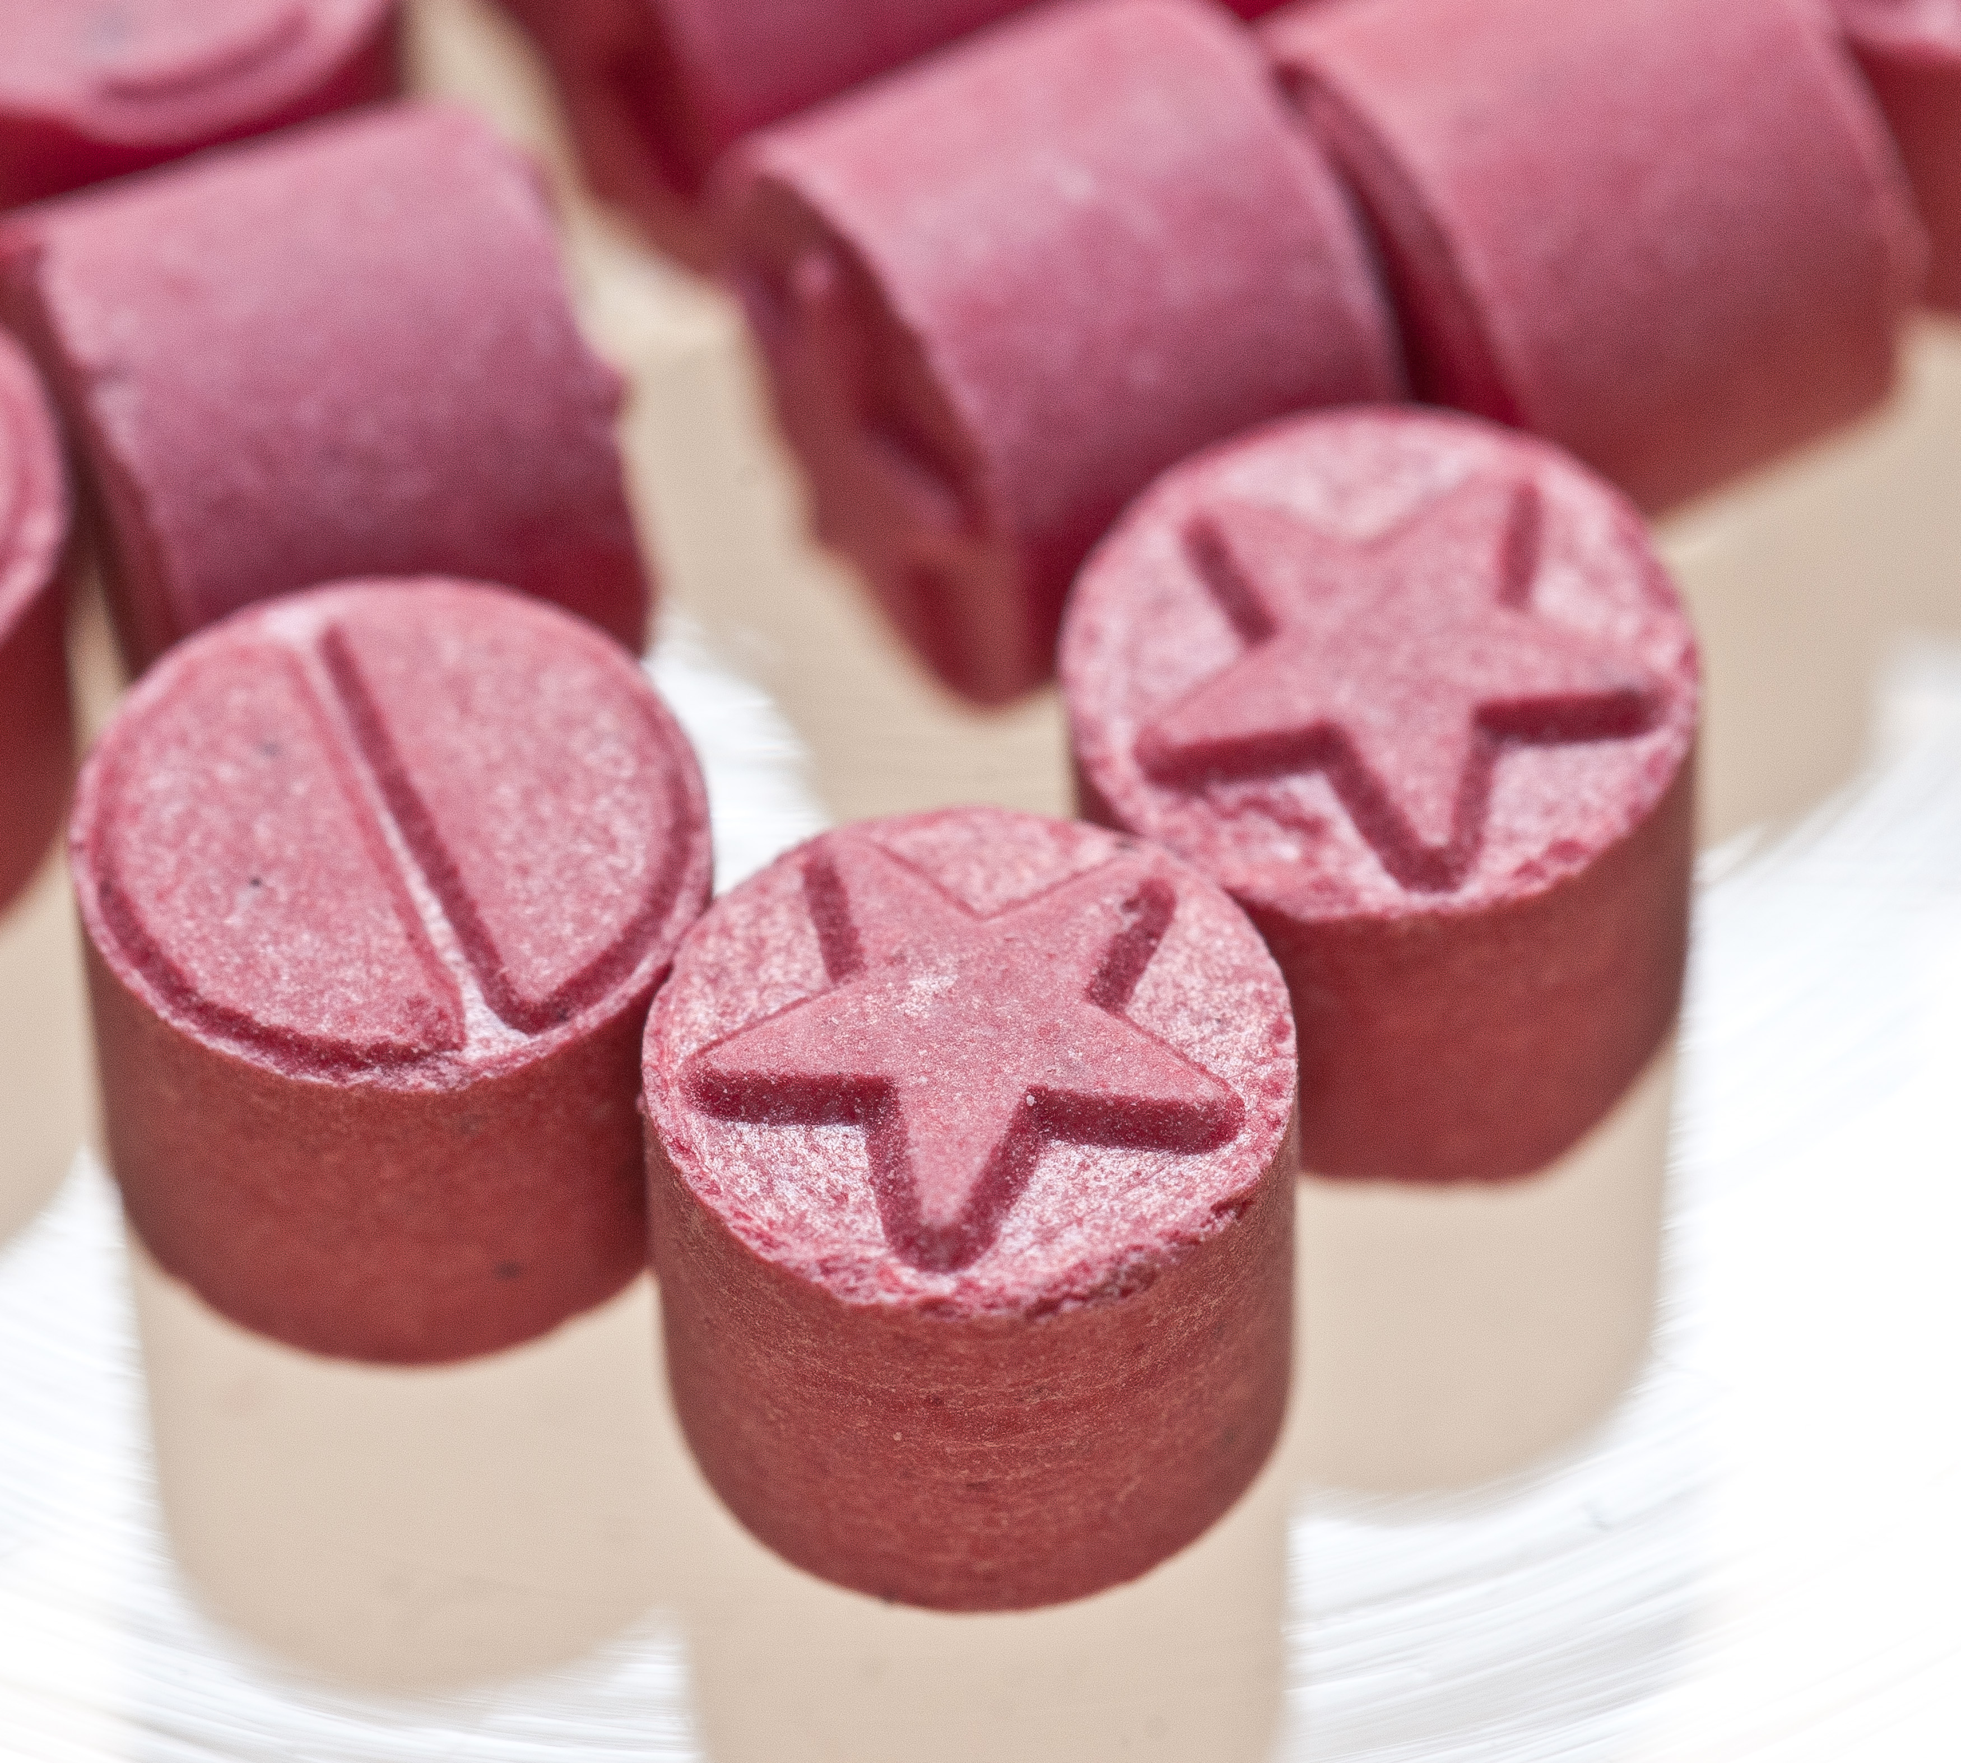
Photos of Abused Drugs
COUNTERFEIT PILLS
HEROIN
METHAMPHETAMINE
COCAINE
Speaker Notes:
You may have seen this image before – A lethal dose of fentanyl can fit on the tip of a pencil.
While fentanyl appears most often in heroin and counterfeit pills, fentanyl and its analogs are also being found in meth, MDMA/Ecstasy and cocaine.
MDMA / ECSTASY
Notes:
You may have seen this image before – A lethal dose of fentanyl can fit on the tip of a pencil.
While fentanyl appears most often in heroin and counterfeit pills, fentanyl and its analogs are also being found in meth, MDMA/Ecstasy and cocaine.

Slide 16
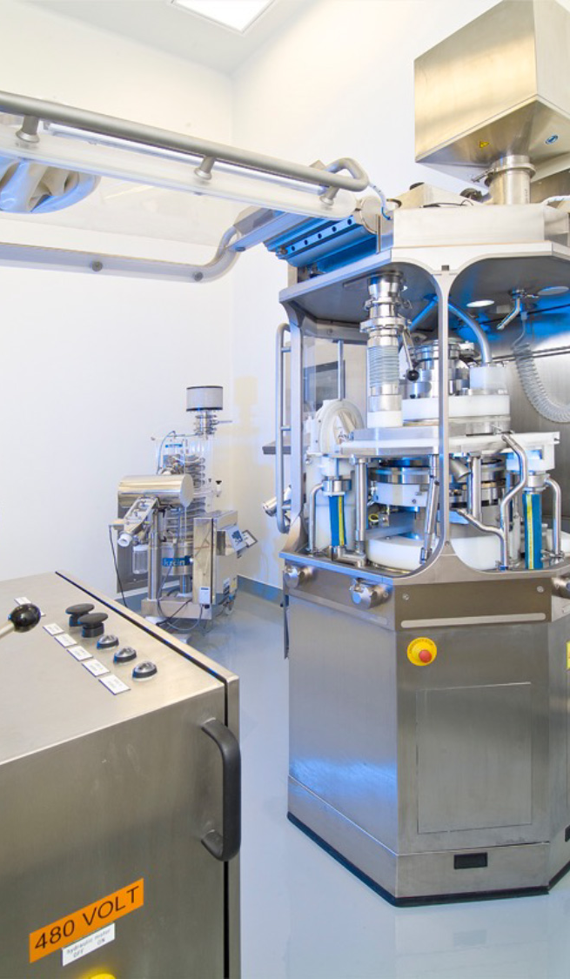
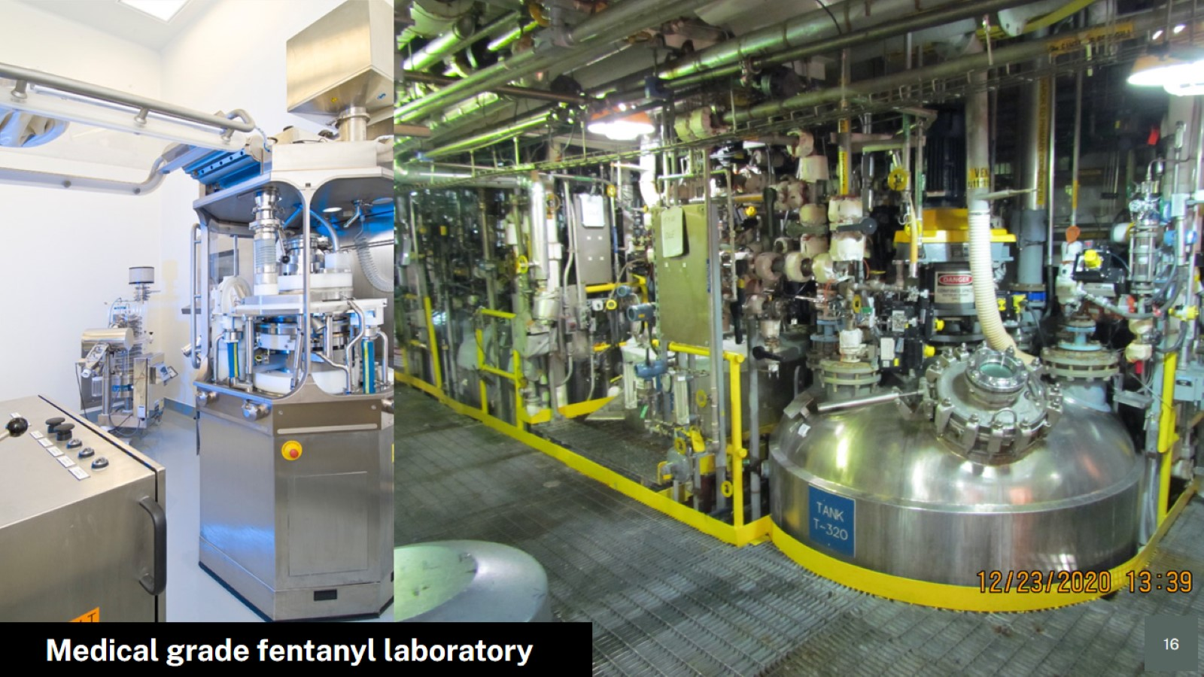
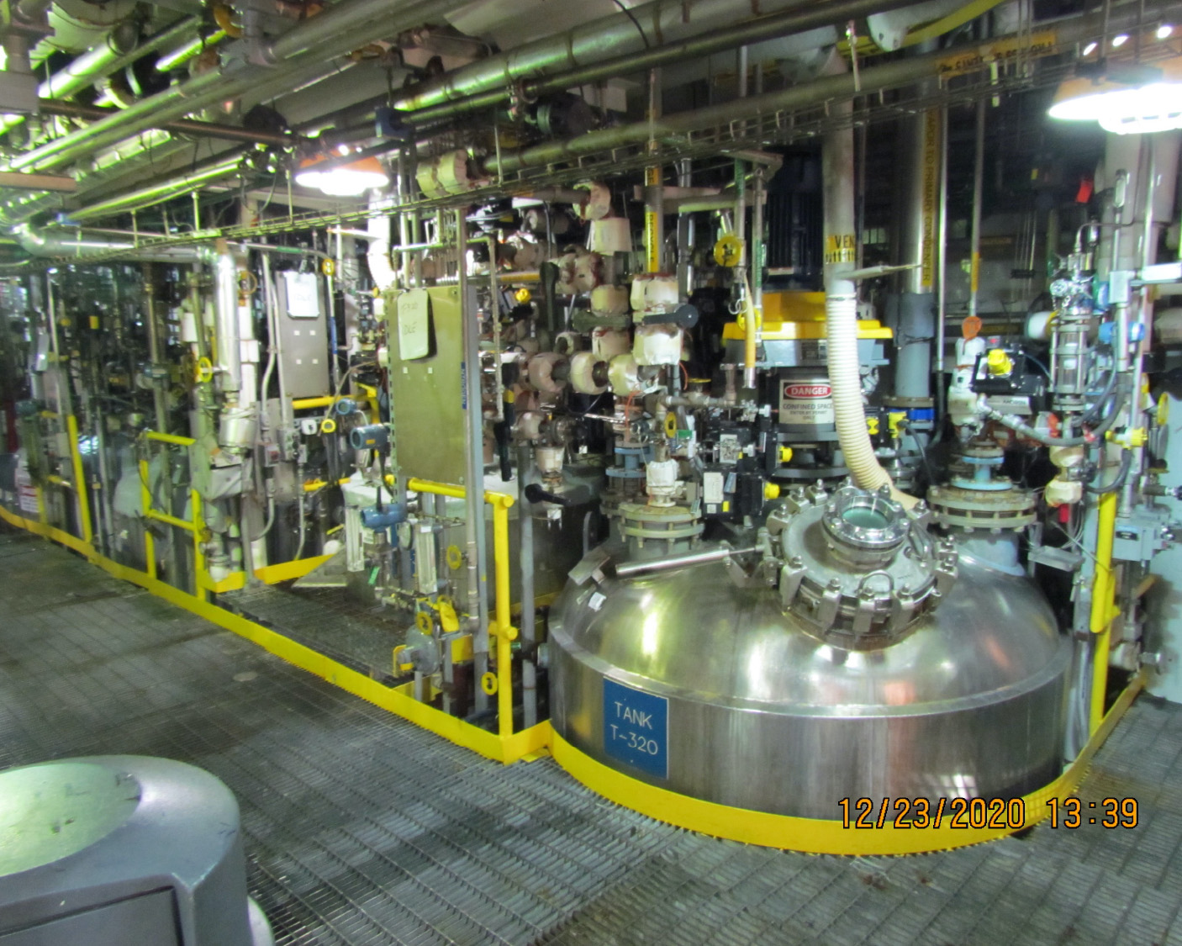
Medical grade fentanyl laboratory
Speaker Notes:
Medical grade fentanyl is made in a clean controlled laboratory, like this one, with strict regulations and taken in hospitals or nursing homes under strict medical care.
Notes:
Medical grade fentanyl is made in a clean controlled laboratory, like this one, with strict regulations and taken in hospitals or nursing homes under strict medical care.

Slide 17
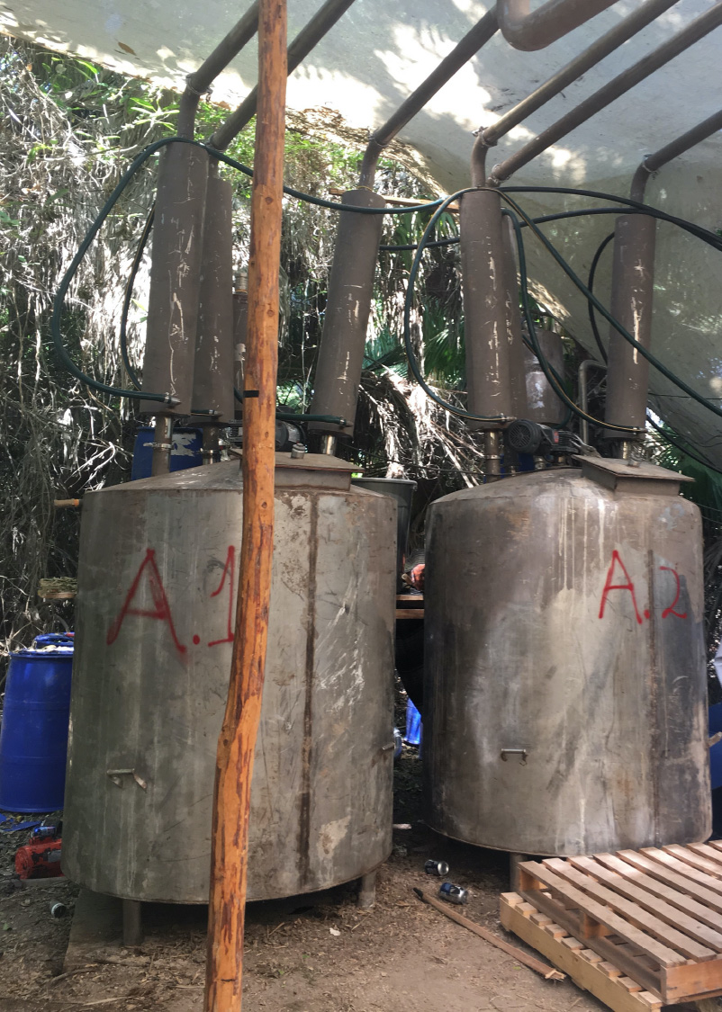
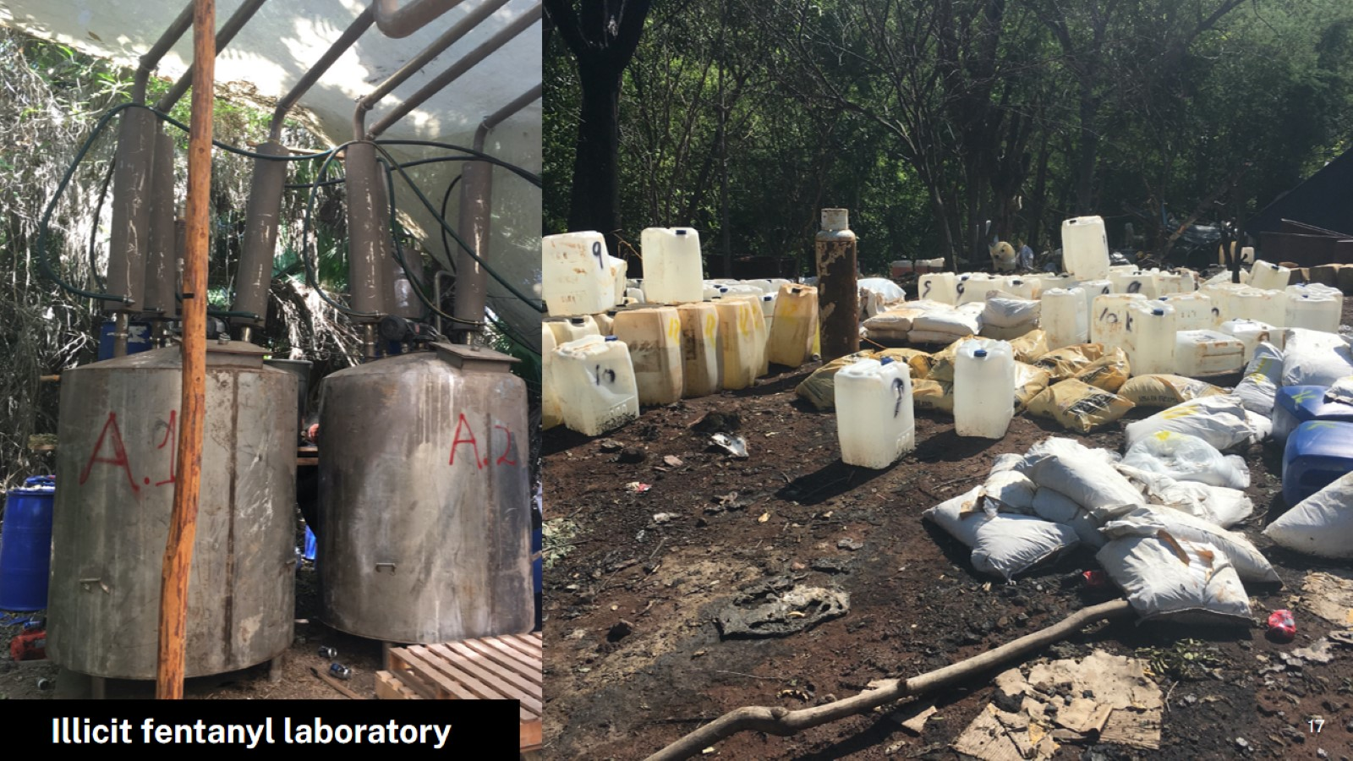
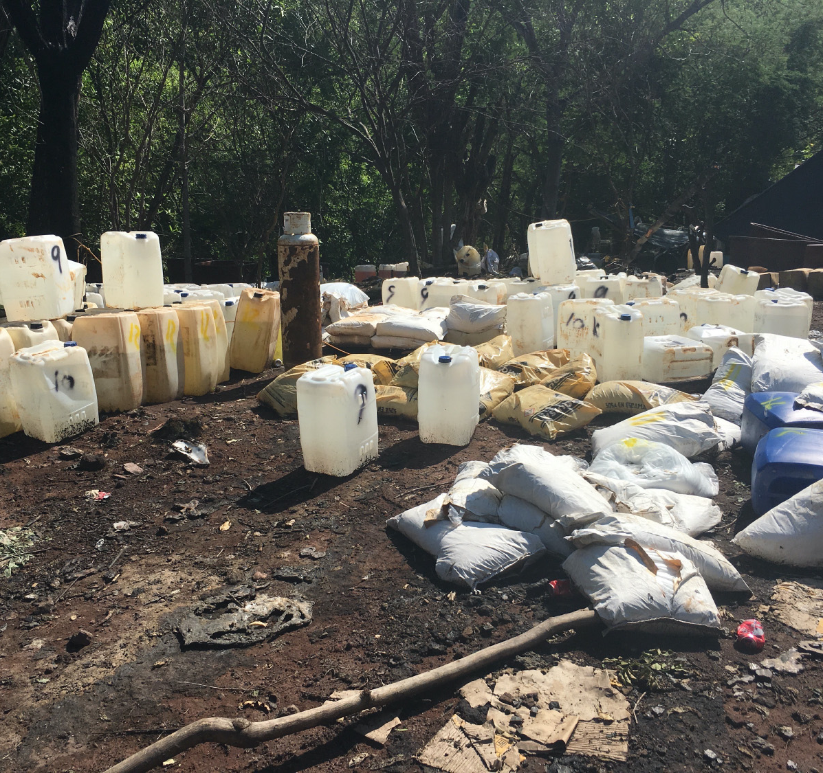
Illicit fentanyl laboratory
Speaker Notes:
But we aren’t talking about medical grade fentanyl.
We are talking about illicit fentanyl made in places like jungles, and warehouses, and garages.
There is no quality control in these operations. There is also no regard for human lives. There is no telling how much fentanyl will end up in one pill.
Notes:
But we aren’t talking about medical grade fentanyl.
We are talking about illicit fentanyl made in places like jungles, and warehouses, and garages.
There is no quality control in these operations. There is also no regard for human lives. There is no telling how much fentanyl will end up in one pill.

Slide 18
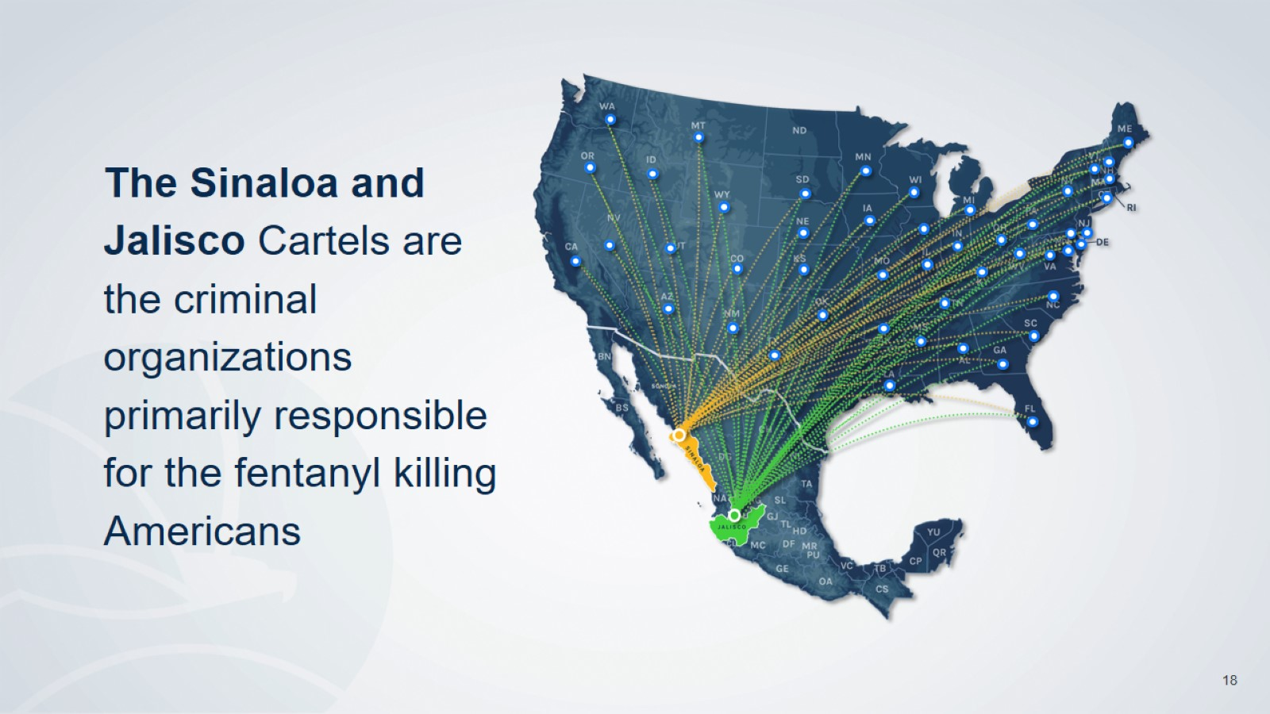
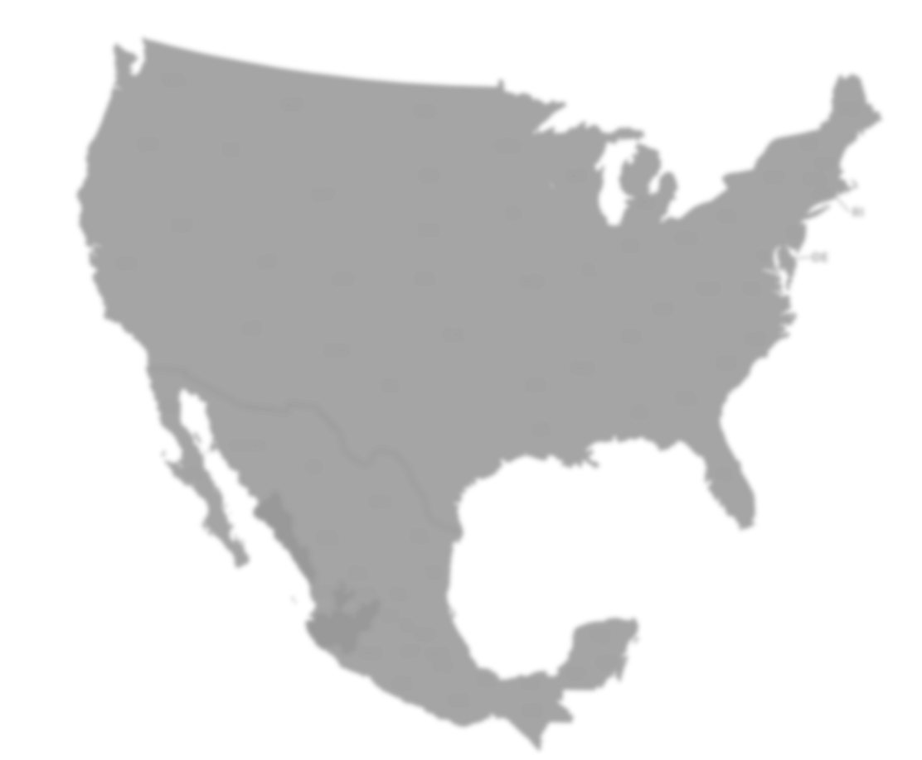
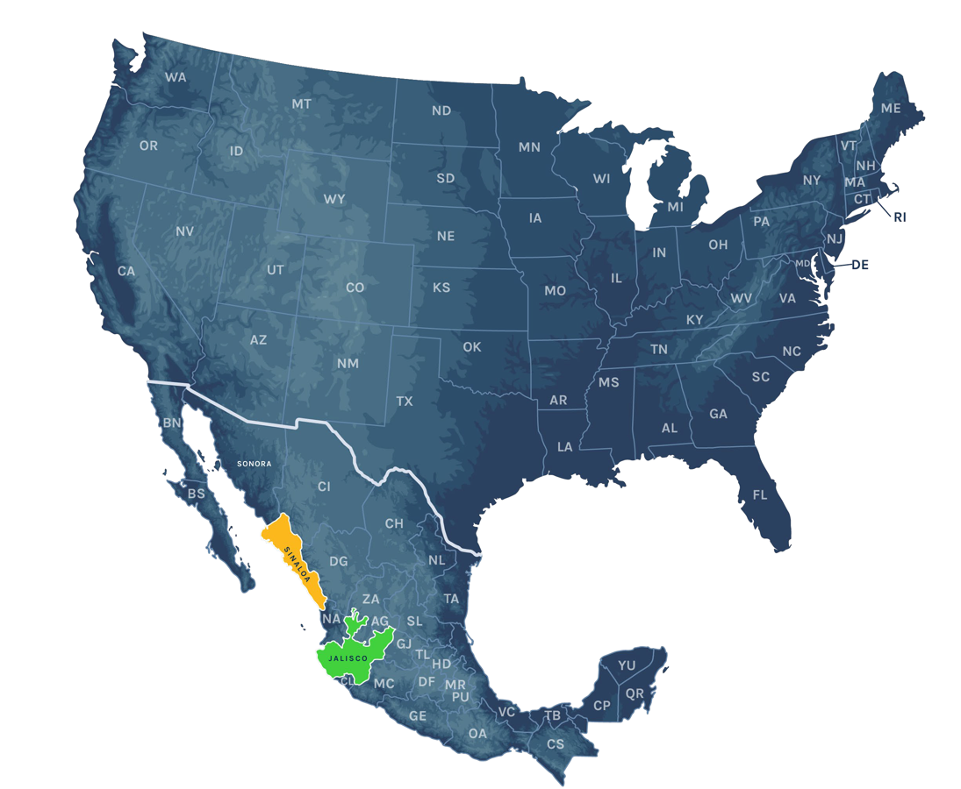









The Sinaloa and Jalisco Cartels are the criminal organizations primarily responsible for the fentanyl killing Americans
Speaker Notes: DEA is actively targeting the two Mexico-based drug cartels that are responsible for most of the fentanyl being trafficked into American communities. They are the Sinaloa and Jalisco cartels and their criminal work reaches across the U.S.
Notes:
DEA is actively targeting the two Mexico-based drug cartels that are responsible for most of the fentanyl being trafficked into American communities. They are the Sinaloa and Jalisco cartels and their criminal work reaches across the U.S.

Slide 19
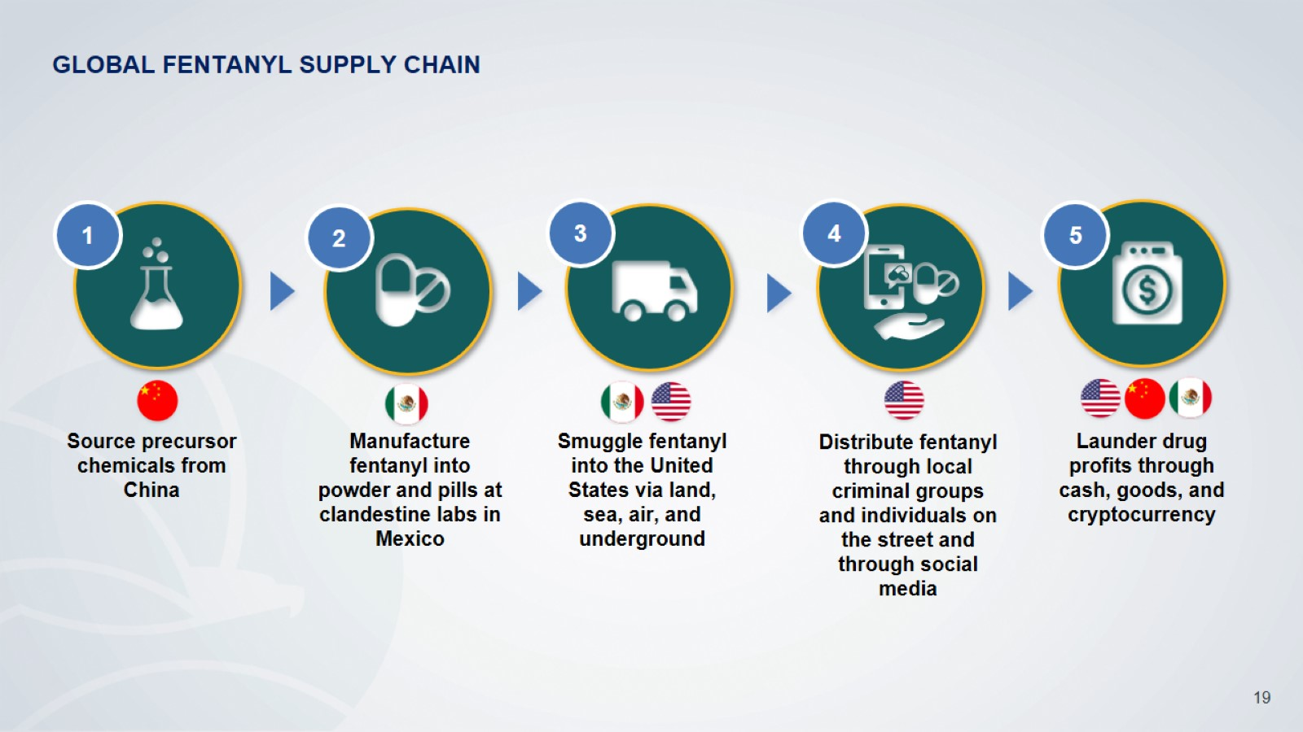









GLOBAL FENTANYL SUPPLY CHAIN
1
2
3
4
5
Source precursor chemicals from China
Manufacture fentanyl into powder and pills at clandestine labs in Mexico
Smuggle fentanyl into the United States via land, sea, air, and underground
Distribute fentanyl through local criminal groups and individuals on the street and through social media
Launder drug profits through cash, goods, and cryptocurrency
Speaker Notes: Here is an infographic that shows you the supply chain that illicit fentanyl takes on its way to American cities and towns. It starts with precursor chemicals from China that are smuggled to Mexico. In Mexico, those chemicals are manufactured into fake pills made to look like legitimate pharmaceuticals. From there, the pills are smuggled into American communities and distributed to individuals. The final step is that the profits made from the sale of these poisons are laundered back to the drug cartels and their suppliers.
Notes:
Here is an infographic that shows you the supply chain that illicit fentanyl takes on its way to American cities and towns. It starts with precursor chemicals from China that are smuggled to Mexico. In Mexico, those chemicals are manufactured into fake pills made to look like legitimate pharmaceuticals. From there, the pills are smuggled into American communities and distributed to individuals. The final step is that the profits made from the sale of these poisons are laundered back to the drug cartels and their suppliers.

Slide 20
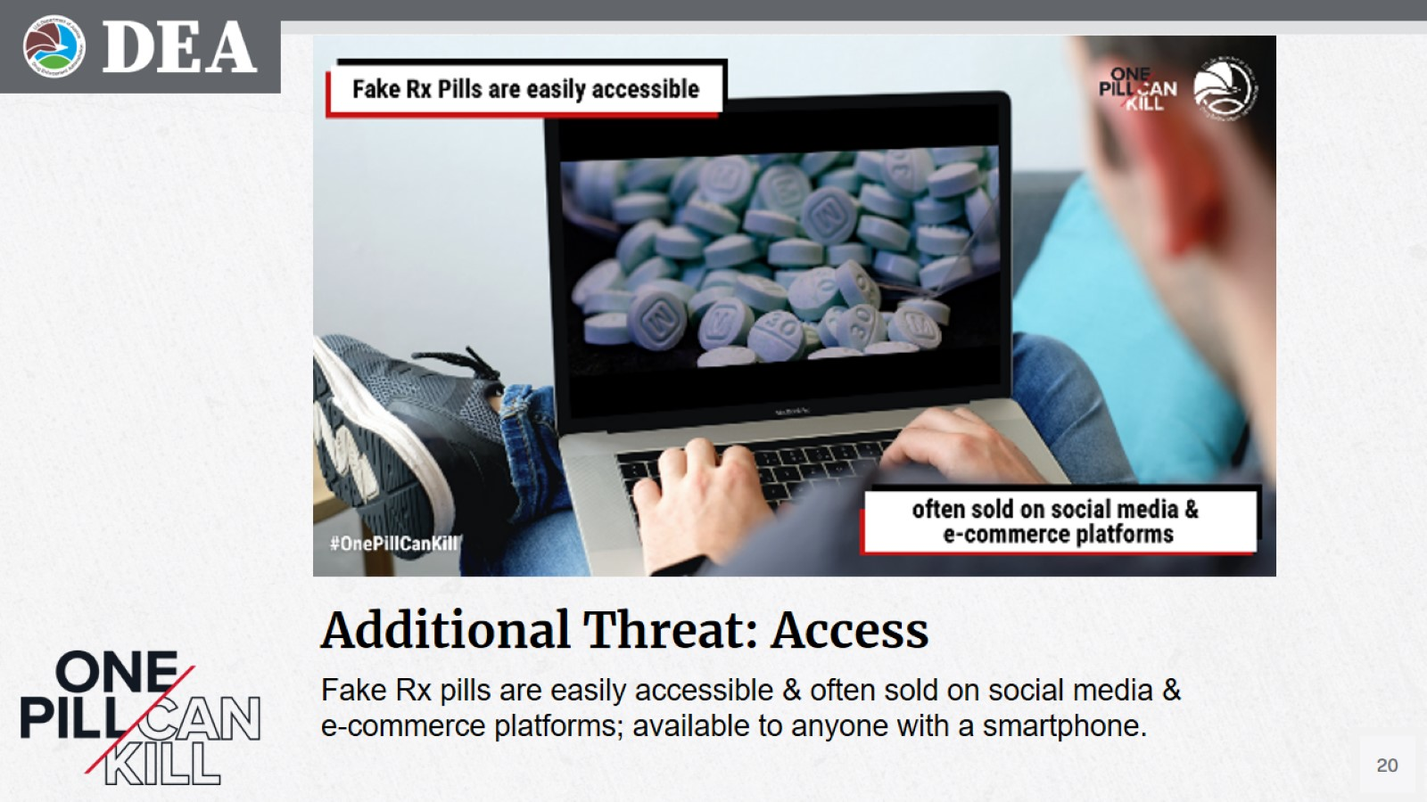
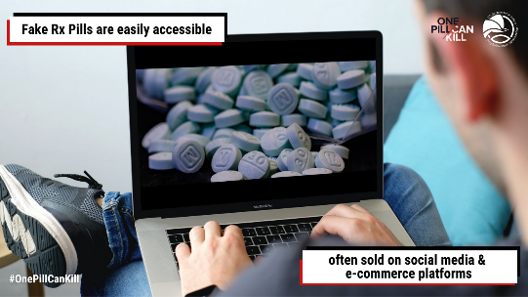
Additional Threat: Access (1 of 2)
Speaker Notes: Social media sites, popular with high schoolers and young adults to share stories and pictures, have also become popular platforms for drug trafficking organizations who use the sites to sell their illicit drugs.
Fake Rx pills are easily accessible & often sold on social media & e-commerce platforms; available to anyone with a smartphone.
Notes:
Social media sites, popular with high schoolers and young adults to share stories and pictures, have also become popular platforms for drug trafficking organizations who use the sites to sell their illicit drugs.

Slide 21
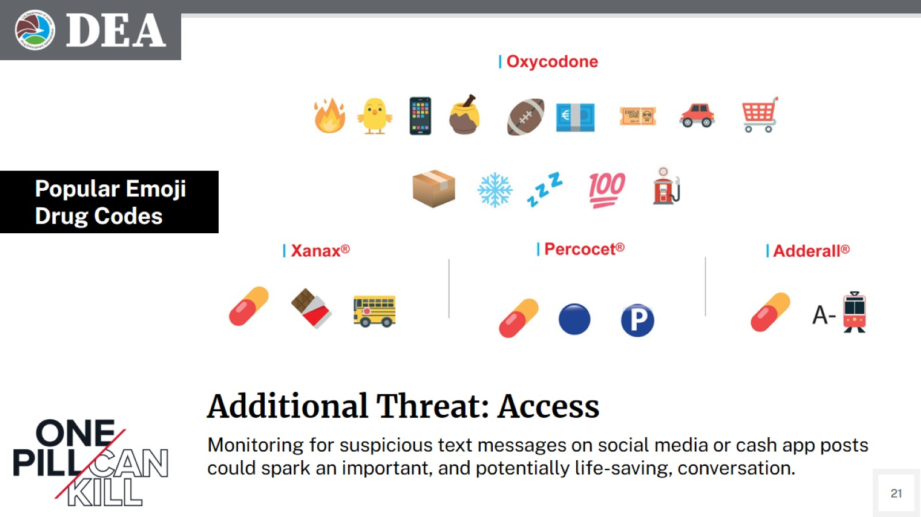
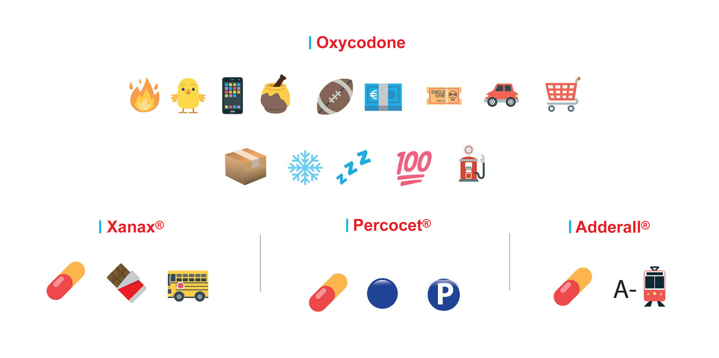
Additional Threat: Access (2 of 2)
Popular Emoji
Drug Codes
Speaker Notes:
Drug traffickers and those seeking these drugs are using a whole language of emojis on social media to communicate about selling and buying these drugs.
Monitoring for suspicious text messages on social media or cash app posts could spark an important, and potentially life-saving, conversation.
DEA works with social media and internet companies to provide information that will help them better understand how dangerous drug traffickers operate in their space.
Monitoring for suspicious text messages on social media or cash app posts could spark an important, and potentially life-saving, conversation.
Notes:
Drug traffickers and those seeking these drugs are using a whole language of emojis on social media to communicate about selling and buying these drugs.
Monitoring for suspicious text messages on social media or cash app posts could spark an important, and potentially life-saving, conversation.
DEA works with social media and internet companies to provide information that will help them better understand how dangerous drug traffickers operate in their space.

Slide 22

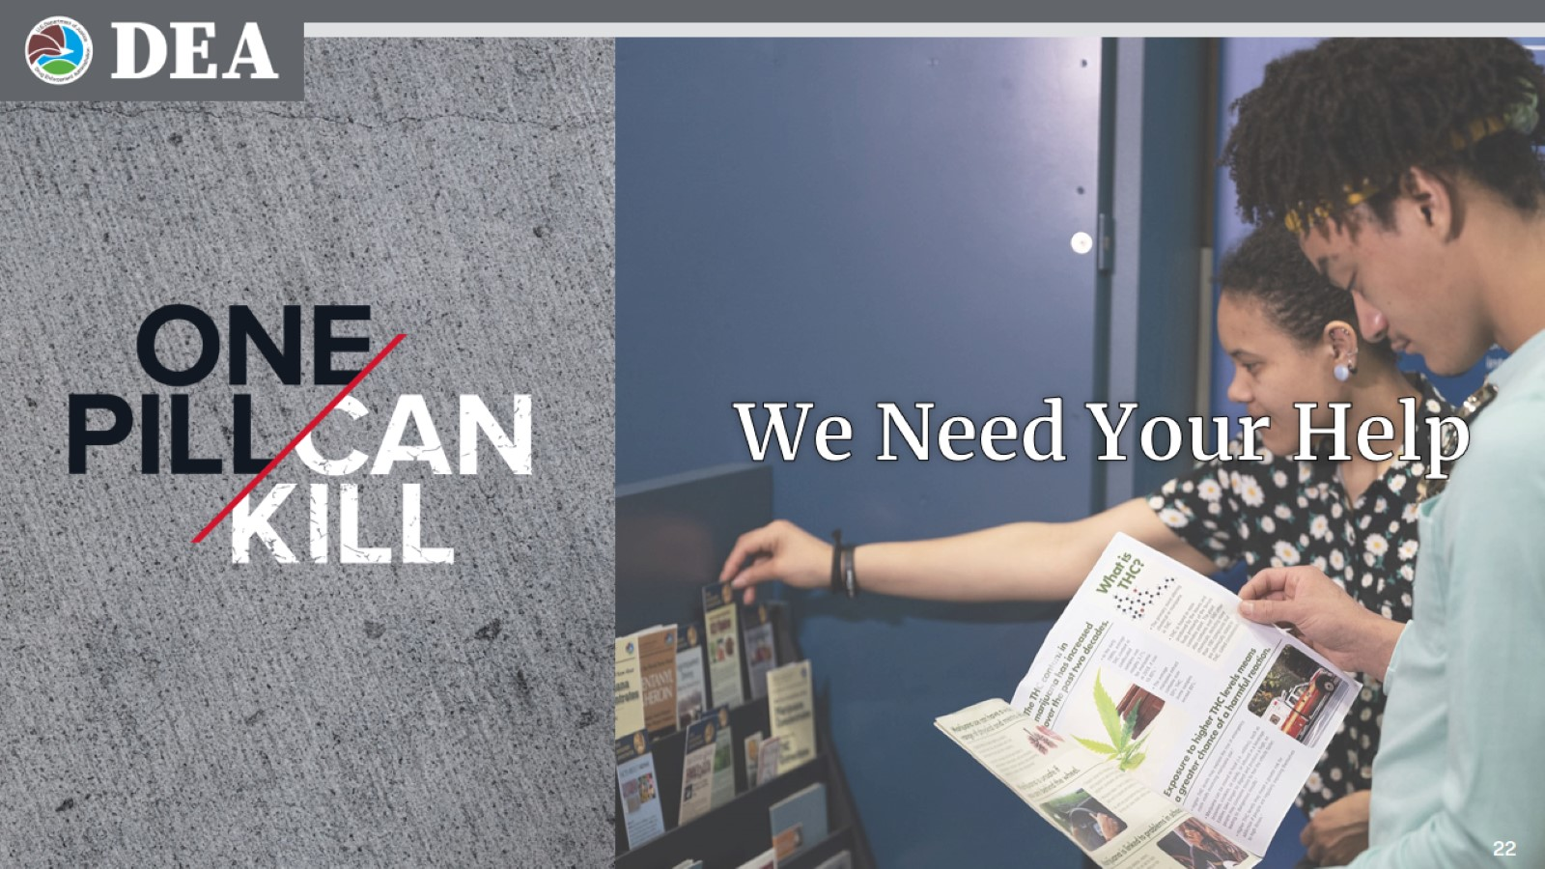
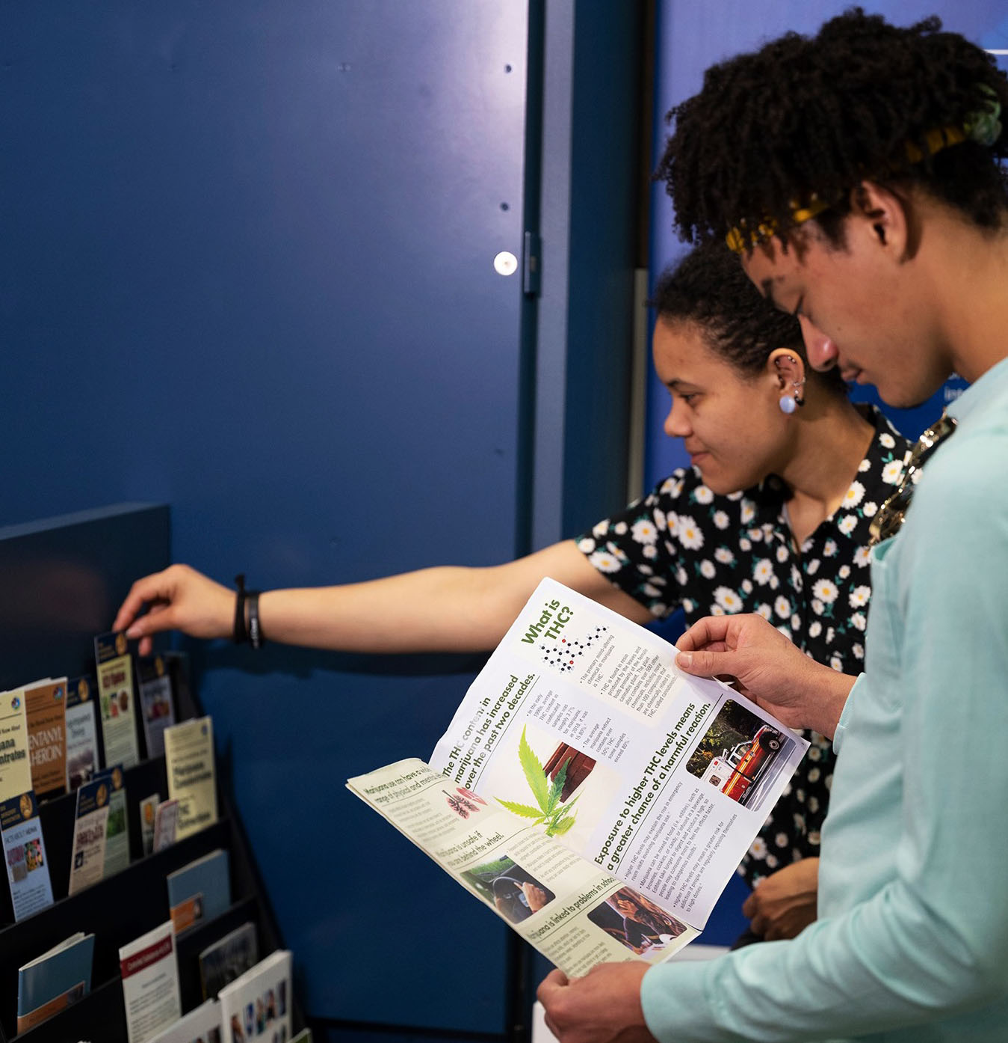
We Need Your Help
Speaker Notes:
DEA has launched “One Pill Can Kill” awareness campaign. Please help us spread the word.
Educate the general public about the dangers associated with fake pills.
Connect people with information and resources related to fake pills, fentanyl, and methamphetamine in an effort to drive down overdose deaths.
Partner with local, state and federal law enforcement, prevention and public health organizations to elevate the awareness of these dangerous and potentially deadly counterfeit pills.
Notes:
DEA has launched “One Pill Can Kill” awareness campaign. Please help us spread the word.
Educate the general public about the dangers associated with fake pills.
Connect people with information and resources related to fake pills, fentanyl, and methamphetamine in an effort to drive down overdose deaths.
Partner with local, state and federal law enforcement, prevention and public health organizations to elevate the awareness of these dangerous and potentially deadly counterfeit pills.

Slide 23
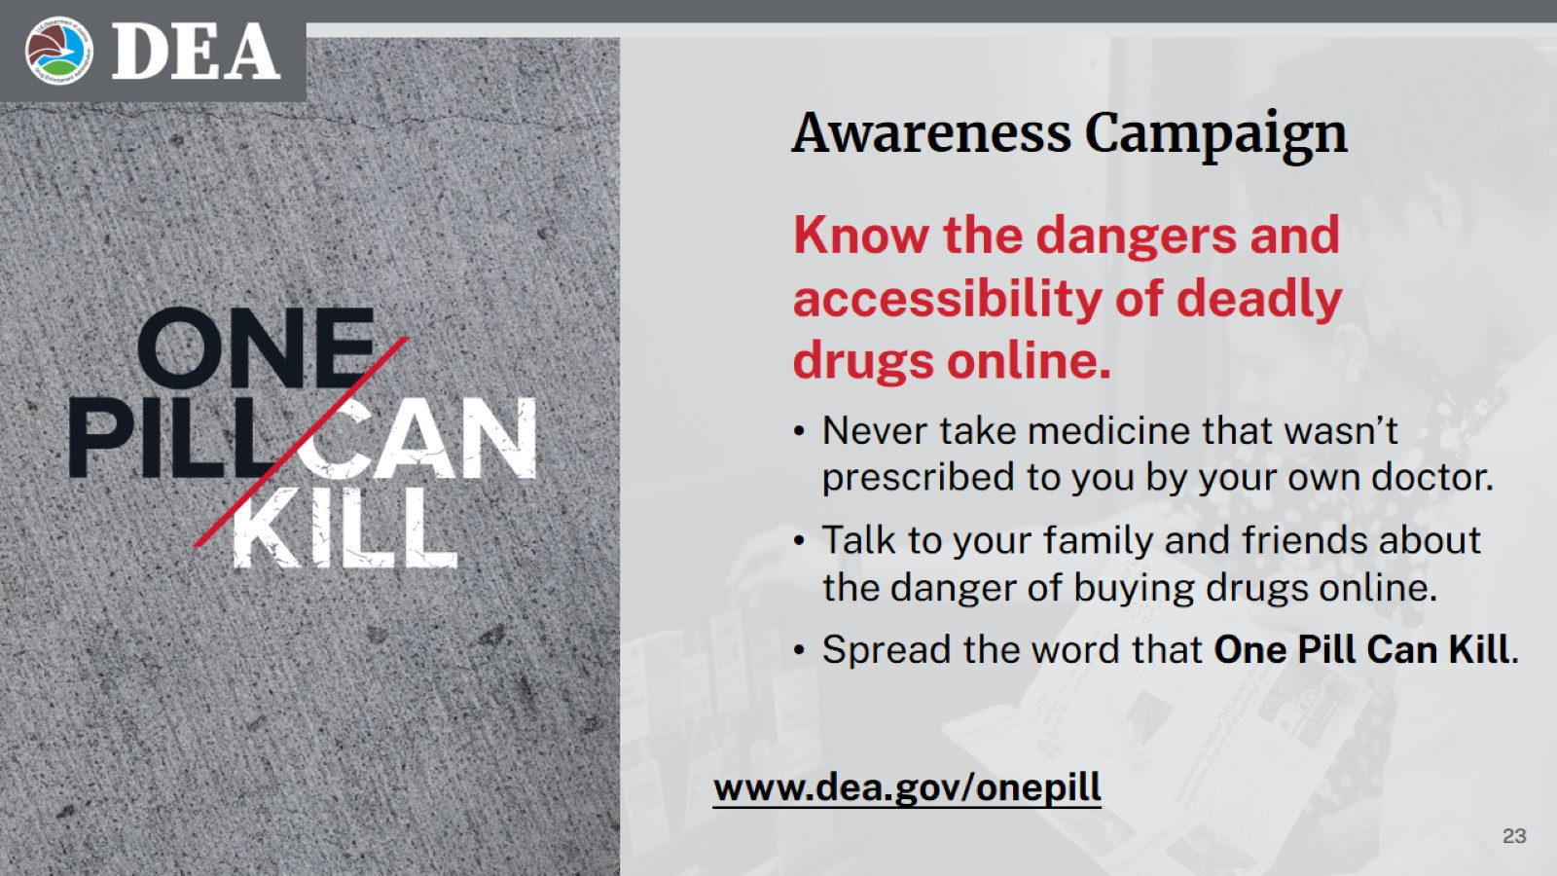
Awareness Campaign
Know the dangers and accessibility of deadly drugs online.
Never take medicine that wasn’t prescribed to you by your own doctor.
Talk to your family and friends about the danger of buying drugs online.
Spread the word that One Pill Can Kill.
Speaker Notes:
Encourage people to only use medications as they are prescribed to them by a licensed medical provider and dispensed by a trusted pharmacy.
Remind people to protect themselves from diversion by securing their prescription medications and cleaning out their medicine cabinets at least twice a year.
Key Messages
The drug overdose crisis in the United States is a clear and present public health, public safety, and national security threat.
One Pill Can Kill. Don’t take this warning lightly. It only takes one counterfeit pill, with a lethal dose of fentanyl, to kill you.
Only take medications that were prescribed to you by a trusted medical professional and dispensed by a licensed pharmacist.
Transnational Drug Trafficking Organizations have capitalized on the opioid epidemic and prescription drug misuse by flooding the United States with mass quantities of counterfeit prescription pills.
DEA will continue its mission to target the most dangerous individuals and organizations who are causing harm in our neighborhoods and communities; we are dedicated to reducing drug-related violence; and we must do our part to lower drug overdose deaths.
Social media sites, popular with high schoolers and young adults, to share stories and pictures have also become popular platforms for drug trafficking organizations who use the sites to sell their illicit drugs.
DEA works with social media and internet companies to provide information that will help them better understand how dangerous drug traffickers operate in their space.
The best way to affect supply is to reduce demand. One of the best ways to reduce demand is through education and awareness.
www.dea.gov/onepill
Notes:
Encourage people to only use medications as they are prescribed to them by a licensed medical provider and dispensed by a trusted pharmacy.
Remind people to protect themselves from diversion by securing their prescription medications and cleaning out their medicine cabinets at least twice a year.
Key Messages
The drug overdose crisis in the United States is a clear and present public health, public safety, and national security threat.
One Pill Can Kill. Don’t take this warning lightly. It only takes one counterfeit pill, with a lethal dose of fentanyl, to kill you.
Only take medications that were prescribed to you by a trusted medical professional and dispensed by a licensed pharmacist.
Transnational Drug Trafficking Organizations have capitalized on the opioid epidemic and prescription drug misuse by flooding the United States with mass quantities of counterfeit prescription pills.
DEA will continue its mission to target the most dangerous individuals and organizations who are causing harm in our neighborhoods and communities; we are dedicated to reducing drug-related violence; and we must do our part to lower drug overdose deaths.
Social media sites, popular with high schoolers and young adults, to share stories and pictures have also become popular platforms for drug trafficking organizations who use the sites to sell their illicit drugs.
DEA works with social media and internet companies to provide information that will help them better understand how dangerous drug traffickers operate in their space.
The best way to affect supply is to reduce demand. One of the best ways to reduce demand is through education and awareness.

Slide 24
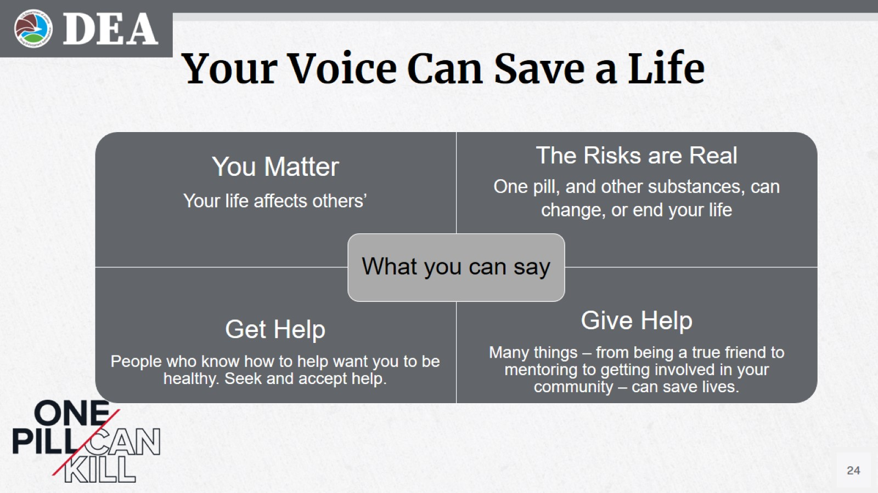
Your Voice Can Save a Life
You Matter
Your life affects others’
The Risks are Real
One pill, and other substances, can change, or end your life
What you can say
Get Help
People who know how to help want you to be healthy. Seek and accept help.
Give Help
Many things – from being a true friend to mentoring to getting involved in your community – can save lives.
Speaker Notes:
It is our hope that now you understand that [you as young people and your friends / the kids you care about] are being targeted and you are in danger because one pill can kill.
That knowledge can protect you, but you can also use it to protect people you care about. Here is what you can say:
The first thing I would tell a [friend / young person I care about] is “You Matter.” Whatever stress or isolation or anger or upset you may feel, your life affects other people’s and their life would be worse if you’re not in it. Your future can make other people’s better.
The next thing I would say is that the risks are real. Substance use has never been healthy. There have always been dangers of addiction or bad decisions. But today’s drug supply is toxic and taking the lives of too many young people.
Third, if you need help; get help. Whether it is [a teacher or a school nurse or a coach / another parent or a doctor or a community organization] start looking and you will find people who want to help. Sometimes pride or fear can keep us for asking for help. Don’t let it. If all else fails, dial 988. It is a free national service from the federal government that can connect you with services that can help.
Finally, you can give help. That may mean having a tough conversation to say you are worried; or it could be getting trained to provide support to peers; or it could mean carrying naloxone. There is something that all of us can do to save the lives of people in our world.
Notes:
It is our hope that now you understand that [you as young people and your friends / the kids you care about] are being targeted and you are in danger because one pill can kill.
That knowledge can protect you, but you can also use it to protect people you care about. Here is what you can say:
The first thing I would tell a [friend / young person I care about] is “You Matter.” Whatever stress or isolation or anger or upset you may feel, your life affects other people’s and their life would be worse if you’re not in it. Your future can make other people’s better.
The next thing I would say is that the risks are real. Substance use has never been healthy. There have always been dangers of addiction or bad decisions. But today’s drug supply is toxic and taking the lives of too many young people.
Third, if you need help; get help. Whether it is [a teacher or a school nurse or a coach / another parent or a doctor or a community organization] start looking and you will find people who want to help. Sometimes pride or fear can keep us for asking for help. Don’t let it. If all else fails, dial 988. It is a free national service from the federal government that can connect you with services that can help.
Finally, you can give help. That may mean having a tough conversation to say you are worried; or it could be getting trained to provide support to peers; or it could mean carrying naloxone. There is something that all of us can do to save the lives of people in our world.

Slide 25
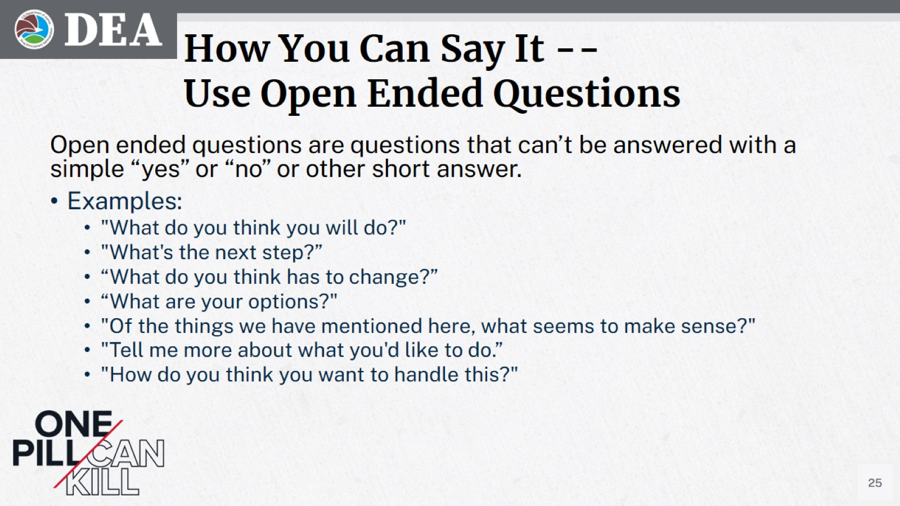
How You Can Say It -- Use Open Ended Questions
Open ended questions are questions that can’t be answered with a simple “yes” or “no” or other short answer.
Examples:
"What do you think you will do?"
"What's the next step?”
“What do you think has to change?”
“What are your options?"
"Of the things we have mentioned here, what seems to make sense?"
"Tell me more about what you'd like to do.”
"How do you think you want to handle this?"
Speaker Notes:
So – how do you have helpful conversations? That is – literally – a whole presentation by itself, but today we’ll talk about two tools you can use.
The first is open-ended questions. [ASK WHO HAS HEARD OF OPEN-ENDED QUESTIONS & WHAT THE AUDIENCE THINKS THEY MEAN]
Very simply, open ended questions are questions that can’t be answered with a simple “yes” or “no” or other short answer.
There are a bunch of examples here. What I would suggest is when you want to have an important conversation, think about the questions you want to ask and take some time to turn them into open-ended questions.
Notes:
So – how do you have helpful conversations? That is – literally – a whole presentation by itself, but today we’ll talk about two tools you can use.
The first is open-ended questions. [ASK WHO HAS HEARD OF OPEN-ENDED QUESTIONS & WHAT THE AUDIENCE THINKS THEY MEAN]
Very simply, open ended questions are questions that can’t be answered with a simple “yes” or “no” or other short answer.
There are a bunch of examples here. What I would suggest is when you want to have an important conversation, think about the questions you want to ask and take some time to turn them into open-ended questions.

Slide 26

How You Can Say It -- The “Information Sandwich” (1 of 2)
Ask before you share information / give advice
Invite to talk
Share your advice / information
Check back
Invite to Talk
Provide Information
Check For Understanding
Speaker Notes:
The next tool is the information sandwich.
If there is an idea or some facts that you want to share, the information sandwich is a great tool to visualize and use.
The first part is an invitation to talk; the middle is the information you want to provide; and the third part is checking back to make sure things make sense and – hopefully – continue the conversation.
Notes:
The next tool is the information sandwich.
If there is an idea or some facts that you want to share, the information sandwich is a great tool to visualize and use.
The first part is an invitation to talk; the middle is the information you want to provide; and the third part is checking back to make sure things make sense and – hopefully – continue the conversation.

Slide 27

How You Can Say It -- The “Information Sandwich” (2 of 2)
Speaker Notes:
So, here is an example…
[CLICK THROUGH AND READ EXAMPLE]
So, let’s break this down … “Can I share something I heard?” is “asking permission,” or an “invitation to talk.” That moment may not be a good time to talk, and that’s ok. Find a better time.
The “information” you are providing are facts about fentanyl.
“What do you think about that?” is a way to “check for understanding.” You may not get a response you like, but that’s ok. It is better to get an open conversation going where you can share more information and work through any attitudes or information that could be risky.
“Can I share something I heard?”
Invite to Talk
“There are fake pills that are laced with fentanyl out there. They look like the real thing, but they’re deadly.”
Provide Information
“What do you think about that?”
Check For Understanding
Notes:
So, here is an example…
[CLICK THROUGH AND READ EXAMPLE]
So, let’s break this down … “Can I share something I heard?” is “asking permission,” or an “invitation to talk.” That moment may not be a good time to talk, and that’s ok. Find a better time.
The “information” you are providing are facts about fentanyl.
“What do you think about that?” is a way to “check for understanding.” You may not get a response you like, but that’s ok. It is better to get an open conversation going where you can share more information and work through any attitudes or information that could be risky.

Slide 28



Your Influence Can Save a Life
Speaker Notes:
And there is more than one way you can use your voice.
If you have a social media presence of any size DEA has created a toolkit of social media resources you can share.
Use the #onepillcankill hashtag on your post so our voices are heard loud and clear.
www.dea.gov/onepill/social-media
Notes:
And there is more than one way you can use your voice.
If you have a social media presence of any size DEA has created a toolkit of social media resources you can share.
Use the #onepillcankill hashtag on your post so our voices are heard loud and clear.

Slide 29



One Pill Can Kill Links
Learn More
Speaker Notes:
If you scan this QR code it will take you right to our online resources. We encourage you to help us start and continue this important conversation. It’s never too early to talk to kids about the dangers of taking a pill that was not prescribed by a doctor and dispensed by a pharmacist. It really only takes one of these fake pills, one time, to kill.
Thank you.
www.dea.gov/onepill
Notes:
If you scan this QR code it will take you right to our online resources. We encourage you to help us start and continue this important conversation. It’s never too early to talk to kids about the dangers of taking a pill that was not prescribed by a doctor and dispensed by a pharmacist. It really only takes one of these fake pills, one time, to kill.
Thank you.

Slide 30


JOIN THE FIGHT
Speaker Notes:
Finally, I ask you today to Join the Fight!
We need every American’s assistance to save lives from fentanyl and other deadly drugs.
Please share what you have seen here today, through conversations and connections.
Participate in Take Back events that remove unwanted medications from our homes and communities.
And go to the Promote page to access resources you can use to get the word out.
Opportunities:
Educate public – especially young people -- about dangers associated with fentanyl
Connect people with information, resources, and support
Participate in efforts, such as Drug Take Back events, to remove drugs from our communities
www.dea.gov/fentanylfree/promote
Toolbox: Billboards, Fact Sheet, Logo, Posters, Public Service Announcements, Social Media
DRUG ENFORCEMENT ADMINISTRATION
Notes:
Finally, I ask you today to Join the Fight!
We need every American’s assistance to save lives from fentanyl and other deadly drugs.
Please share what you have seen here today, through conversations and connections.
Participate in Take Back events that remove unwanted medications from our homes and communities.
And go to the Promote page to access resources you can use to get the word out.

Slide 31

Thank You!
Presenter Name
Contact Info

